Slide 1
Control Room
2020
J.Hillairet

Slide 2
Control Room (CR)
Control Room (aka "CR") is a graphical interface whose purpose is:
To plot various WEST database signals
Does not (always) require to know the name of the diagnostic, signals are described with meaningful names
To plot WEST Session Leader plasma setup (aka “PCS waveforms”)
Can plot previous pulse setups or “next pulse” setup (pulse number: 0).
The graphical interface organization can be personalized, saved and reopened later
To open Control Room, open a terminal and type:
module load tools_dc
CR

Slide 3
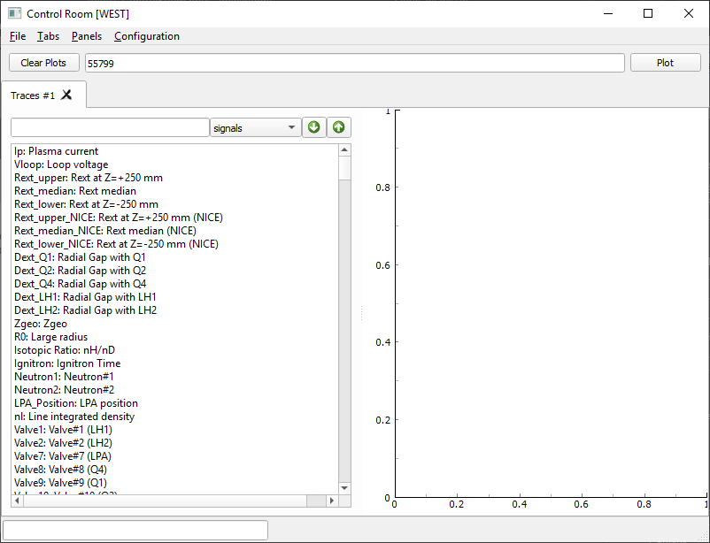
Control Room graphical interface description
Pulse numbers
When you open Control Room, it is likely to appear like that
Plot zone
WEST Signals list
(can be hidden)
Download progress bar

Slide 4
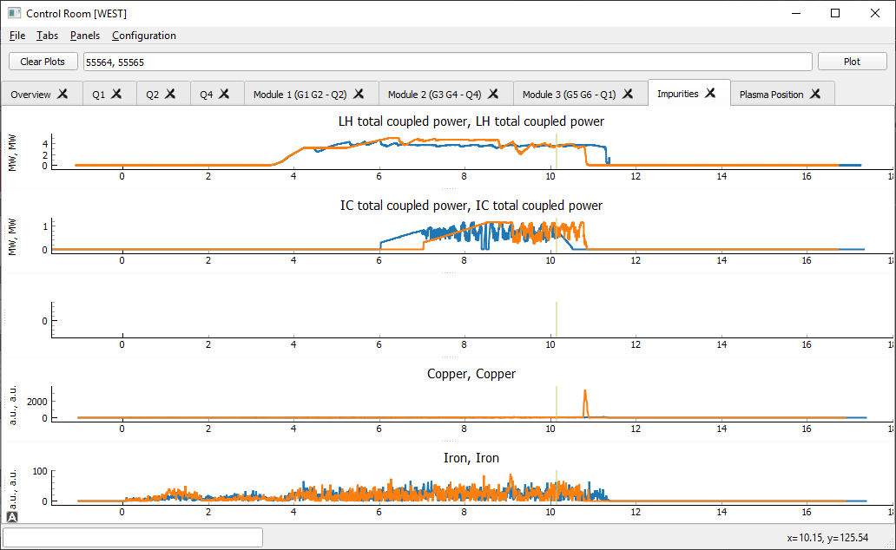
Control Room graphical interface description
The Graphical Interface can be personalized, (& saved/reopened)
Pulse numbers
Multiple « Tabs »
Multiple graphs (« Panels »)

Slide 5
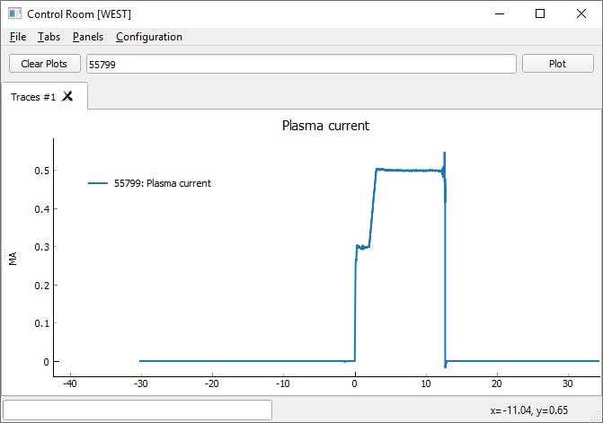
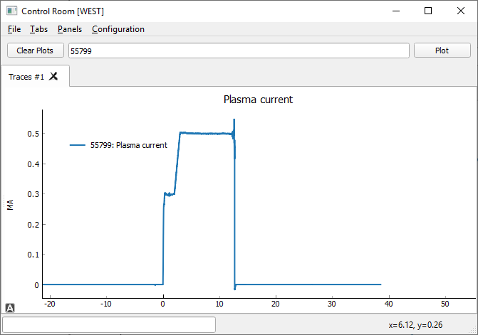

Span
Hold Left Clic and moving: Span

Slide 6
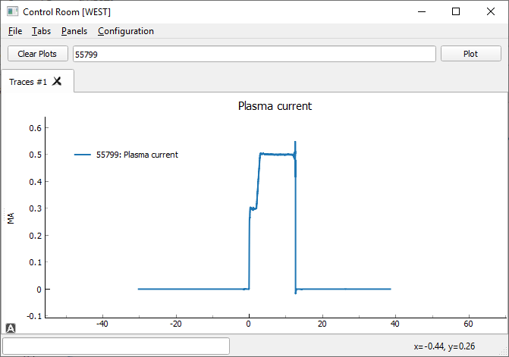
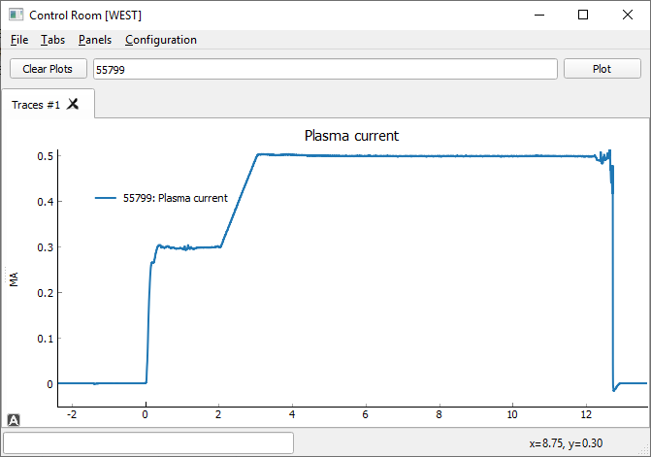
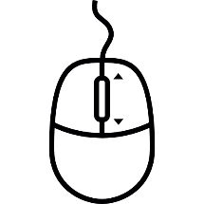
Zoom
Hold Right Clic and moving: zoom in/out in x/y direction (x: right/left, y:up/down)
Central Wheel:
If performed on the y axis: vertical zoom
If performed on the x axis: horizontal zoom
If performed on the graph zone: scaling

Slide 7
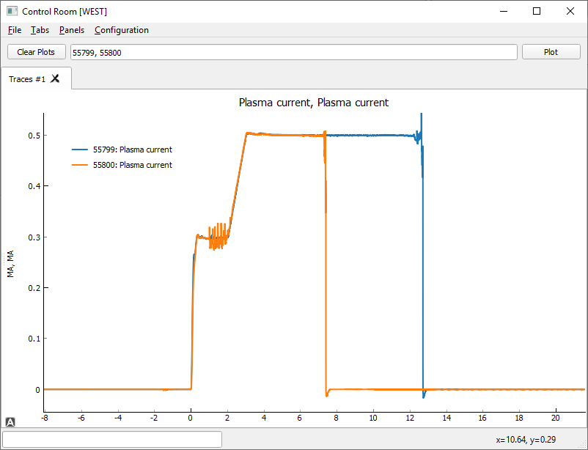
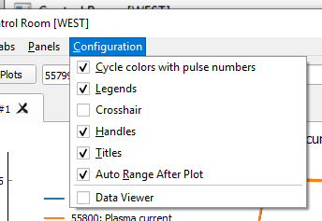
Curve Colors (1/2)
Default: color corresponds with pulse number

Slide 8
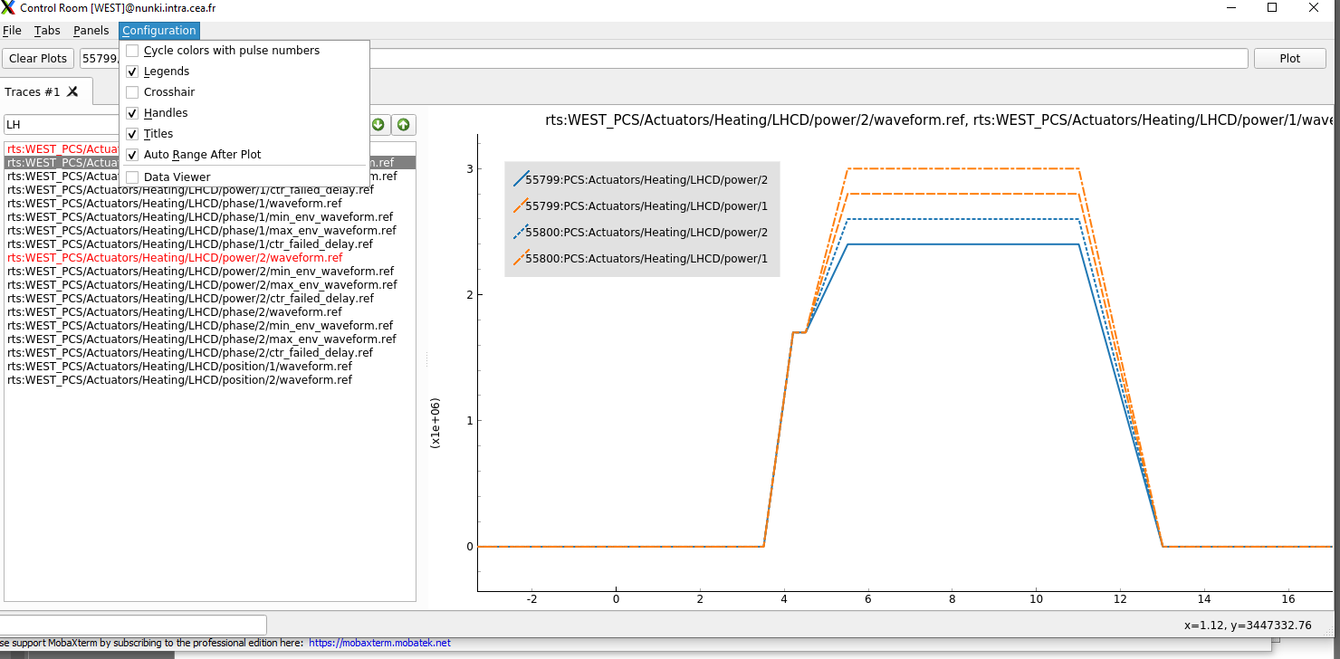
Curve Colors (2/2)
Other choice: Color corresponds with signal names
Line style change with pulse number

Slide 9
Graphical Interface Description

Slide 10
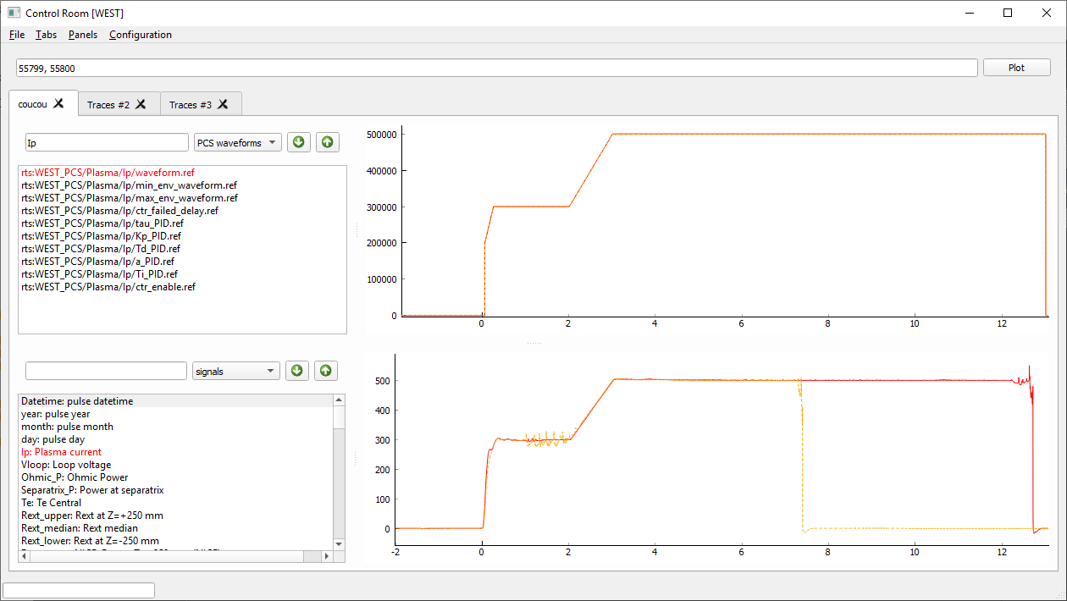
Control Room graphical interface description

Slide 11
“Tabs”.
A Tab contains one of few Panels
Tabs can be added, renamed and removed.
“Panel”.
Panel contains time-plot
Panels can be added and removed (vertically stacked)
Time-plot zone
Time-plot zone

Slide 12
Pulse number(s) to plot (séparated by a comma « , »)
Convenient aliases:
0: next pulse (PCS waveforms only)
-1: last pulse
-2: before last pulse, etc.
Search zone, to search and filter a signal name
Signal type selector
“signals” (WEST database signals, from ARCAD (tsbase) and IMAS)
or
“PCS waveforms” (pulse configuration for the PCS)
It possible to superpose both kinds (but beware that the units does not always match
Signal name selector (double click to select/deselect)
Double-click on a signal name will select it for plotting.
It is possible to select few signal names.
Selected signal naless appears in red.
The selection zone can be resized or hidden (« Panels » menu)

Slide 13
Examples of daily usage

Slide 14

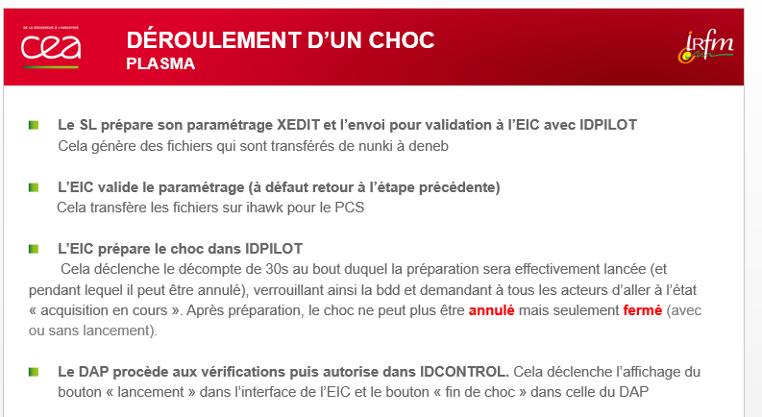
Control Room for the Engineer in Charge (EiC)
EiC are in charge to check the Session Leader pulse setup, aka the “PCS waveforms”
Control Room allows the EiC (but also all CR users) to check the next pulse settings
Pulse settings are described by the Plasma Control System (PCS) waveforms
After the pulse, signals can be compared to PCS waveforms
Warning: the next pulse settings are not always available for reading! It depends of the IDPILOT sequence
Next pulse setting (pulse “0”) is only available during this time frame.
Once the pulse validated, the PCS .xml files are moved and hence no more accessible for reading.

Slide 15

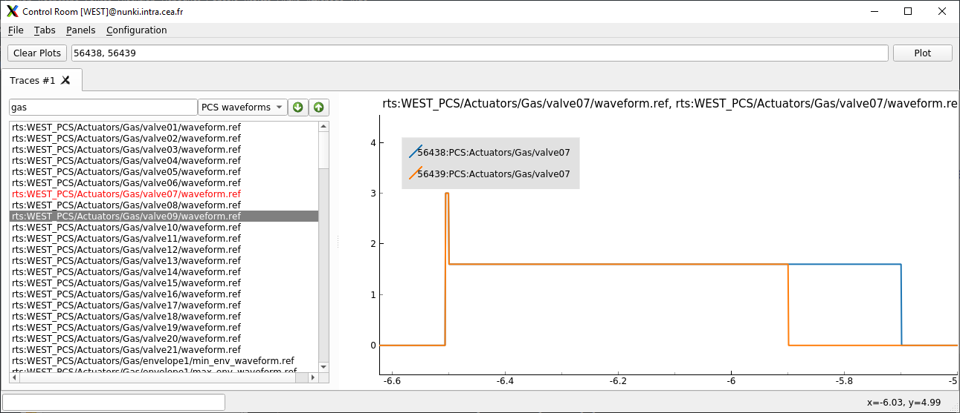
Example - SL to EiC : “on next pulse, I’ve reduced the prefill”
Prefill is generally made with the valve #7
SL comment:
Comparing the previous pulse with the next pulse:
(0 should be used here instead of 56439 in real situation)

Slide 16
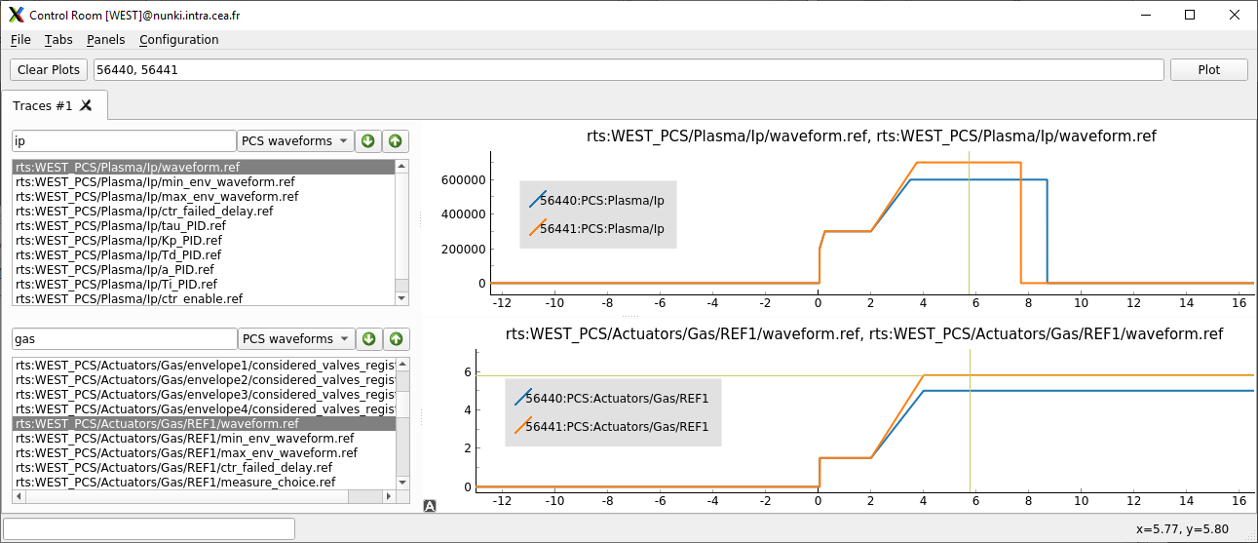
Example - SL to EiC : “on next pulse, I’ve increased plasma current and density”
SL comment:
Comparing the previous pulse with the next pulse:
(0 should be used here instead of 56441 in real situation)

Slide 17
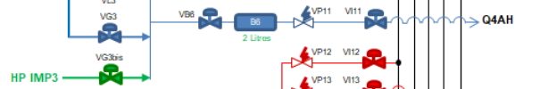

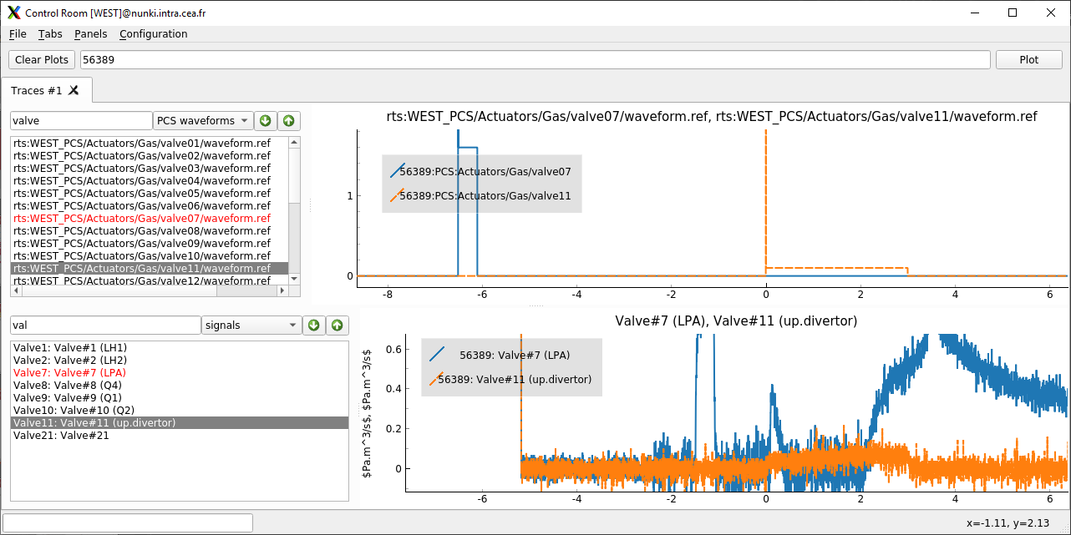
Example – Two gas injected during pulse
Impurity gas line #11 used for N₂
SL comment:

Slide 18
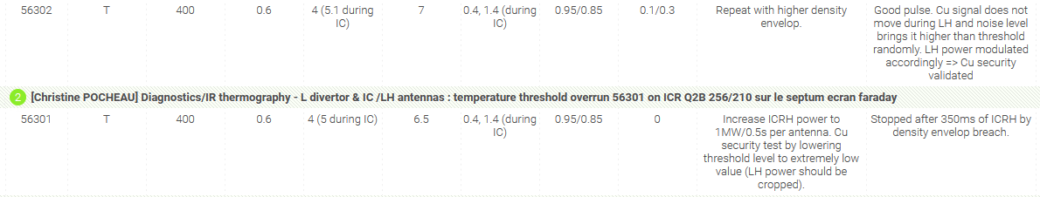
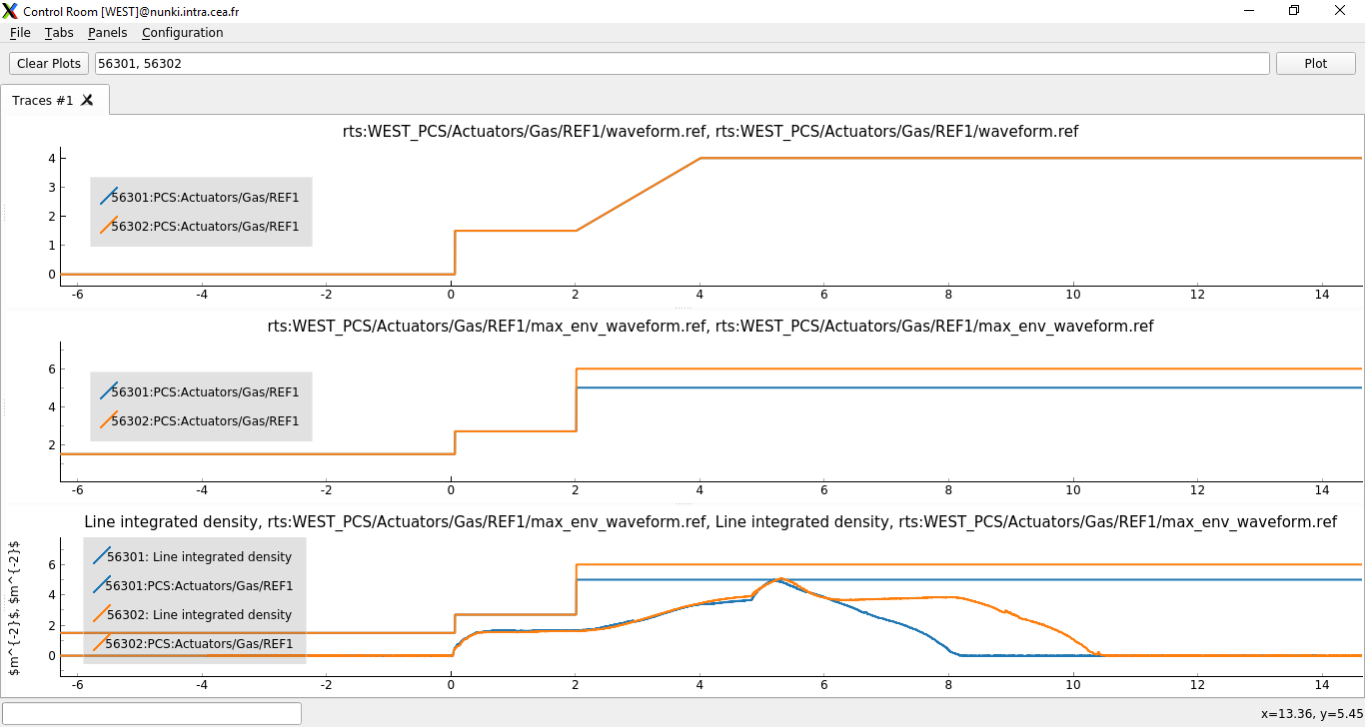
Example – SL to EiC: “I’ve increased the density envelope”
SL comment:

Slide 19

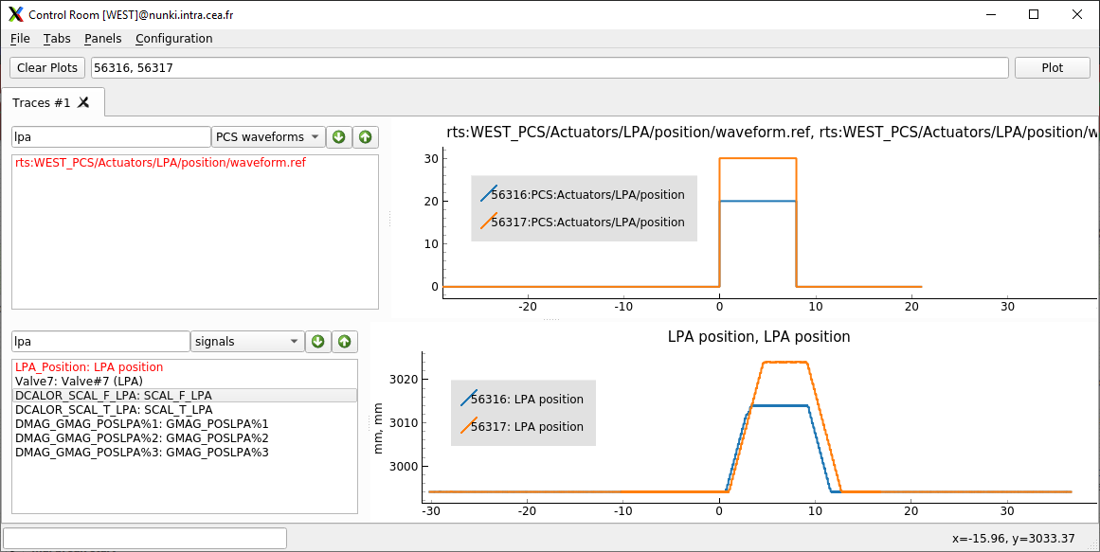
Example – SL to EiC “I’ve moved the LPA 1cm further away”
SL comment:
SL setup the LPA radial position movement (∆R in mm)
Can be compared post pulse with the achieved position (R_{LPA} in meter)

Slide 20
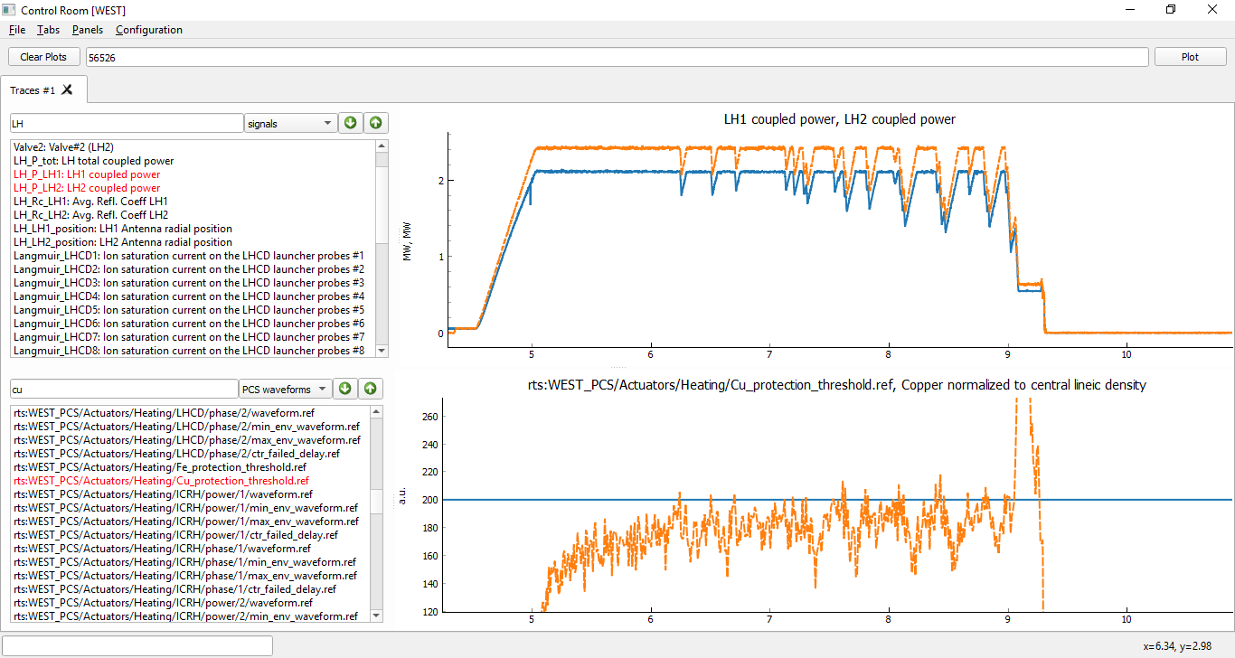
Example - Checking the cause of LH power reduction on a pulse
EiC comment
LH power is reduced is the Copper signal normalized to the core density (DSURVIE-SCU19/nl) exceeds a threshold (defined by the SL)
2 signals selected: LH1 & LH2 coupled powers
1 PCS waveforms & 1 signal selected:
Cu threshold
Cu signal normalized to central density
SURVIE signal exceeds defined Cu-level threshold few times

Slide 21

Reporting Bugs

Slide 22
I found a bug! How can I report it?
At least:
Write me an email explaining the situation (and what should be the “normal” situation)
If you can reproduce it: please list of the steps you’ve made, It always helps a lot.
Best:
Do the same thing in the PPPAT bug tracker: https://github.com/IRFM/PPPAT/issues (requires github account, free)
The bug tracker helps keeping traces and following bug resolution!

