Slide 1


Slide 2
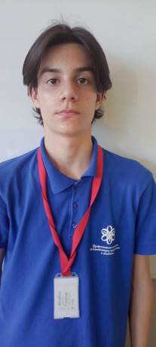
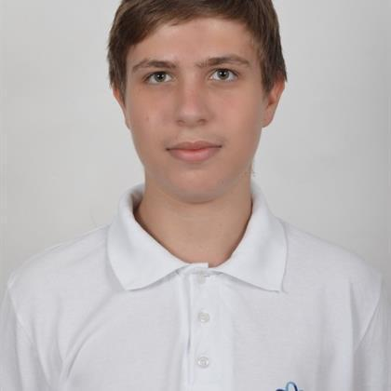
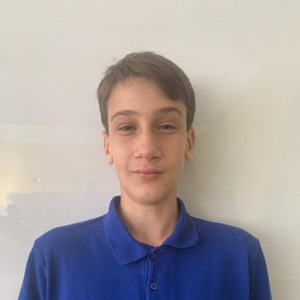
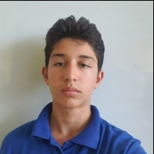
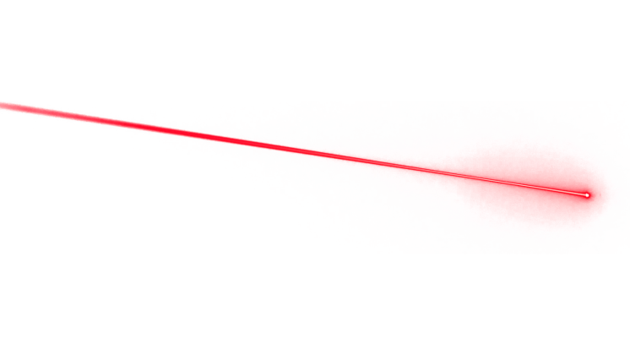




Team members
Ivaylo Gyurov
Kaloyan Ivanov
Alexander Ivanov
Daniel Hristov
Scrum Trainer
Back-end developer
Front-end developer
Front-end developer

Slide 3
Mission
Our mission is to make learning fun. So we are providing a game which gives a wonderful opportunity to those who want to learn physics and still have an enjoyable experience.

Slide 4









Used technologies and languages

Slide 5
Now lets move to the game!

Slide 6
Thank you for the attention!

