Slide 1
Homogeneous (HMM) and Non-Homogeneous Hidden Markov Models (NHMM)
Upmanu Lall
Hyun-Han Kwon
Abed Khalil
Carlos Lima
Prospero Herrera
Florida, August 2008

Slide 2
Overview
Introduction
Markov and Hidden Markov Models
Background
Parameter Estimation via EM
The Viterbi Algorithm
Extensions of HMM
Emission Probabilities
A Simple Example
Non-Homogeneous Hidden Markov Models
References

Slide 3
Introduction
Dataset: Sequential data → often from measurements of time series (e.g. daily rainfall data, currency exchange rate, stock market, etc.)
Main Goals:
Identify and interpret the temporal structure in the data
Develop capacity to simulate time series that have the “memory” and statistics similar to the original series
If an exogenous predictor is available, develop predictive sequences

Slide 4
Introduction
Main Assumptions:
Stationary time series: Model parameters do not change with time
P(rain) or P(wet|wet) are invariant with time: Poisson or Markov Chain
{P(rain|hidden state=i); P(hidden state =i)} invariant with time: HMM
In this case P(rain) changes with time, but does not conditional on hidden state
{P(rain|hidden state=i); P(hidden state =i); P(hidden state =i|exogenous predictor)} does not change with time: NHMM
In this case, P(exogenous predictor) may change with time, but we are not modeling that process – we are just using “known values” of that predictor
In this case P(rain), P(rain|hidden state=i) and P(hidden state =i) change with time, but not conditional on hidden state

Slide 5
Markov Models
Joint Probability Distribution of sequential observations:
If we assume that observation at time n is independent of previous observations, except the observation at time n-1, we obtain a first-order Markov chain:

Slide 6
Markov Models
“Markov Property”:
Therefore, the distribution of x_{n} depends only on the immediately previous observations and is independent of all other prior observations
The stationary assumption implies is the same for all
: Homogeneous Markov Model

Slide 7
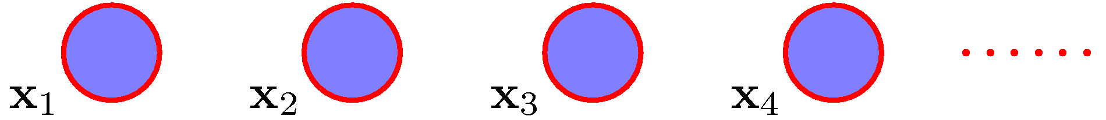
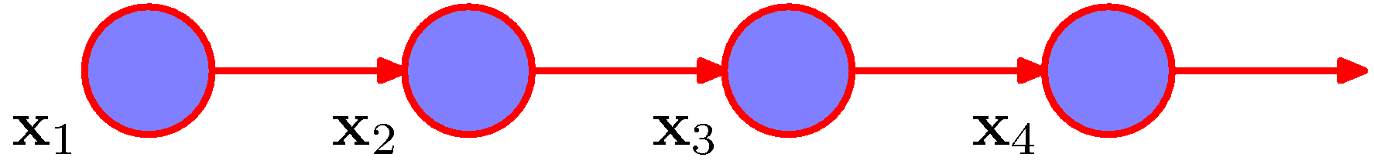
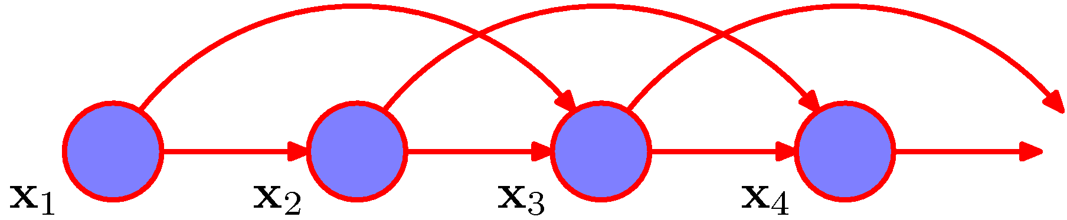
Markov Models
Graphically:
iid observations
First order Markov chain
Second order Markov chain
source: [1]

Slide 8
Markov Models
Simple examples of Markov Models:
1) When x is a discrete variable → Modeling of rainfall occurrence assuming a first order Markov model. x =1 (rainfall) or x = 0 (no rainfall). Rainfall occurrence at time n depends only on the rainfall occurrence at time n-1. Probability of rainfall occurrence follows a conditional Bernoulli distribution: 2 x 2 table shows the conditional probabilities:
2) When x is a continuous variable → Autoregressive (AR) class of models:

Slide 9
Markov Models
Curse of Dimensionality:
As the number of states considered is increased (e.g., 0= no rain, 1 = light rain, 2= moderate rain, 3= heavy rain) the number of parameters to be estimated increases dramatically.
A first-order Markov model with K = 2 states, has 2 parameters: P_{ww} and P_{dd}
The general case has K(K-1), which for 4 states gives 12 parameters
If additional memory (order =M) is needed, then the number of parameters increases rapidly: K^{M} (K-1), which for M=2 and K = 4, is 48
Solution: Introduction of latent variables → State Space Models!

Slide 10
Hidden Markov Models
Basic Idea:
“Long memory” or long term variations in the “state” of the system have a different dynamics than the short term dynamics.
The probability distribution of the short term dynamics can then depend on the value of the long term state – this allows longer memory with fewer parameters
The state need not be “known” – hidden variable z_{n}
z_{n} is continuous → Linear Dynamical Systems, Kalman filters
z_{n} is discrete → Hidden Markov Models
State Space Models

Slide 11
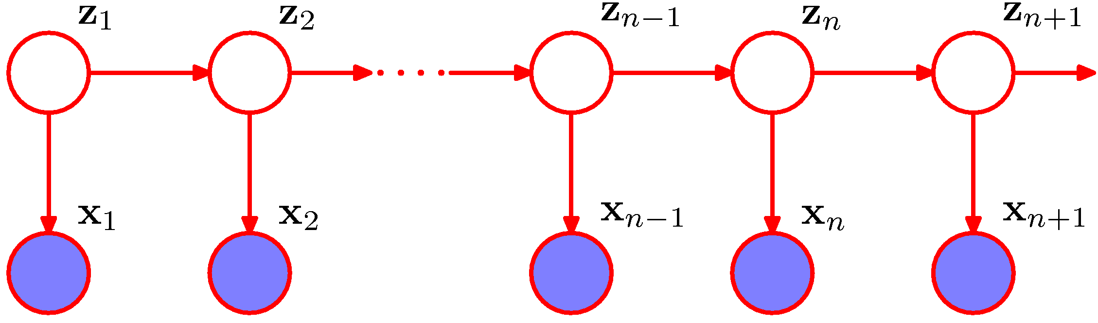
Hidden Markov Models
Graphical Representation:
Hidden variables
source: [1]
Observed data
Conditional Independence Property
z_{n} do not need to have the same dimensionality of x_{n} !

Slide 12
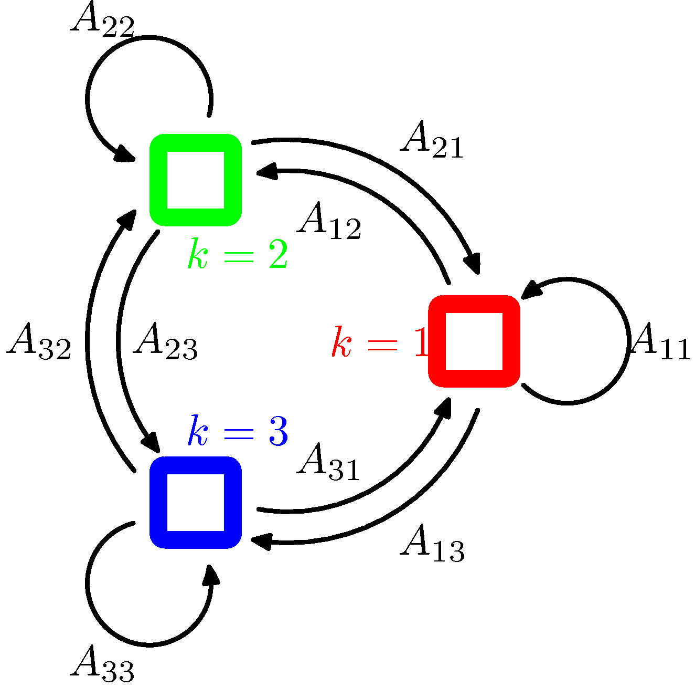
Hidden Markov Models
Mathematical Formulation:
z_{n} = Multinomial Latent variable;
p(z_{n}|z_{n-1}) = Conditional probability;
A = Transition matrix of Probabilities:
Transition diagram of a 3 state matrix
source:[1]

Slide 13
Hidden Markov Models
Mathematical Formulation:
Conditional Distribution:
Since there is no parent node for the first node z₁, it has only a marginal distribution given by:

Slide 14
Hidden Markov Models
Mathematical Formulation:
We finalize the model specifications by defining the conditional distribution of the observed variables, also known as emission probabilities:
Where θ is a set of parameters of the conditional distribution of x_{n}and K is the total number of hidden states.

Slide 15
Hidden Markov Models
Mathematical Formulation:
Examples of emission probabilities:
Normal Distribution
Bernoulli Distribution
Homogeneous Model → Parameters are the same for all n.

Slide 16
Hidden Markov Models
Joint Probability Distribution over latent and observed variables:
Initial node
Transition probability matrix
Emission Probabilities

Slide 17
Hidden Markov Models
Parameter Estimates (Learning phase) via Maximum Likelihood
Observed Data:
Likelihood function is obtained through the marginalization (summation) of the joint distribution over all possible values of the latent variables:
Our final goal is to maximize the above expression with respect to the parameters:

Slide 18
Hidden Markov Models
Parameter Estimates (Learning phase) via Maximum Likelihood
Main issues:
Summation over z_{n} are not independent;
Cannot perform the summations explicitly → N variables with K states each = K^{N} terms
Direct maximization is not tractable → no closed-form solutions
Solution: Expectation-Maximization (EM) algorithm
Usually applied when there are two or more sets of parameters to estimate in addition to latent (or hidden) variables. In our case, we have

Slide 19
Hidden Markov Models
The Expectation-Maximization (EM) algorithm
The complete log-likelihood function can be written as

Slide 20
Hidden Markov Models
The Expectation-Maximization (EM) algorithm – When z is known
The sufficient statistics are:
An the MLE for the case of complete data (z is observed in this case) are given by:

Slide 21
Hidden Markov Models
The Expectation-Maximization (EM) algorithm
In the case of Gaussian emissions, where , the MLE gives:

Slide 22
Hidden Markov Models
The Expectation-Maximization (EM) algorithm
Natural interpretations:
Similar interpretation applies to the other parameter estimates

Slide 23
Hidden Markov Models
The Expectation-Maximization (EM) algorithm – Expectation step:
From the log-likelihood function, we have the following expectations:
Those sufficient statistics are obtained via recursive forward-backward procedures or the Baum-Welch algorithm, see [1] and [2] for details.
Once we have those statistics, we plug in them into the log-likelihood formula to obtain the M-step of the algorithm for iteration (p+1):

Slide 24
Hidden Markov Models
The Expectation-Maximization (EM) algorithm – Maximization step:

Slide 25
Hidden Markov Models
The Expectation-Maximization (EM) algorithm
The EM algorithm begins by choosing starting values of π and A , subject to the summation constraints – related to their probabilities. Usually random values are picked up.
It iterates between computing the previous estimates (M-step) and the Baum-Welch algorithm using the updated values (E-step).

Slide 26
Hidden Markov Models
The Viterbi Algorithm
In several applications we want to find the most probable sequence of hidden states – assuming that the hidden variables have some meaning
The most probable sequence of states is not the same as the set of states that are individually most probable [1] → In the latter, we are not accounting for the transitions that may happen (or not) between states (or transition probabilities)
Therefore, the EM algorithm is not enough;
Most probable sequence is found using the max-sum algorithm, or Viterbi algorithm. This is a dynamic programming solution for the assignment of each day to a hidden state such that the likelihood of the final assignment is maximum

Slide 27
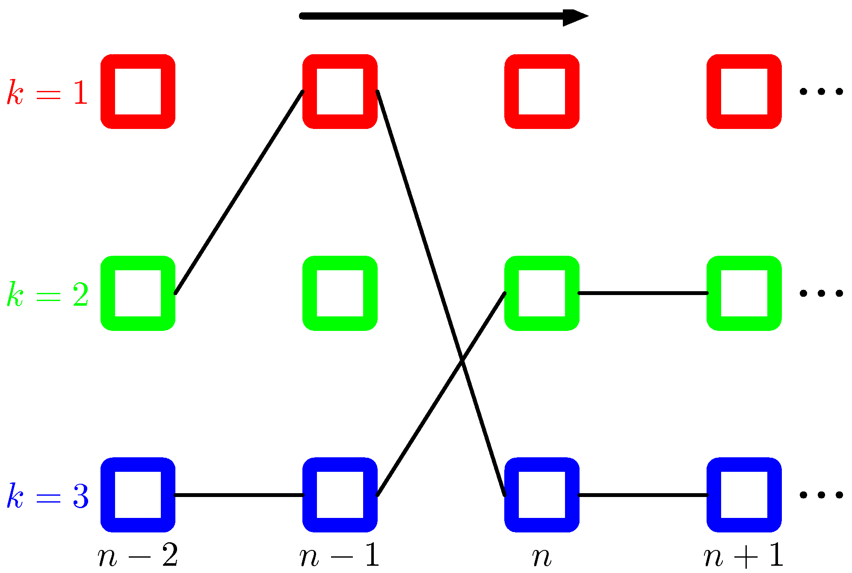
Hidden Markov Models
The Viterbi Algorithm
It searches along the space of paths to find the most probable one → complexity of the Viterbi algorithm is linear with respect to the length of the chain. More details in [1].
Two possible paths in a three-state HMM lattice. Source:[1]

Slide 28
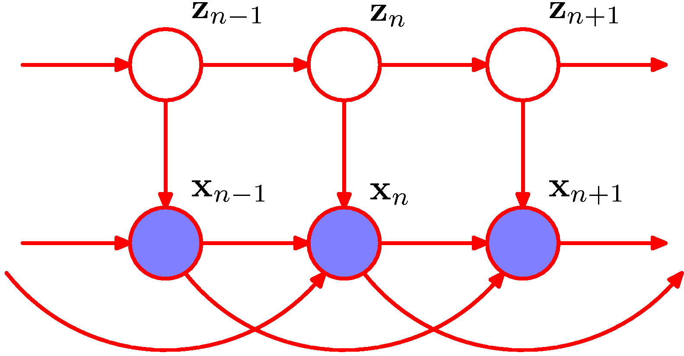
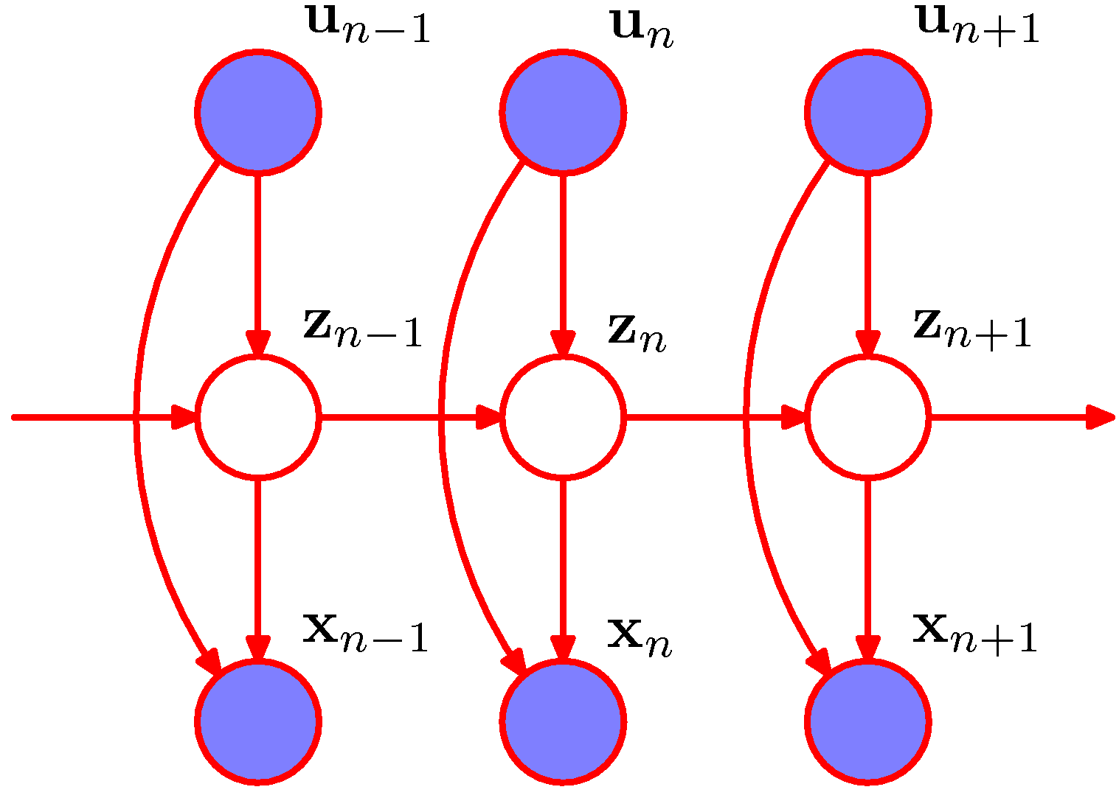
Hidden Markov Models
Extensions (for especial and particular applications)
Autoregressive HMM – The observations depend on hidden variables as well as the two previous observations
Input-output HMM – Both transition and emission probabilities depend on values of another sequence of observations
source [1]

Slide 29
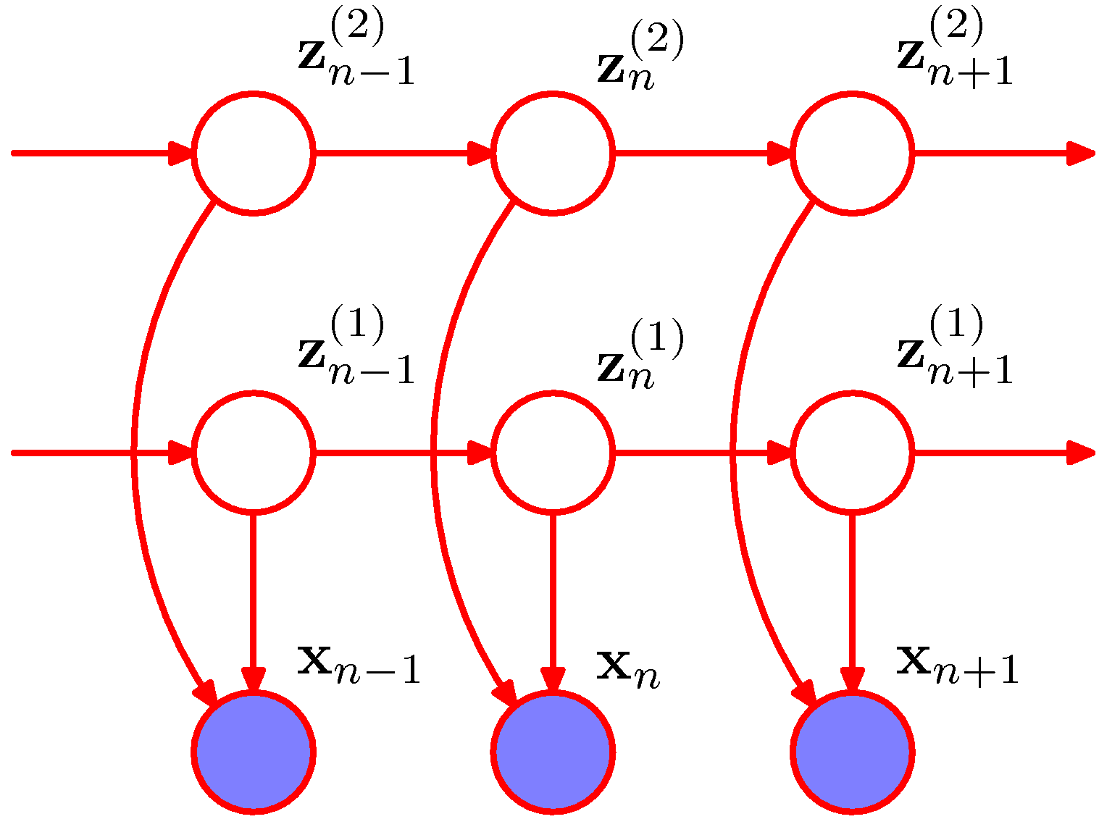
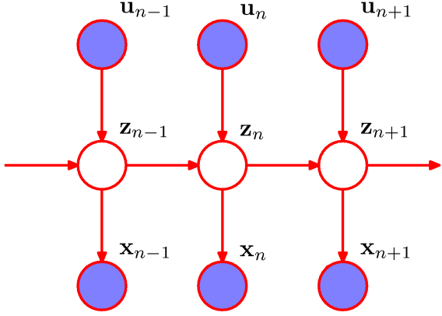
Hidden Markov Models
Extensions (for especial and particular applications)
Factorial HMM – Two Markov chains of hidden variables
Non-homogeneous HMM – transition probabilities are no more constant across the sequence (or time)
source [1]

Slide 30
Hidden Markov Models
Main emissions probability distributions included in the HMM Java code ( the C code in Matlab adds many others include Chain HMM and spatial structure through Chow-Liu trees
M (# of variables) independent Bernoulli
Multivariate Gaussian
Independent Delta-Exponential
Independent Delta-Gamma

Slide 31
Hidden Markov Models
A simple Example
Modeling Daily Rainfall Occurrence for 10 rainfall stations in South Florida
HMM-Bernoulli (Poisson) emission - works with Java Code
HMM-Chain emission – works with Matlab Code
-------------------
Goal: Examine effect of adding hidden states; and MC vs Poisson for daily rainfall; basic fitting
Model Specifications:
# of hidden states: 4 → As the number of hidden states increases, the time needed to calibrate (or estimate the model parameters) increases as well.
# of states for rainfall: 2 (0 and 1)
Emission distribution → 10 independent Bernoulli
100 simulations

Slide 32
Hidden Markov Models
A simple Example
Phases:
Pre-processing → The input data (files with rainfall occurrence data and model specifications) are organized.
Processing
Calibration or training phase → The model parameters are estimated;
Simulation → Using the model parameters estimated in the previous phase, we simulate likely states of rainfall occurrence for the 10 rainfall gauges;
Post Processing → We compare statistics of observed and simulated data in order to assess the model ability to reproduce statistics of the historical data;

Slide 33
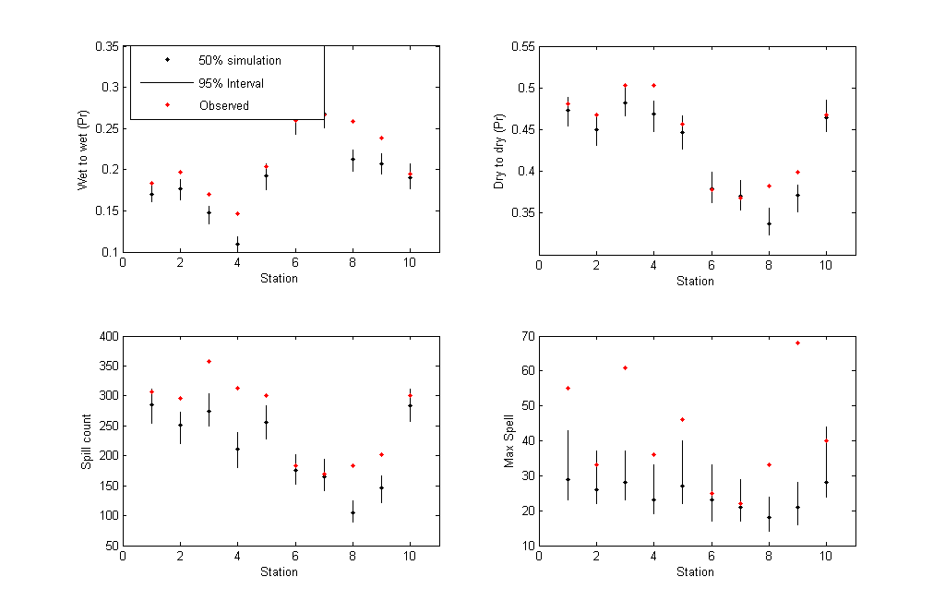
Hidden Markov Models
A simple Example: Post-processing results

Slide 34
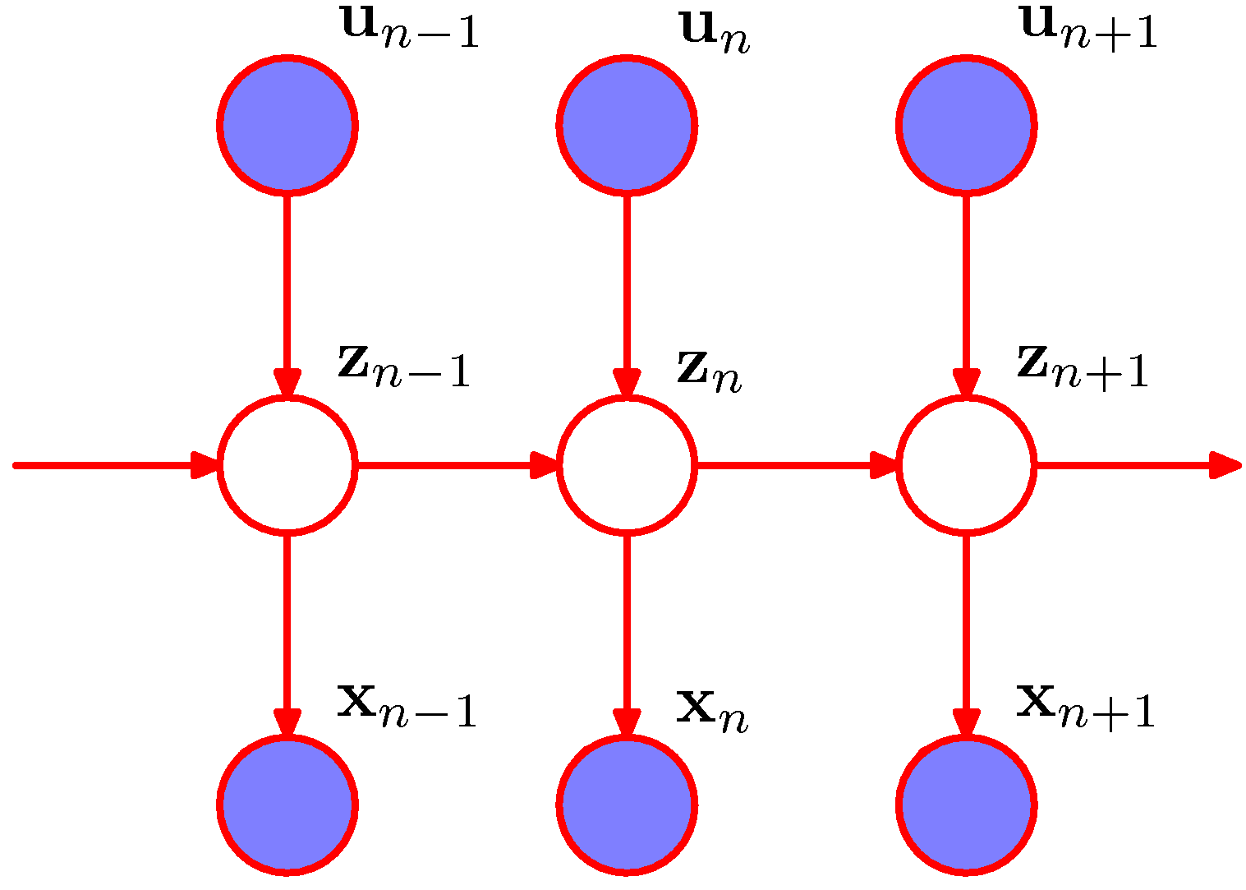
Non-Homogeneous HMM
Graphical representation
Transition probabilities are no more stationary → depend on observed data
Several applications in the literature, including rainfall downscaling
source [1]

Slide 35
Non-Homogeneous HMM
Joint Probability Distribution
Now we need to specify the conditional distribution (or input distribution) of z_{n}. In the MVN-HMM toolbox, we have only the transition-logistic implemented:
where K is the number of hidden states and σ and ρ are parameters to be estimated.

Slide 36
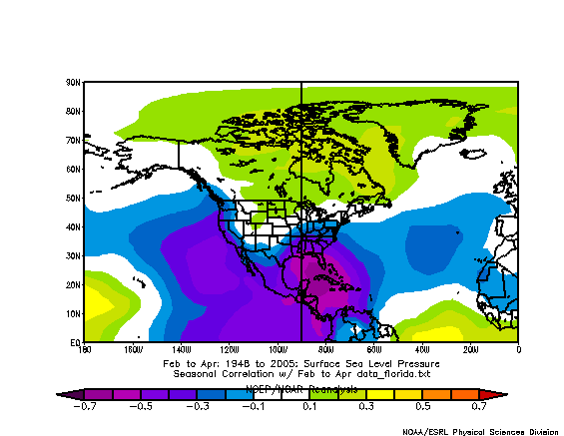
Non-Homogeneous HMM
Variable Selection
If we know that there is some exogenous variable that explains part of the variance of our data, we can use it to model the hidden states. The natural question that arises is: how do we identify and select those variables?
E.g. Correlation maps of seasonal average rainfall in South Florida and SLP and SST fields.
Possible area to extract an climate index in order to predict hidden states for FMA
FMA SLP field versus South Florida rainfall

Slide 37
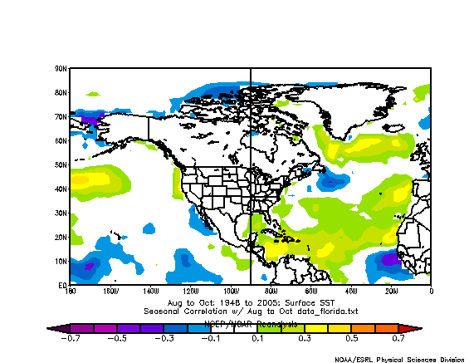
Non-Homogeneous HMM
Variable Selection
Another key area to obtain a climate index
ASO SST field versus South Florida rainfall

Slide 38
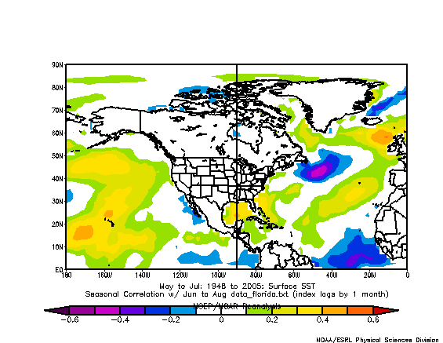
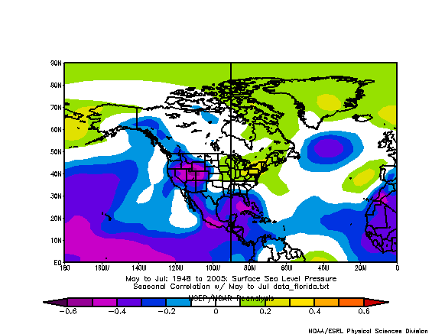
Non-Homogeneous HMM
Variable Selection
Several key areas to obtain climate indexes
MJJ SST field versus South Florida rainfall
MJJ SLP field versus South Florida rainfall

Slide 39
Non-Homogeneous HMM
Variable Selection
Important points:
We need a physical explanation to justify the climate predictors: For instance, positive anomalies of SST → increase evaporation → moisture transport → enhance rainfall
We should include only the explanatory variables that really explain the data variability (feature or variable selection) → inclusion of many predictors may lead to overfitting;
Cross-validation may be necessary to assess model performance;
If we know the likely states of our climate index predictor in the future (e.g. via IPCC scenarios), we can downscale regional scenarios of rainfall. For instance, it’s possible that a preference for a given state (e.g. associated with extreme events of rainfall) will occur in the future.

Slide 40
Nonhomogeneous Hidden Markov Models (NHMM)
A stochastic model of observed daily rainfall on a spatial network of stations,
Hidden states reflect different unobserved climate modes with different daily rainfall statistics
The hidden states have Markov memory
The hidden states probability of selection and state transition probabilities may in turn depend on an exogenous predictor
Exogenous Predictors:
Simulation:
Wavelet RC, GCM Seasonal Rain or mean SLP or SST in climate change, or re-analysis mode, concurrent SST or SLP…
Forecast:
Wavelet RC seasonal rain simulation, GCM or RCM seasonal Forecast rain or climate attributes, prior season climate pre-cursors such as SST, OLR …

Slide 41
NHMM-based daily rainfall simulation
Preceding Observed
Climate Variables
Large Scale Seasonal
Predictions from GCM
Input Vector
(R_{days}|X_{climate},X_{GCM})
Preceding Exogenous Variable
X₁:X_{T}←X_{FMA}
X₁:X_{T}←X_{MJJ}
X₁:X_{T}←X_{ASO}
X₁:X_{T}←X_{NDJ}
R₁
R₂
…
R_{t}
…
R_{T-1}
R_{T}
……..
……..
R₁
R₂
…
R_{t}
…
R_{T-1}
R_{T}
S₁
S₂
…
S_{t}
…
S_{T-1}
S_{T}
S₁
S₂
…
S_{t}
…
S_{T-1}
S_{T}
X₁
X₂
…
X_{t}
…
X_{T-1}
X_{T}
X₁
X₂
…
X_{t}
…
X_{T-1}
X_{T}
Every Year

Slide 42
Everglades National Park region and rainfall stations used

Slide 43
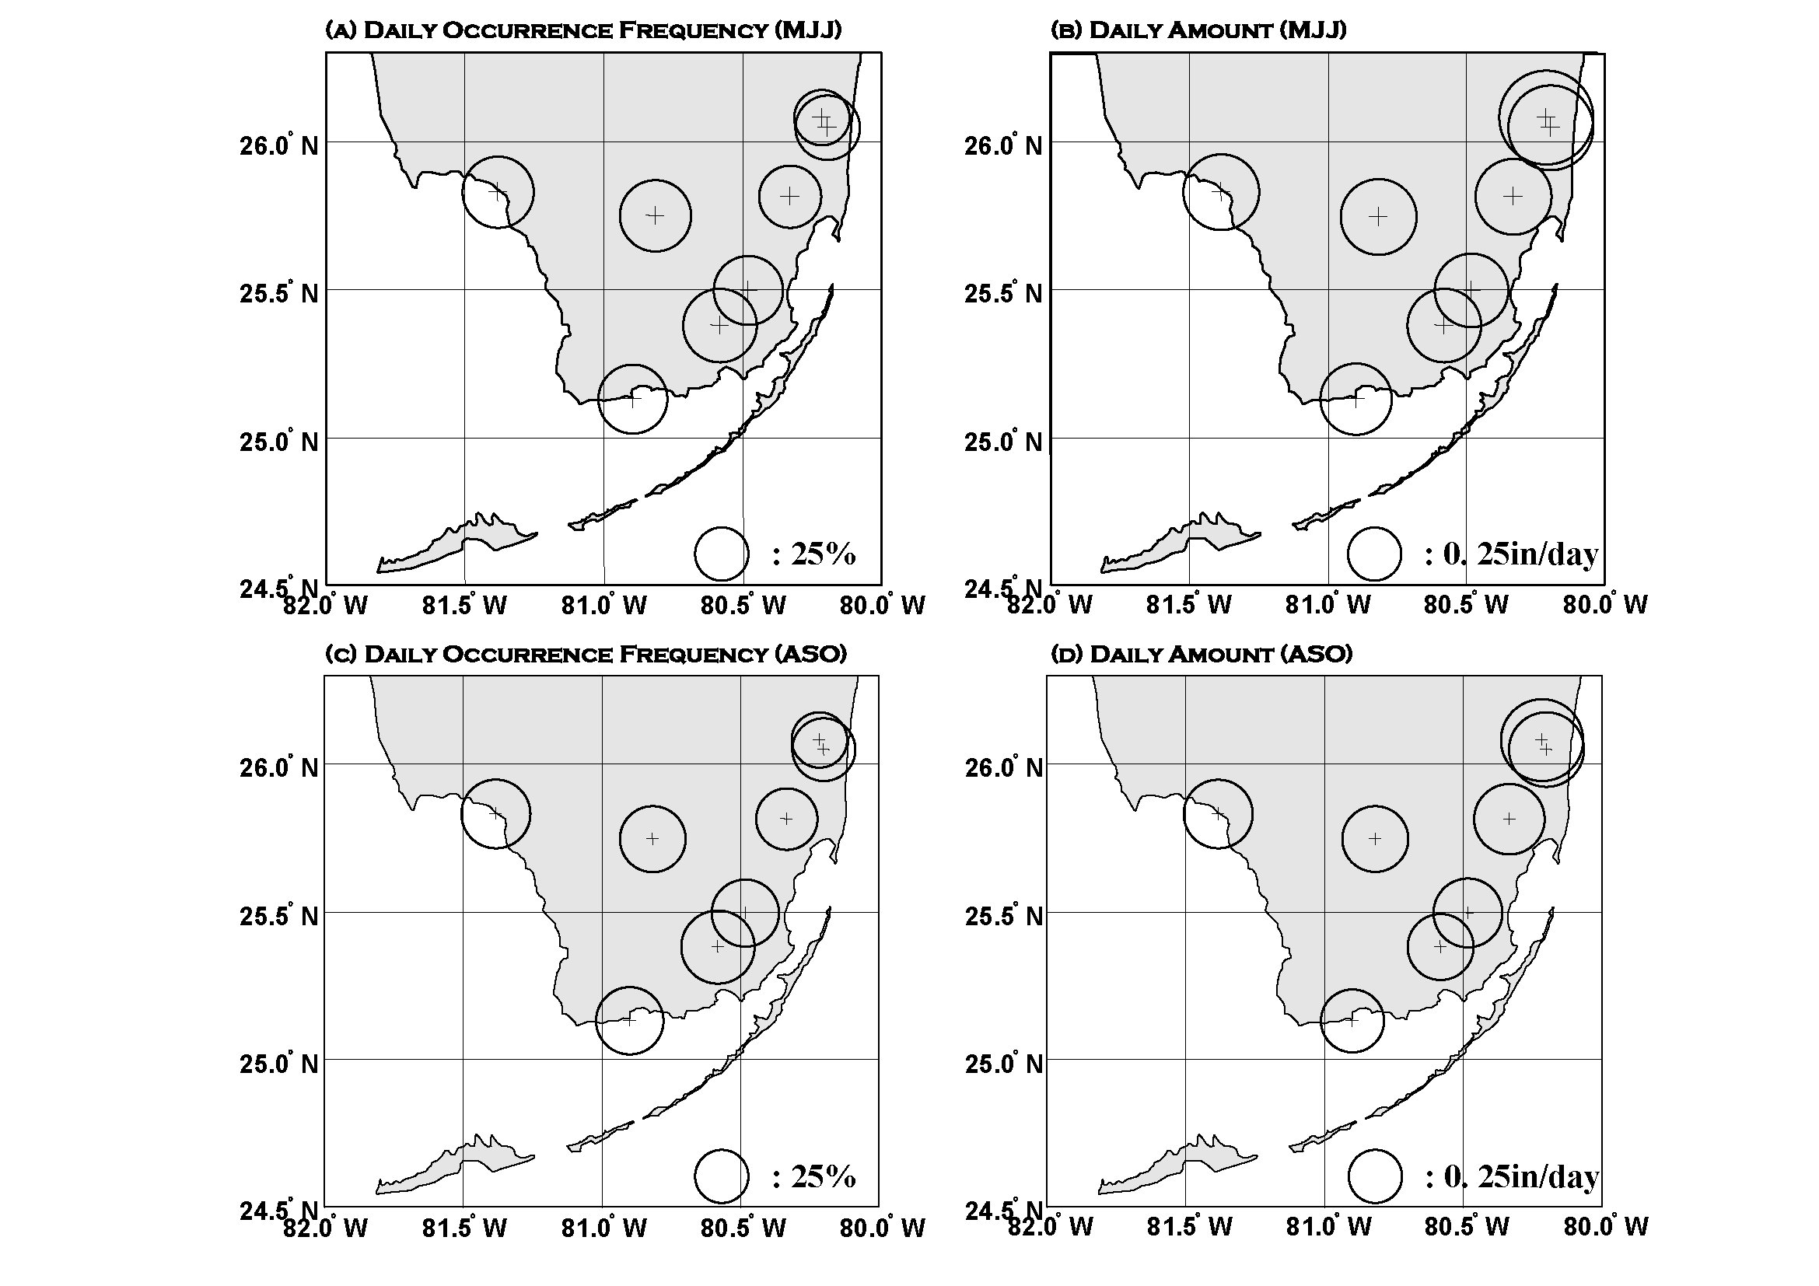
Rainfall station locations and Statistics
Circle radius denotes climatological daily rainfall probability 1979–2000: (a) the May 1 - July 31, (c) August 1 - October 31, and the corresponding rainfall amount: (b) the May 1 - July 31, (d) August 1 - October 31.
Notes:
. Rainfall station locations. Circle radius denotes climatological daily rainfall probability 1979–2000: (a) the May 1 - July 31, (c) August 1 - October 31, and the corresponding rainfall amount: (b) the May 1 - July 31, (d) August 1 - October 31.

Slide 44
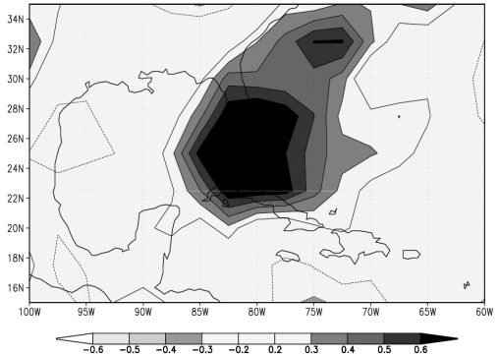
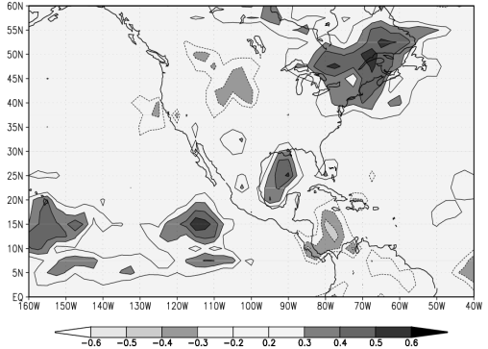
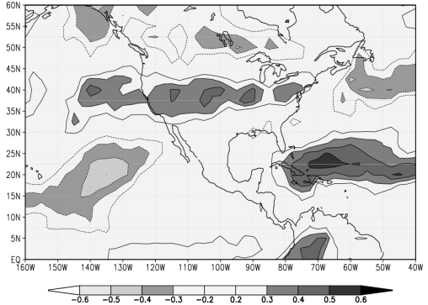
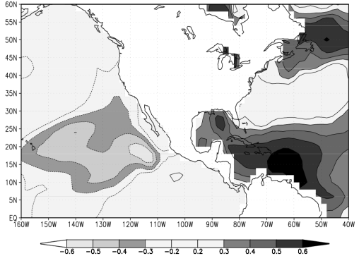
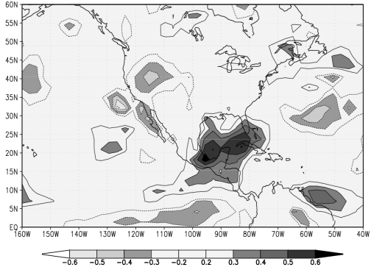
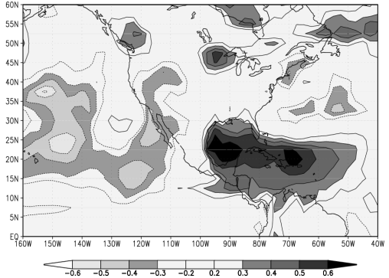
Climate Predictors
The correlation map between Everglades National Park MJJ-ASO precipitation and climate Fields.
a) ERA-40 reanalysis MJJ Precipitation with ENP MJJ Precipitation,
b) FMA OLR with ENP MJJ Precipitation,
c) MJJ ECHAM Precipitation Forecast with ENP MJJ Precipitation,
d) MJJ OLR with ENP ASO Precipitation,
e) MJJ SST with ENP ASO Precipitation,
f) ASO DEMETER Precipitation Forecasting with ENP ASO Precipitation.
MJJ Season
ASO Season
a
d)
b)
e)
c)
f)
Notes:
The correlation map between Everglades National Park MJJ-ASO precipitation and climate Fields. a) ERA-40 reanalysis MJJ Precipitation with ENP MJJ Precipitation, b) FMA OLR with ENP MJJ Precipitation, c) MJJ ECHAM Precipitation Forecast with ENP MJJ Precipitation, d) MJJ OLR with ENP ASO Precipitation, e) MJJ SST with ENP ASO Precipitation, f) ASO DEMETER Precipitation Forecasting with ENP ASO Precipitation.

Slide 45
Simulation Results with ERA-40
a)
b)
c)
d)
e)
f)
Notes:
The MJJ seasonal statistics of a) precipitation amount, b) wet days, c) wet to wet probability, d) dry to dry probability, e) maximum dry spell length and f) 7-day dry spell length of NHMM-simulated daily rainfall versus the observed (solid) averaged over all 8 stations. Plotted is the median of 50 NHMM simulations (circle). All statistics per season were averaged across the 8 stations. The input “predictor” is ERA-40 reanalysis MJJ seasonal precipitation amount. The error bars indicate the entire range of the 50 simulations, with the inter-quartile range given by the shaded area.

Slide 46
Estimated State Sequence
MJJ Season
1z | 2 | 3 | 4 | 5

Slide 47
Estimated State Sequence
ASO Season
1 | 2 | 3

Slide 48
The estimated percentage of amount and frequency of seasonal rainfall according to each state
(a-b): MJJ Season five states,
(c-d): ASO Season three states
a)
b)
c)
d)

Slide 49
Anomaly composites of 850-hPa wind (vectors) and OLR (contours)
MJJ Season
MJJ State1(421days)
MJJ State2(123days)
MJJ State3(509days)
MJJ State4(286days)
MJJ State5(685days)

Slide 50
Anomaly composites of 850-hPa wind (vectors) and OLR (contours)
ASO State1(389days)
ASO State2(987days)
ASO State3(648days)

Slide 51
Mean seasonal variation of daily state occurrence

Slide 52
MJJ Seasonal Statistics
a)
b)
c)
d)
e)
f)

Slide 53
ASO Seasonal Statistics
a)
b)
c)
d)
e)
f)

Slide 54
References
[1] Bishop, C. M. Pattern Recognition and Machine Learning. Springer. 2006.
[2] Jordan, M. I. and Bishop, C. M. An Introduction to Graphical Models. to be published.
[3] Kirshner, S. Quick Start Manual for the MVN-HMM Toolbox. 2005. Available at http://www.cs.ualberta.ca/~sergey/MVNHMM/.

