Slide 1
Microsoft Excel
Absolute Addressing
ISW Presentation #3

Slide 2
Why Spreadsheets and Microsoft Excel?
Spreadsheets are the most common, general-purpose software for data analysis and reporting.
Excel and spreadsheets are not always the best tool for data analysis, but they are great for quick analysis, reporting, and sharing.
Lots of applications:
Simple database for lists (tasks, TODO items, recipes, …)
Charts and reports
Notes:
Excel is like a Swiss-army knife. Works on many data problems. May not be the best tool for large problems (cutting down tree with a pocket knife), but often a good first start.

Slide 3
Objectives
Explain an "address" in Excel and its purpose.
Compare and contrast relative address with absolute address.

Slide 4
Background: Spreadsheet
A spreadsheet organizes information into a two-dimensional array of cells (a table).
A cell has two components:
an address - specified given a column letter and row number
a location - that can store a number, text, or formula
The power of a spreadsheet is that we can write simple formulas (commands) to perform calculations and immediately see the results of those calculations.
Spreadsheets are very common in business and reporting applications.

Slide 5
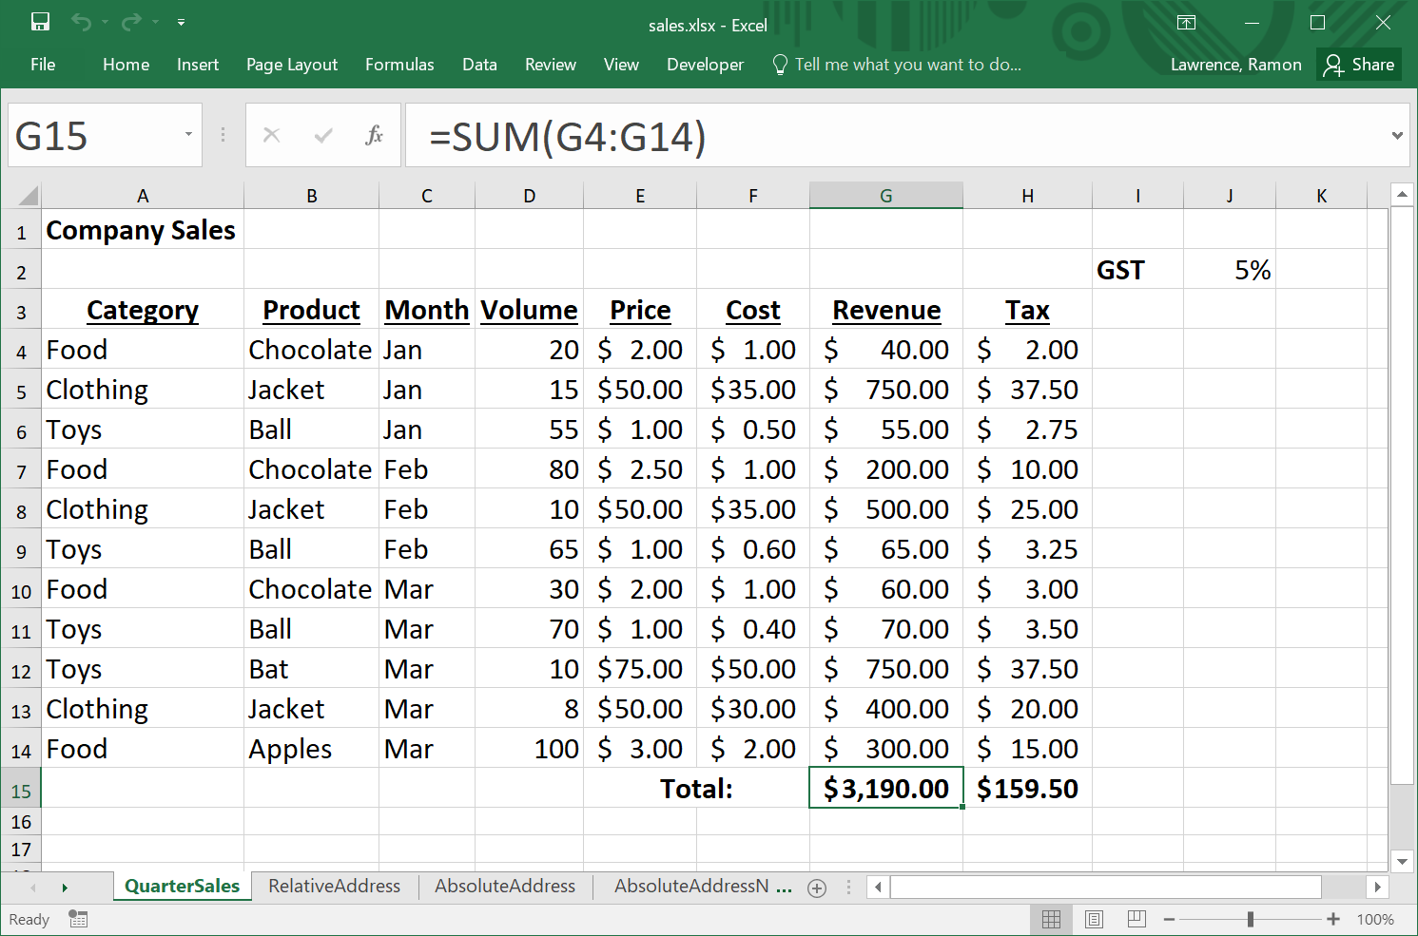
Spreadsheet Addressing
An address identifies a cell by a column letter then a row number.
formula in cell
columns
rows
Cell G15
Notes:
What is in cell C6?

Slide 6
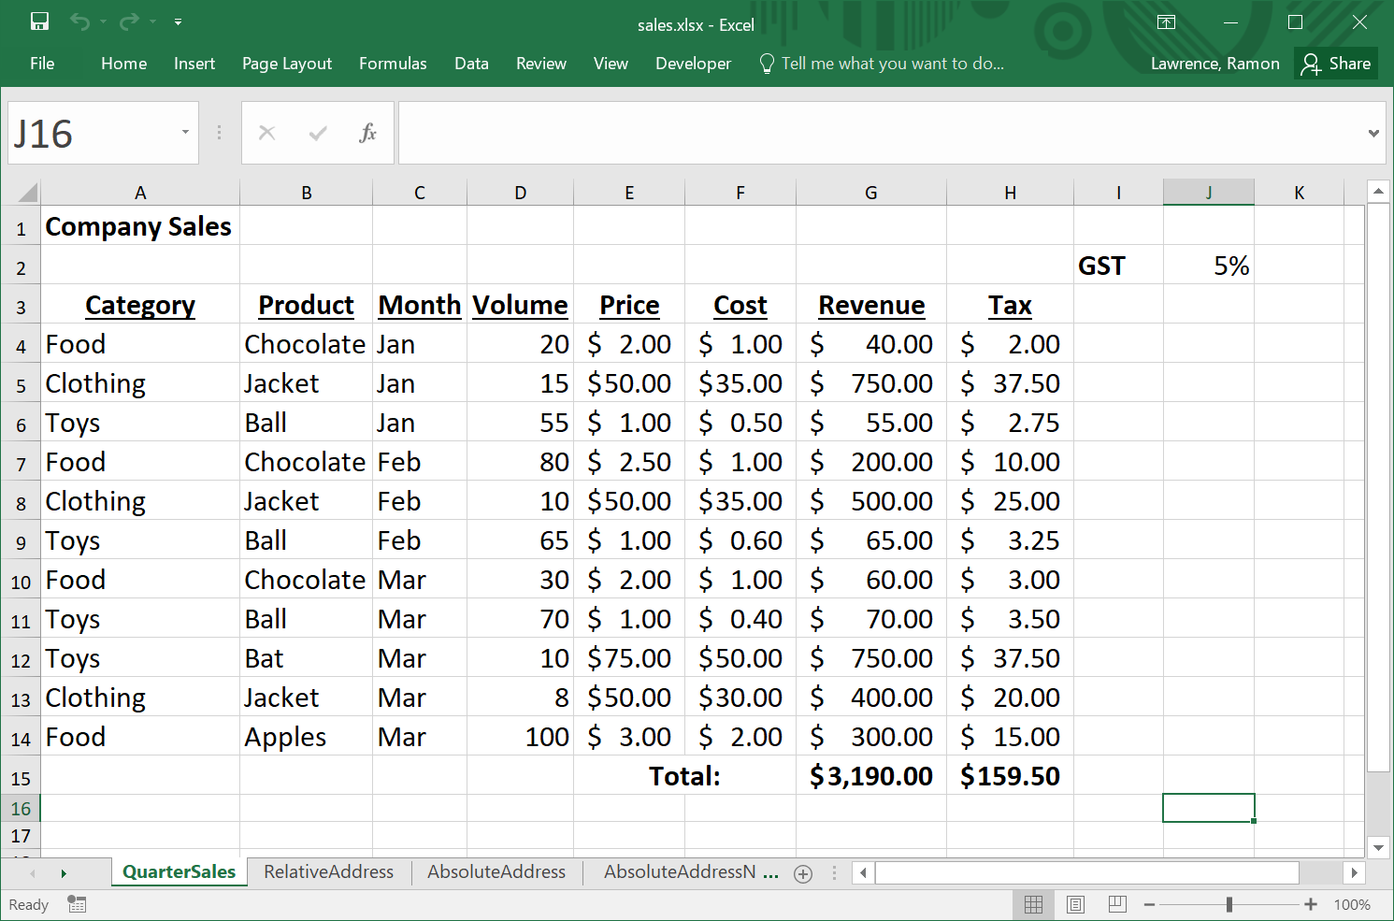
Address Question
Question: What is in cell F12?
A) nothing
B) $50
C) Mar
D) $30
Notes:
Answer: B
What is in cell 12F?

Slide 7
Thought Questions
Is an address unique?
What would the letter(s) be for column 30?
Notes:
Yes unique. It refers to a single location.
AD = 30 = 1 * 26^1 + 4 * 26^0

Slide 8
Copying Formulas
When a cell containing a formula is copied to another cell, all addresses are updated based on the relative difference in locations between the cells. This is default behavior. Why?
An absolute address has a dollar sign "$" in front of one or both of the column and row in an address. The row and/or column DO NOT CHANGE when the formula is copied.
Useful when have constants (e.g. GST) that are located in a particular cell.
Example:
Cell A1 has the formula =A2+B1
Copy contents of cell A1 to cell C4.
Formula changes to =C5+D4 because moved down three rows and over two columns.
If cell A1 had the formula =$A$2+$B$1, then the same formula would be in cell C4.
Question: What if formula was =$A2+B$1?
Notes:
Formula is =$A5+D$1.

Slide 9
Formulas and References Question
Question: Cell A1 contains the following: =$B2+D$4. What is the formula if the cell is copied to cell D3?
A) error
B) =$B2+D$4
C) =$B4+F$4
D) =$B4+G$4
Notes:
Answer: D

Slide 10
Conclusion
Spreadsheets are general purpose tools for data analysis that consist of a table of cells which contain data and formulas.
You have learned:
What an address is used for in Excel.
Address in formulas change when a cell is copied to another cell
Absolute addresses use a $ to indicate row/column should not change when copied.

