Slide 1
Inference for Distributions of Categorical Data
lesson 1
Chi-Square Goodness-of-Fit Tests

Slide 2
Chi-Square Goodness-of-Fit Tests
Learning Objectives
After this section, you should be able to…
COMPUTE expected counts, conditional distributions, and contributions to the chi-square statistic
CHECK the Random, Large sample size, and Independent conditions before performing a chi-square test
PERFORM a chi-square goodness-of-fit test to determine whether sample data are consistent with a specified distribution of a categorical variable
EXAMINE individual components of the chi-square statistic as part of a follow-up analysis

Slide 3
Here’s what the company says about the color distribution of its M&M’S Milk Chocolate Candies: On average, the M&M’S Milk Chocolate Candies will contain 13% of each of browns and reds, 14% yellows, 16% greens, 20% oranges and 24% blues.
The one-way table below summarizes the data from a sample bag of M&M’S Milk Chocolate Candies. In general, one-way tables display the distribution of a categorical variable for the individuals in a sample.
Since the company claims that 24% of all M&M’S Milk Chocolate Candies are blue, we could use the one-sample z test for a proportion.
H₀: p = 0.24
H_{a}: p ≠ 0.24
where p is the true population proportion of blue M&M’S. We could then perform additional significance tests for each of the remaining colors.
Color | Blue | Orange | Green | Yellow | Red | Brown | Total
Count | 9 | 8 | 12 | 15 | 10 | 6 | 60
× pretty inefficient ×

Slide 4
Comparing Observed and Expected Counts
We need a new kind of significance test, called
chi-square goodness-of-fit test
The null hypothesis in a chi-square goodness-of-fit test should state a claim about the distribution of a single categorical variable in the population of interest. In our example, the appropriate null hypothesis is
H₀: The company’s stated color distribution for
M&M’S Milk Chocolate Candies is correct.
The alternative hypothesis in a chi-square goodness-of-fit test is that the categorical variable does not have the specified distribution. In our example, the alternative hypothesis is
H_{a}: The company’s stated color distribution for
M&M’S Milk Chocolate Candies is not correct.

Slide 5
Comparing Observed and Expected Counts
We can also write the hypotheses in symbols as:
H₀: p_{blue} = 0.24, p_{orange} = 0.20, p_{green} = 0.16, p_{yellow} = 0.14, p_{red} = 0.13, p_{brown} = 0.13,
H_{a}: At least one of the p_{i}’s is incorrect
where p_{color} is the true population proportion of M&M’S Milk Chocolate Candies of that color.

Slide 6
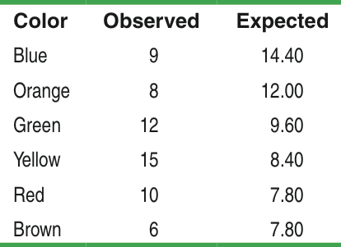
Expected Counts
A sample bag of M&M’s milk Chocolate Candies contained 60 candies.
Assume H0 is correct:
H0: 13% of each of browns and reds, 14% yellows,16% greens, 20% oranges and 24% blues.
Calculate the expected counts for each color.
The idea of the chi-square goodness-of-fit test:
Assume H₀ is true, compare the observed counts (from sample) with the counts that would be expected.
The more the observed counts differ from the expected counts, the more evidence we have against the null hypothesis.

Slide 7
The Chi-Square Statistic
Definition:
The chi-square statistic is a measure of how far the observed counts are from the expected counts. The formula for the statistic is

Slide 8
Chi-Square Goodness-of-Fit Tests
Example: Return of the M&M’s
The table shows the observed and expected counts for our sample of 60 M&M’s Milk Chocolate Candies. Calculate the chi-square statistic.

Slide 9
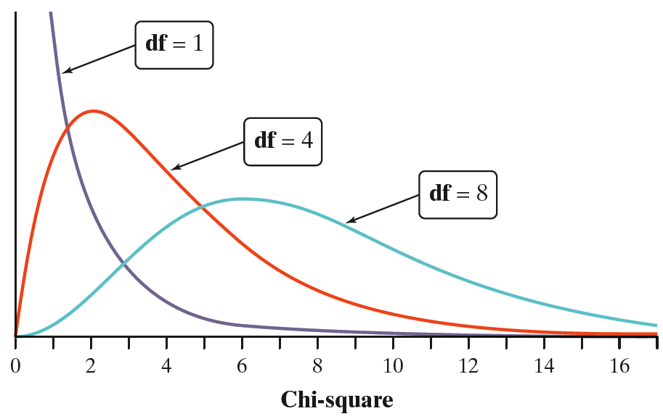
Chi-Square Goodness-of-Fit Tests
The Chi-Square Distributions
The Chi-Square Distributions
The chi-square distributions are a family of distributions that take only positive values and are skewed to the right.
The chi-square goodness-of-fit test uses the chi-square distribution with df = n - 1.
n is the number of categories.

Slide 10
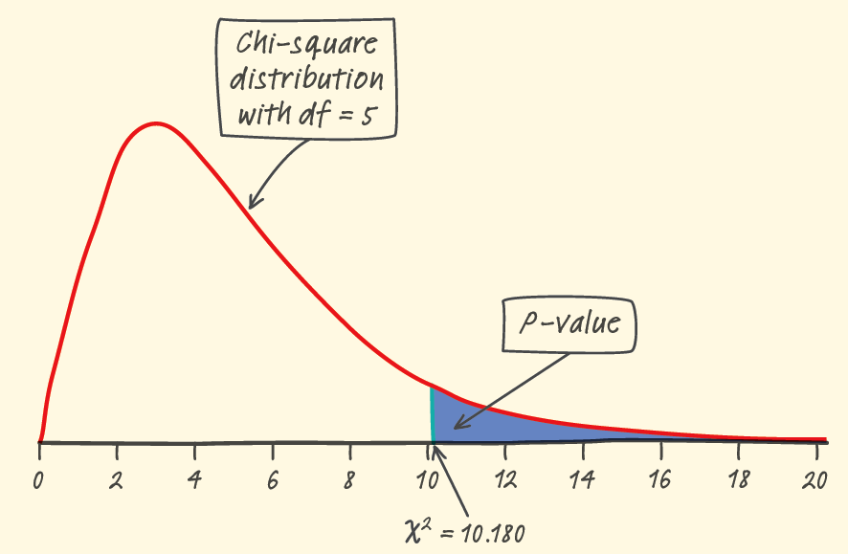
Example: Return of the M&M’s
Since our P-value(0.07) is greater than α(0.05).
Therefore, we fail to reject H₀.
We don’t have sufficient evidence to conclude that the company’s claimed color distribution is incorrect.

Slide 11
Chi-Square Goodness-of-Fit Tests
Carrying Out a Test
Conditions: Use the chi-square goodness-of-fit test when
Random
The data come from a random sample or a randomized experiment.
Large Sample Size
All expected counts are at least 5.
Independent
Individual observations are independent.
When sampling without replacement, check that the population is at least
10 times as large as the sample (the 10% condition).

Slide 12
Before we start using the chi-square goodness-of-fit test, we have two important cautions to offer.
1. The chi-square test statistic compares observed and expected counts. Don’t try to perform calculations with the observed and expected proportions in each category.
2. When checking the Large Sample Size condition, be sure to examine the expected counts, not the observed counts.
The Chi-Square Goodness-of-Fit Test
Suppose the Random, Large Sample Size, and Independent conditions are
met. To determine whether a categorical variable has a specified distribution, expressed as the proportion of individuals falling into each possible category, perform a test of
H₀: The specified distribution of the categorical variable is correct.
H_{a}: The specified distribution of the categorical variable is not correct.
We can also write these hypotheses symbolically using p_{i} to represent the
proportion of individuals that fall in category i:
H₀: p₁ = ___, p₂ = ___, …, p_{k} = ___.
H_{a}: At least one of the p_{i}’s is incorrect.
Start by finding the expected count for each category assuming that H₀ is
true. Then calculate the chi-square statistic

Slide 13

Chi-Square Goodness-of-Fit Tests
Example: When Were You Born?
Are births evenly distributed across the days of the week? The one-way table below shows the distribution of births across the days of the week in a random sample of 140 births from local records in a large city. Do these data give significant evidence that local births are not equally likely on all days of the week?
Day | Sun | Mon | Tue | Wed | Thu | Fri | Sat
Births | 13 | 23 | 24 | 20 | 27 | 18 | 15
State: We want to perform a test of
H₀: Birth days in this local area are evenly distributed across the days of the week.
H_{a}: Birth days in this local area are not evenly distributed across the days of the week.
The null hypothesis says that the proportions of births are the same on all days. In that case, all 7 proportions must be 1/7. So we could also write the hypotheses as
H₀: p_{Sun} = p_{Mon} = p_{Tues} = . . . = p_{Sat} = 1/7.
H_{a}: At least one of the proportions is not 1/7.
We will use α = 0.05.
Plan: If the conditions are met, we should conduct a chi-square goodness-of-fit test.
• Random The data came from a random sample of local births.
• Large Sample Size Assuming H₀ is true, we would expect one-seventh of the births to occur on each day of the week. For the sample of 140 births, the expected count for all 7 days would be 1/7(140) = 20 births. Since 20 ≥ 5, this condition is met.
• Independent Individual births in the random sample should occur independently (assuming no twins). Because we are sampling without replacement, there need to
be at least 10(140) = 1400 births in the local area. This should be the case in a large city.

Slide 14
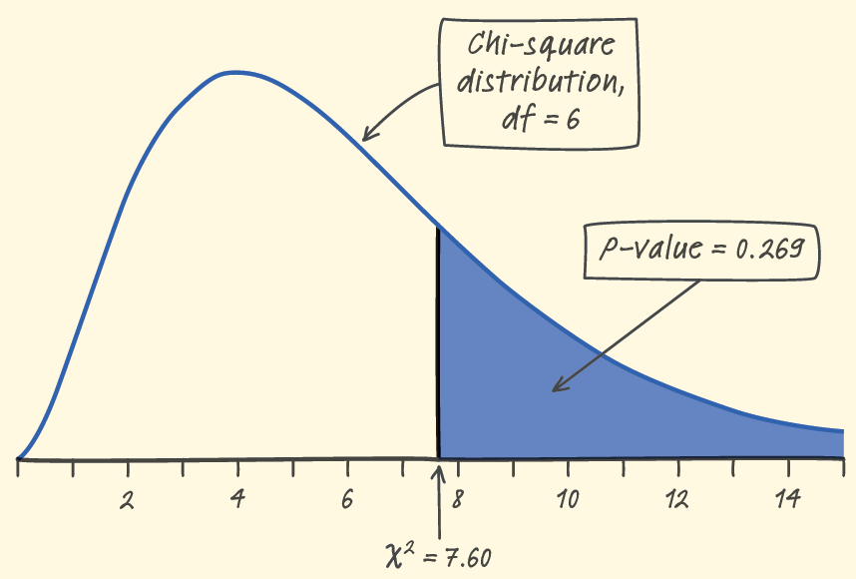
Chi-Square Goodness-of-Fit Tests
Example: When Were You Born?
Do: Since the conditions are satisfied, we can perform a chi-square goodness-of-fit test. We begin by calculating the test statistic.
P-Value:
Using Table C: χ² = 7.60 is less than the smallest entry in the df = 6 row, which corresponds to tail area 0.25. The P-value is therefore greater than 0.25.
Using technology: We can find the exact P-value with a calculator: χ²cdf(7.60,1000,6) = 0.269.
Conclude: Because the P-value, 0.269, is greater than α = 0.05, we fail to reject H₀. These 140 births don’t provide enough evidence to say that all local births in this area are not evenly distributed across the days of the week.

Slide 15
Inference for Distributions of Categorical Data
lesson 2
Chi-Square Test for Homogeneity

Slide 16
Example
On the campus of a large university, the students are freshmen, sophomores, juniors and seniors. The school officials had heard several complaints about the food services, but felt that the complaints differed across the four grades. To get students input, a random sample of students was selected from each grade. Each selected students was asked, “Are the current food services satisfactory?” The answers were recorded as “satisfactory” or “not satisfactory”. The answers are summarized as follows.
Is there any significant evidence to indicate whether the proportion of students satisfied with the current food services differs in different grades at the significance level of 0.05?
 | Satisfactory | Not Satisfactory | Sample size
Freshman | 156 | 44 | 200
Sophomore | 144 | 56 | 200
Junior | 98 | 52 | 150
Senior | 88 | 62 | 150
Total | 486 | 214 | 700

Slide 17
Example
 | Satisfactory | Not Satisfactory | total
Answers | 486 | 214 | 700
H0: p1=0.65
p2=0.35
Ha: At least one of these proportions are incorrect
p1 and p2 are the proportions of Satisfactory and Not Satisfactory respectively
Chi-square goodness-of-fit test
Based on this table, we have that the distribution of current food services satisfactory is:
P(satis) = 0.6943
P(not satis) = 0.3057

Slide 18
Chi-square test for homogeneity
P(satis) = 0.6943
P(not satis) = 0.3057
 | Satisfactory | Not Satisfactory | Sample size
Freshman | 156 | 44 | 200
Sophomore | 144 | 56 | 200
Junior | 98 | 52 | 150
Senior | 88 | 62 | 150
Total | 486 | 214 | 700
H0: The distributions of students satisfied with the current food services are the same across all four grades.
Ha: The distributions of students satisfied with the current food services are the same across all four grades.

Slide 19
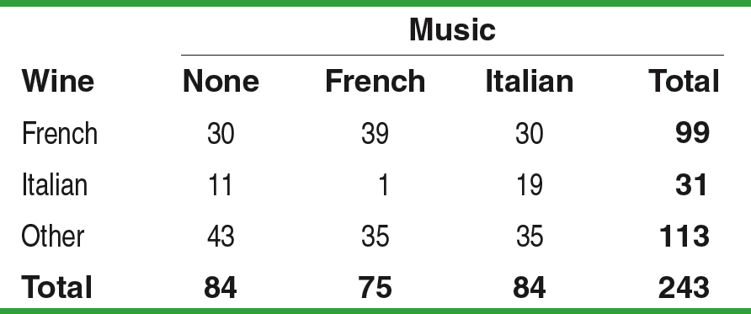
Example: Does Music Influence Purchases?
Researchers suspect that background music may lead to different buying behaviors.
One study in a supermarket compared three randomly assigned treatments: no music, French accordion music, and Italian string music.
Under each condition, the researchers recorded the numbers of bottles of French, Italian, and other wine purchased. The table below summarizes the data.
H₀: There is no difference in the distributions of wine purchases at this store when no music, French accordion music, or Italian string music is played.
H_{a}: There is a difference in the distributions of wine purchases at this store when no music, French accordion music, or Italian string music is played.

Slide 20
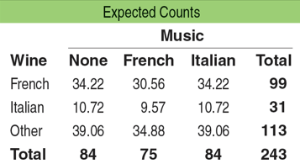
Finding Expected Counts
Finding Expected Counts
The expected count in any cell of a two-way table when H₀ is true is

Slide 21
Calculating the Chi-Square Statistic
In order to calculate a chi-square statistic for the wine example, we must check to make sure the conditions are met:
All the expected counts in the music and wine study are at least 5.
The treatments were assigned at random.
Just as we did with the chi-square goodness-of-fit test, we compare the observed counts with the expected counts using the statistic

Slide 22
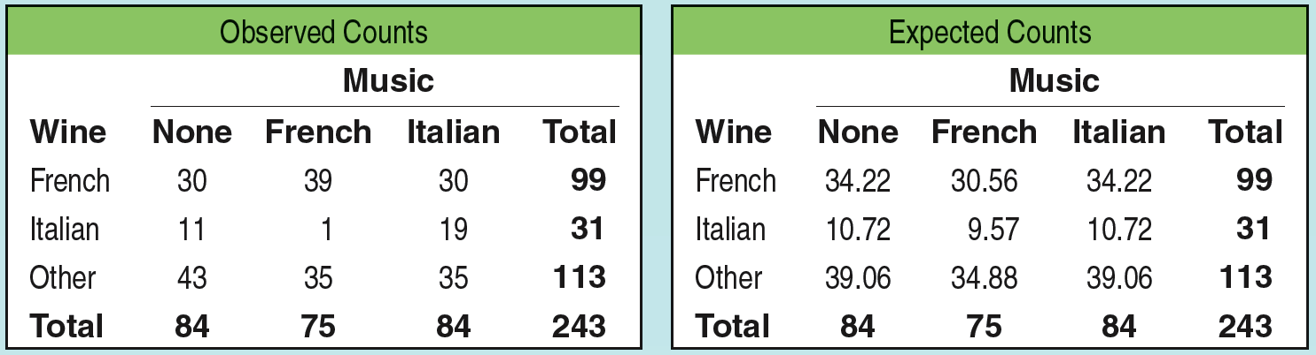
Calculating The Chi-Square Statistic

Slide 23
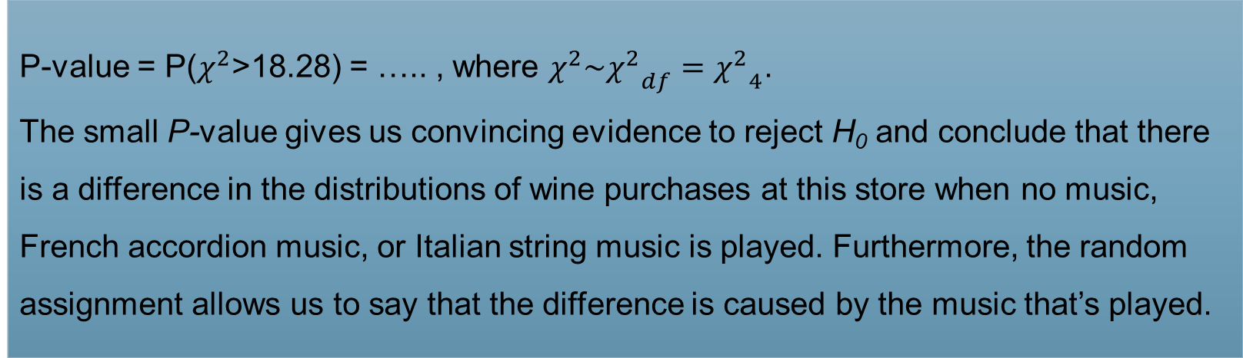
Example: Does Music Influence Purchases?
P-value = P($χ^{2}$>18.28) = ….. , where $χ^{2}\sim {χ^{2}}_{df}={χ^{2}}_{4}$.
The small P-value gives us convincing evidence to reject H₀ and conclude that there is a difference in the distributions of wine purchases at this store when no music, French accordion music, or Italian string music is played. Furthermore, the random assignment allows us to say that the difference is caused by the music that’s played.

Slide 24
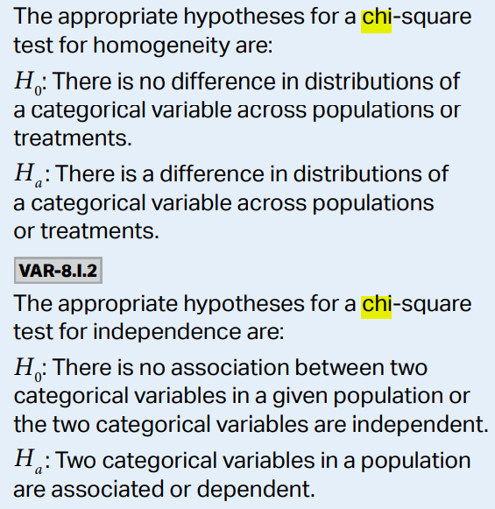

Slide 25
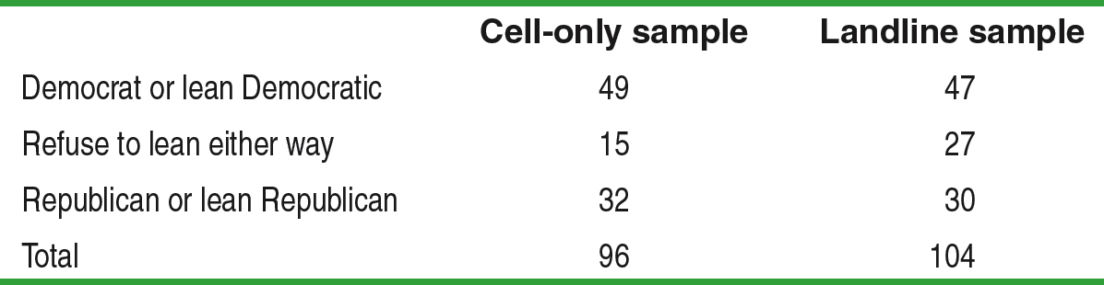
Example: Cell-Only Telephone Users
Random digit dialing telephone surveys used to exclude cell phone numbers. If the opinions of people who have only cell phones differ from those of people who have landline service, the poll results may not represent the entire adult population. The Pew Research Center interviewed separate random samples of cell-only and landline telephone users who were less than 30 years old. Here’s what the Pew survey found about how these people describe their political party affiliation.
State: We want to perform a test of
H₀: There is no difference in the distribution of party affiliation in the cell-only and landline populations.
H_{a}: There is a difference in the distribution of party affiliation in the cell-only and landline populations.
We will use α = 0.05.

Slide 26
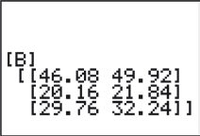
Inference for Relationships
Example: Cell-Only Telephone Users
Plan: If the conditions are met, we should conduct a chi-square test for homogeneity.
• Random The data came from separate random samples of 96 cell-only and 104 landline users.
• Large Sample Size We followed the steps in the Technology Corner (page 705) to get the expected counts. The calculator screenshot confirms all expected counts ≥ 5.
• Independent Researchers took independent samples of cell-only and landline phone users. Sampling without replacement was used, so there need to be at least 10(96) = 960 cell-only users under age 30 and at least 10(104) = 1040 landline users under age 30. This is safe to assume.

Slide 27
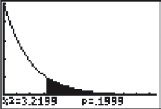
Inference for Relationships
Example: Cell-Only Telephone Users
Do: Since the conditions are satisfied, we can a perform chi-test for homogeneity. We begin by calculating the test statistic.
P-Value:
Using df = (3 – 1)(2 – 1) = 2, the P-value is 0.20.
Conclude: Because the P-value, 0.20, is greater than α = 0.05, we fail to reject H₀. There is not enough evidence to conclude that the distribution of party affiliation differs in the cell-only and landline user populations.

Slide 28
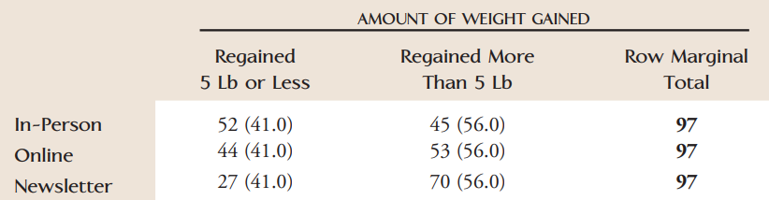
The article “Daily Weigh-ins Can Help You Keep Off Lost Pounds, Experts Say” describes an experiment in which 291 people who had lost at least 10% of their body weight in a medical weight loss program were assigned at random to one of three groups for follow-up. One group met monthly in person, one group “met” online monthly in a chat room, and one group received a monthly newsletter by mail. After 18 months, participants in each group were classified according to whether or not they had regained more than 5 pounds, resulting in the data below.
Does there appear to be a difference in the weight regained proportions for the three follow-up methods?

Slide 29
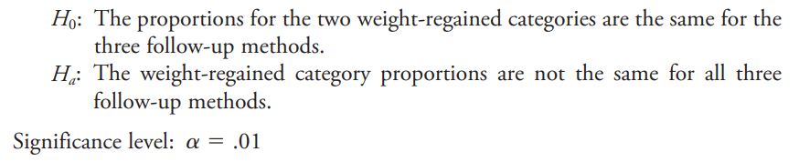

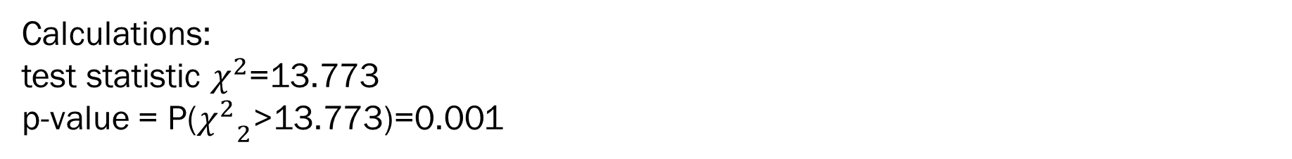
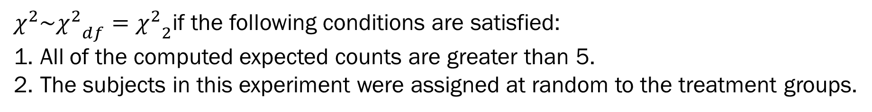
We will carry out a Chi-square test for the homogeneity.
$χ^{2}\sim {χ^{2}}_{df}={χ^{2}}_{2}$if the following conditions are satisfied:
All of the computed expected counts are greater than 5.
The subjects in this experiment were assigned at random to the treatment groups.
Calculations:
test statistic $χ^{2}$=13.773
p-value = P(${χ^{2}}_{2}$>13.773)=0.001
Conclusion:
Since P-value(0.001) is less than the significance level of 0.05, we reject H0. The weight regained proportions are not the same for the three follow-up methods.

Slide 30
Inference for Distributions of Categorical Data
lesson 3
Chi-Square Test for Independence

Slide 31
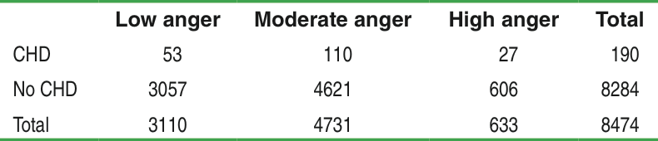
Relationships Between Two Categorical Variables
A study followed a random sample of 8474 people with normal blood pressure for about four years. All the individuals were free of heart disease at the beginning of the study. Each person took the Spielberg Trait Anger Scale test, which measures how prone a person is to sudden anger. Researchers also recorded whether each individual developed coronary heart disease (CHD). This includes people who had heart attacks and those who needed medical treatment for heart disease. Here is a two-way table that summarizes the data:

Slide 32
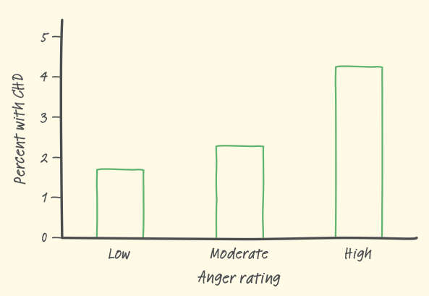
Find the conditional probability of CHD given different levels of anger.
There is a clear trend:
as the anger score increases, so does the percent who suffer heart disease.
Do the data provide convincing evidence of an association between anger level and heart disease in the population of interest?

Slide 33
The Chi-Square Test for Association/Independence
H₀: There is no association between anger level and heart disease in the population of people with normal blood pressure.
H_{a}: There is an association between anger level and heart disease in the population of people with normal blood pressure.
No association between two variables means the variables are independent.
H₀: Anger and heart disease are independent in the population of people with normal blood pressure.
H_{a}: Anger and heart disease are not independent in the population of people with normal blood pressure.

Slide 34
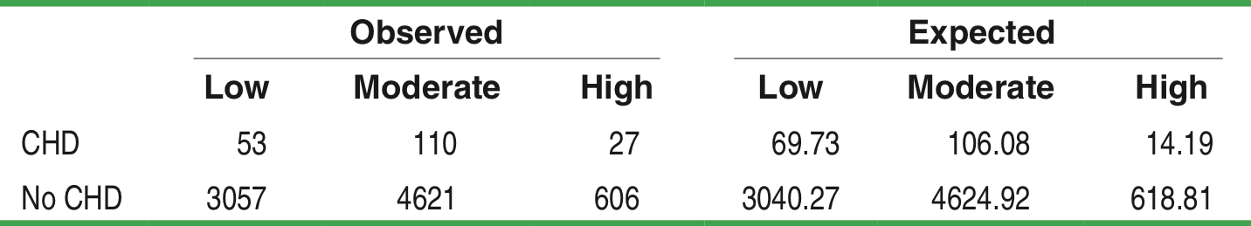
Example: Angry People and Heart Disease
State: We want to perform a test of
H₀: There is no association between anger level and heart disease in the population of people with normal blood pressure.
H_{a}: There is an association between anger level and heart disease in the population of people with normal blood pressure.
We will use α = 0.05.

Slide 35
Example: Angry People and Heart Disease
Plan:
If the conditions are met, we should conduct a chi-square test for independence.
• Random
The data came from a random sample of 8474 people with normal blood pressure.
• Large Sample Size
All the expected counts are at least 5, so this condition is met.
• Independent
Because we are sampling without replacement, we need to check that the total number of people in the population with normal blood pressure is at least 10(8474) = 84,740. This seems reasonable to assume.

Slide 36
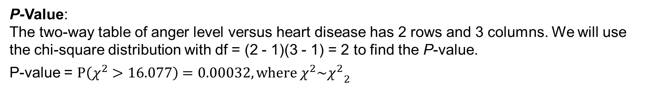
Do: Since the conditions are satisfied, we can perform a chi-test for association/independence.
We begin by calculating the test statistic.
P-Value:
The two-way table of anger level versus heart disease has 2 rows and 3 columns. We will use the chi-square distribution with df = (2 - 1)(3 - 1) = 2 to find the P-value.
P-value = $P\left(χ^{2}>16.077\right)=0.00032, where χ^{2}\sim {χ^{2}}_{2}$
Conclude: Because the P-value (0.00032) is less than α = 0.05, we reject H₀ and conclude that anger level and heart disease are associated in the population of people with normal blood pressure.

Slide 37
http://www.ltcconline.net/greenL/java/statistics/catstatprob/categorizingstatproblemsjavascript.html

