Slide 1
Logistic Regression
GA DAT3

Slide 2
Agenda
Linear Regression Review
From Linear to Logistic
Performance Measures
GLMs, Exponential Family
Relationship to Naive Bayes

Slide 3
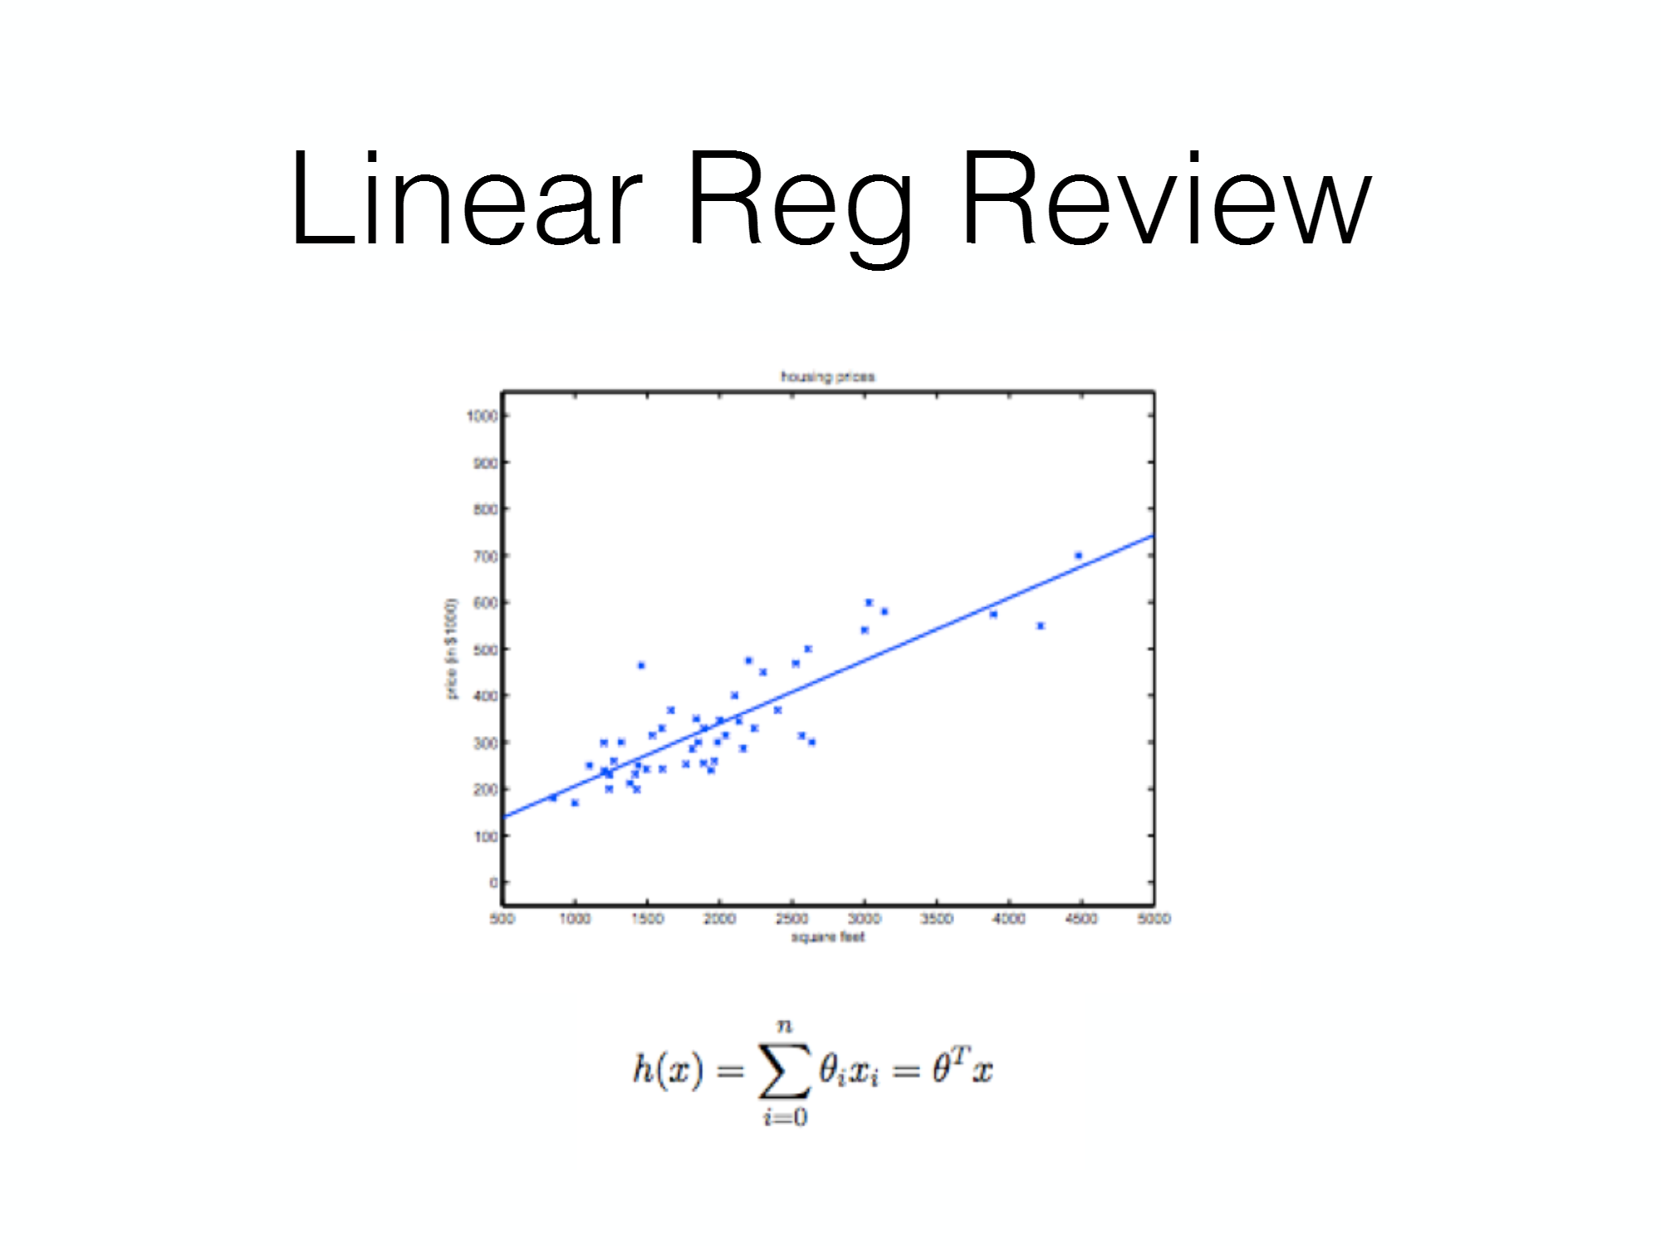

Slide 4
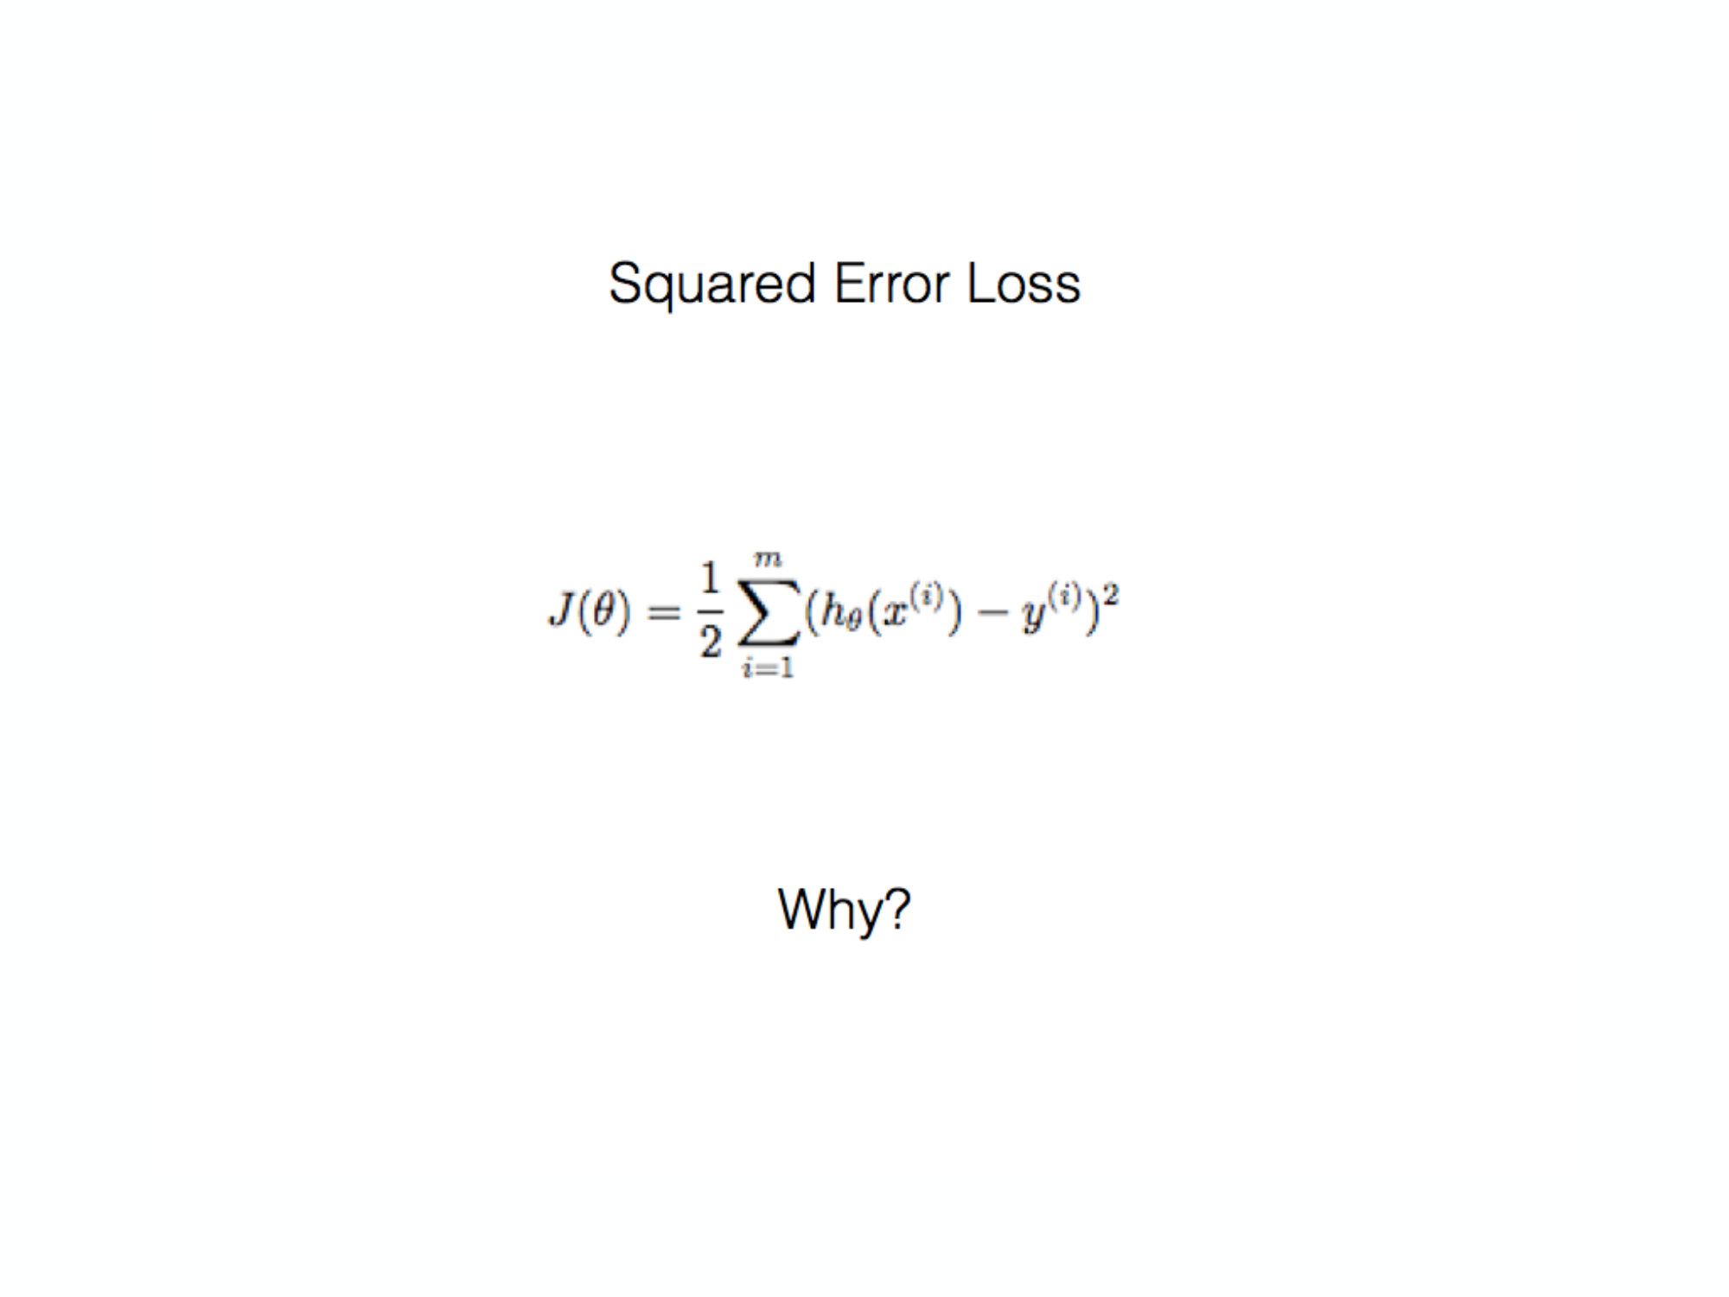

Slide 5
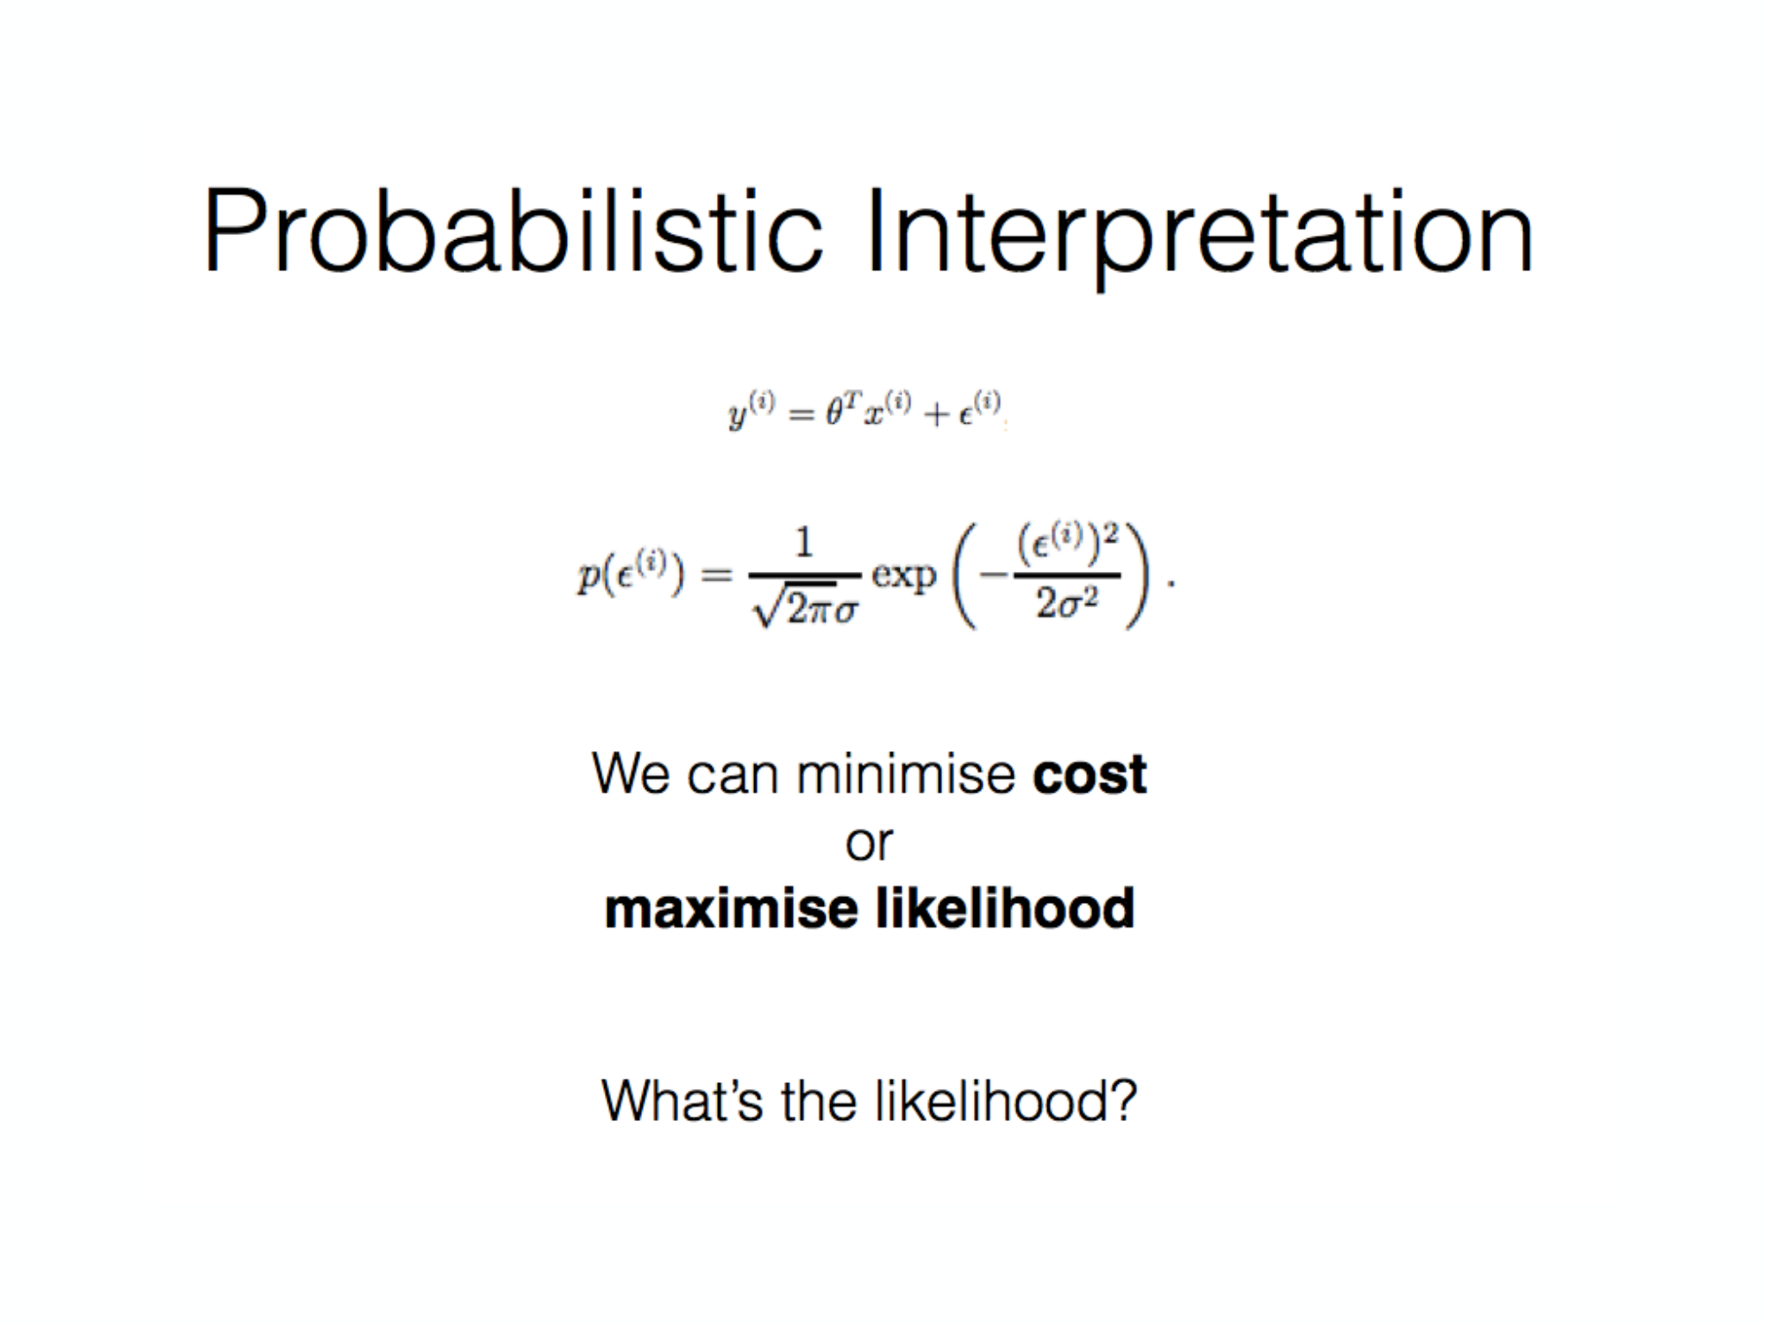

Slide 6
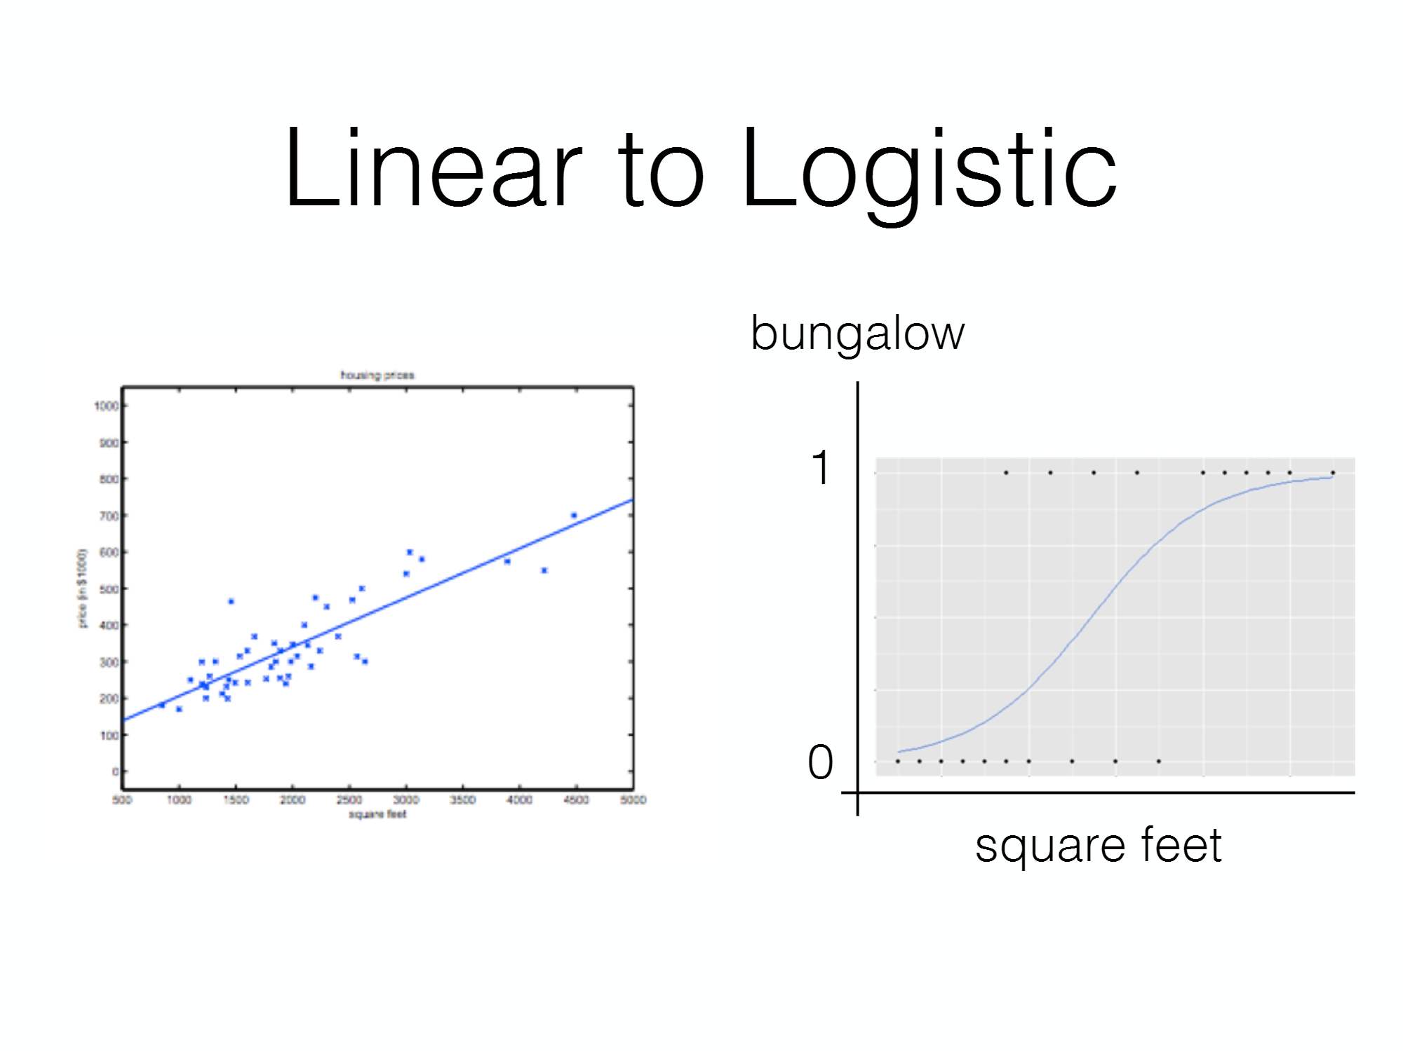

Slide 7

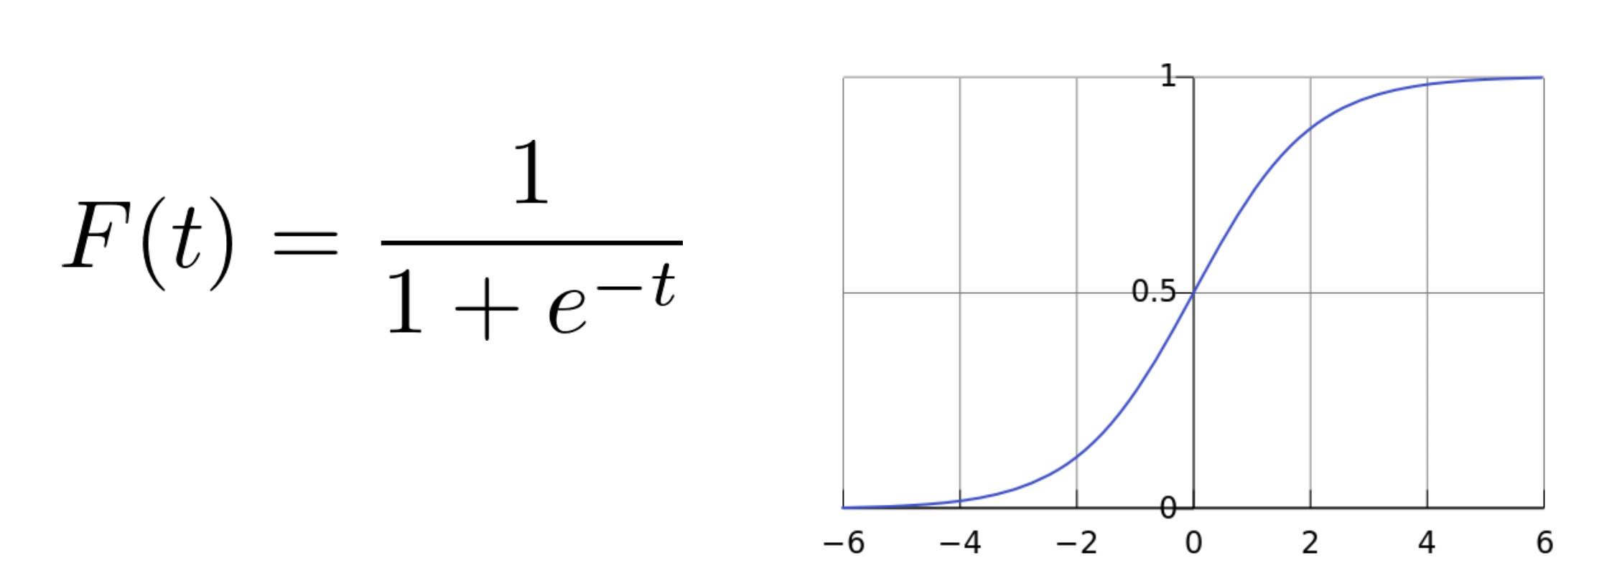
Logistic function
The logistic function always returns a value between zero and one.

Slide 8
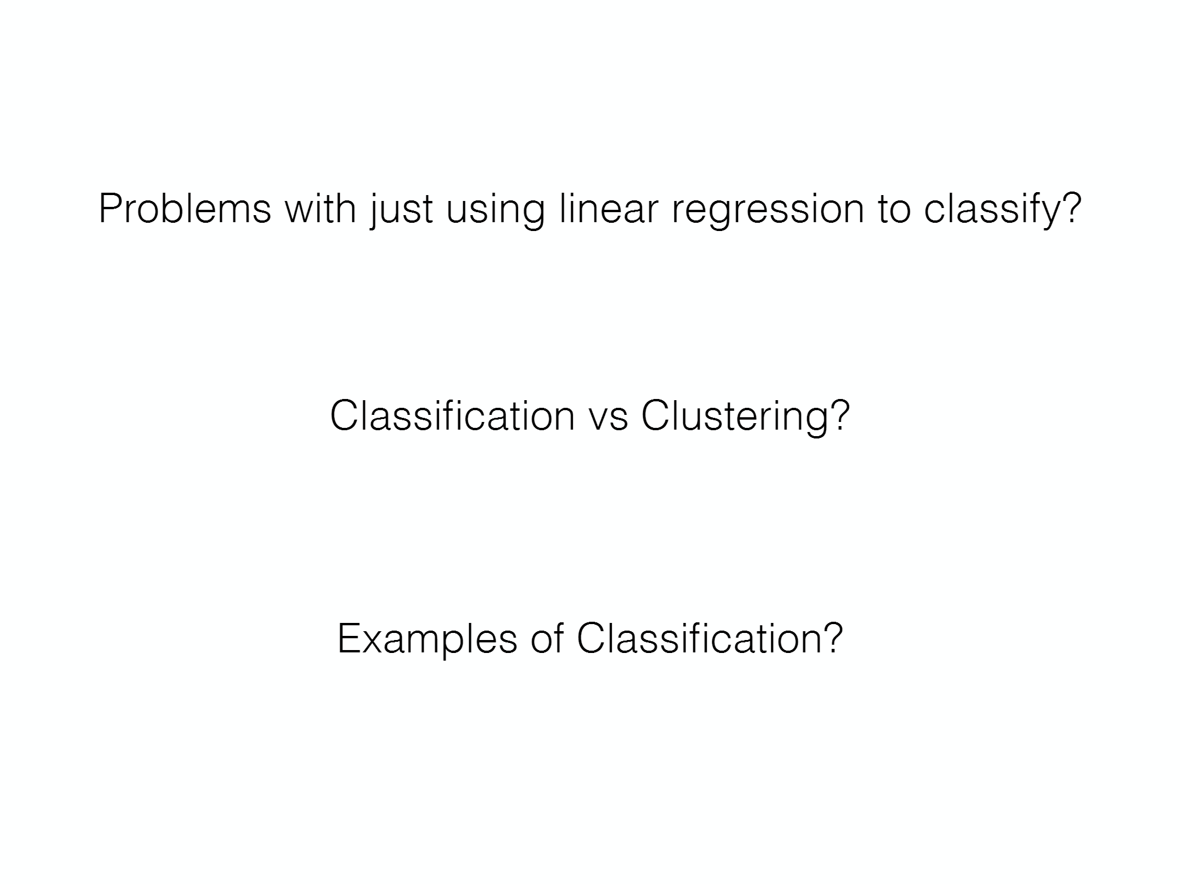

Slide 9
Performance Measures
Predict whether tumors are malignant or benign:
● Accuracy: fraction of instances that are classified correctly
○ does not differentiate between malignant tumors that were classified as being benign, and benign tumors that were classified as being malignant.
● In some problems, the costs associated with all types of errors may be the same
● In this problem, failing to identify malignant tumors is likely more severe than failing to identify benign tumors as malignant

Slide 10
Performance Measures
True positive: correctly classifying a malignant tumor
True negative: correctly classifying a benign tumor
False positive: a benign tumor that is incorrectly classifier as being malignant
False negative: a malignant tumor that is incorrectly classifier as being benign

Slide 11
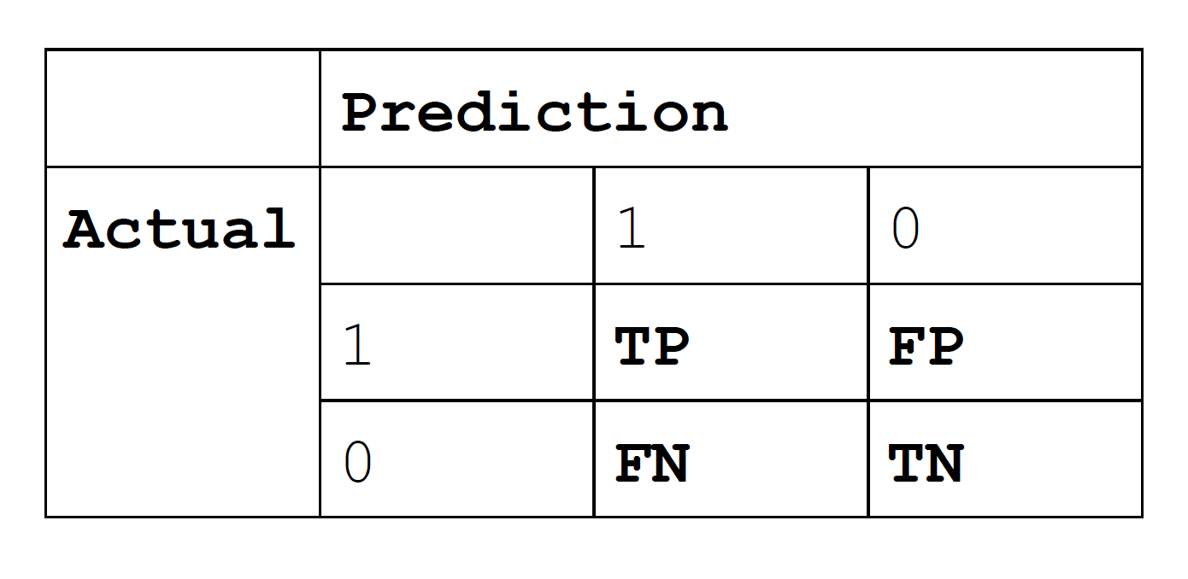
Confusion Matrix

Slide 12
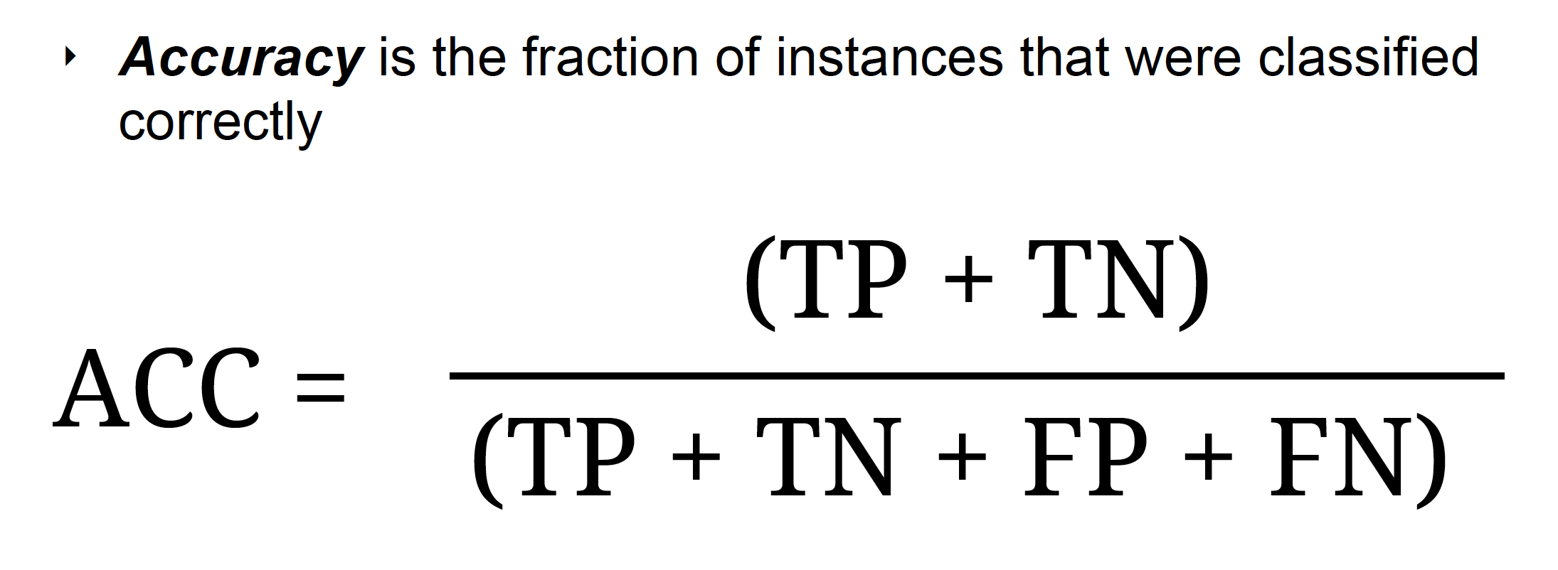
Performance Measures

Slide 13
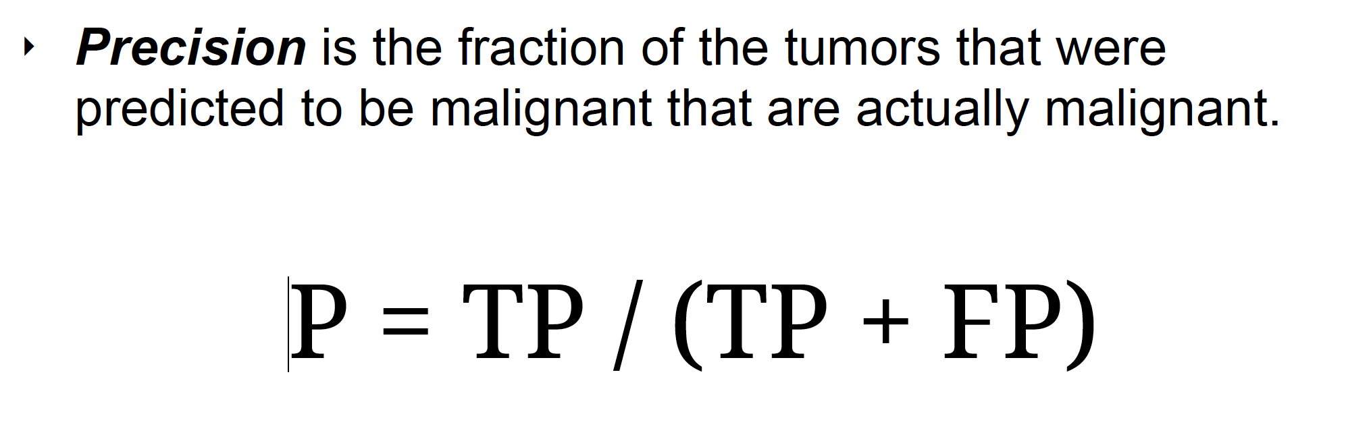
Performance Measures

Slide 14
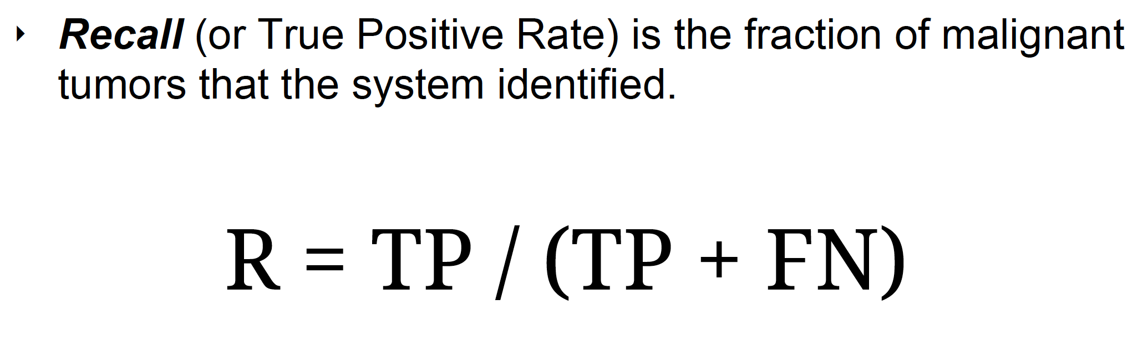
Performance Measures

Slide 15
Performance Measures

Slide 16
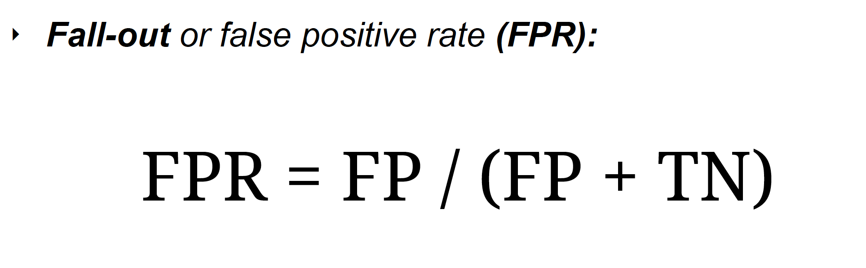
Performance Measures

Slide 17
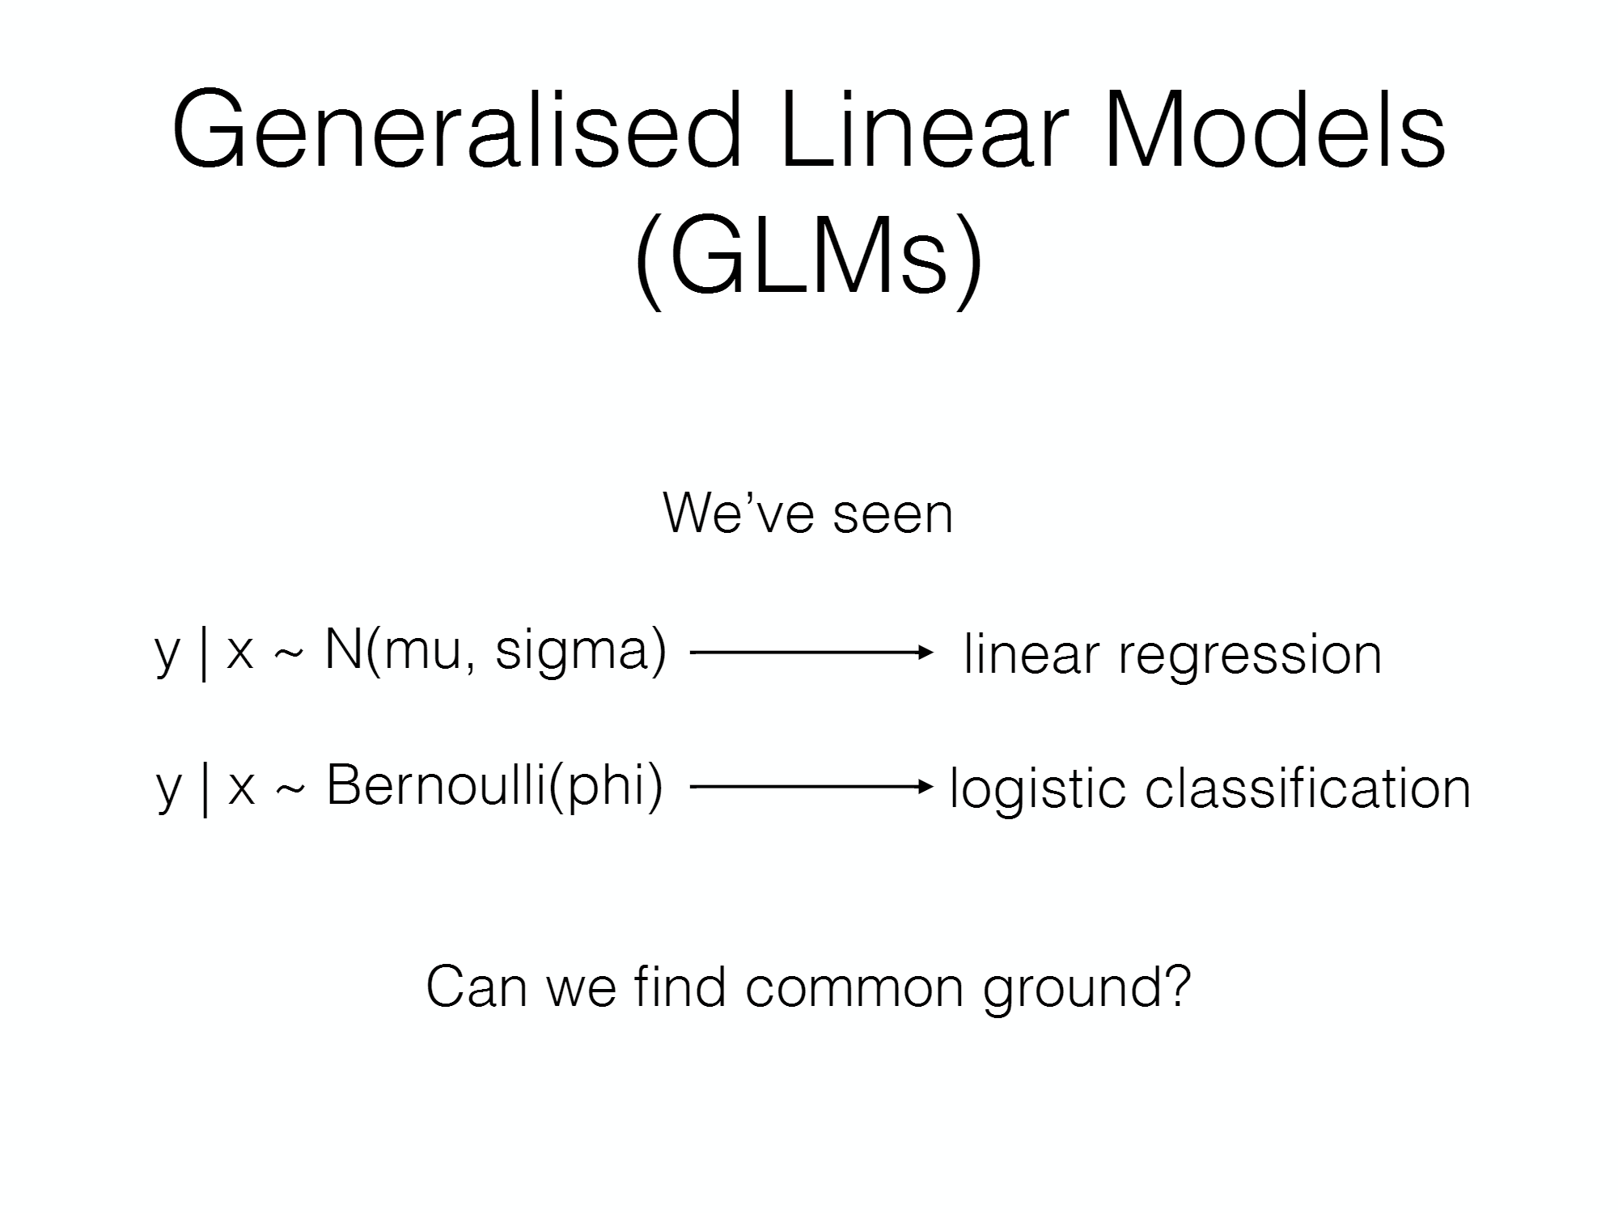

Slide 18
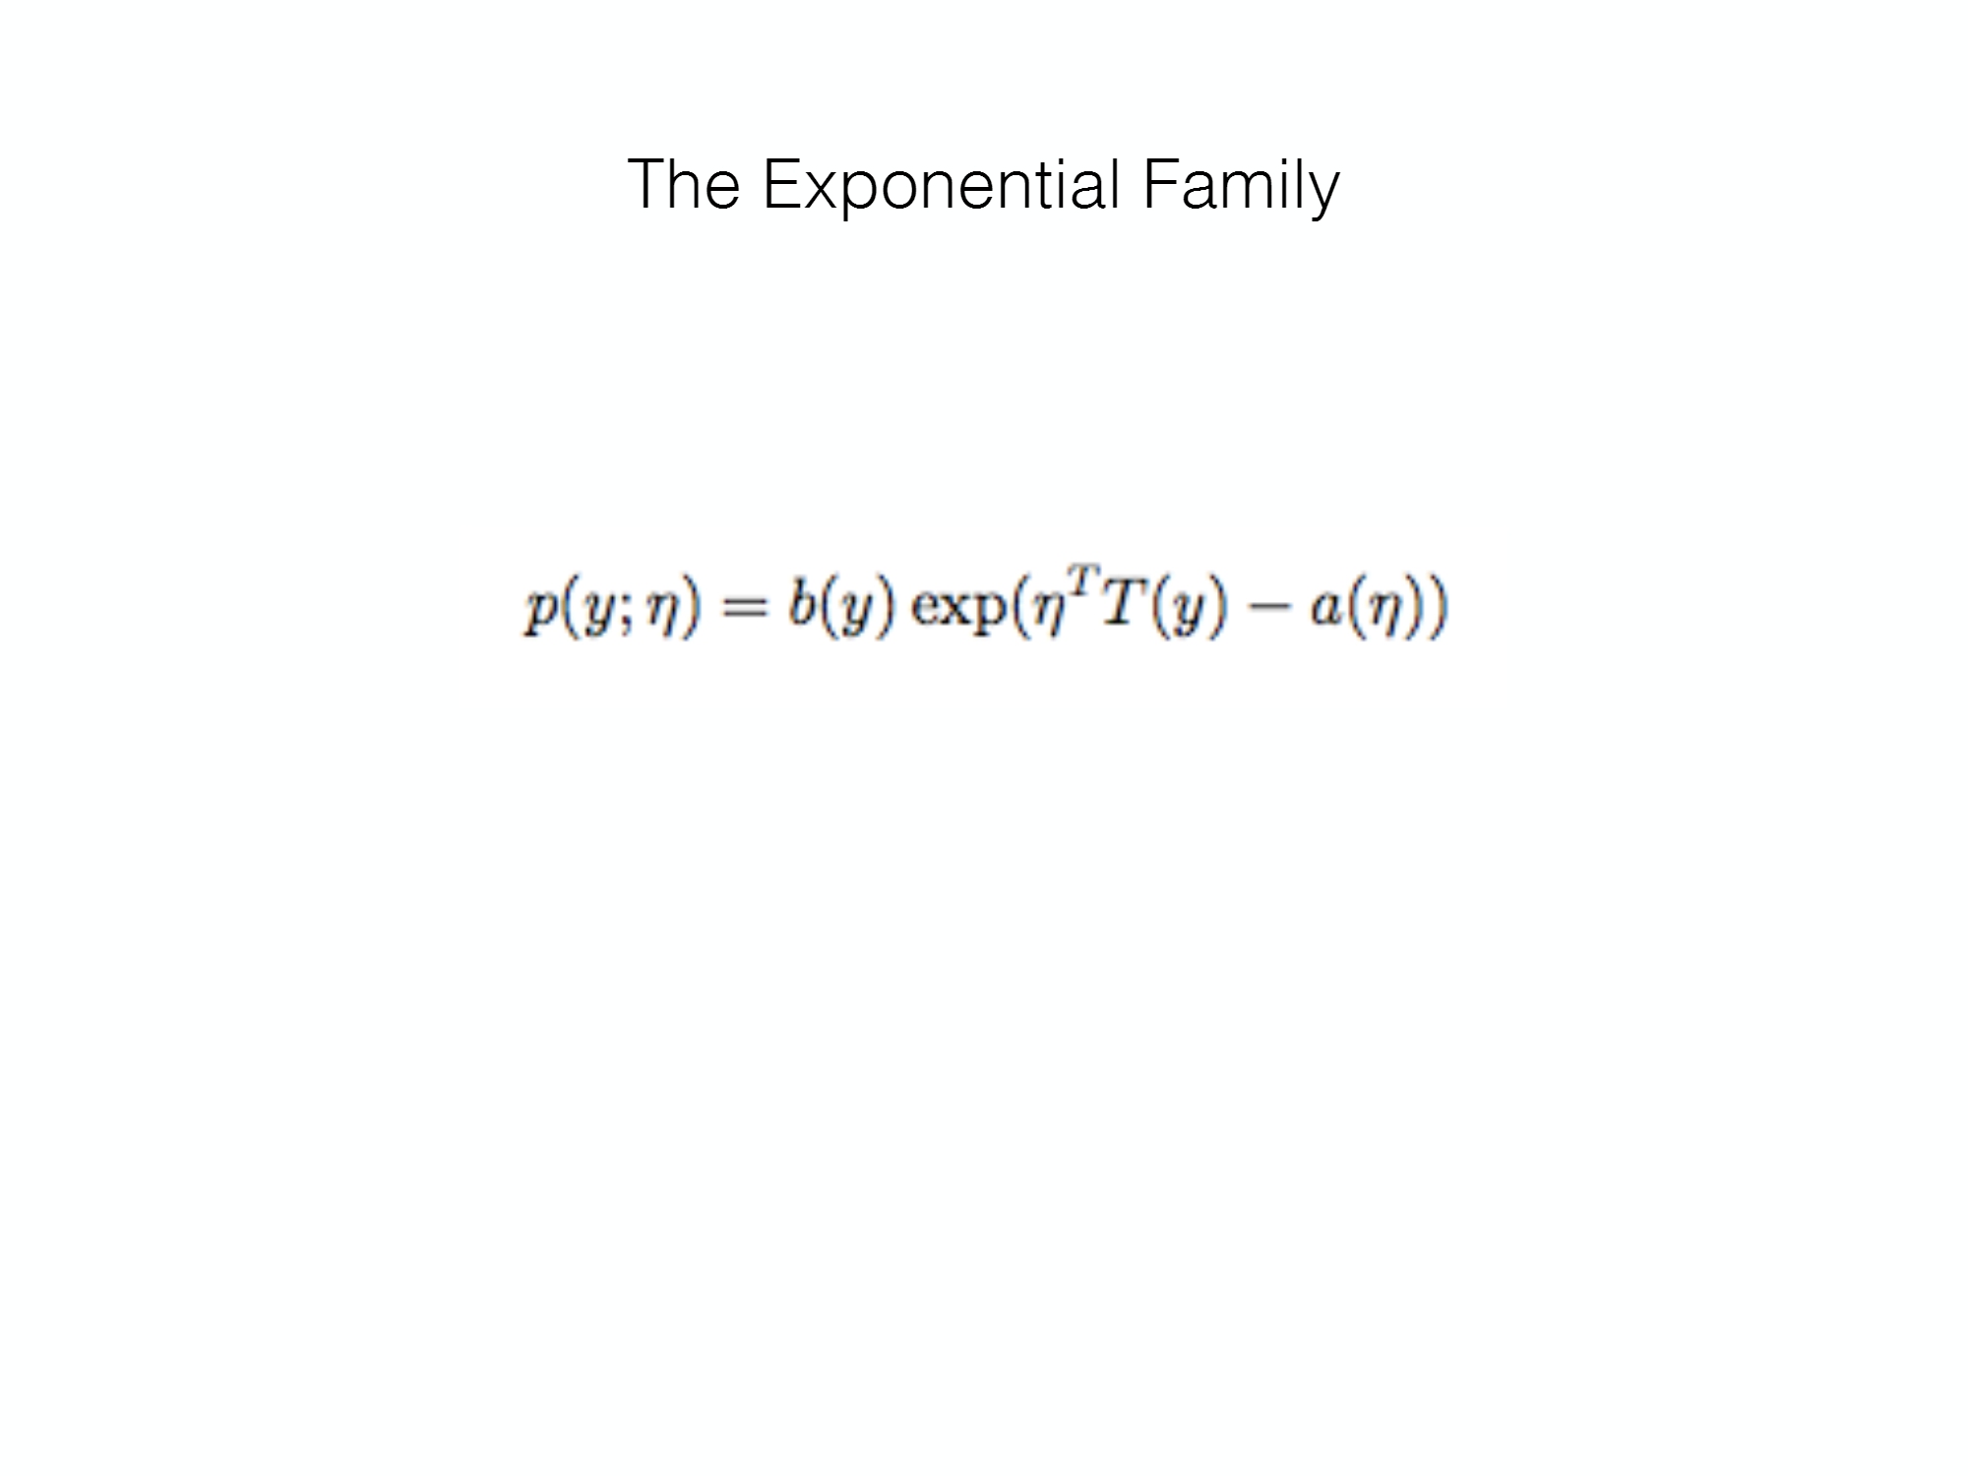

Slide 19
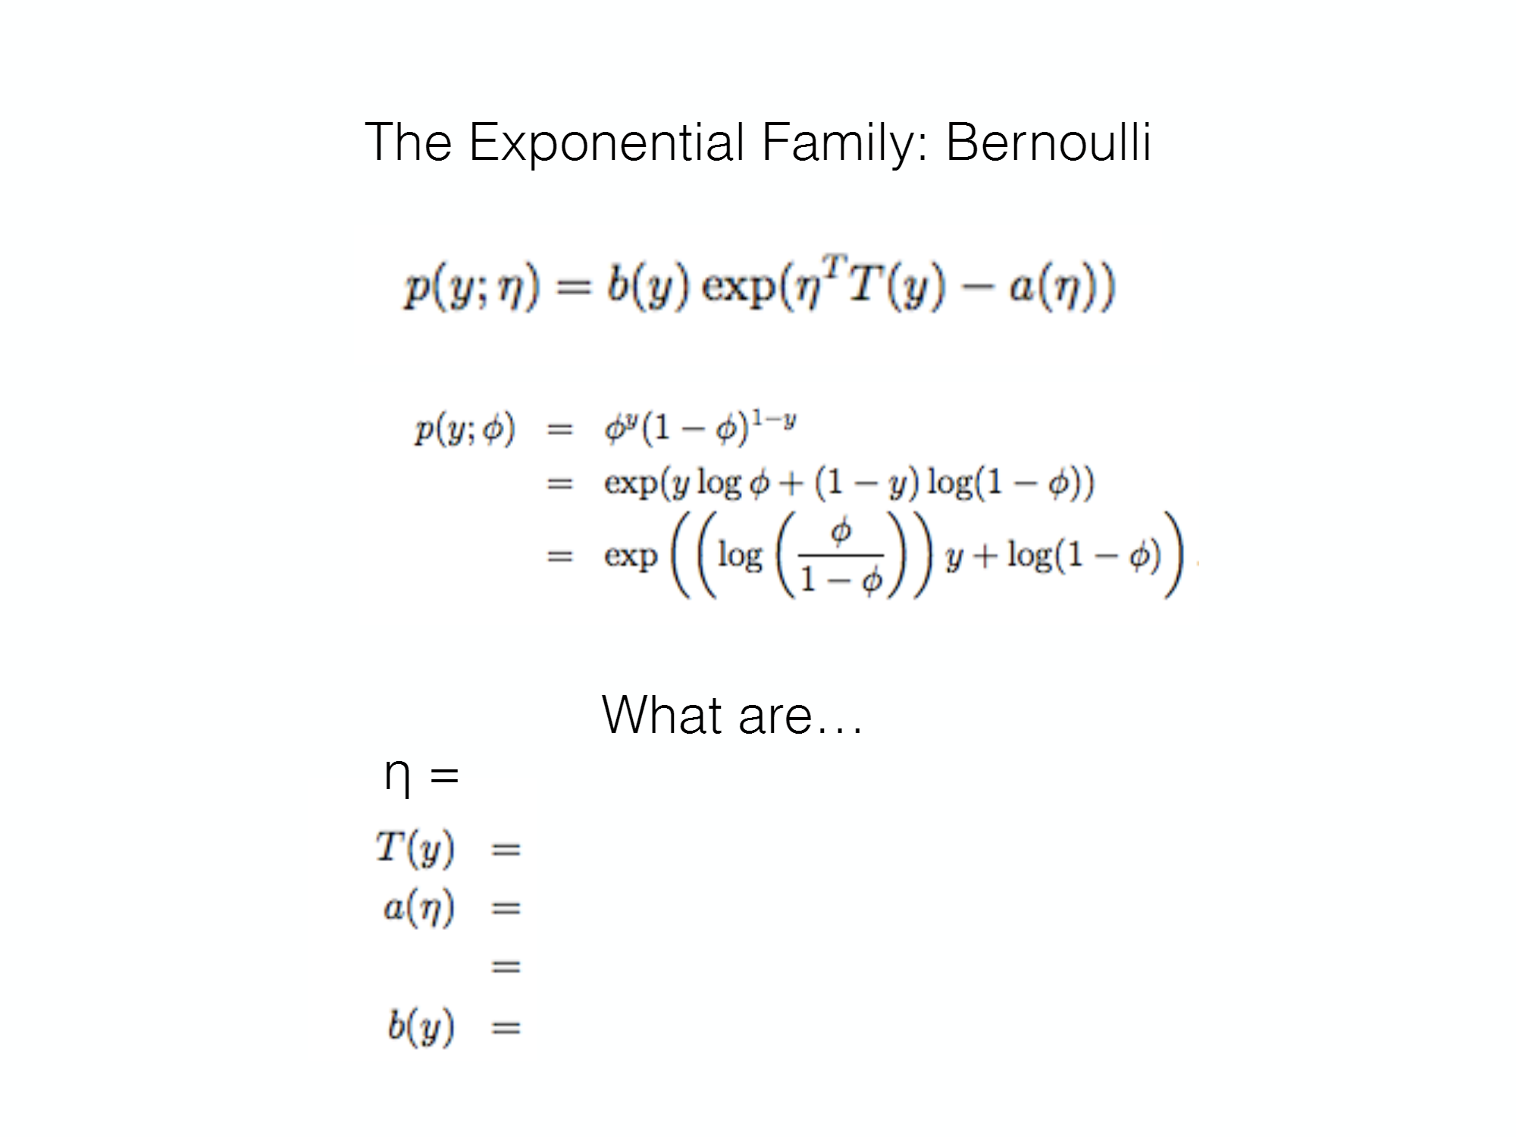

Slide 20
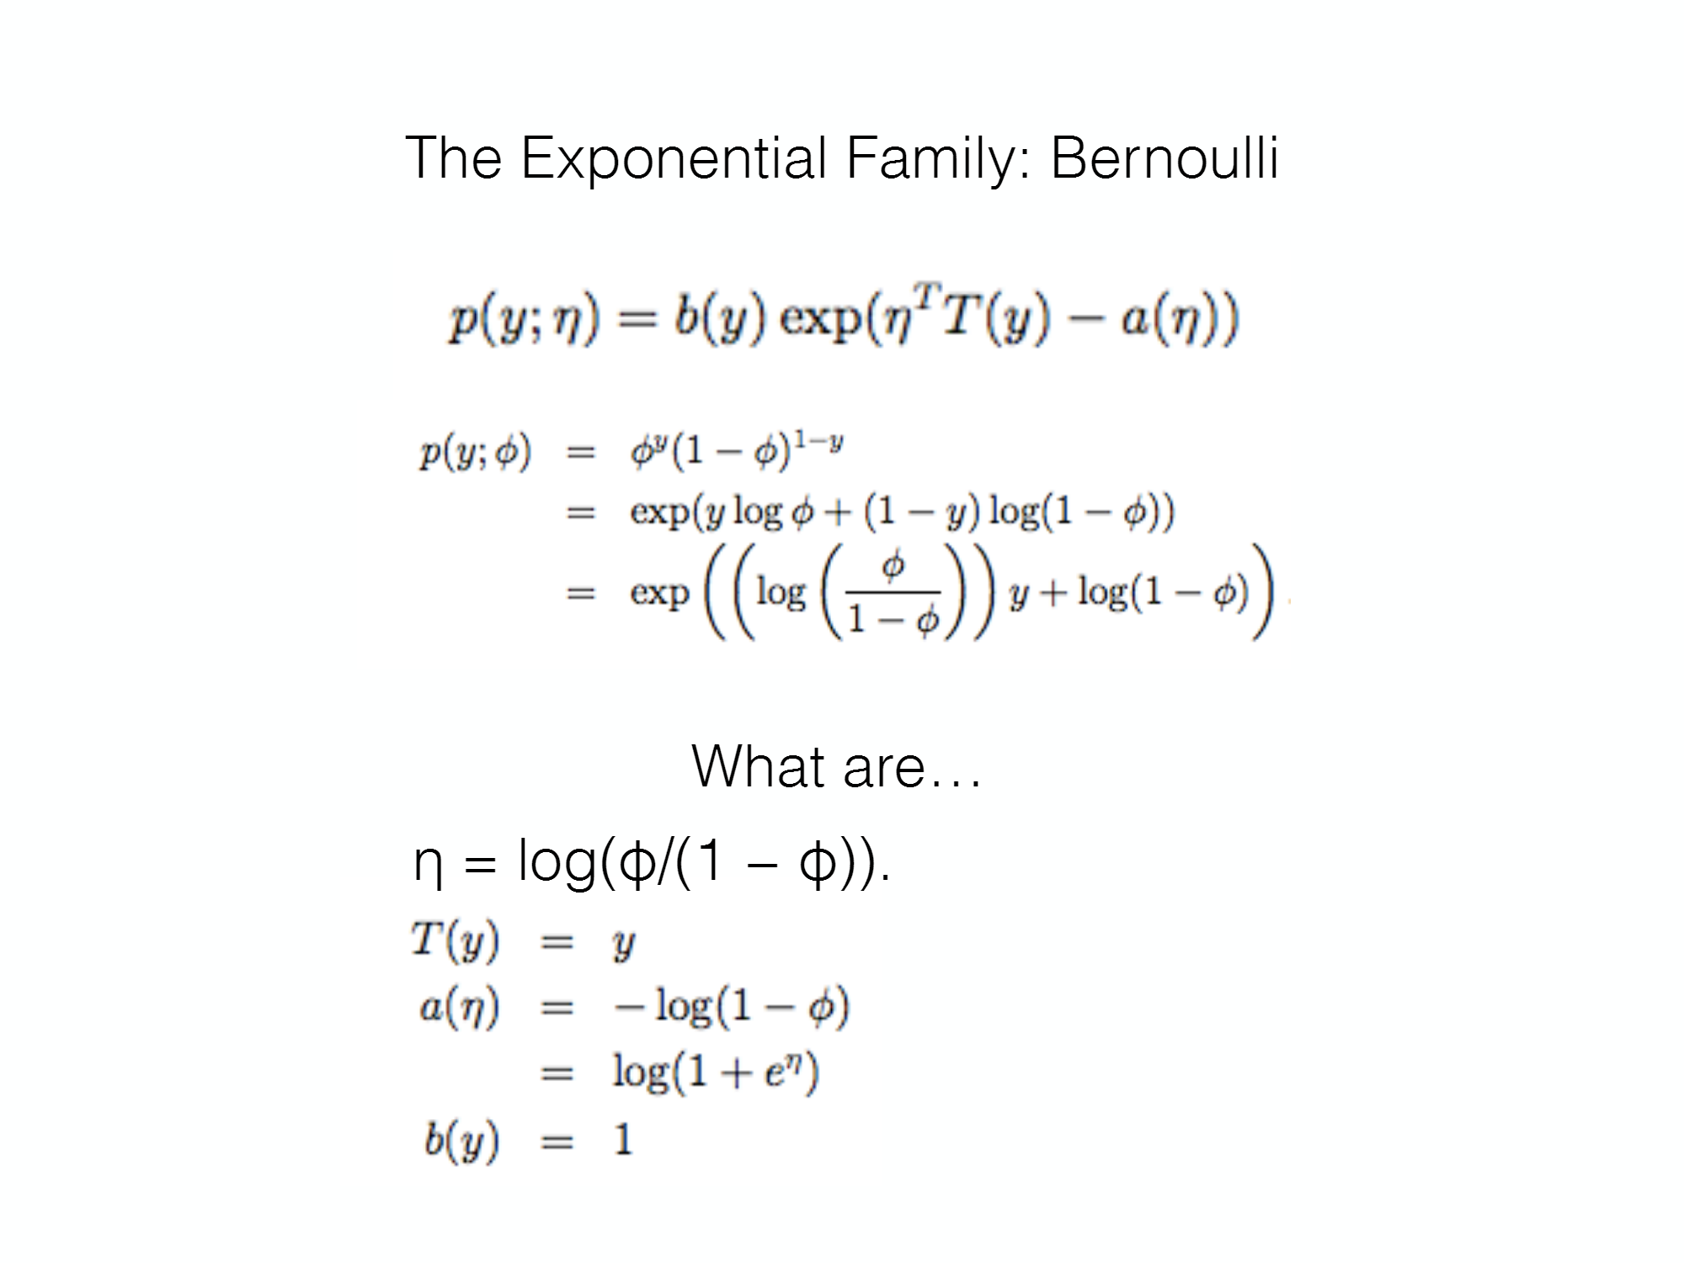

Slide 21
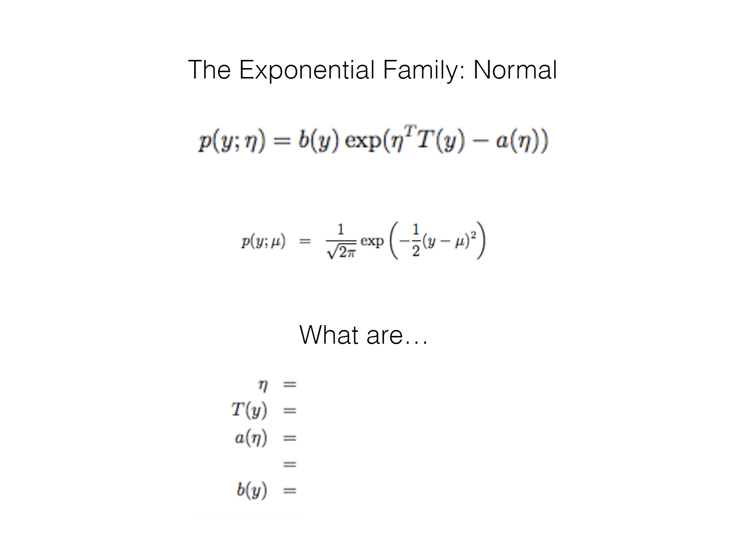

Slide 22
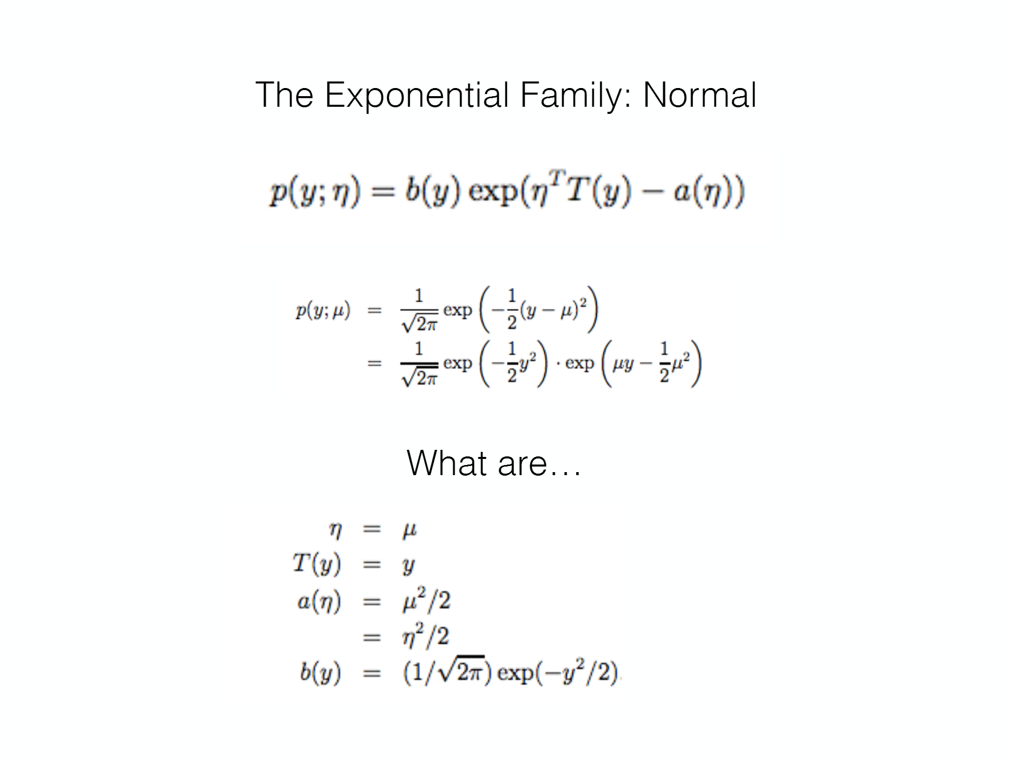

Slide 23
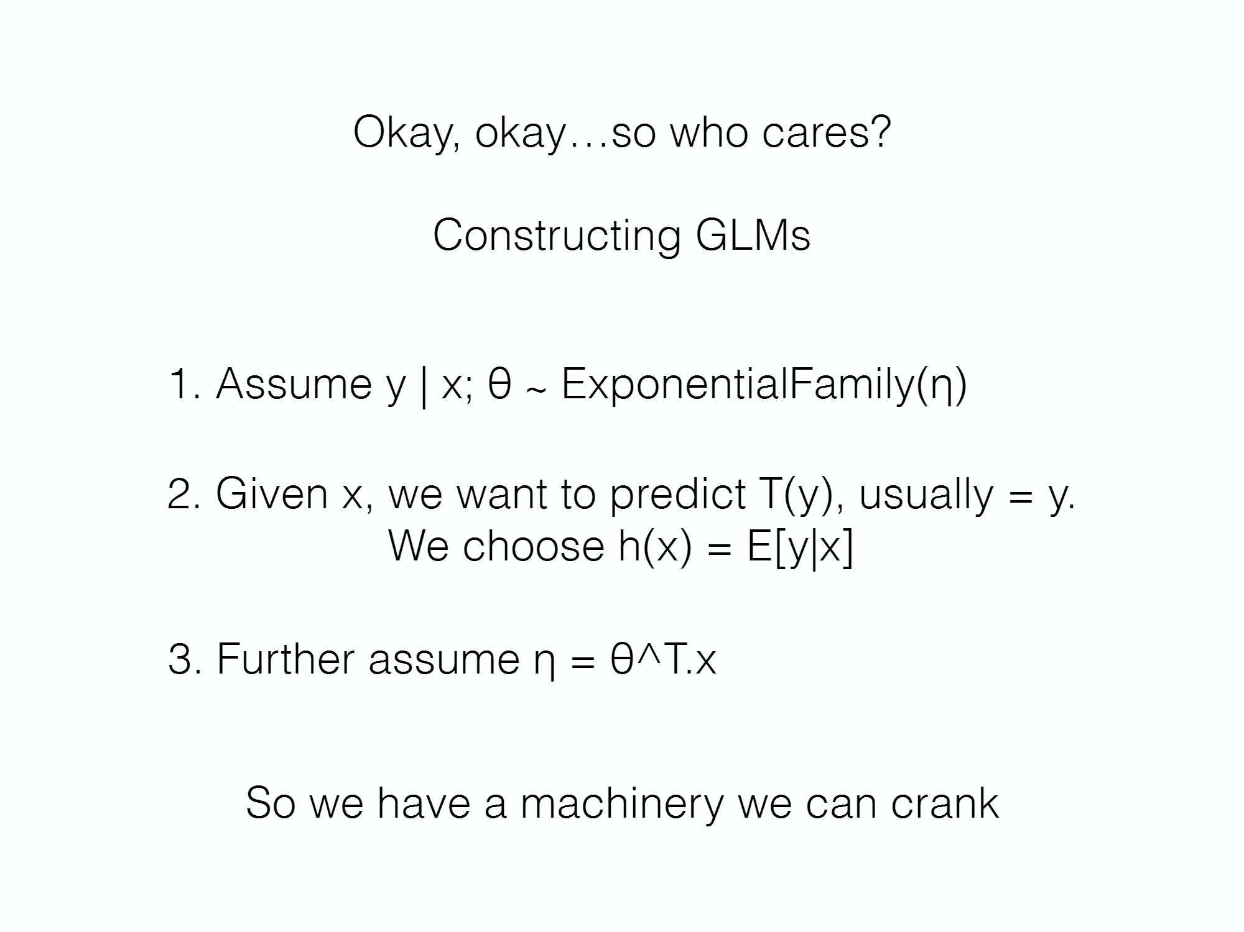

Slide 24
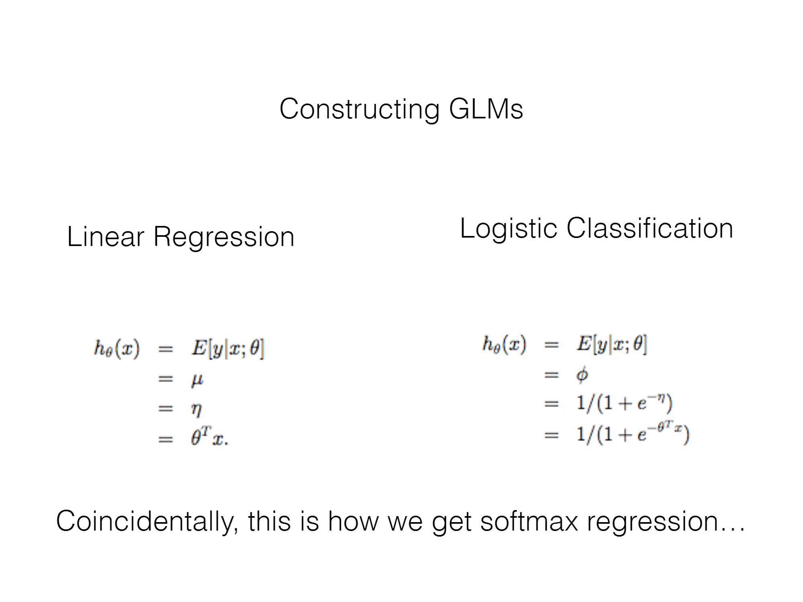

Slide 25
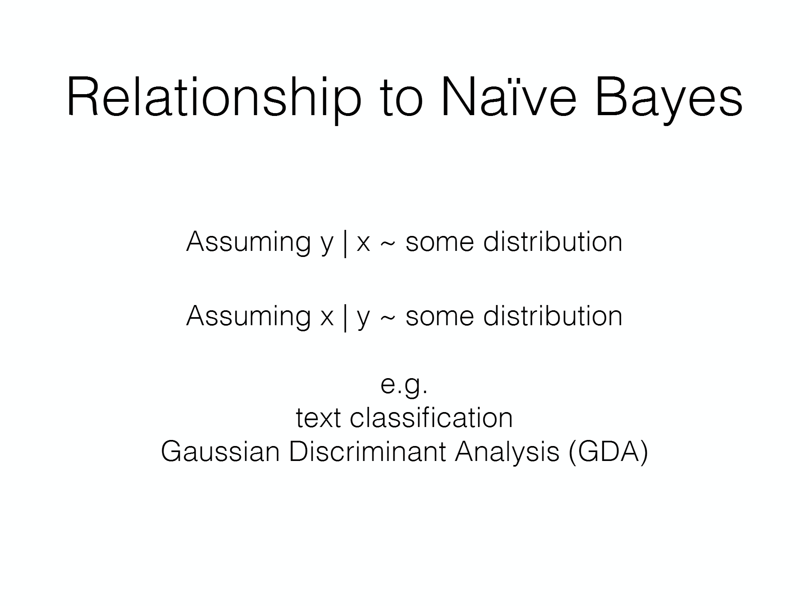

Slide 26
Q??

