Slide 1
Latest version
Which operating system are you using?
MacOS / Linux
You will need to run the app locally on a Meta Quest headset wirelessly. You must meet the requirements for a wireless setup.
You cannot run PC-VR or use a tethered setup.
Windows
You will need to use either:
a cable connecting your VR headset to your computer (tethered setup), compatible with single player setups only
A mobile hotspot or VPN service, compatible with tethered, wireless and multiplayer setups
What type of network are you using?
Public / Institutional
e.g. Eduroam
Private
e.g. private Wi-Fi
or mobile hotspot
Which type of VR headset are you using?
Key
Other†
You will need to use a PC-VR setup via Steam.
†Other headsets include:
HTC Vive
HTC Vive Pro
Valve Index
Any Meta Quest
Do you have a strong and stable internet connection?
Which configuration are you looking for?
Single-
person
Are you running the server and client on the same computer?
No
No
Yes
Multi-person
Yes
You can choose a tethered or wireless setup.
Your computers must be connected via an ethernet cable or LAN (internet connection not required).
You must use a tethered setup, such as Meta Quest Link or SteamVR.

Slide 2
Previous version
Which operating system are you using?
MacOS / Linux
You will need to run the app locally on a Meta Quest headset (you cannot run PC-VR).
You must meet the requirements for a Wi-Fi setup*.
* IMPORTANT: This setup requires a strong and stable internet connection that allows communication over the network.
Windows
What type of network are you using?
Public / Institutional
e.g. Eduroam
You will need to use a cable to connect your VR headset to your computer, see tethered setup.
*Requirements for a Wi-Fi setup: a strong and stable internet connection that allows communication over the network
†Other headsets include:
HTC Vive
HTC Vive Pro
Valve Index
‡ Via the Meta Quest Developer Hub, for Meta Quest headsets only
apk - Meta Quest headsets + wifi
executable (PC-VR):
Tethered:
SteamVR - ANY
Oculus Link - Meta Quest headsets
Meta Quest Dev Hub (wired) – Meta Quest headsets
Wireless (requires wifi that meets requirements):
Oculus AirLink - Meta Quest headsets
Meta Quest Dev Hub (wireless) – Meta Quest headsets
Private
Which type of VR headset are you using?
You will need to use a PC-VR setup via SteamVR.
Other†
Any Meta Quest
Do you have a strong and stable internet connection?
Which configuration are you looking for?
Single-
person
Are you running the server and client on the same computer?
No
No
Yes
Multi-person
Yes
You can choose any installation option.
Your computers must be connected via an ethernet cable or LAN (internet connection not required).
Follow PC-VR
or
tethered Meta Quest‡ instructions.

Slide 3
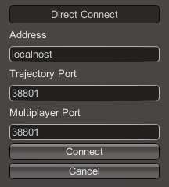
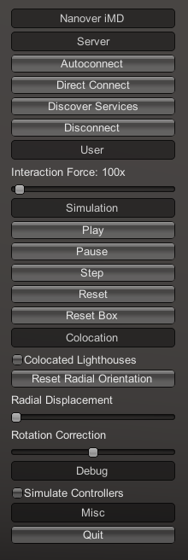

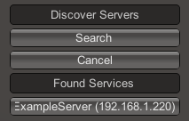
Ideas & notes for documenting the VR UI
Autoconnect: connects to the first server found on the network (uses the default parameters). Do not use this if there are multiple servers running on your network.
Dark grey boxes are headings
Direct Connect: toggles a menu that allows you to change the IP address and trajectory/multiplayer ports of the server you wish to connect to. Use this if you are not using the default ports (specified when you create a server) or if you are connecting to an IP of a different machine/cloud server.
Server: different options for connecting to a server
User: scale the interaction force applied by the user.
Simulation: commands relating to the simulation or simulation box.
Discover Services: toggles a menu for searching for servers on the network.
Disconnect: if we are connected to a server, disconnect from it.
Click “Search”. If there are servers available, they will appear underneath.

