Slide 1
Smart Energy Consumption Analysis and Prediction Using Machine Learning - MOHAMED NABIL HUSSAIN Z

Slide 2
TECHNOLOGIES USED
TensorFlow / Keras-Used to design, train, and deploy the LSTM deep learning model for energy consumption forecasting.
Flask-A lightweight Python web framework used to integrate the ML model and serve predictions through a web application.
HTML-Structures the web pages of the energy monitoring dashboard.
CSS-Styles and layouts the dashboard for a clean and user-friendly interface.
JavaScript– Enables interactivity and communicates with Flask APIs for real-time predictions.
Pandas-Handles data cleaning, preprocessing, feature engineering, and time-series manipulation.
NumPy-Performs efficient numerical operations and array processing for ML computations.
Matplotlib-Generates energy consumption visualizations such as hourly, daily, and device-wise charts.
Scikit-learn-Provides preprocessing tools, evaluation metrics, and the baseline Linear Regression model.

Slide 3
OVERVIEW
Collected dataset from Kaggle named (Home_C.csv)
Cleaned data: handled missing values, timestamp gaps, and outliers
Converted timestamps to datetime and resampled (hourly/daily)
Engineered features: hour, weekday, weekend, lag (1/24/48), rolling averages
OVERVIEW OF MODEL CREATION
BASELINE MODEL(LINEAR REGRESSION):
Selected features such as previous hour usage, daily aggregates, device-level usage, and time-based features.
Normalized the features using MinmaxScaler to improve model stability.
Trained a Linear Regression model to predict House overall feature for the next hour.

Slide 4

LSTM MODEL
Converted the dataset into sequence windows (lookback = 48 hours). Used past 48 readings as input to predict the next hour’s usage. Defined an LSTM model with layers such as:
LSTM(64)
LSTM(32)
Dense(1)
Applied StandardScaler on sequences to stabilize gradients. Compiled the model with:
Optimizer: Adam
Loss: MAE
Trained the LSTM model over multiple epochs and monitored loss curves. Compared its performance against the baseline LR model.
MODEL PERFORMANCE:

Slide 5
CORE FEATURES OF FLASK APP
• Real-time energy prediction via Flask API
• Device-wise forecasting and analytics
• Hourly/daily/weekly/monthly visualization dashboard
• Smart energy-saving suggestions engine
SYSTEM ARCHITECTURE
Model Storage: Saved LSTM model, scaler, and label encoder.
Flask Backend: Loads models, accepts user input, regenerates features, predicts (1 hr /day/ week / month), and generates charts + smart tips.
Frontend (HTML/CSS/JS): Dashboard UI with charts, device analytics, and prediction interface.
User Flow: User enters reading → Flask processes → LSTM predicts → Forecast energy
Dashboard page → displays charts.

Slide 6
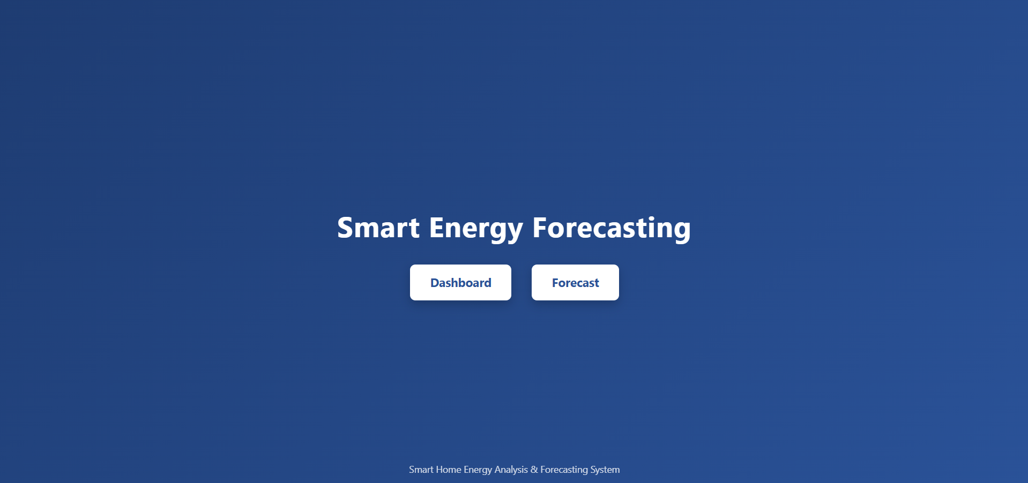
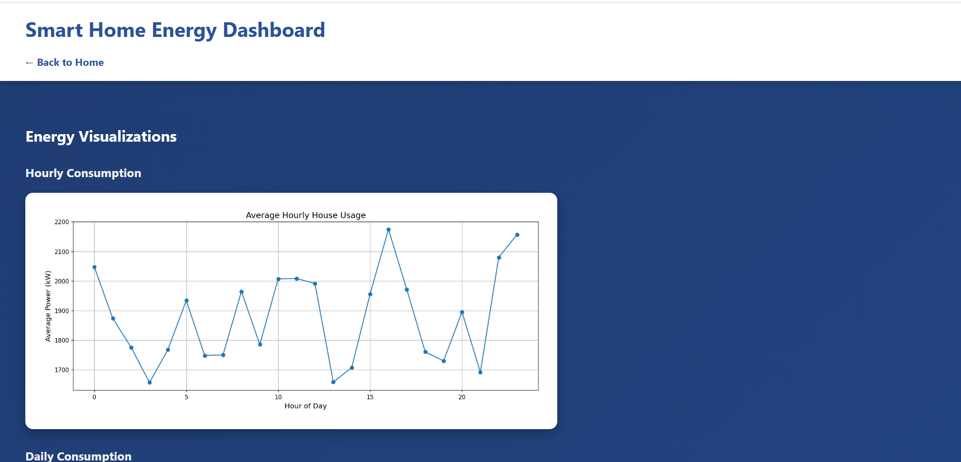
FLASK OUTCOMES
HOME PAGE
DASHBOARD PAGE
HOURLY CONSUMPTION

Slide 7
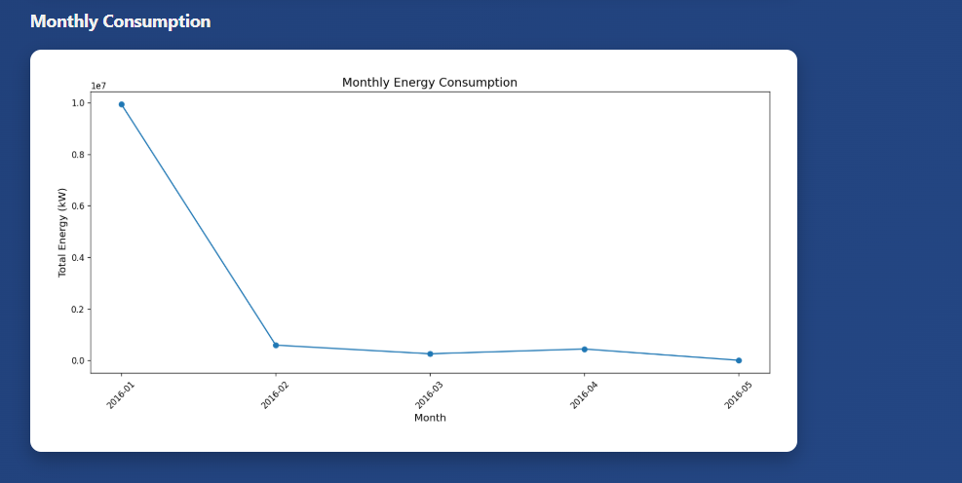
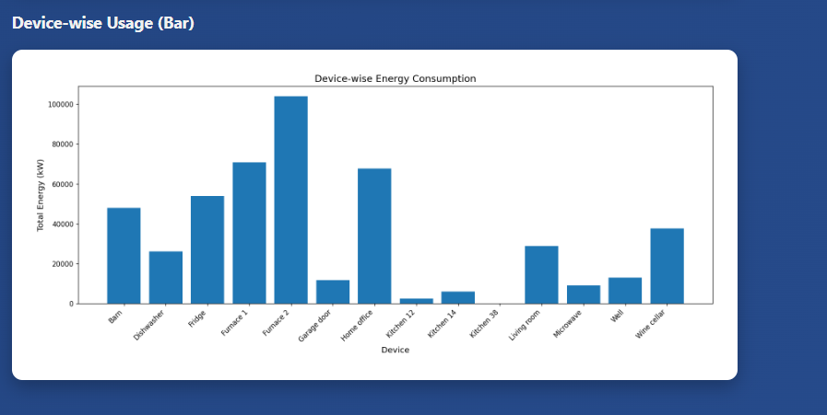
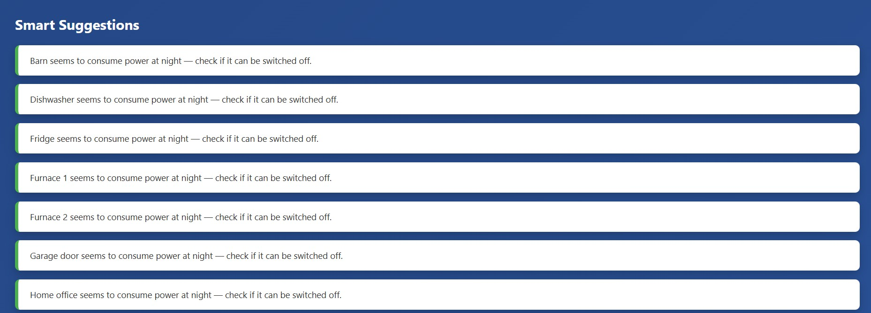
DASHBOARD PAGE
MONTHLY CONSUMPTION
DASHBOARD PAGE
DEVICE WISE CONSUMPTION
DASHBOARD PAGE
SMART SUGGESTIONS

Slide 8
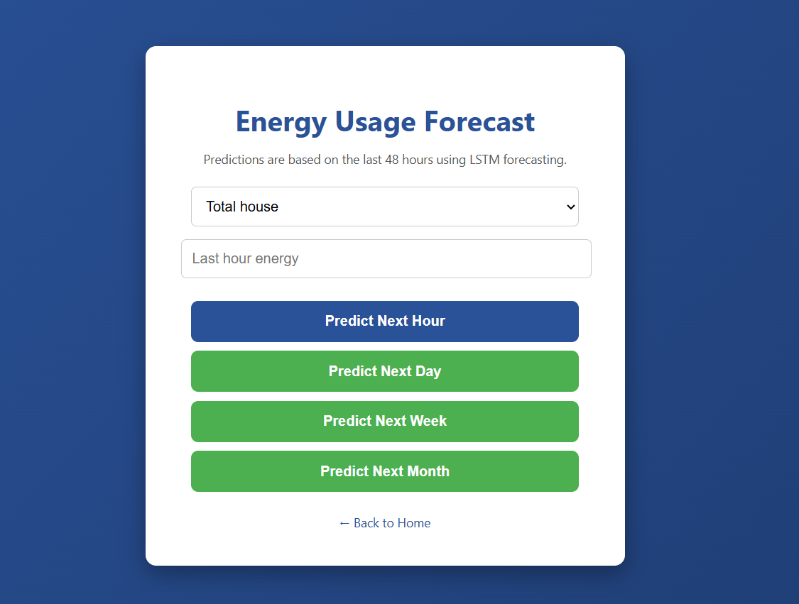
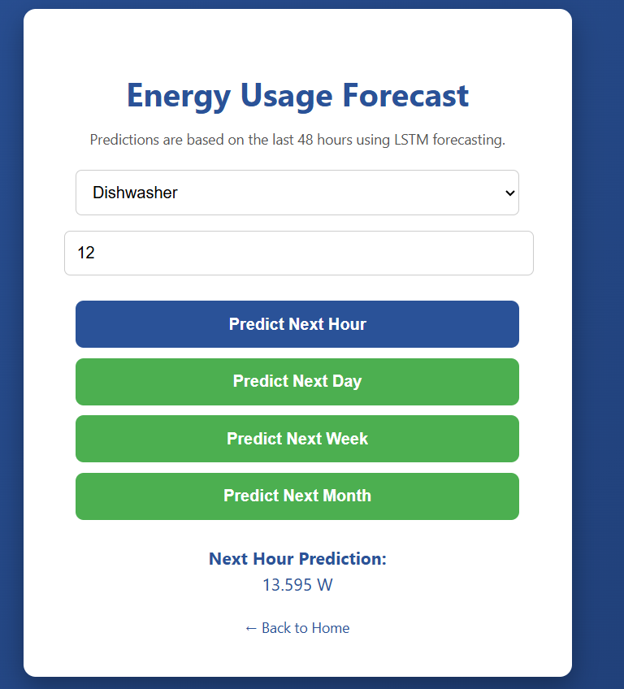
FORECAST PAGE
FORECAST PAGE
PREDICTION RESULT

Slide 9
FUTURE ENHANCEMENTS
• Cloud deployment
• Live IoT sensor integration
VIDEO OF THE PROJECT
https://drive.google.com/drive/u/0/folders/1URBIDigw3x61_zgymSsy7HlOB9lJ34zB

Slide 10
THANK YOU

