Slide 1
AI-AGENTIC CYBER
INVESTIGATIONPLATFORM
Presented By :
Atharv Kumbhar Angad Mistry Pooja Mahale Pradnyesh Mhatre
Guide Name : Dr. Vanitha Soman

Slide 2

Content
1
Introduction
Literature Review
Limitations
Problem Statement
Proposed Solution
6
Technology Used
System Architecture
and Working
Future Scope
Conclusion
References
2
7
3
8
4
9
5
10

Slide 3

Introduction
Cybersecurity investigations involve analyzing security logs and digital forensic artifacts to identify suspicious activities and potential cyberattacks.Traditional investigations can be time-consuming because analysts must manually examine large amounts of data.The AI-Agentic Cyber Investigation Platform (AACIP) combines deterministic analysis tools with AI-assisted reasoning to support cyber investigations.
Key Features:
  Analyzes security logs and digital forensic artifacts.
  Extracts evidence using deterministic tools.
  Uses AI agents to assist with investigation and reasoning.
  Classifies findings as FACT, INFERENCE, HYPOTHESIS, or UNKNOWN.
  Generates risk assessments and evidence-backed incident reports.

Slide 4
Literature Review
Sr No | Research / Reference | Technology / Approach | Year | Limitation / Research Gap
1 | Survey of Hallucination in Natural Language Generation | Large Language Models and hallucination mitigation | 2023 | AI-generated text can contain unsupported or incorrect information.
2 | NIST SP 800-86: Guide to Integrating Forensic Techniques into Incident Response | Digital forensics and incident response procedures | 2006 | Provides forensic guidance but does not implement AACIP's AI evidence-grounding architecture.
3 | MITRE ATT&CK Framework | Cyberattack tactics and techniques knowledge base | Continuously maintained | Provides a structured knowledge base but does not independently validate every AI-generated investigation finding.

Slide 5

Limitations
  Large volumes of security logs increase investigation
time.
  AI models may generate incorrect or unsupported findings.
  Traditional prompt-based safeguards cannot guarantee
factual accuracy.
  Manual verification of investigation results is time-consuming.
  Security findings may lack direct links to original forensic evidence.
  Vague evaluation methods can overestimate investigation accuracy.
  Complex investigations require correlation across multiple
evidence sources.

Slide 6
Problem Statement
  Modern Security Operations Centers face alert fatigue, massive log volumes, and a shortage of skilled security analysts.
  Unconstrained AI models may generate convincing but unsupported findings, creating risks during cyber investigations.
  Traditional prompting techniques cannot guarantee that every AI-generated claim is supported by evidence.
AACIP addresses the need for a secure and traceable cyber investigation system that validates findings, preserves evidence provenance, and distinguishes verified observations from AI-generated conclusions.

Slide 7

Proposed Solution
AACIP introduces Architecturally Enforced Evidence Grounding.
  Uploads and validates digital forensic artifacts.
  Uses deterministic tools to extract evidence from logs.
  Classifies findings as FACT, INFERENCE, HYPOTHESIS, or UNKNOWN.
  Enforces grounding invariants G0–G4 and G7.
  Builds an evidence-backed graph connecting users, IPs, hosts, and files.
  Uses AI agents to formulate and validate competing hypotheses.
  Calculates risk using deterministic rules.
  Generates structured incident reports with traceable evidence.
Core Principle:
  "Deterministic tools produce evidence. LLMs reason over evidence.
An LLM is never the unquestioned source of truth."

Slide 8
Technology Used
Backend and Core Engine
  Python 3.12+
  FastAPI and Uvicorn
  Pydantic v2
  SQLAlchemy 2 and Alembic
Database and Security
  SQLite and PostgreSQL
  SHA-256 hashing
  Argon2 password hashing
  PyJWT authentication and
access control
AI and Investigation
  AI-agent orchestration
  OpenAI-compatible model
interfaces
  NVIDIA NIM, Nemotron, and
DeepSeek R1 integrations
  Deterministic log parsers and
IOC extraction
Frontend and Testing
  Interactive web dashboard
  SVG-based evidence graph
  Server-Sent Events (SSE)
  pytest, httpx, Ruff, and mypy

Slide 9
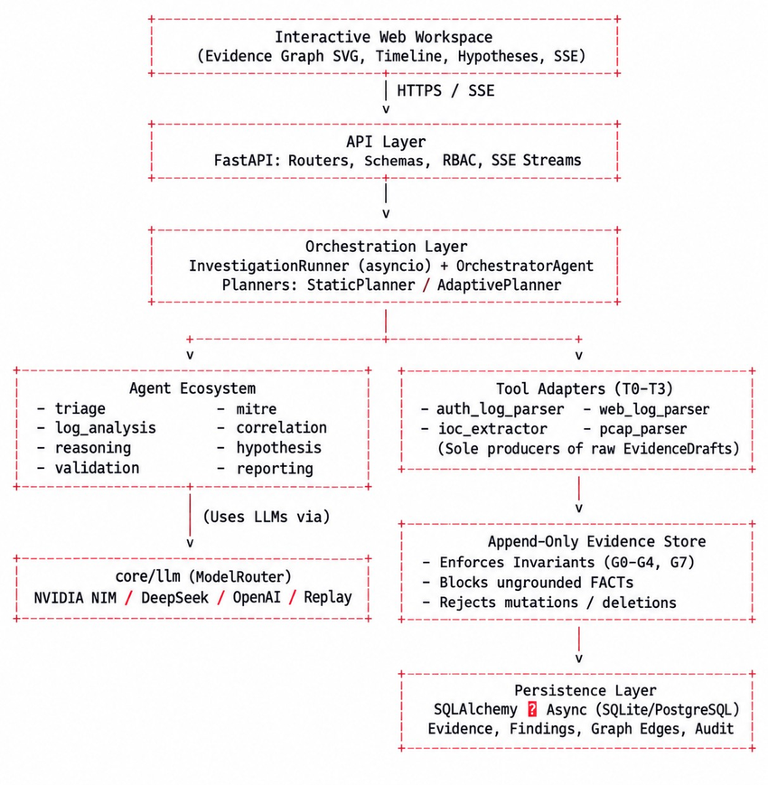
System Architecture
2

Slide 10

System Working
  Artifact Ingestion: Uploads and validates security logs and digital artifacts.
  Investigation Planning: Selects suitable analysis tasks.
  Evidence Extraction: Extracts indicators from logs using deterministic tools.
  Grounding Validation: Checks findings against predefined evidence rules.
  Graph Correlation: Connects related entities using evidence-backed relationships.
  Hypothesis Validation: Tests AI-generated explanations against available evidence.
  Risk Assessment: Calculates investigation risk using predefined scoring rules.
  Report Generation: Produces a structured report containing findings and evidence references.
Workflow:
Artifact Ingestion → Investigation Planning → Evidence Extraction → Grounding Validation → Graph Correlation → Hypothesis Validation → Risk Assessment → Report Generation

Slide 11
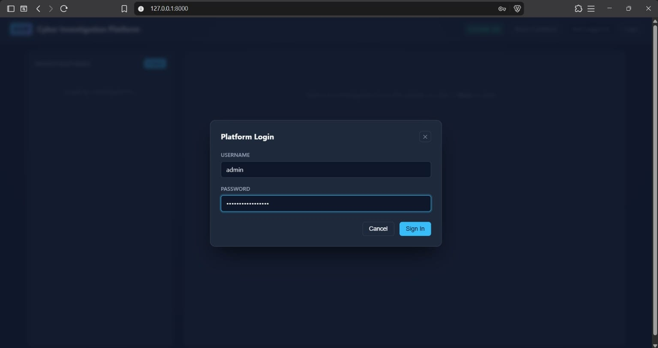
Results

Slide 12
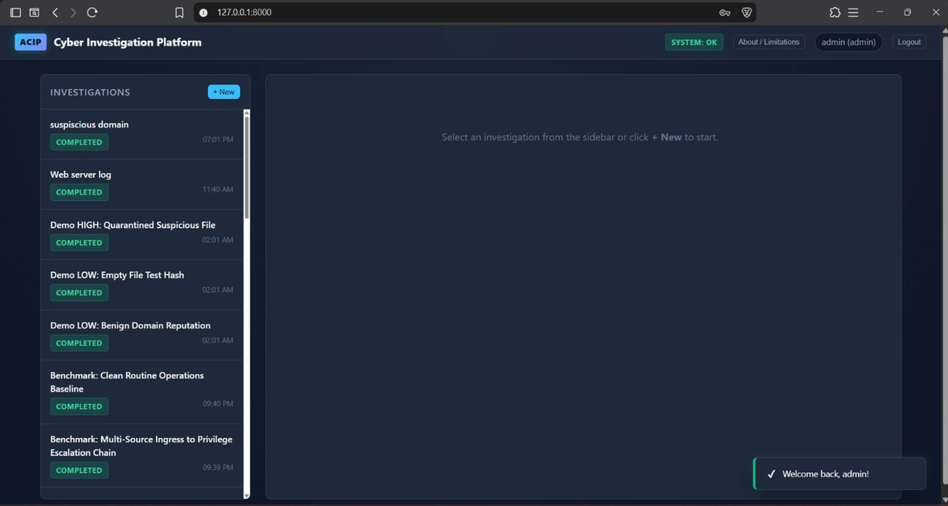

Slide 13
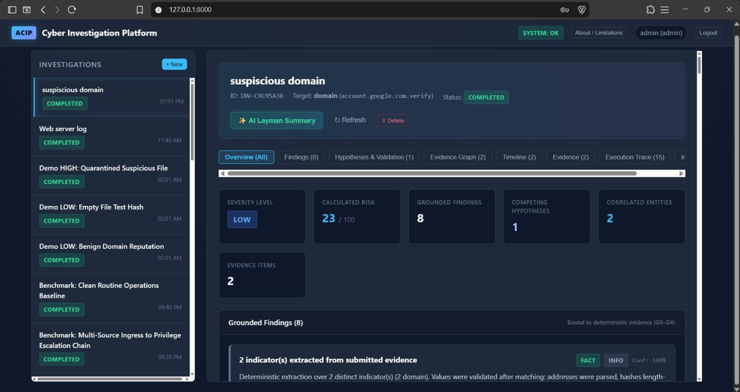

Slide 14
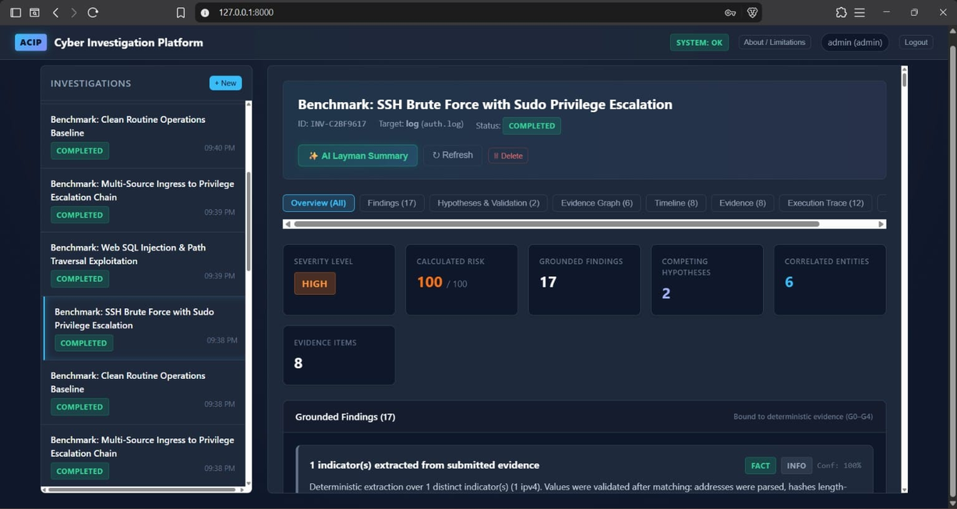

Slide 15
Evidence Validation and Finding Classification
Category | Meaning | Validation Requirement
FACT | Directly observed information | Must reference verified deterministic evidence.
INFERENCE | A conclusion derived from evidence | Must include evidence citations and explicit reasoning.
HYPOTHESIS | A possible explanation | Must include a valid condition under which it could be disproved.
UNKNOWN | Information that cannot currently be established | Severity is restricted to INFO.

Slide 16
Future Scope
Short-Term Enhancements:
Long-Term Enhancements:
  Support additional log formats and forensic artifacts.
  Improve detection rules and hypothesis validation.
  Expand automated testing with adversarial inputs.
  Enhance evidence visualization and investigation reports.
  Integrate additional threat-intelligence services.
  Support large-scale investigations using PostgreSQL.
  Strengthen evidence integrity and chain-of-custody mechanisms.
  Develop advanced evaluation datasets and performance benchmarks.

Slide 17

Conclusion
AACIP provides an evidence-grounded approach to AI-assisted cyber investigation.
  Automates digital evidence extraction and log analysis.
  Reduces reliance on manual investigation of security events.
  Prevents findings from being accepted without required validation.
  Distinguishes observed facts from inferences and hypotheses.
  Supports evidence traceability and structured risk assessment.
  Generates organized incident reports for security analysts.
  AACIP aims to make AI-assisted cyber investigations more reliable, explainable, and auditable.

Slide 18

References
1. NIST SP 800-86 – Digital Forensics Guide
https://csrc.nist.gov/pubs/sp/800/86/final
2. MITRE ATT&CK Framework
https://attack.mitre.org/
3. Python Documentation
https://docs.python.org/3/
4. FastAPI Documentation
https://fastapi.tiangolo.com/
5. Pydantic Documentation*
https://docs.pydantic.dev/
6. Research Paper – Survey of Hallucination in Natural
Language Generation
https://doi.org/10.1145/3571730

Slide 19

Thank You

