Slide 1


Automated Solar Tracker
19CCE384 DESIGN & INNOVATION LAB
Team 110

Slide 2

CONTENT
Problem statement
Literature survey
Flowchart
Tools & Hardware
Timeline
Reference

Slide 3

PROBLEM STATEMENT
An optimal control on two axes and design for solar tracker which called altitude and azimuth is challenge.
Designing an optimal control system for a solar tracker that tracks the sun's position in real-time along these two axes can be a challenge due to a number of factors, including the complexity of the system, the variability of the sun's position depending on the time of day and location, and the need to balance accuracy and precision with energy efficiency and cost-effectiveness.

Slide 4
LITERATURE SURVEY

Slide 5
Literature survey-1
Automatic Solar Tracking System
Year: 2022
A prototype solar panel is discussed in this paper based on the sun's rays as the reason for its design and construction. Arduino is used as the main control circuit. As a result of the programming of this device, the LDR sensor, when it detects sun rays, will provide direction to the Servo Motor in order to move the solar panel. Consequently, the solar panel is positioned so that it can receive the maximum amount of sunlight.

Slide 6
LITERATURE SURVEY-2
Automatic Sun-Tracking System
Year: 2020
This paper describes an automatic sun tracking system, based on two stepper motors, and moving solar panel. To gain more energy from the sun, the active surface of the solar cells should be perpendicular to solar radiation, which means that the panel must follow the path of the sun all the time. The orientation of the solar panel towards the sun is achieved by using a C++ program. An experimental comparison between a fixed panel and a moving one is presented.

Slide 7
LITERATURE SURVEY-3
Design of an automatic solar tracking controller: Solar tracking controller
Year: 2017
The parallel rays of the sun irradiating directly gives the best output and hence the panel must directly face the sun throughout the day for maximum efficiency. The designed solar tracker is controlled using controllers and servo motor to obtain the good performance. The system can be programmed to rotate at various step angles as per need and also the sensitivity of the system can also be altered giving much greater flexibility over traditional systems. The system has been designed for single axis tracking but the algorithm can be extended to be used for dual axis tracking as well.

Slide 8
LITERATURE SURVEY-4
Design and Development of an Automatic Solar Tracker
Year: 2017​
​
The paper explores the various existing solar tracker systems available in the market, which are generally categorized into single-axis, dual-axis, and altitude-azimuth trackers. The authors compare the advantages and disadvantages of each type of solar tracker system and emphasize the importance of having an automatic solar tracking system to achieve the maximum energy output. Paper explores the various existing solar tracker systems available in the market, which are generally categorized into single-axis, dual-axis, and altitude-azimuth trackers. The authors compare the advantages and disadvantages of each type of solar tracker system and emphasize the importance of having an automatic solar tracking system to achieve the maximum energy output.
​

Slide 9
NOVELTY
Automated solar trackers have been around for several years, but there are still opportunities for novelty and innovation in this field. One potential area of novelty is in the use of digital voltmeter it displays the voltage reading on a digital display of the solar panel at regular instances.
The amount of additional energy produced is 25% - 30% more than existing solar panels.
​

Slide 10
FLOWCHART
Start
Determine the location of Solar Panel
Choose tracker mechanism
Decide Control System for tracker
Determine the sensors
Design the hardware components of tracker
Write a programmable code for the tracker
Test the tracker in all possible cases
Modify if necessary
The End

Slide 11
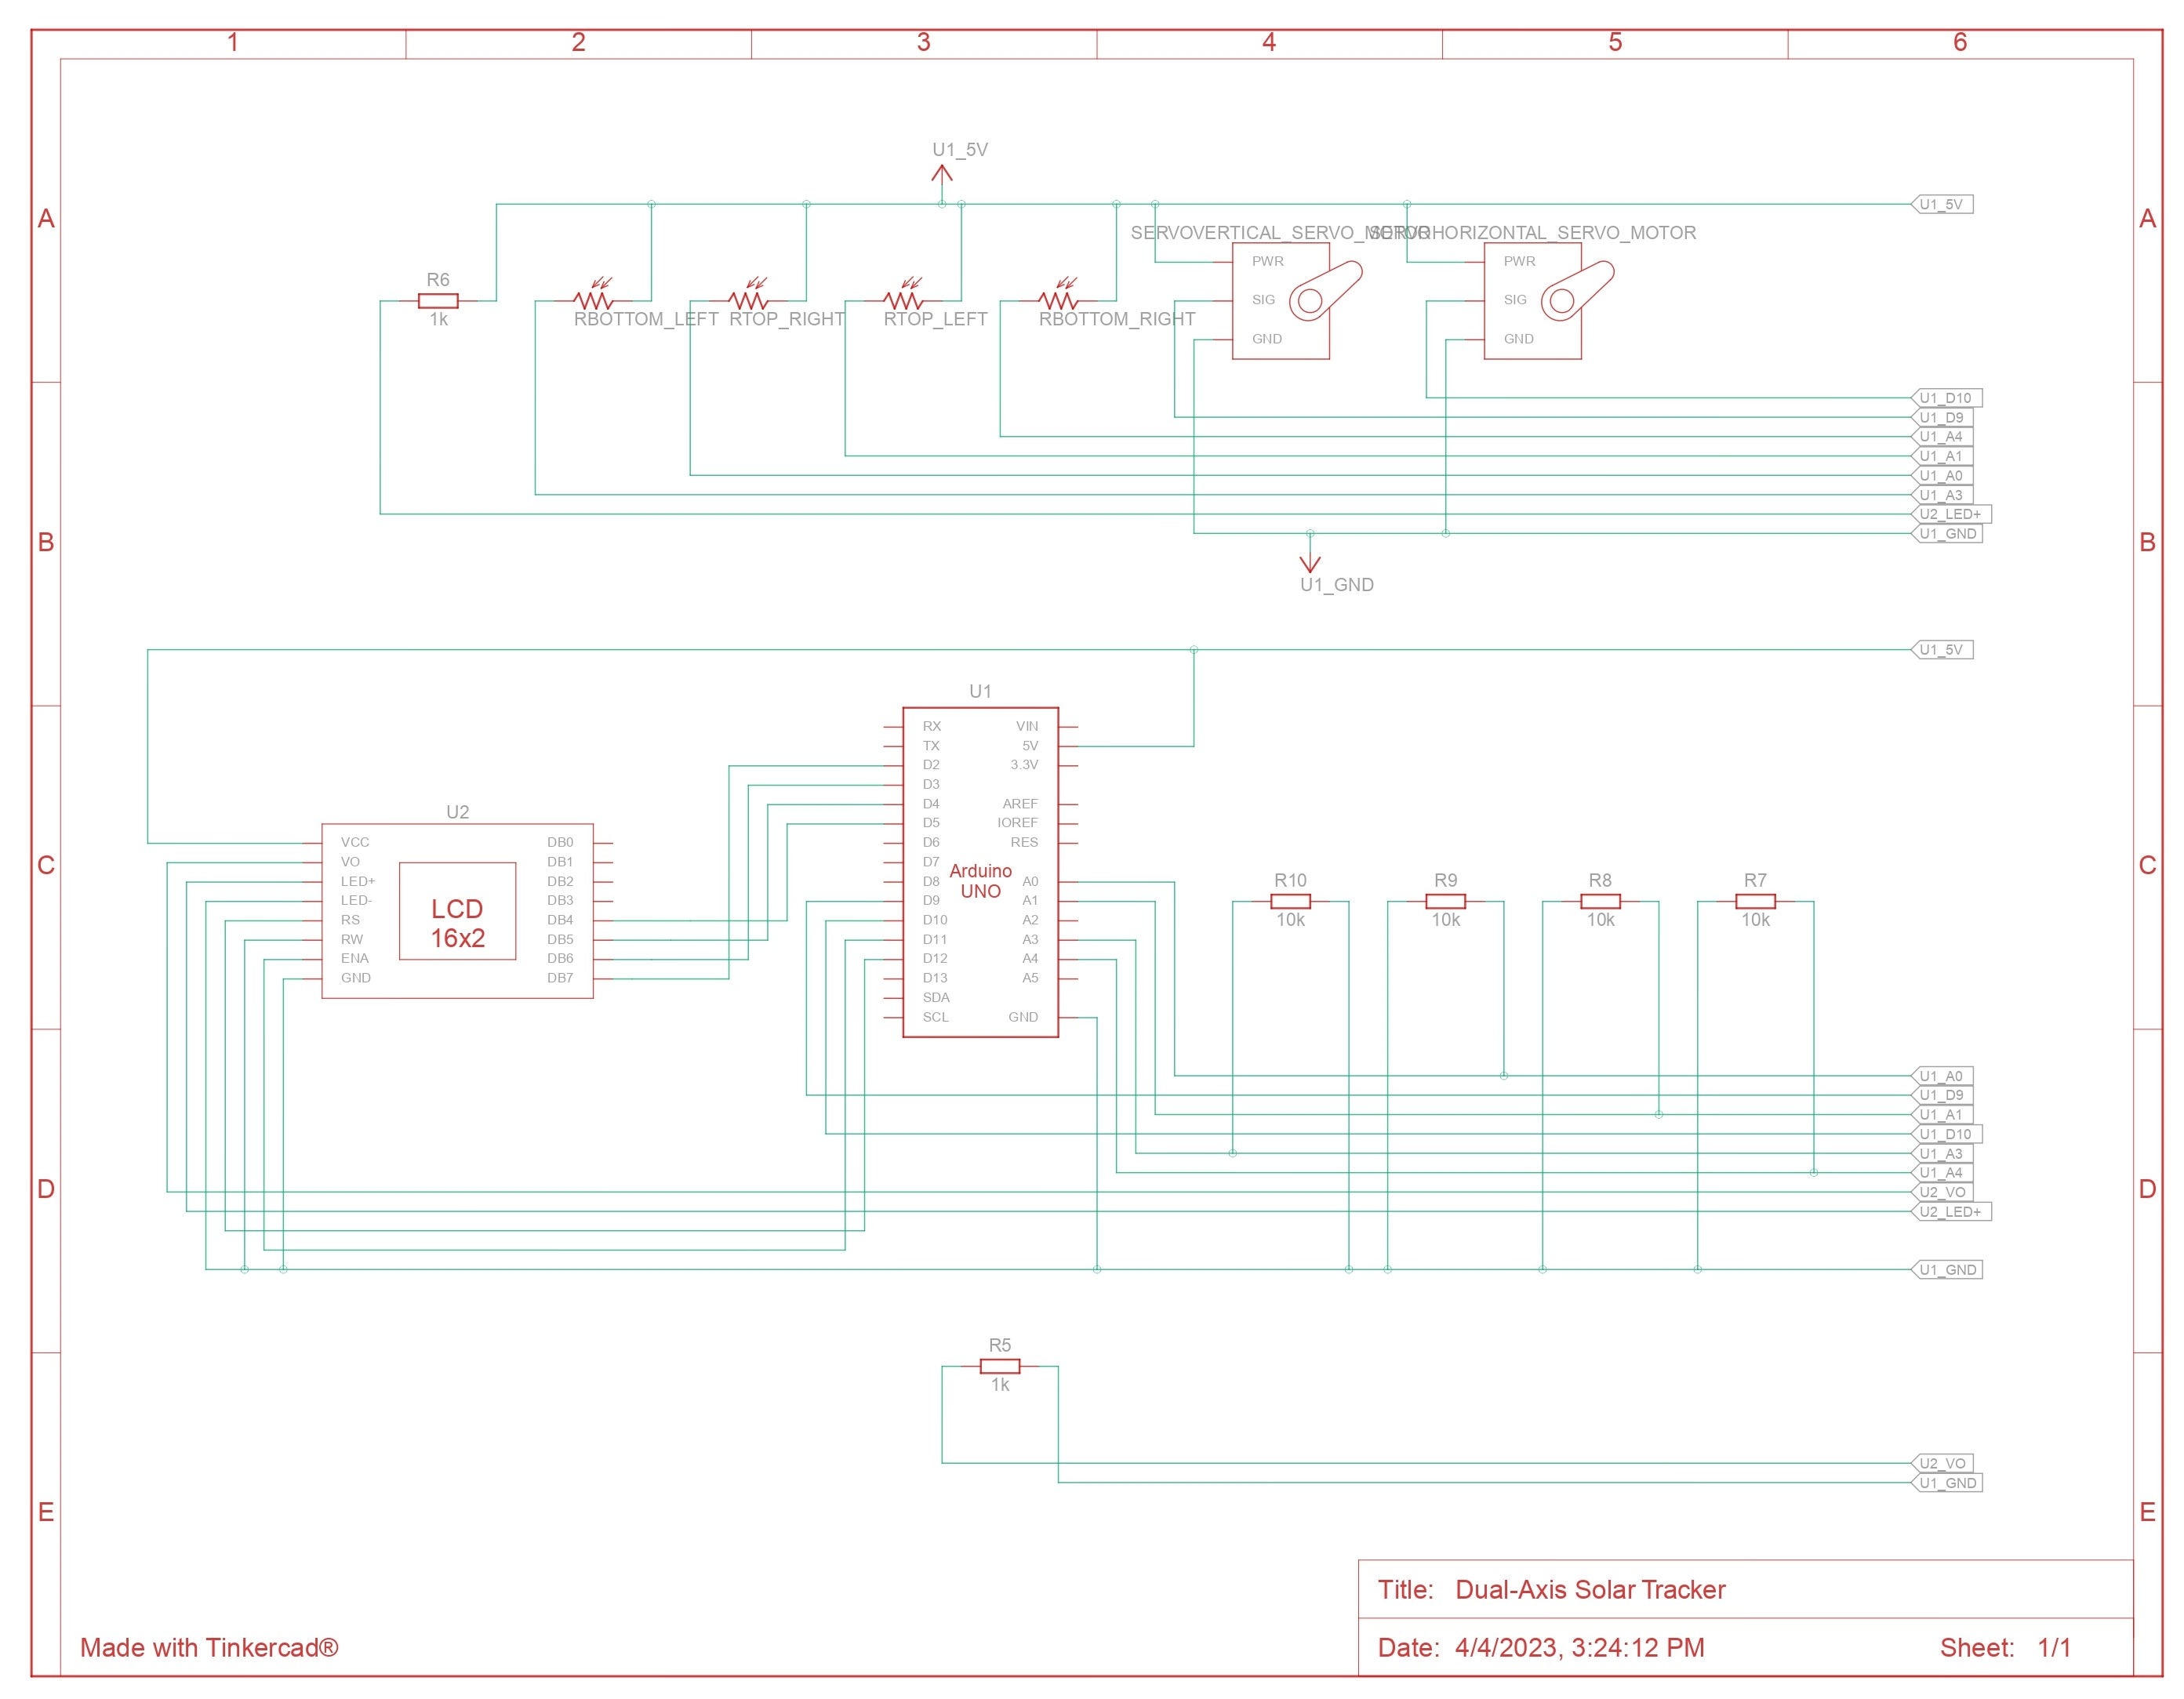
CIRCUIT DIAGRAM

Slide 12
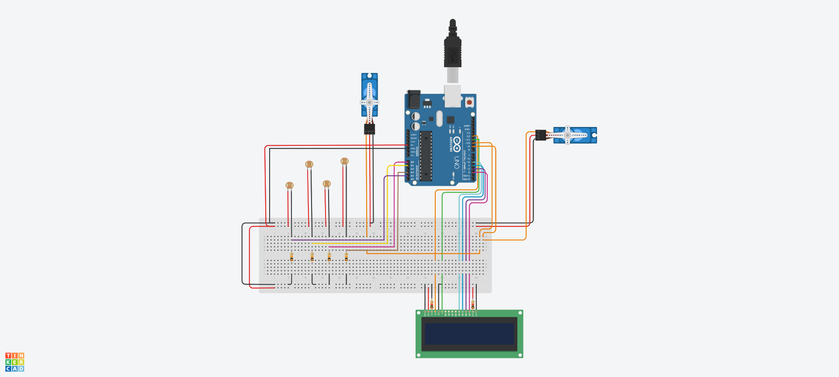
SIMULATION

Slide 13
TIMELINE
February
Identifying literature review and design
April
Simulation and Presentation
May
Hardware setup and Partial prototype review
June
Code debugging and optimization review

Slide 14
References
A. Sharma, V. Vaidya and K. Jamuna, "Design of an automatic solar tracking controller: Solar tracking controller," 2017 International Conference on Power and Embedded Drive Control (ICPEDC), Chennai, India, 2017
K. Charafeddine and S. Tsyruk, "Automatic Sun-Tracking System," 2020 International Russian Automation Conference (RusAutoCon), Sochi, Russia, 2020
M. S, R. K, R. P, H. P. S M, G. S and B. M, "Automatic Solar Tracking System," 2022 International Conference on Power, Energy, Control and Transmission Systems (ICPECTS), Chennai, India, 2022
Design and Development of an Automatic Solar Tracker by Jerin Kuriakose Tharamuttama , Andrew Keong Ng
https://ieeexplore.ieee.org/stamp/stamp.jsp?tp=&arnumber=8081141
https://ieeexplore.ieee.org/stamp/stamp.jsp?tp=&arnumber=9208086
https://ieeexplore.ieee.org/stamp/stamp.jsp?tp=&arnumber=10047670
https://www.sciencedirect.com/science/article/pii/S1876610217365025/pdf?md5=f5e41ab4d2f4c2ba978daef504a6d34a&pid=1-s2.0-S1876610217365025-main.pdf

Slide 15
THANK YOU
B Lakshmikanth Reddy CB.EN.U4CCE20011
D Abhiram CB.EN.U4CCE20021
K Sai Hrithik CB.EN.U4CCE20027
N Charan Reddy CB.EN.U4CCE20035

