Slide 1


Medical Chatbot Development: Utilizing Knowledge Graph & Machine Learning Techniques
19CCE495 : Project phase 1
TEAM ID : ECE013
Project Advisor : Ms.G.Prabha

Slide 2
Team MEMEBERS
Name of the student | Roll Number
B.Lakshmikanth Reddy | CB.EN.U4CCE20011
Ch.Sohith Reddy | CB.EN.U4CCE20012
D.Sai Tarun | CB.EN.U4CCE20014
P.Gowtham Kumar | CB.EN.U4CCE20073

Slide 3
PROBLEM STATEMENT
To construct a question answering Chatbot that can answer user’s queries based on the information available in Knowledge graph and provide sufficient information regarding medical issues.

Slide 4

Abstract
The rapid progress in information and artificial intelligence technologies facilitates the shift from traditional to smart care services.
This system establishes a knowledge graph model to assist people in accessing medical information. It encompasses design, knowledge extraction, knowledge graph building, and query response. By inputting symptoms, the system predicts potential diseases and offers remedies.
Unlike manual internet searches, this autonomous system saves time by providing comprehensive disease-related information from the knowledge graph.

Slide 5
Motivation
If a patient wants to know about a disease, they have to search everything regarding the disease and will have to find the answers by reading the content available in internet.
2. Construction of such Chatbot can help the user find answers to his queries and know every aspect of the disease or anything regarding the disease & also remedial measures.
3. The project is driven by the key motivations which are Enhanced Information Retrieval, Contextual Understanding, Evidence-Based Decision Making, Empowering Patients.

Slide 6
Objectives
To implement web scraping techniques to gather related medical data from various sources & data cleaning.
To build a comprehensive medical knowledge graph.
To develop a question-answering system with the developed knowledge graph in integration with the front-end developed website.
To assess the effectiveness of the created chatbot using various metrics.

Slide 7
Novelty
The existing systems has limited interactivity with the chatbot. In our project we would like the user to have maximum understanding of the system using a user friendly website where they can directly either chat or visualize the graph relations between diseases and their attributes with easy accessibility.

Slide 8
Timeline
Review | Month | Milestone
1 | Sep 2023 | Literature Survey Data Scraping
2 | Oct 2023 | Data Cleaning & Data Translation
3 | Nov 2023 | Enhancing & testing the knowledge graph Building a baseline structure
4 | Jan 2024 | Integration of chatbot with developed knowledge graph technique
5 | Feb 2024 | Development of front-end website
6 | Mar 2024 | Paper Draft
7 | May 2024 | Draft of Report
8 | Jun / Jul 2024 | Project Completion & Documentation of final report

Slide 9
Literature Survey
Title of the paper | Year | Authors | Publication | Comments
Research on medical question answering system based on knowledge graph | 2021 | Zhhixue Jiang, Chengying Chi, And Yunyun Ahan | IEEE Access | An explanation which is fully based on knowledge graph & also query Q&A system. An experiment based on Knowledge Graph & Query System.
A Novel web scraping approach using the additional information obtained from web pages | 2020 | Erdinc Uzun | IEEE Access | How to understand a complicated website Studies related to Web scraping
Research on information extraction of technical documents and construction od domain knowledge graph | 2020 | Huaxuan zhao Yueling Pan Feng Yang | IEEE Access | Explained about what is a knowledge graph Gave a detailed explanation about Neo4j app for the construction of KG.
Knowledge Graph assisted end-to-end medical dialog generation | 2023 | Deeksha Varshney Aizan zafar Nirunashu kumar Behera Asif Ekbal | ELSEVIER Research paper | MedDialog-EN data which consists of data b/w doctor-patient conversations. New methods of reasoning & attention mechanisms designed.
Question Answering Over Knowledge Graphs: A Case study in Tourism | 2022 | Sereh Aghaei, Elie Raad, And Anna Fesnel | IEEE Access | A semi-automatic generic approach is introduced to create training data using facts in the KG. NLQ's are automatically mapped into query patterns according to questions grammatical information

Slide 10
Data Scraping
To build a comprehensive medical knowledge graph, an essential step is to gather relevant data from various sources through data scraping. The process involves extracting structured and unstructured information from trusted medical websites.
Identifying Data Sources
Designing Web Scraping Strategies
Implementing Data Scraping
Data Transformation and Storage in MongoDB

Slide 11
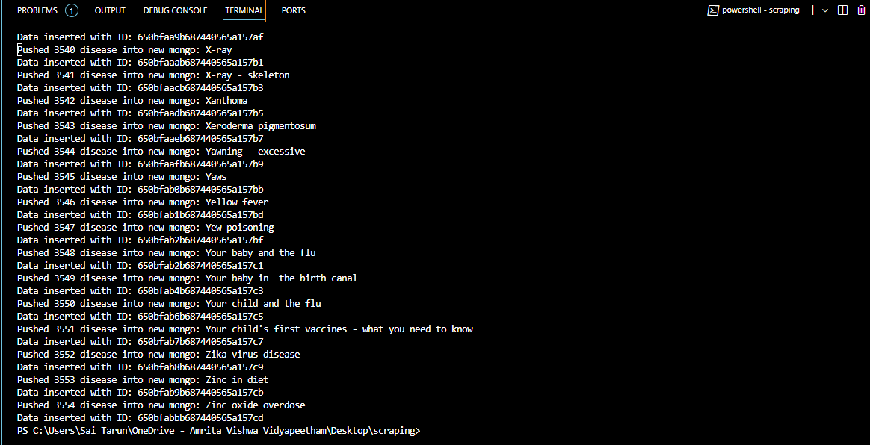
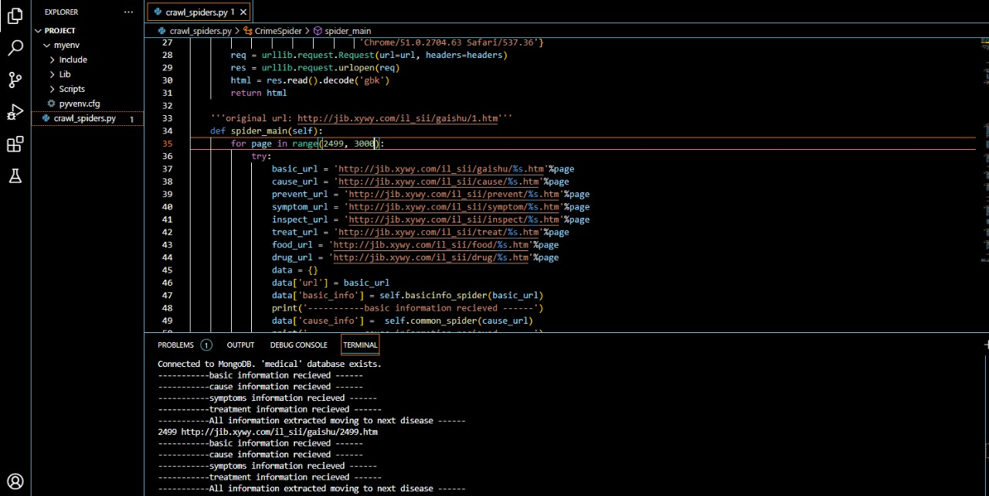
Results:

Slide 12
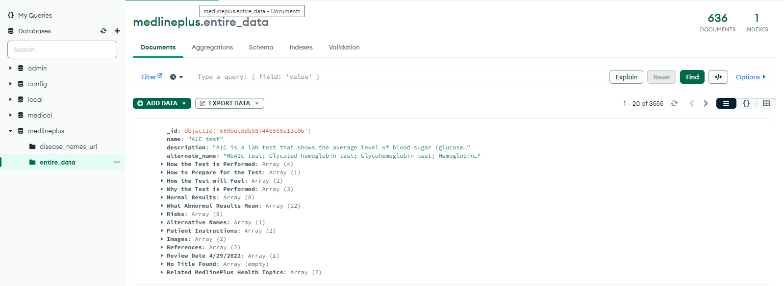
Dataset:

Slide 13
References
[1]Jiang, Zhixue, Chengying Chi, and Yunyun Zhan. "Research on medical question answering system based on knowledge graph." IEEE Access 9 (2021): 21094-21101.
[2] E. Uzun, "A Novel Web Scraping Approach Using the Additional Information Obtained From Web Pages," in IEEE Access, vol. 8, pp. 61726-61740, 2020, doi: 10.1109/ACCESS.2020.2984503.
[3] H. Zhao, Y. Pan and F. Yang, "Research on Information Extraction of Technical Documents and Construction of Domain Knowledge Graph," in IEEE Access, vol. 8, pp. 168087-168098, 2020, doi: 10.1109/ACCESS.2020.3024070.
[4]Varshney, Deeksha, et al. "Knowledge graph assisted end-to-end medical dialog generation." Artificial Intelligence in Medicine 139 (2023): 102535.
[5]Aghaei, Sareh, Elie Raad, and Anna Fensel. "Question answering over knowledge graphs: A case study in tourism." IEEE Access 10 (2022): 69788-69801.

Slide 14


