Slide 1
BUFR update for ARO
Jennifer Haase
Input from Jeff Ator and team @NOAA
2024-01-17

Slide 2
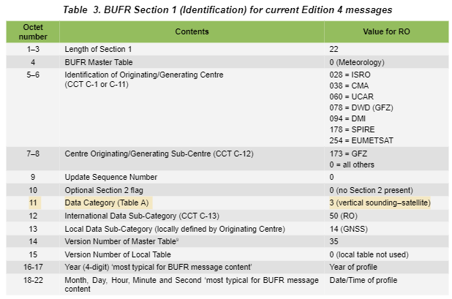
Changes to BUFR for ARO
Neill Bowler (MetOffice): Nov 1, 2022
„For ARO or others this would have to be 2: vertical soundings (other than satellite).”
Recent update:
Jeff Ator (NOAA): Nov 23, 2023
„they agreed [WMO] to support an International Subcategory value of 50 for "Radio occultation sounding" in Common Code Table C-13 when the Data Category value is 2, and not just when the Data Category value is 3. This will be part of the next update cycle to the WMO manual in May/June of next year.”

Slide 3
Checkout bufr files
CHEK12 OUTT 012020
BUFR^@ blahblahblah7777
My team will also handle getting the data to Jeff when he is ready to receive it. Is it safe to assume this data will come over your existing line 169 over ftps-in (or ftpin357)?
169 is CW3E SIO, currently sending radiosonde data from independent sites to NOAA
I would expect the file oc_20221208200040_n49t_iop03_ucsd.bufr under iop03 to have a WMO header at the top.
And then other BUFR messages inside would start with BUFR and end with 7777.
If this is following a similar format to the RO data we should be able to get some headers assigned for you once you are ready.
If you just want to put a placeholder for the WMO header we generally use a test header (CHEK12 OUTT MMDDHH) so the top line might look something like this:

Slide 4
I was presuming that we'd receive the data (individual profiles) via headed GTS messages, which is typical for all of the satellite-based radio occultation data that we process.
That said, and from a BUFR encoding standpoint, the general practice for radio occultation data is one individual RO profile per BUFR message, at least for satellite-based data which are the only examples I've ever seen to this point.

Slide 5
since the same 3-10-026 radio occultation sequence descriptor will still be used in Section 3, then I think it should still work with most if not all existing reader software, because that's what most software keys on in order to read a BUFR message..
In #2 above I'm only suggesting to include one additional preceding descriptor 0-01-008 prior to that 3-10-026 sequence, in order to store the aircraft tail number as an identifier associated with the following data. This will help clarify that the radio occultation data in 3-10-026 is from an aircraft and not from a satellite, and which is also why I suggested to use a Data Category value of 2 rather than 3 in Section 1.
On a related note, and if you want, I could also propose that an International Subcategory value of 50 means "Radio occultation sounding" when the Data Category value is 2 and not just when the Data Category value is 3. That way, you wouldn't need to change that International Subcategory value to "Missing" in your messages, which is one of the suggestions I had made earlier.

Slide 6
We provided some bufr data for review
Processing -> cdaac netcdf -> ropp utility -> ropp format -> wmo bufr format
In this folder:
https://agsweb.ucsd.edu/gnss-aro/ar2023/postProc/level2/
you can find some bufr files for iop03 iop04 and iop05 from 2023.

Slide 7
Initial concerns based on test bufr
First off, the originating center for these messages is currently set to a value of 0 in Sections 1 and 4, which in turn means that it was encoded by the WMO Secretariat. Obviously that's not correct, so you'll need to pick a different number from Common Code Table C-1 in Part C of the WMO 306 Manual. There are already numbers defined for a wide range of U.S. agencies including FNMOC, NOAA/NWS, NOAA/OAR, NASA, UCAR, NCAR, etc., so if this project happens to be affiliated with or funded under contract to any of those agencies then it may be an appropriate choice. But if none of those seem appropriate, then you're also welcome to use a value of 9 which is a catchall for "NOAA/NWS - Other" and which may end up being your best fallback option.

Slide 8
Initial concerns based on test bufr
2. Since these data are measured from an airplane rather than a satellite, then I think it would be more appropriate for you to use a Section 1 Data Category value of 2 for "Vertical soundings (other than satellite)", rather than a value of 3 for "Vertical soundings (satellite)", and then just set your corresponding International Subcategory value to 255 for "Missing", since a value of 50 only means "Radio occultation sounding" when the Data Category is 3. You can still use 3-10-026 as your main sequence descriptor in Section 3, and that way it will still be identifiable as radio occultation data, but it might be a good idea to also precede that with an additional new descriptor 0-01-008 where you can encode the tail number of the airplane to help make it clearer what's going on here.

Slide 9
Initial concerns based on test bufr
3. I noticed that all of your mean frequency values corresponding to descriptor 0-02-121 were encoded with a value of 0.0 Hz. I'm assuming that's just some default placeholder rather than an actual measured value, so I would suggest to encode those as "Missing" instead.
4. Similarly, I noticed that all of your satellite classification values corresponding to descriptor 0-02-020 were encoded with values of 401, 402, 403, or 404, and which I presume should also be "Missing" instead since these aren't really satellite observations.

Slide 10
holly.uhlenhake@noaa.gov
jeff.ator@noaa.gov

