Slide 1
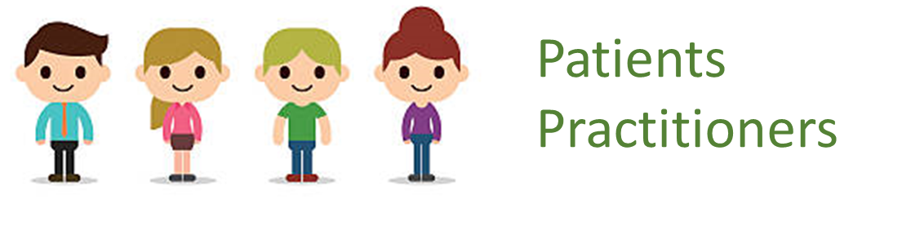
HTML Landing Page +Spring MVC
Web Application
SPRING BOOT
Java Utility Classes
KIE Application Framework
KIE Libraries
KIE Functions (DROOLS)

