Slide 1
SnapYummy
Intelligent Cooking Assistant
IRS Group 8

Slide 2





System Architecture
Knowledge
Recipes Recommendation
Recipes
Intent
Ingredients
preference
Recognition & Reasoning
Recipe KG
Knowledge Discovery
Perception
Knowledge Modelling
Text
Image
UI Framework
Knowledge Acquisition
User

Slide 3
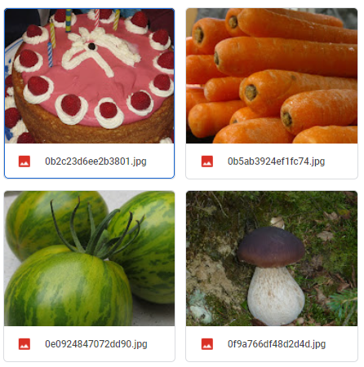
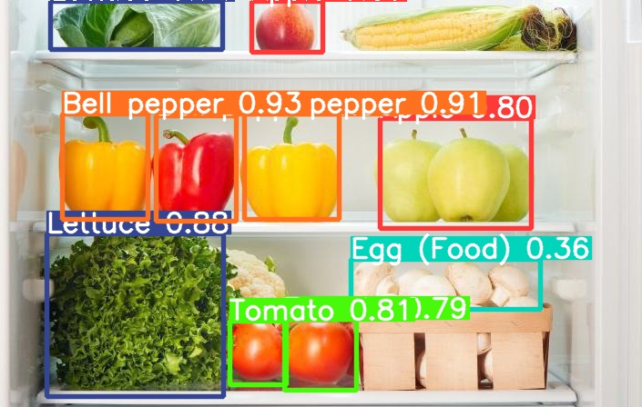
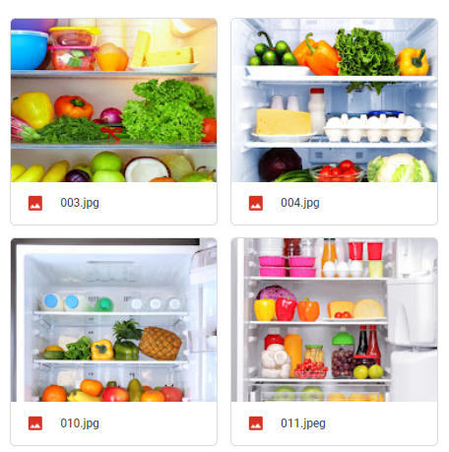
Food Detection (YOLOv5)
80 epochs on Food dataset
1.6k Food dataset (from FiftyOne)
300 epochs on Refrigerator dataset
200 Refrigerator dataset (labelled by us)
Data Acquisition
Learning
Reasoning

Slide 4
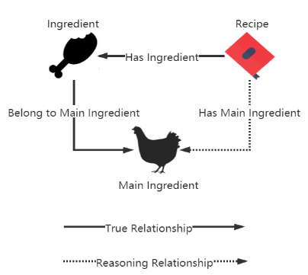
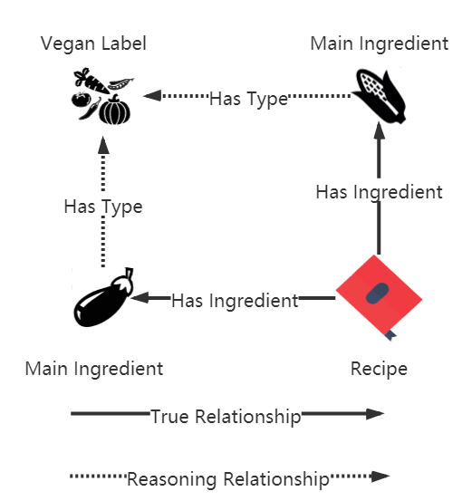
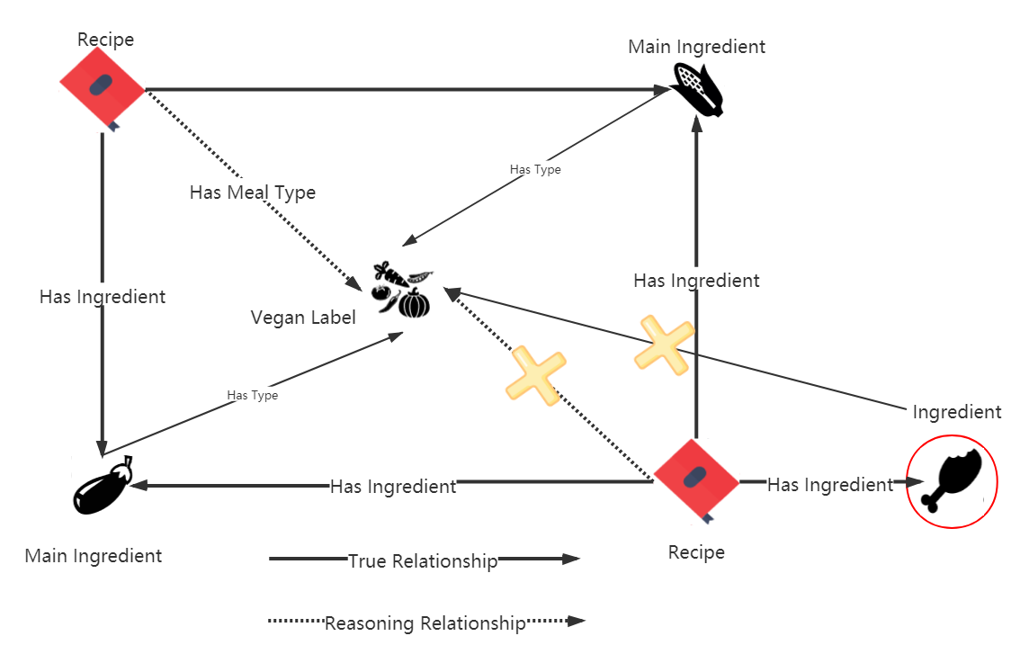
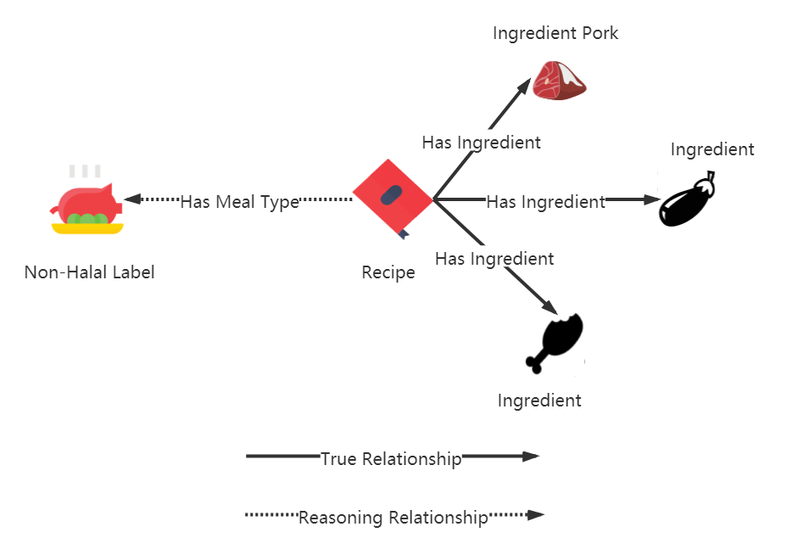
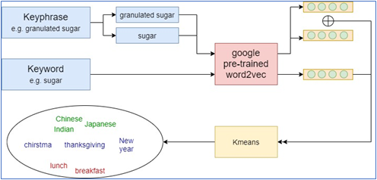
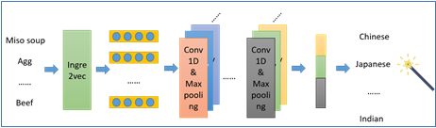
Knowledge
Engineering
Knowledge Discovery
Rule based knowledge discovery
Knowledge Modeling
Knowledge Representation using Knowledge Graph
Knowledge Acquisition
Similarity Based
Main Ingredients Alignment
word2vec + Kmeans Clustering for knowledge extraction
Ingre2vec based CNN for cuisine type predict
Data Acquisition
Food.com Recipe Dataset
What’s cooking Dataset

Slide 5

Intent Detection
browsing
what can I cook?
random or preference
cooking ingredients input
preference
need modify input?
random
no
dietary and cuisine preference
yes
get recipe
instructions
cooking time
all information
recipe image
ingredients list
more result

Slide 6





System
Cooking
Knowledge Graph
Intent Detection
Intent Context
backend
Object Detection
Telegram bot
Message Parameters

Slide 7
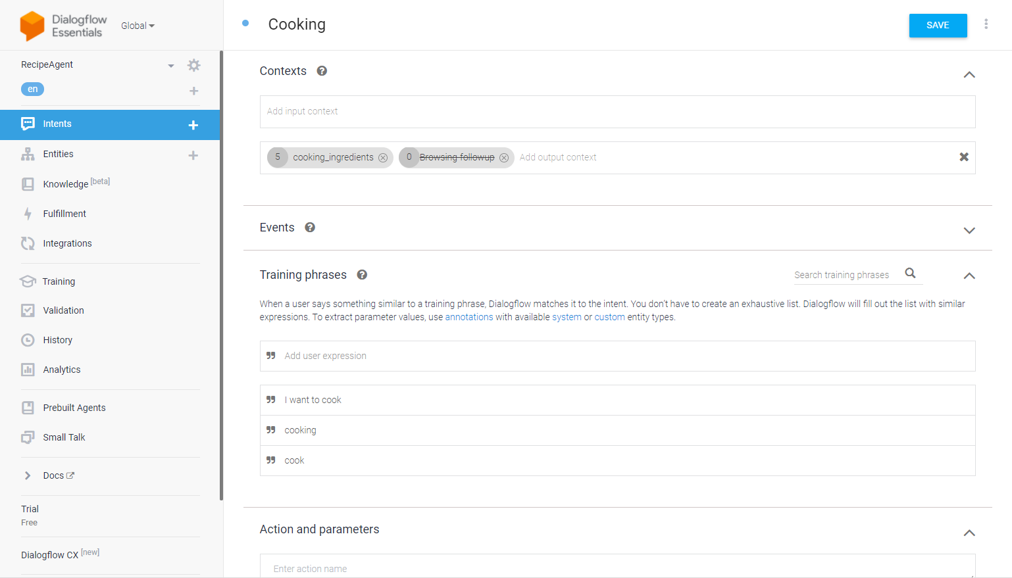

Slide 8
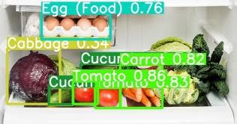
System
Input Ingredients
Knowledge Graph
Intent Detection
Intent Context
Cooking
backend
Ingredients Input
Object Detection
Telegram bot
Message Parameters
Ingredients:
meat, cucumber, egg, cabbage, carrot and tomato

Slide 9
System
Input Modification
Knowledge Graph
Intent Detection
Intent Context
Cooking
backend
Ingredients Input
need modify input
Object Detection
Telegram bot
Message Parameters
meat, cucumber, egg, cabbage, carrot, tomato
Ingredients:
cucumber, egg, cabbage, carrot, tomato

Slide 10
dietary and cuisine preference
System
Knowledge Graph
Intent Detection
Intent Context
Cooking
backend
Ingredients Input
Object Detection
Telegram bot
need modify input
dietary and cuisine preference
Message Parameters
Ingredients:
cucumber, egg, cabbage, carrot, tomato
cuisine preference:
Chinese
dietary preference:
Halal
Recipe List:
[Recipe 1,Recipe 2..Recipe 10]

Slide 11
System
more result
Knowledge Graph
Intent Detection
Intent Context
Cooking
backend
Ingredients Input
Object Detection
Telegram bot
need modify input
dietary and cuisine preference
Message Parameters
Ingredients:
cucumber, egg, cabbage, carrot, tomato
cuisine preference:
Chinese
more result
dietary preference:
Halal
Recipe List:
[Recipe 1,Recipe 2..Recipe 10]
New Recipe1,new Recipe2...

Slide 12
get recipe information
System
Knowledge Graph
Intent Detection
Intent Context
Ingredients Input
backend
need modify input
Object Detection
Telegram bot
dietary and cuisine preference
Message Parameters
more result
Ingredients:
cucumber…
Choosen recipe:
Recipe1
cuisine preference:
Chinese
get recipe
dietary preference:
Halal
Recipe List:
[Recipe 1,Recipe 2..Recipe 10]

Slide 13
System
Browsing
Knowledge Graph
Intent Detection
Intent Context
browsing
backend
random browse
Object Detection
Telegram bot
preference browse
Parameters
Recipe List:
Recipe1, Recipe2...
New Recipe 1, New Recipe 2,...

