Slide 4
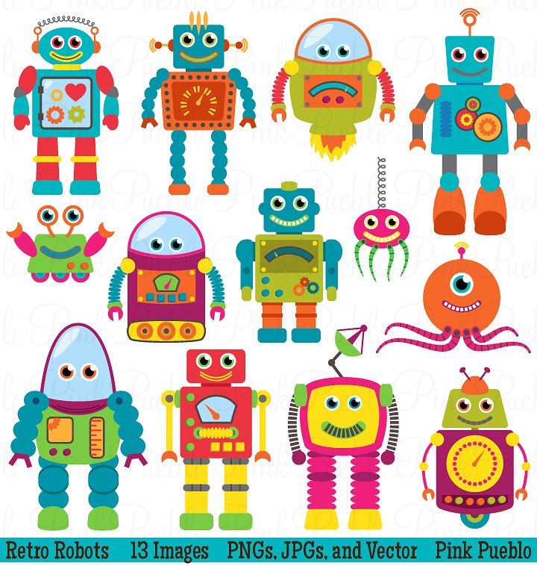




Slide 5
Patient Matching System
Patient Matching System

Slide 6
Pepper Project Group
CAO LIANG | A0012884E
GENG LIANGYU | A0195278M
HAN DONGCHOU FRANCIS | A0195414A
ONG BOON PING | A0195172B
TAN CHIN GEE | A0195296M
Patient Matching System
Patient Matching System

Slide 7

Pepper Project Group
CAO LIANG | A0012884E
GENG LIANGYU | A0195278M
HAN DONGCHOU FRANCIS | A0195414A
ONG BOON PING | A0195172B
TAN CHIN GEE | A0195296M
Patient Matching System
Patient Matching System

Slide 8
Pepper Project Group
CAO LIANG | A0012884E
GENG LIANGYU | A0195278M
HAN DONGCHOU FRANCIS | A0195414A
ONG BOON PING | A0195172B
TAN CHIN GEE | A0195296M
Patient Matching System
Patient Matching System

Slide 9


