Slide 1


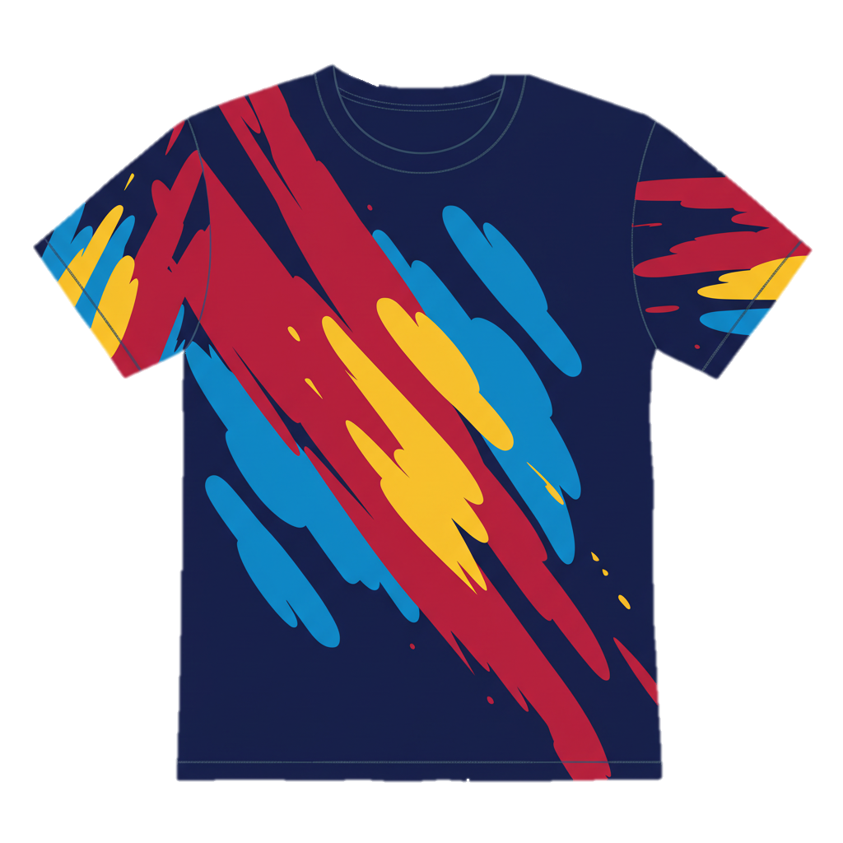
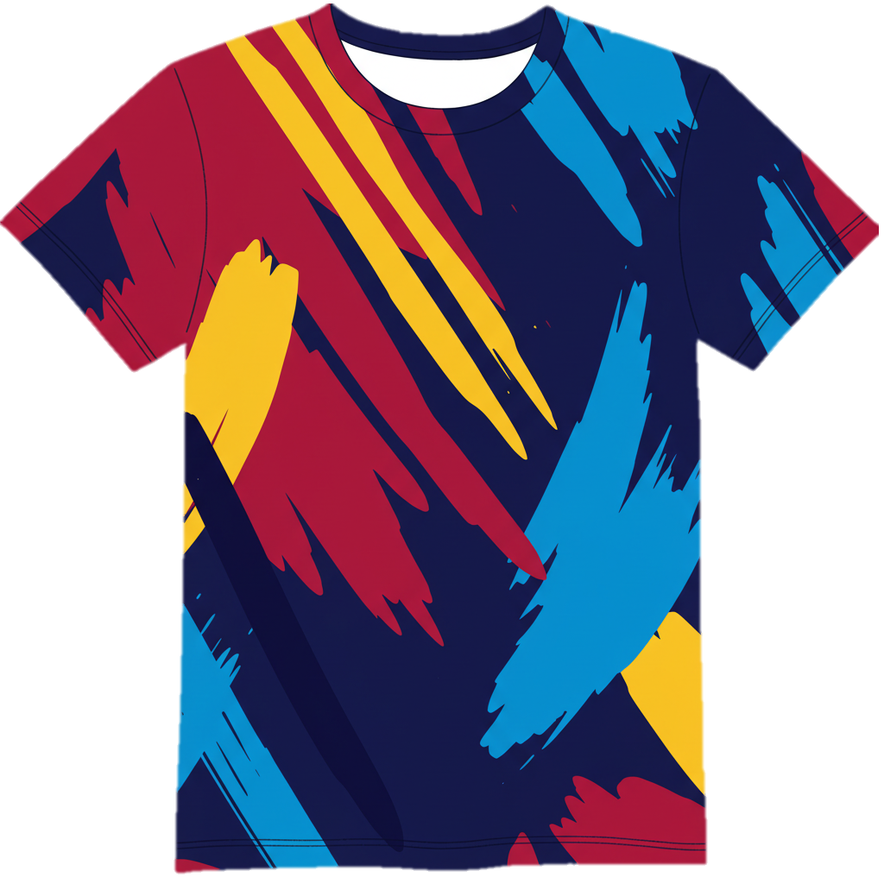




WRO SINGAPORE NATIONALS 2025
ROBOMISSION SEASON QUEST 2
FRONT DESIGN:
BACK DESIGN:
Judge
Judge
Sponsors

