Slide 1


SCALE-CCL: A Scalable Collective Communication Library for Wide-Area Distributed Training
Jiaheng Xiong, Qiaolun Zhang, Paolo Medagliani, Michele Ferrero, Xiaomin Liu, Meng Lian, Nicola Di Cicco, Baosen Zhao, Mëmëdhe Ibrahimi, Francesco Musumeci, Massimo Tornatore
December 1st , 2025

Slide 2
Outline
Background
Motivation
System Model
Problem Statement
Heuristic Algorithm
Results

Slide 3
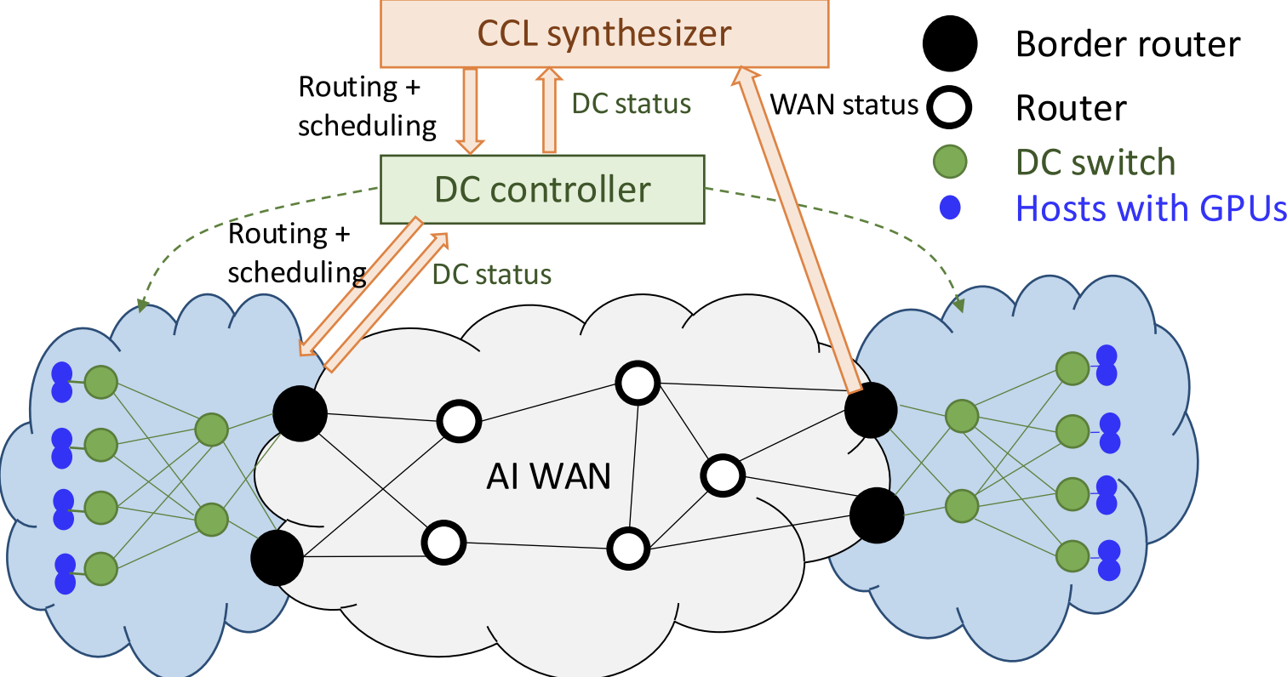
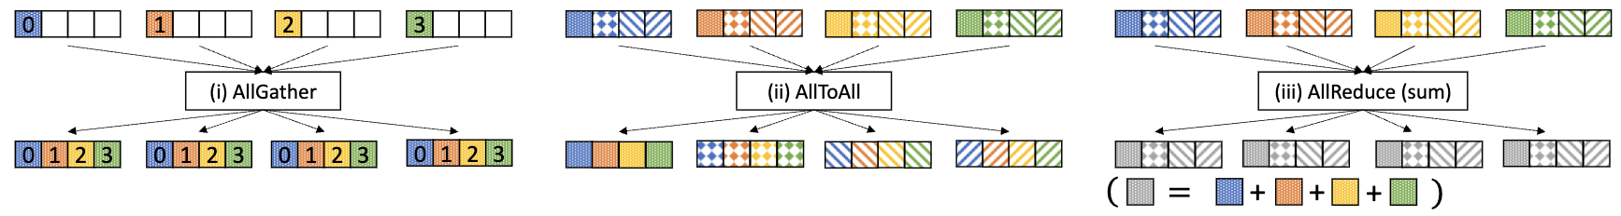
Background
Across Data Center distributed Training:
Model sizes keep growing, and future workloads may exceed the capacity of a single datacenter
Compute and data resources are often distributed across multiple geographic regions
Current CCL algorithms don’t adopt WAN scenario
Collective Communication Libraries (CCL): let multiple GPUs do routing and scheduling of chunks in a coordinated way so they can work together as a single, unified training system
Fig 1: Example of Different Collective Communications ^{[1]}
[1] Shah, Aashaka, et al. "{TACCL}: Guiding collective algorithm synthesis using communication sketches." 20th USENIX Symposium on Networked Systems Design and Implementation (NSDI 23). 2023.

Slide 4
Motivation: Dynamic Environment
The link rate varies over time in WAN.
Traffic can surge from nearly idle to full link capacity within seconds
The fluctuation magnitude can reach ±100% or even higher^{[1]}
The CCL synthesizer needs to respond quickly
TECCL often responds at a timescale of tens or even hundreds of seconds. (Can not adopt WAN)
[1] Singh, Rachee, et al. "RADWAN: rate adaptive wide area network." Proceedings of the 2018 Conference of the ACM Special Interest Group on Data Communication. 2018.

Slide 5





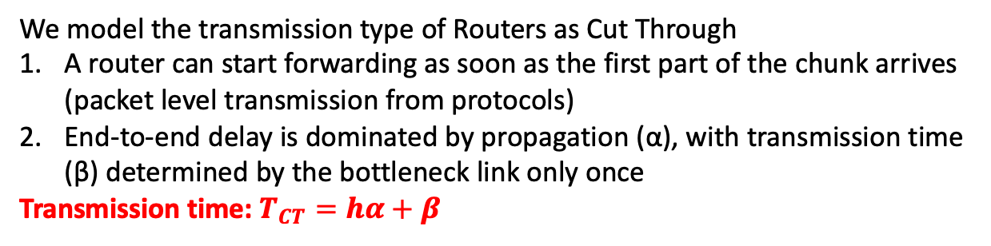

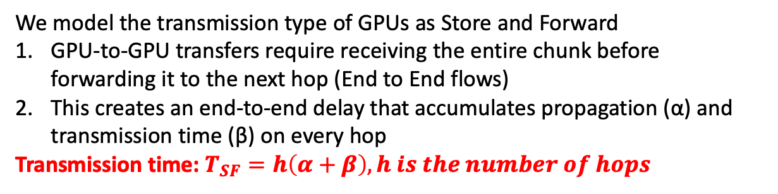
System Model (Different Transmission Type)
Node 0
Node 1
Node 2
We model the transmission type of GPUs as Store and Forward
GPU-to-GPU transfers require receiving the entire chunk before forwarding it to the next hop (End to End flows)
This creates an end-to-end delay that accumulates propagation (α) and transmission time (β) on every hop
Transmission time: $T_{SF}=h\left(α+β\right), h is the number of hops$
$$β$$
$$α$$
$$β$$
$$α$$
(a) Store and Forward
Node 0
Node 1
Node 2
We model the transmission type of Routers as Cut Through
A router can start forwarding as soon as the first part of the chunk arrives (packet level transmission from protocols)
End-to-end delay is dominated by propagation (α), with transmission time (β) determined by the bottleneck link only once
Transmission time: $T_{CT}=hα+β$
$$β$$
$$α$$
$$α$$
(b) Cut-Through
Notes:
multicast in a big topic

Slide 6
Problem Statement
Given
Network topology of multiple data centers
Collective operation
Chunk size
Number of chunk
Problem statement
Decide
Routing of subchunks
Scheduling of forwarding chunks in one node
Objective
Minimize the required to finish the collective
Constraints
Link latency
Node can only send a chunk after receiving it
Notes:
multicast in a big topic

Slide 7
System Model (Abstract Topology)
GPU 0
Switch 2
GPU 4
GPU 0
GPU 4
Switch 0
Border Router 2
Border Router 0
Border Router 0
Border Router 2
GPU 1
GPU 5
GPU 1
GPU 5
WAN
Switch 4
GPU 2
Switch 1
Border Router 3
GPU 6
GPU 2
GPU 6
Border Router 1
Switch 3
Border Router 1
Border Router 3
GPU 3
GPU 7
GPU 3
GPU 7
DC 0
DC 1
(a) Physical Topology
(b) Logical Topology
We abstract the physical topology to logical topology as Fig. (b)
Different field perform different function:
Intra-DC field: leverages dense local connectivity to quickly diffuse subchunks among GPUs
WAN field: forwards subchunks across border routers as early as possible toward the remote DC
Remote-DC field: completes the final dissemination once subchunks arrive at the destination datacenter

Slide 8
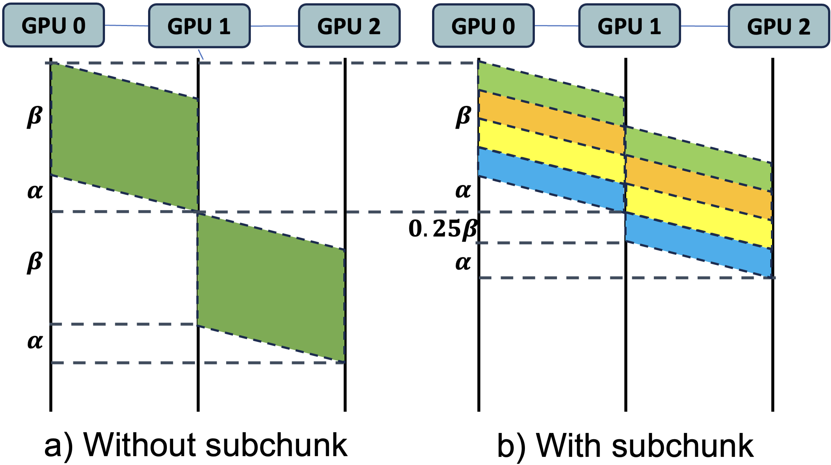
Flow Chart of the Proposed Algorithm
Partition into subchunks
Local load balance
Next event
Subchunk sorting
Event handle
Transmission start/complete
Reception start/complete
Transmission
Collective finished
No
Each chunk will be divided into multiple sub-chunks, and independent decisions will be made for each sub-chunk
Yes

Slide 9
Flow Chart of the Proposed Algorithm
Border Router 0
Partition into subchunks
GPU
Sub chunk: 0,1,2,3
Queue 0
Queue 1
Border Router 1
Local load balance
Local load balance
Next event
Border Router 0
GPU
Sub chunk: 0,1,2,3
Queue 0: 2,3
Subchunk sorting
Event handle
Transmission start/complete
Reception start/complete
Queue 1: 0, 1
Border Router 1
Local-Only Decisions: Nodes assign subchunks based on their own state and neighbors’ known holdings.
Per-Neighbor Queues: Avoid redundant sends by tracking neighbor status and balancing load across queues.
Scope: Load balancing applies to inter-DC/WAN links; intra-DC uses broadcast only.
Transmission
Collective finished
No
Yes

Slide 10
Flow Chart of the Proposed Algorithm
Border Router 0
GPU
Sub chunk: 0,1,2,3
Queue 0
Partition into subchunks
Queue 1
Border Router 1
Local load balance
Local load balance
Next event
Border Router 0
GPU
Sub chunk: 0,1,2,3
Queue 0: 2,3
Queue 1: 0, 1
Border Router 1
Subchunk sorting
Event handle
Transmission start/complete
Reception start/complete
Intra-DC network: broadcast
GPU to border router link and border router to border router link: load balancing
Local-Only Decisions: Nodes assign subchunks based on their own state and neighbors’ known holdings
Per-Neighbor Queues: Avoid redundant sends by tracking neighbor status and balancing load across queues
Transmission
Collective finished
No
Yes

Slide 11
Flow Chart of the Proposed Algorithm
Q[0]: 1
GPU 0
Q[5]: 3, 5
GPU to Border Router
Q[4]: 3, 6
Partition into subchunks
Q[1]: 1,2
GPU3
Border Router 0
GPU 1
Q[2]: 1,3
GPU 2
Local load balance
Next event
Border Router 1
(a) Before subchunk sorting
Q[0]: 1
GPU 0
Q[5]: 3, 5
Subchunk sorting
Q[1]: 2
Q[4]: 6
Event handle
Transmission start/complete
Reception start/complete
Border Router 0
GPU 1
GPU3
Q[2]: 3
GPU 2
Transmission
Border Router 1
(b) After subchunk sorting
1. Before Sorting — Redundancy Exists
Subchunks like 1 and 3 appear in multiple queues (e.g., Q[1] of BR0 and Q[2] of BR1 both hold 1,3) → leads to redundant transmissions
2. Sorting — Resolve Duplicates Locally
For each duplicate subchunk, choose the (sender, receiver) pair with lowest estimated delay, and remove it from other queues
3. After Sorting — Unique Assignments
Each subchunk now appears in only one queue
Collective finished
No
Yes

Slide 12
Flow Chart of the Proposed Algorithm
GPU to GPU
Partition into subchunks
[0, 1]
[0]
GPU 1
GPU 1
Local load balance
Next event
[0, 2]
[1, 3]
[2]
[1]
GPU 4
GPU 0
GPU 2
GPU 4
GPU 0
GPU 2
Subchunk sorting
Event handle
Transmission start/complete
Reception start/complete
GPU 3
GPU 3
[2, 3]
[3]
Transmission
(a) Before subchunk sorting
(b) After subchunk sorting
For GPU to GPU, Subchunk sorting only performs the function of preventing redundant sending (Sending several same subchunks to the same receiver)
Collective finished
No
Yes

Slide 13


Numerical Result: Topology
GPU 0
GPU 4
GPU 0
12.5 GBps
GPU 4
Border Router
Border Router
Border Router
Border Router
GPU 1
GPU 5
GPU 1
GPU 5
GPU 2
GPU 6
GPU 2
GPU 6
Border Router
WAN
Border Router
Border Router
WAN
Border Router
GPU 3
GPU 7
GPU 3
GPU 7
50 GBps
$$α=0.7μs$$
Fully Connected
12.5 GBps
$$α=0.7μs$$
Min Connected
Test topologies with different internal connectivities within the data center (connectivity = number of edges in the current topology / number of edges in a fully connected graph): randomly vary the number of internal edges in each DC, ensuring that each DC remains a connected graph
Vary the propagation delay of the links in the WAN

Slide 14
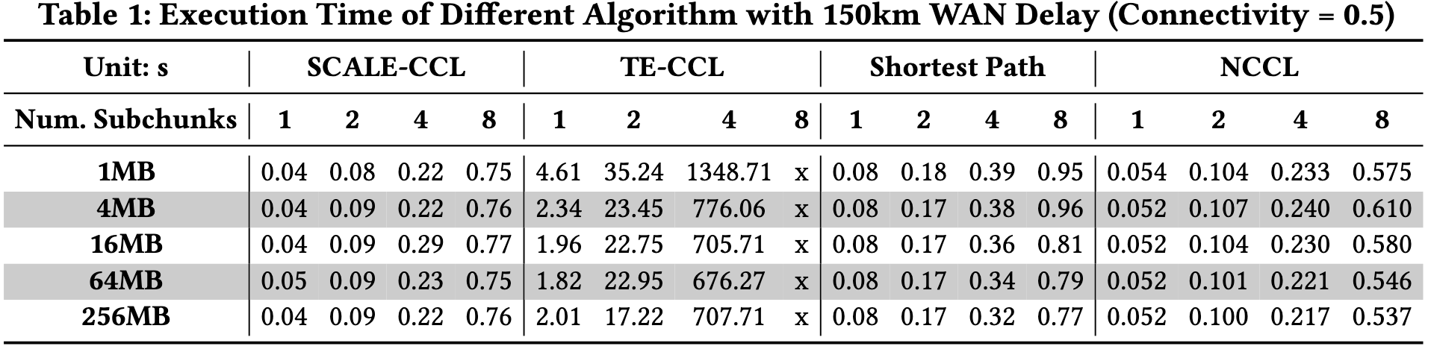
Numerical Result: Scalability Analysis
SCALE-CCL
Scheduling time stays below 1 s in all cases (e.g., 1 MB: 0.04 → 0.75 s)
Grows smoothly and near-linearly with the number of subchunks
TE-CCL
At 1 subchunk, takes 2–5 s depending on chunk size
At 4 subchunks jumps to 600–1300 s, and fails entirely at 8 subchunks (more than 1 hour)
Shortest Path (SPH)
Runs in the 0.3–1.0 s range across all settings
Consistently slower than SCALE-CCL (e.g., 1 MB / 8 subchunks: 0.95 s vs. 0.75 s)
NCCL
Largely insensitive to chunk size (1–256 MB shows small variation)
Increases with subchunks: from ≈0.05 s (1 subchunk) to ≈0.55–0.61 s (8 subchunks)

Slide 15
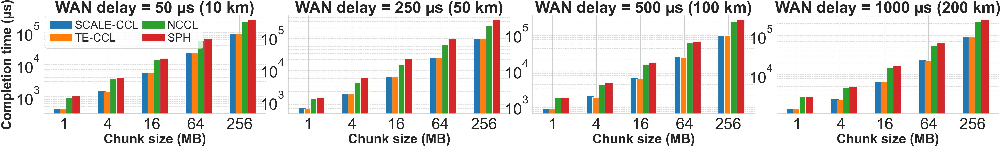
Numerical Result: Different WAN Delay
8.9%
Completion Time vs. chunk size under different WAN delay with 0.5 connectivity and 1 Subchunk per GPU
SCALE-CCL
Stays within 10% of TE-CCL across all WAN delays and chunk sizes (max gap ≈ 8.9%, avg ≈ 3%)
At 250 µs and 256 MB: 90,252 µs, only 0.3% slower than TE-CCL (90,002 µs)
TE-CCL
Achieves the lowest completion time, but only slightly better than SCALE-CCL (sub-10% gap everywhere)
Completion time increases with WAN delay similarly to SCALE-CCL, but requires much higher scheduling overhead (from Table 1)
Shortest Path (SPH)
Significantly slower than WAN-aware schemes
Curves grow more steeply with WAN delay, showing poor robustness to higher propagation latency
NCCL
Also degrades under WAN delay
Lacks WAN-aware path selection, so its completion time tracks propagation delay more closely

Slide 16
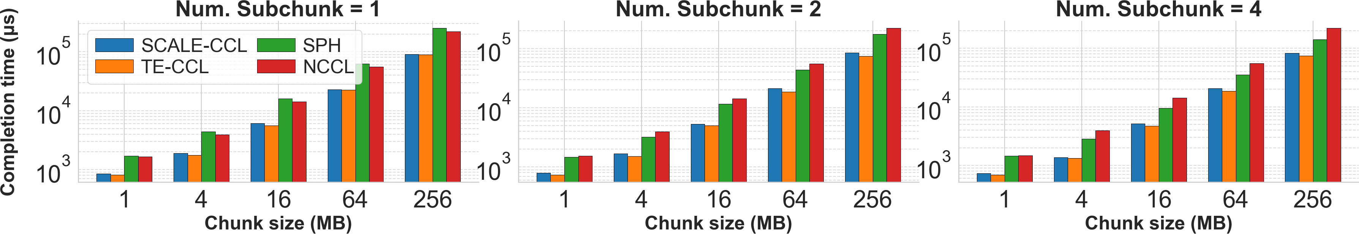
Numerical Result: Different Subchunks
Completion Time vs. chunk size under different number of Subchunks with 100 km WAN Delay and 0.5 connectivity
SCALE-CCL
Within 10–15% of TE-CCL across all chunk sizes and subchunks
More subchunks reduce completion time (e.g., at 16 MB & 2 subchunks: 5313 µs)
TE-CCL
Best completion time in all settings
Also benefits from subchunking but with high synthesis cost (per Table 1)
SPH
Much slower than SCALE-CCL (e.g., 16 MB & 2 subchunks: 11,566 µs)
Improves with more subchunks but still far behind WAN-aware methods
NCCL
At 16 MB & 2 subchunks: 14,251 µs (≈2.7× slower than SCALE-CCL)
Weak sensitivity to subchunks for medium/large chunks due to fixed ring structure

Slide 17
Conclusion
We presented SCALE-CCL, a WAN-aware collective communication library that synthesizes AllGather schedules across geo-distributed datacenters
By combining subchunking, local queue–based decisions, and a lightweight event-driven scheduler, SCALE-CCL reacts to WAN variability while keeping schedule generation extremely fast
Experiments show that SCALE-CCL maintains near-optimal completion time while scaling to large topologies and high subchunk counts, making WAN-aware collective scheduling practical for modern cross-DC training

