Slide 1
Uno: A One-Stop Solution for Inter- and Intra-Data Center Congestion Control and Reliable Connectivity
Tommaso Bonato* ^{1,3}, Sepehr Abdous* ^{2,3}, Abdul Kabbani ³, Ahmad Ghalayini ³,Nadeen Gebara ³, Terry Lam ³, Anup Agarwal ^{3,5}, Tiancheng Chen ¹, Zhuolong Yu ³, Konstantin Taranov ³, Mahmoud Elhaddad ³, Daniele De Sensi ⁴, Soudeh Ghorbani ², Torsten Hoefler ¹
¹ETH Zürich, ²Johns Hopkins University, ³Microsoft, ⁴Sapienza University Of Rome, ⁵CMU, * Equal contribution

Slide 2

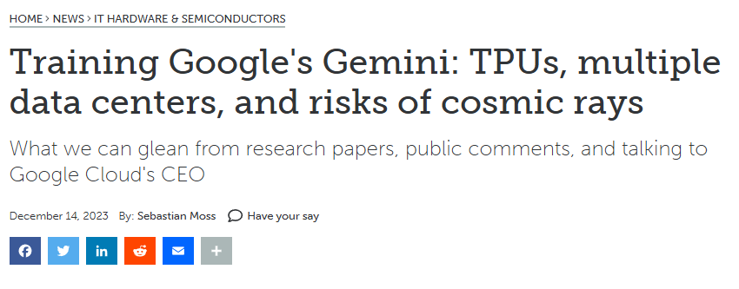
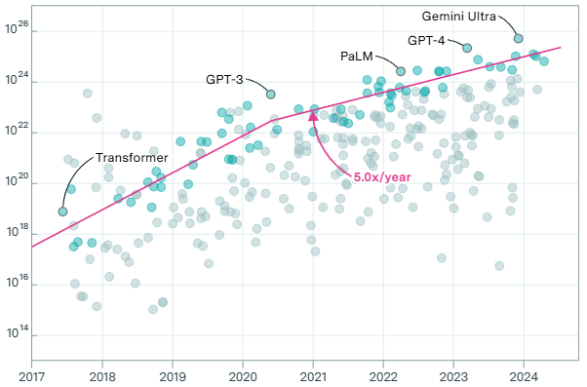
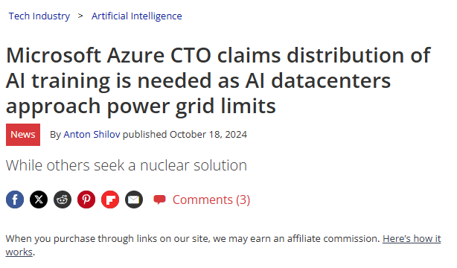

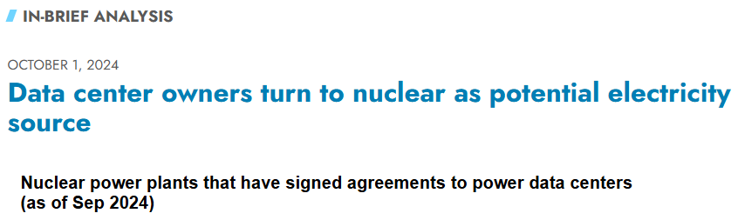
Motivation
Frontier LLM Models
[1]
Training Compute (FLOP)
4-5x increase per year
Increasing power demand
"We had to scale to more compute, and that compute was not available as part of one cluster. We had to go to multi-cluster training"
GPT4.5 Team
April 2025
Publication
"We don't disclose exactly the details of how many locations but Gemini Ultra was trained across multiple sites, and multiple clusters within those sites."
Thomas Kurian, CEO Google Cloud
December 2023
Problem: local power limitation, increased complexity
Solution: training across multiple datacenters
[1] Training Compute of Frontier AI Models Grows by 4-5x per Year, Report, Epoch AI, 2024
Notes:
As we all know the required training compute of the frontier LLMs has been exponentially increasing in the recent years
The current trend is …
This means that we need to both scale-up and scale-out the training infra which increases the power demand
Even though the industry leaders are trying to tackle this issue by securing stable sources of power – eventually we will hit local power limitation
One of the solution is
In fact the industry leaders such as … are already deploying cross-DC traing
Specifically there is a recent quote from … even though they do not disclose the details, they confirm

Slide 3
Motivation
Frontier LLM Models
[1]
Training Compute (FLOP)
Significant inter- and intra-DC traffic co-existence inside DCs
Efficient communication becomes challenging
4-5x increase per year
Increasing power demand
"We had to scale to more compute, and that compute was not available as part of one cluster. We had to go to multi-cluster training"
GPT4.5 Team
April 2025
Publication
"We don't disclose exactly the details of how many locations but Gemini Ultra was trained across multiple sites, and multiple clusters within those sites."
Thomas Kurian, CEO Google Cloud
December 2023
Problem: local power limitation, increased complexity
Solution: training across multiple datacenters
[1] Training Compute of Frontier AI Models Grows by 4-5x per Year, Report, Epoch AI, 2024
Notes:
As we all know the required training compute of the frontier LLMs has been exponentially increasing in the recent years
The current trend is …
This means that we need to both scale-up and scale-out the training infra which increases the power demand
Even though the industry leaders are trying to tackle this issue by securing stable sources of power – eventually we will hit local power limitation
One of the solution is
In fact the industry leaders such as … are already deploying cross-DC traing
Specifically there is a recent quote from … even though they do not disclose the details, they confirm

Slide 4
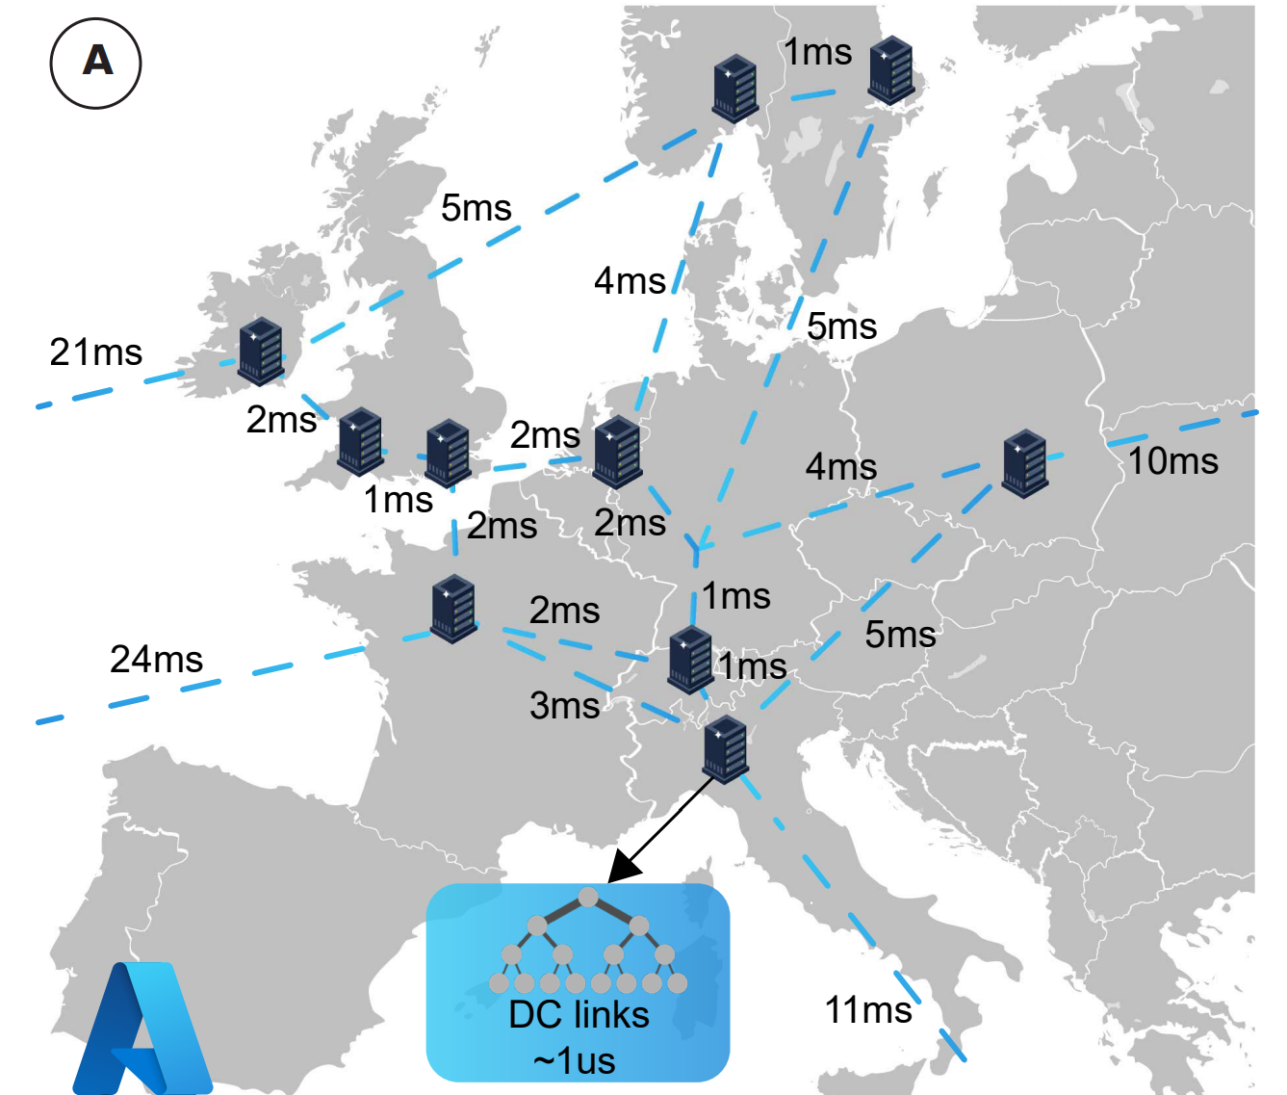
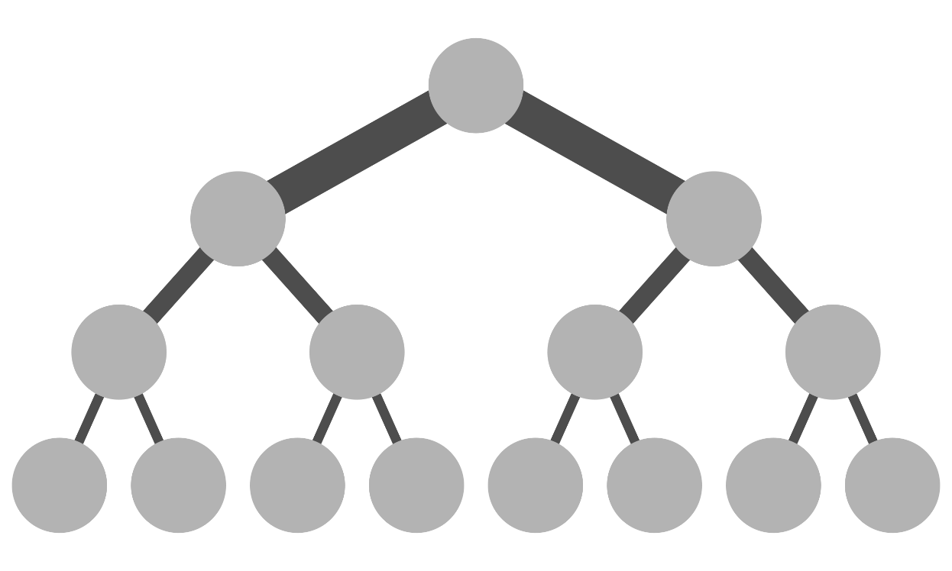
Motivation
Typical fat tree DC topology
Azure DCs in Europe
DC_{A}
A
B
DC_{B}
Short Cables (<100m) → ~1us latency
RTT from A to B → ~12us
Long cables (>100km) → >1ms latency
RTT from DC_{A} to DC_{B} → 10ms
1000x latency difference
RTT = Round-Trip Time

Slide 5
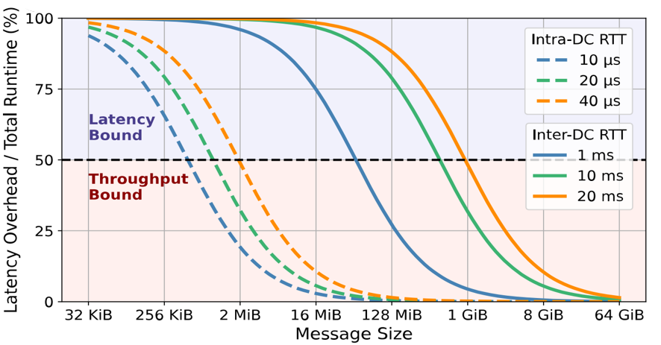
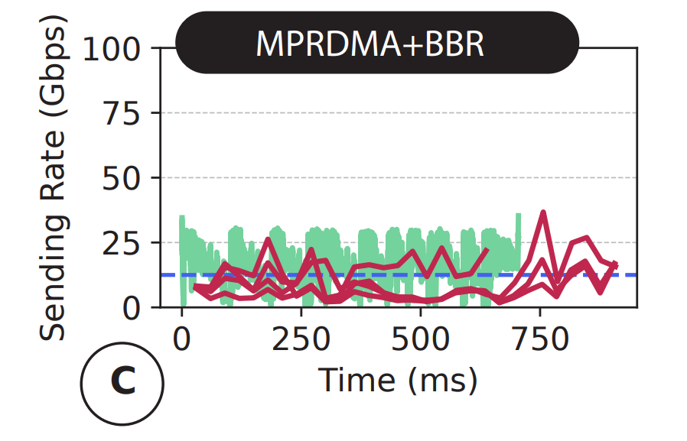
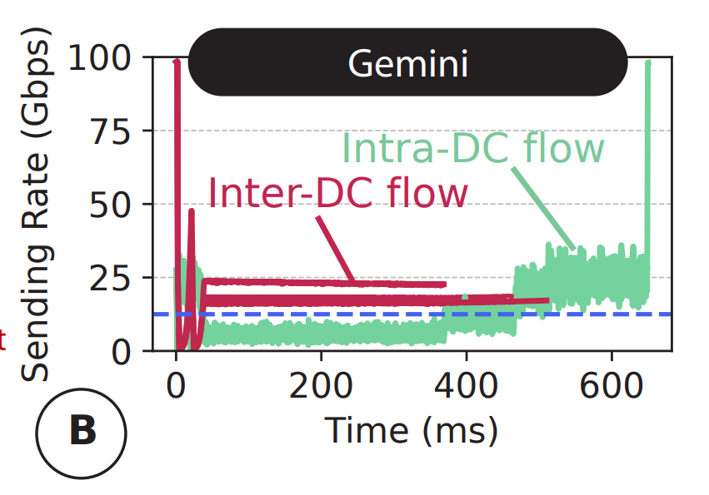
Inter- and intra-DC RTTs have huge gaps
Intra-DC
Slow loss detection and recovery
>1 ms RTT across datacenters
BDP <-> Buffer sizes mismatch
512x
~ 100 MB buffering per port with 10 ms inter-DC RTT
Unfairness / slow convergence to fairness
Inter-DC
Huge gap in congestion notification and reaction granularity
Existing solutions fall short in efficiently converging to fairness
Separate control loops
8:1 incast from senders both inside and across datacenters
Unified control loops
Reaching guaranteed fairness is challenging
Reaches fairness but convergences is very slow
Inter-DC flow
Intra-DC flow
[BBR: Congestion-based congestion control., Commun. ACM 2017]
[Congestion Control for Cross-Datacenter Networks, ToN 2022]
[Multi-Path transport for RDMA in datacenters, NSDI 2018]
Notes:
This huge gap between inter- and intra-DC RTTs directly affects traffic characteristics. Specifically, in this figure, we highlight the portion of the message transmission time that is dedicated to the propagation delay across different message sizes and intra- and inter-DC RTTs. Here we see that as we increase the message size, the intra-DC transmission quickly becomes bound by the transmission capacity (or throughput) rather than the propagation delay. Specifically, for messages larger than 2 MB, link propagation delay plays less than 50% role in the total message transmission latency. For messages larger than 128 MB, the contribution of propagation delay almost reaches 0.
Meanwhile, things are much different for inter-DC traffic. Unlike intra-datacenter traffic, inter-DC transmission are hugely bound by the link propagation delay due to millisecond-scale RTTs. Specifically, with 20ms inter-DC RTT, message transmission stays latency bound as long as messages are smaller than 1 GB which is 512x larger than the threshold where intra-DC messages become throughput bound.
This huge gap plus the fact that inter- and intra-DC traffic co-exist inside datacenters create challenges for efficiently handling both inter- and intra-DC traffic. Specifically, inter-DC flows are quite vulnerable to packet loss as the loss notification and recovery would take a long time. For instance, our measurements across two production datacenters show that packet losses create at least 65ms extra delay as the inter-DC RTT is 65ms.
Also, unlike intra-DC workloads, there exists a significant mismatch between typical DC switch buffer sizes and the BDP of inter-DC flows which hinders efficient congestion management. For instance, congestion control protocols such as DCTCP typically set the ECN marking threshold based on the typical flow BDP. Considering 10ms inter-DC RTT, we would need ~ 100 MB of buffer capacity per port in network switches for effective ECN marking which is unreasonably high.
Also the significant difference between intra- and inter-DC RTTs create a huge gap between the frequency at which intra- and inter-DC flows receive congestion notifications and react to it. This creates fairness issues. To show this, we simulate eight large 1 GB flows (four in a local DC and in a remote datacenter) all going to the same destination in the local datacenter under two common practices for congestion control. In one, we use separate control loops for inter- and intra-DC flows. We use MPRDMA for intra-DC flows and BBR for inter-DC traffic. We observe that with different control loops there is no way to guarantee fair transmission. We also simulate Gemini, a recently proposed transport protocol which provides a unified control loop for inter and intra- DC traffic with guaranteed fairness. While guaranteeing fairness, Gemini experiences very slow convergence time to fairness longer than the flow’s completion times. This is due to the huge gap in congestion reaction granularities.

Slide 6
Inter- and intra-DC RTTs have huge gaps
Intra-DC
Slow loss detection and recovery
>1 ms RTT across datacenters
Uno
BDP <-> Buffer sizes mismatch
~ 100 MB buffering per port with 10 ms inter-DC RTT
Unfairness / slow convergence to fairness
Inter-DC
Huge gap in congestion notification and reaction granularity
Existing solutions fall short in efficiently converging to fairness
Reliability is the most important aspect
Throughput Bound
Latency Bound
Congestion Control is crucial
Vastly diverse RTTs and delayed feedback
Most messages are latency bound.
Mismatch between BDP and buffer capacity.
Single loss can have a dramatic impact.
UnoCC
Fair between different RTTs. Uses phantom queues to mitigate BDP mismatch.
UnoRC
Incorporates erasure coding with load balancing (UnoLB) to limit drops.
Notes:
We design uno, a system with a unified logic for inter- and intra-DC traffic to address these challenges. To efficiently handle throughput bound traffic for which effective congestion control plays a key role, we design UnoCC, a congestion control module that provides fair data transmission and resolves BDP buffer size mismatch using virtual queues called phantom queues. To address the slow loss recovery challenge for latency bound traffic, we also propose UnoRC, a reliable connectivity module that uses erasure coding and load balancing to avoid the extra delay imposed by packet loss. Together these modules create Uno’s design. We will next discuss the details of each of these modules.

Slide 7
UnoCC: fast and fair congestion control for intra- and inter-DC traffic
Phantom Queues
Virtual queues implemented as a counter
Increase when a packet arrives
Decrease at a constant rate
BDP <-> buffer size mismatch
PQ
Phantom Queues (PQs)
Physical Queue
Input
Ports
PQ
Output
Ports
Physical Queue
Switch
Can grow potentially unbounded to better assess congestion levels
Leaving headroom to absorb bursts
Enabling early congestion detection
Notes:
The design of UnoCC addresses two problems: BDP and buffer size mismatch for inter-DC traffic which prevents effective ECN marking and also the fairness issue.
To address the first challenge, UnoCC uses the phantom queues to perform ECN marking. Phantom queues are virtual queues of arbitrary sizes and drain rates. Using phantom queues has the following benefits:
While physical queues are typically shallow with a fixed size, the arbitrary size of phantom queues helps us better assess the degree of congestion for large BDPs.
The drain rate of phantom queues is typically slightly lower than physical queues (for instance in our experiments the drain rate of phantom queues is set to 90% of physical queues). This provides early congestion detection. Also, using phantom queues with appropriate drain rates, we can ensure that the physical queues remain lightly occupied while network is fully utilized.
Lastly, phantom queues are easily implementable using counters. The counter increases upon enqueueing a packet and decreases at a constant rate.
Overall, using phantom queues, UnoCC resolves the BDP / buffer size mismatch

Slide 8
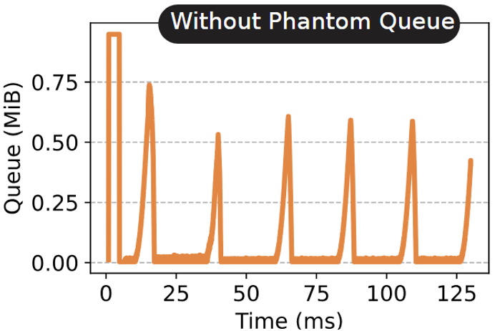
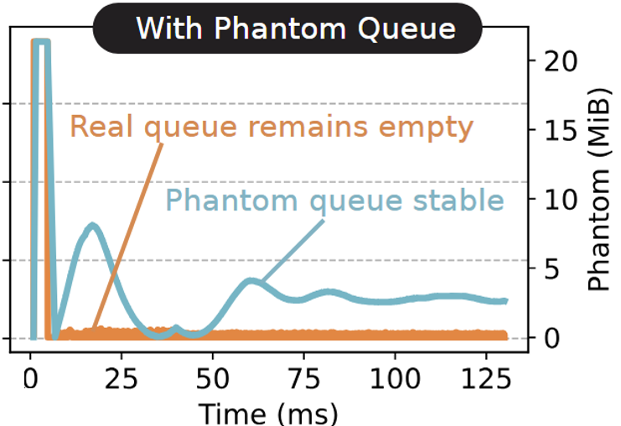
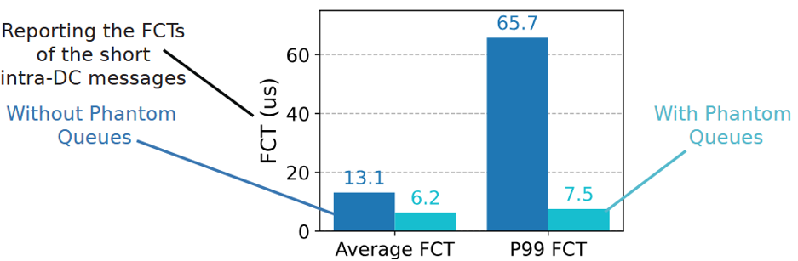
UnoCC: fast and fair congestion control for intra- and inter-DC traffic
Google RPCs beside eight long-lived cross-DC flows
BDP <-> buffer size mismatch
Phantom Queues (PQs)
8.7x
Notes:
To better highlight the impact of phantom queues, we generate periodic RPC messages alongside eight long-lived flows. This picture shows the queue occupancy of a port without phantom queues. We can clearly see the queue occupancy fluctuations. With phantom queues however, we see that the physical queue remains almost empty. Also, we observe that with appropriate drain rates (90% of link bandwidth in this example), phantom queues do not cause network underutilization as the FCTs improve with phantom queues. For instance, the 99’th percentile FCT improves by 8.8x with phantom queues.

Slide 9
UnoCC: fast and fair congestion control for intra- and inter-DC traffic
We can potentially achieve fairness using AIMD.
BDP <-> buffer size mismatch
ECN
marked
[Congestion Control for Cross-Datacenter Networks, ToN 2022]
But, convergence happens slowly.
Phantom Queues (PQs)
Inter-DC
flow
Unfairness/slow convergence
Intra-DC
flow
Notes:
Regarding the fairness issue, in the Gemini paper, it is shown proven that we can guarantee fairness using Additive Increase Multiplicative Decrease rate adjustment. However, as we have shown earlier, the convergence to fairness happens quite slowly due to the huge gap in the congestion detection and reaction granularity of intra- and inter-DC traffic. Specifically, consider one inter-DC flow and one intra-DC flow that compete over the same link and experience the same degree of congestion.

Slide 10
UnoCC: fast and fair congestion control for intra- and inter-DC traffic
We can potentially achieve fairness using AIMD.
BDP <-> buffer size mismatch
ECN
marked
[Congestion Control for Cross-Datacenter Networks, ToN 2022]
But, convergence happens slowly.
Phantom Queues (PQs)
Inter-DC
flow
Inter-DC RTT
Unfairness/slow convergence
Intra-DC
flow
Intra-DC
RTT
Rate reduced at different granularities, prolonging convergence to fairness
Same degree of congestion captured differently, causing configuration sensitivity
Notes:
While the marked packets cover almost two RTTs in the intra-DC flow, it is only a small portion of the inter-DC RTT. This creates two problems:
inter- and intra-DC traffic react to congestion at different frequencies, prolonging the convergence time.
and
2) Since same degree of congestion is captured differently across inter- and intra-DC flows, the fairness convergence time becomes very sensitive to the appropriate configuration of the rate reduction constant. In particular, these multiplicative decrease constants must be scaled so that the same number of ECN marked packets relatively result in the same degree of rate reduction across all flows.

Slide 11
UnoCC: fast and fair congestion control for intra- and inter-DC traffic
We can potentially achieve fairness using AIMD.
BDP <-> buffer size mismatch
[Congestion Control for Cross-Datacenter Networks, ToN 2022]
But, convergence happens slowly.
Phantom Queues (PQs)
Inter-DC
flow
Unfairness/slow convergence
Intra-DC
flow
Epoch
Unified reaction granularity to congestion
Rate reduced at different granularities, prolonging convergence to fairness
Same degree of congestion captured differently, causing configuration sensitivity
Notes:
We find out that these problems can be avoided by simply using a unified reaction granularity across all flows. Specifically, instead of applying rate reduction per RTT, unoCC applies rate reduction per epoch. Epochs are constant periods of time chosen based on the intra-DC RTT. This way, UnoCC reacts to congestion at the same granularity across both intra- and inter-DC traffic, lowering the convergence time. Also, as the congestion degree is captured similarly across intra- and inter-DC traffic, we only need to scale the multiplicative decrease constants based on intra- and inter-DC RTT to ensure appropriate rate adjustment, thus avoiding configuration sensitivity.
UnoCC also has other elements for which we refer you to the paper for more details. For example, UnoCC has a mechanism called QuickAdapt which drastically reduces rate during extreme congestion events to ensure fast reaction to congestion. Also, UnoCC differentiates phantom queue congestion from physical queue congestion and applies a smoother rate reduction mechanism upon phantom queue congestion.
Using these mechanisms, UnoCC ensures fast convergence to flow-level fairness.

Slide 12
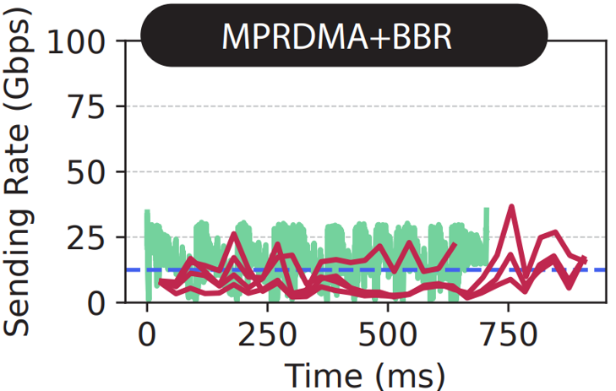
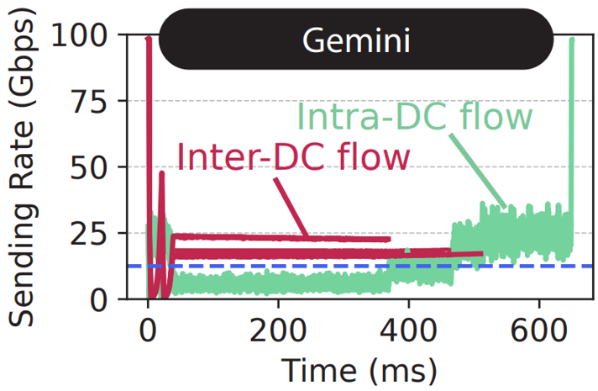
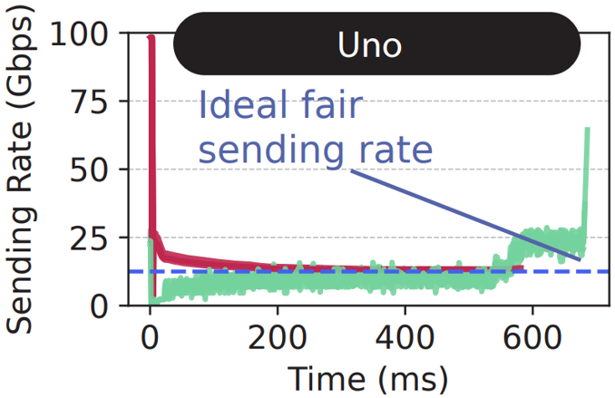
UnoCC: fast and fair congestion control for intra- and inter-DC traffic
8:1 incast from senders both inside and across datacenters
BDP <-> buffer size mismatch
Phantom Queues (PQs)
Unfairness/slow convergence
Unfairness
Slow convergence to fairness
Unified reaction granularity to congestion
Drastic rate reduction under extreme congestion
Smoother rate reduction upon phantom queue congestion
Fast convergence to fairness
Notes:
To show this, we simulate four 1 GB flows in a local datacenter and four in a remote datacenter all going toward the same destination in the local datacenter. As we have shown before, MPRDMA+BBR experiences unfairness and Gemini experiences long convergence time. UnoCC, on the other hand, ensures fast convergence to bandwidth fair share.

Slide 13
UnoRC: Reliable connectivity through load balancing and erasure coding
Packet losses are destructive when latency-bound
Path₁
Path₂
Losses are recovered through erasure coding
DC_{A}
Corruption
Failure
DC_{B}
Path₃
Source
Destination
Path₄
Data
Packets
Block
Block
Parity
Packet
3,1 EC Configuration
Data Packet is lost but receiver can still reconstruct the block
However, a link failure would still prevent the block from being delivered
Notes:
In addition to UnoCC, Uno’s design comes with a reliable connectivity module for inter-DC traffic name UnoRC. UnoRC targets two challenges:
When messages are bound by propagation delay (which is common in inter-DC traffic), even a single packet loss can be destructive and create millisecond-level extra delay.
While techniques such as erasure coding help with single packet drops, they fail to efficiently address drops imposed by failures.
To address these, UnoRC combines load balancing and erasure coding. Specifically, when transmitting data, it is broken into blocks and a specific number of parity packets are associated to every block. In this example every block has three packets and one parity packet is created for each block. As long as at least 3 out of for packets per block is received by the receiver, the data block and be reconstructed.
UnoRC then distributes the packets across different paths. This way, even if a packet gets dropped for every reason, UnoRC can still reconstruct the data at the receiver using erasure coding, relieving it from the need for packet re-transmission and its consequent delays.

Slide 14
UnoRC: Reliable connectivity through load balancing and erasure coding
Packet losses are destructive when latency-bound
Path₁
Path₂
Losses are recovered through erasure coding
DC_{A}
DC_{B}
Path₃
Link
Failure
Erasure coding helps recovery from drops but not from failures
Destination
Source
Path₄
Data
Packets
Adaptive load balancing to utilize multipathing
Block
Block
Parity
Packet
Tightly integrate LB with EC to ensure resiliency even with failures
3,1 EC Configuration
The block is reconstructed even with a link failure thanks to multipathing
UnoRC quickly learn to avoid the failing path by looking at when it last was active
Notes:
Tommaso add text

Slide 15
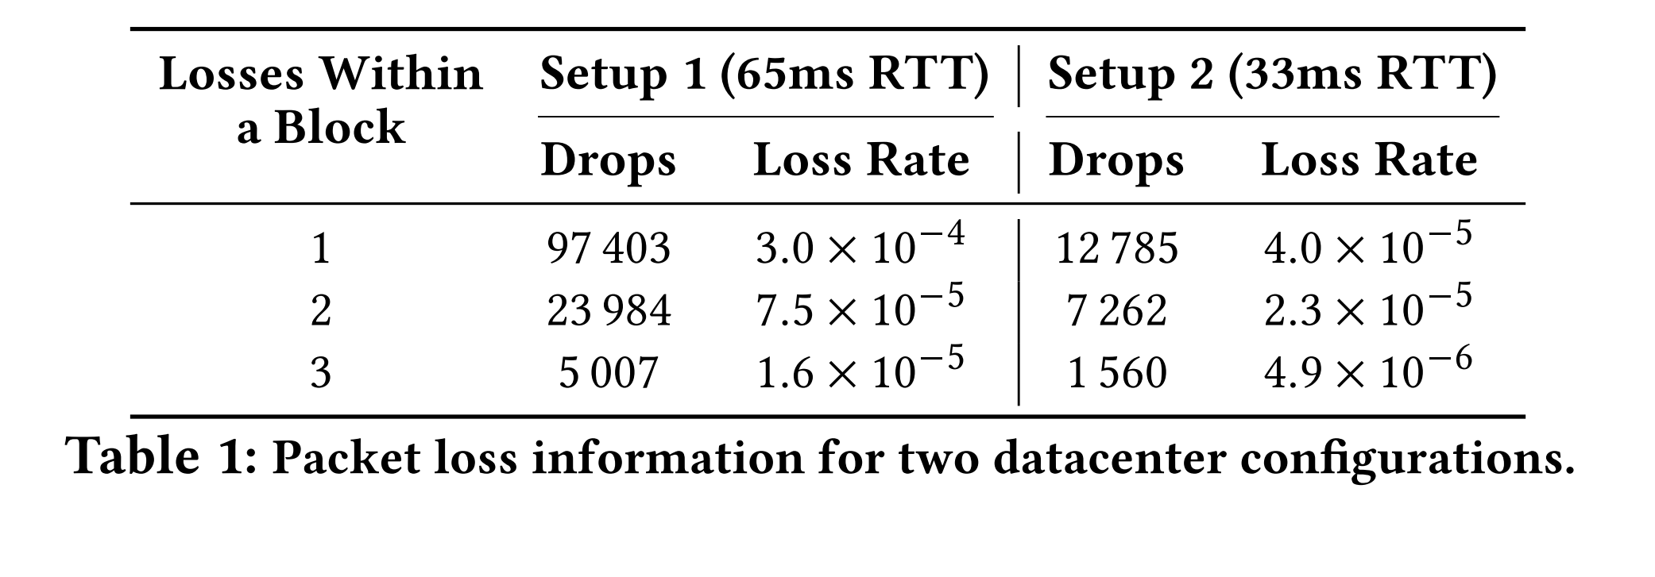
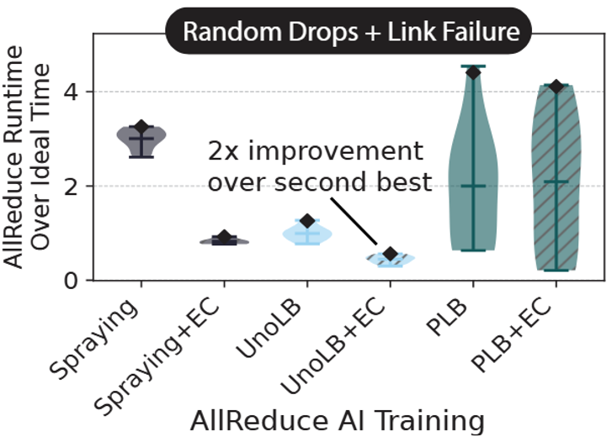
UnoRC: Reliable connectivity through load balancing and erasure coding
Measured Drop Rates
Packet losses are destructive when latency-bound
Losses are recovered through erasure coding
Erasure coding helps recovery from drops but not from failures
CrossPipe Schedule
Adaptive load balancing to utilize multipathing
Tightly integrate LB with EC to ensure resiliency even with failures
[CrossPipe: Towards Optimal Pipeline Schedules for Cross-Datacenter Training, ATC 2025]
Notes:
Tommaso add text

Slide 16
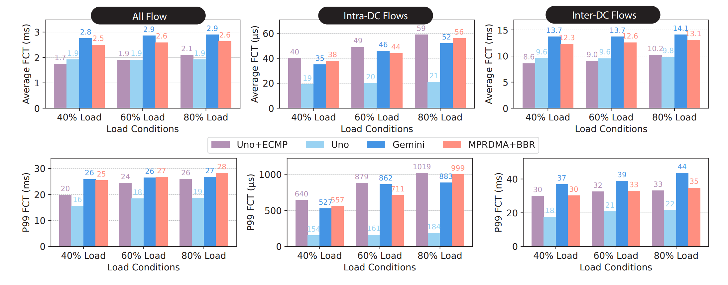
Uno is performant under realistic workload
Large-scale simulations with 100 Gbps links and an RTT difference of 128x between intra-DC and inter-DC
Running Datacenter Traces
Google web search + Alibaba WAN
4.8x and 5.4x lower p99 FCT than Gemini and MPRDMA+BBR
2x and 1.6x lower p99 FCT than Gemini and MPRDMA+BBR
Notes:
At last, we evaluate Uno as a complete system under realistic workloads. We use Htsim to simulate two 8-ary fattree datacenters connected through border switches with 8 links between them. We set the inter-DC propagation delay so that the inter-DC RTT is 128x larger than intra-DC RTT. We evaluate Uno under various degrees of load while having a 1-to-4 ratio between inter- and intra-DC flows. We use google websearch for intra-DC traffic and Alibaba WAN traces for generating inter-DC workload. These figures, compare Uno’s average and 99’th percentile latency for both inter- and intra-DC flows against Gemini and MPRDMA+BBR. We observe that Uno improves the latency of both inter- and intra-DC traffic across different degrees of load. For instance, under 80% load, Uno improves the 99’th percentile latency of intra- and inter-DC flows by up to 5 and 2x.

Slide 17



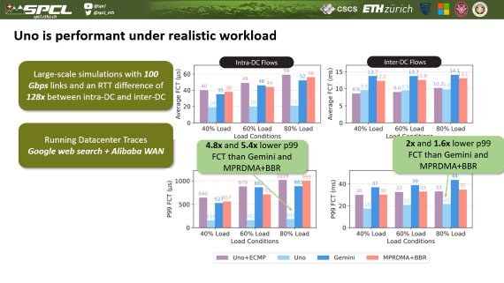
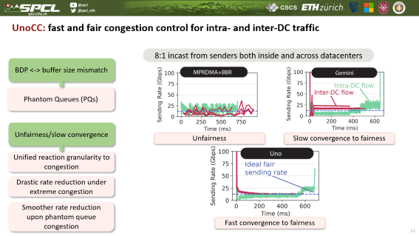
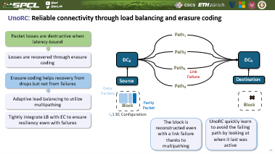
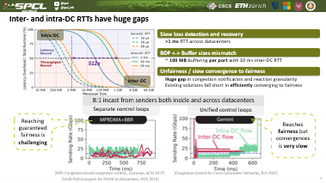

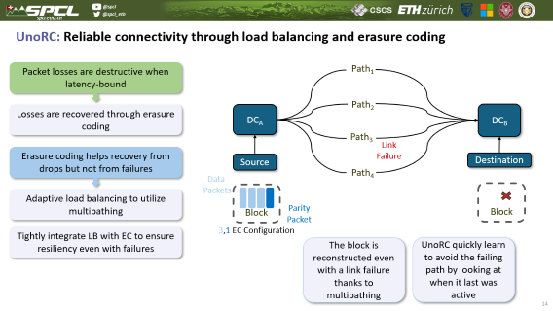
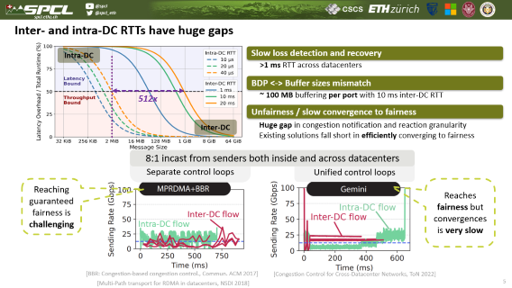
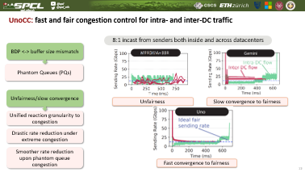
Conclusions
Paper:
Open-source code and artifact:
Notes:
Through Uno’s design, we presented a unified system for efficiently handling intra- and inter-DC traffic. Uno’s elements (UnoCC and UnoRC) facilitate fast convergence to fairness and reliable connectivity. We also showed that Uno outperforms existing paradigms and improves the tail latency by up to 5x. Uno’s codebase is publicly available in our github repository.

Slide 18
BackUp Slides

Slide 19
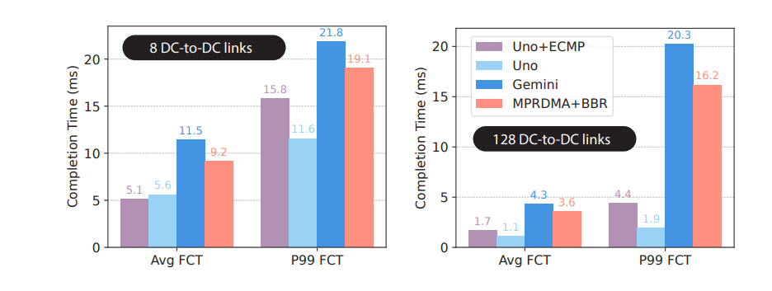
Uno Benchmarks
Permutation Workload

Slide 20
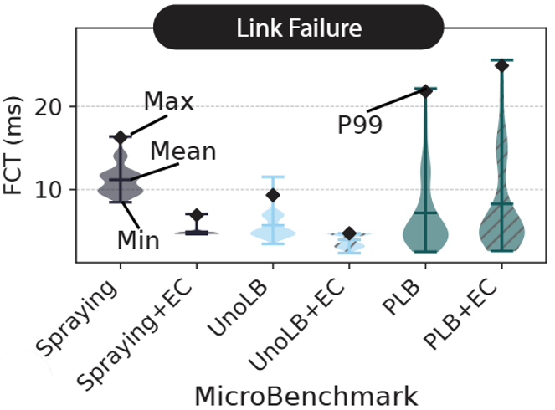
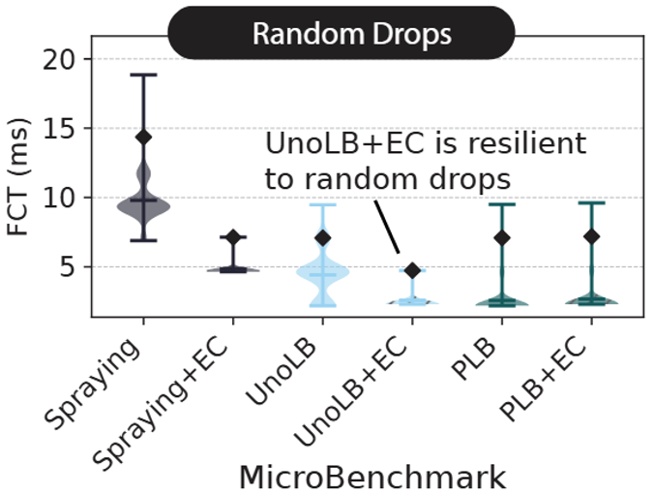
UnoRC: Reliable connectivity through load balancing and erasure coding
Measured Drop Rates
Packet losses are destructive when latency-bound
Losses are recovered through erasure coding
Erasure coding helps recovery from drops but not from failures
Permutation workload
CrossPipe Schedule
Adaptive load balancing to utilize multipathing
Tightly integrate LB with EC to ensure resiliency even with failures
[CrossPipe: Towards Optimal Pipeline Schedules for Cross-Datacenter Training, ATC 2025]
Notes:
To highlight UnoRC’s potential, we …
TOMMASO: add the text here

