Slide 1

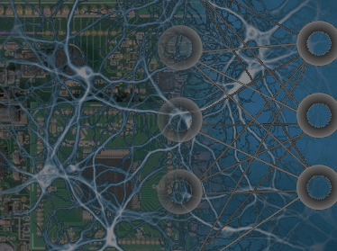

Minsky Lab
Digital-Twin Junior
TOGA NETWORKS LTD., A HUAWEI COMPANY

Slide 2



a Comprehensive Portfolio of AI-driven Network Intelligence Tools
Digital Twin Junior:
A rich ecosystem of features
Traffic Modeling
Troubleshooting guide
Network Topology
AI-Powered Engine
Log Analysis
Simulations & Scenarios
Network
Visualization
Included capabilities:
Network simulation and scenario modeling
Traffic Modeling: analysis and forecasting
Network Topology mapping and diagnostics
Automated log interpretation
Interactive tools: Network visualization, Troubleshooting guide

Slide 3
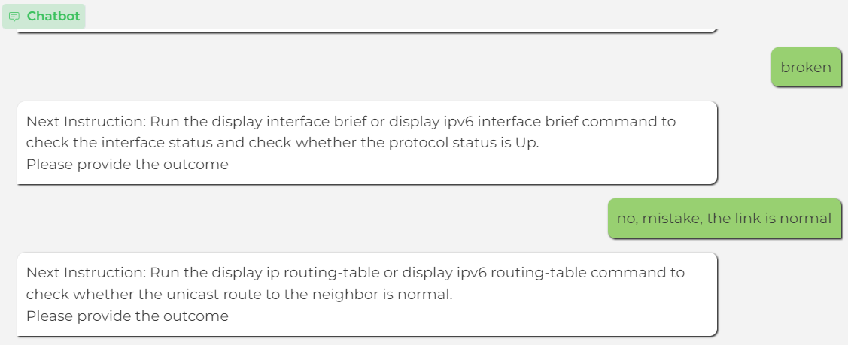
Digital Twin Junior: Log Analysis and Interactive Troubleshooting
Traffic Modeling
Troubleshooting guide
Network Topology
AI-Powered Engine
Log Analysis
Log entry explanation
Network status extraction: logs, alarms
Alarm Description:
After receiving a Hello packet from a neighbor, the device records information about the neighbor and starts a timer for the neighbor. If the device does not receive any Hello packet from the PIM neighbor before the timer expires, the device reports a trap.
Simulations & Scenarios
Network
Visualization
2019-06-12T10:20:30.000Z WARNING PKI/4/HTTP_GET_CRL_ERR: file_name:[test.crl] Manually obtaining CRL [test.crl] through HTTP failed (Reason=[URL resolution failed]). category=PKI subCategory=CRL component=HTTP, eventID=HTTP_GET_CRL_ERR,vendor=Huawei,product=Fat AP,version=V200R022C00, timestamp: [2019-06-12 10:20:30] [ rid:T6zHJ38AAAEAAAo2BCwAAAMk ip:[192.158.1.38]:1813/UDP
Log Name | Describes the log name) | hwPimNeighborLos
NbrIntIndex | Index of the interface where the neighbor resides | 2
NbrUpTime | Time when a neighbor relationship is established | 2020-12-12 10:20:30
Recommendation for a solution
1. Check whether the reset msdp peer command is run in the user view on the peer device.
• If is performed, wait until the peer is re-established.
• If not, go to Step 2.
2. Run the display this command in the MSDP view of the peer device to check whether an MSDP peer is configured.
• If yes, go to step 3.
• If no, run the peer connect-interface <interface-type> <interface-number> command in the MSDP view to configure an MSDP peer.
3. Run the display interface brief command to check whether the shutdown command is configured on the peer interface.
• If so, run the undo shutdown command in the interface view to clear the alarm.
• If no, go to step 4.
4. Collect alarm and configuration information, and contact technical support personnel.
2019-06-13T11:21:31.000Z WARNING PKI/4/HTTP_GET_CRL_ERR: file_name:[test1.crl] Manually obtaining CRL [test1.crl] through HTTP failed (Reason: Failed to save the response message). category=PKI subCategory=CRL eventID=HTTP_GET_CRL_ERR,vendor=Huawei,product=Fat AP,version=V200R022C00, timestamp: [2019-06-13 11:21:31] [ rid:T6zHJ38AAAEAAAo2BCwAAAMk ip:[192.158.1.39]:1813/UDP
Key abilities of the network assistant
Summary of the incident
Analyze and explain network events
Identify causes
Suggest solutions
Resolve alarms
Summarize incidents
Interactive step-by-step procedure following
The root cause of hwPimNeighborLoss was investigated. Here are the main findings:
Step 1: Ping/Ping IPv6 command outcome: broken (link between neighbors is not normal) Step 2: Display interface brief/Display IPv6 interface brief command outcome: no, mistake (link is normal) Step 3: Display IP routing-table/Display IPv6 routing-table command outcome: seems ok
Conclusion: The problem was not solved.
Identify API call
Extract arguments
Execute
Get output

Slide 4
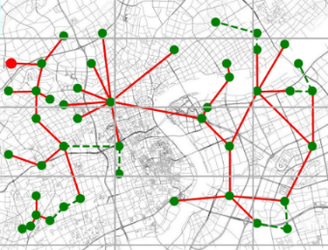
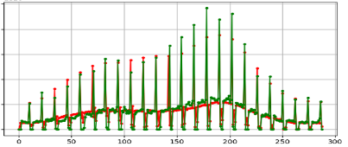
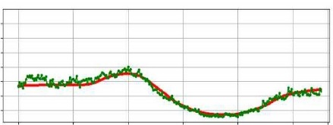
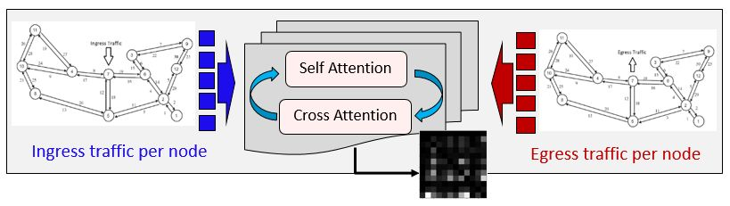
Digital Twin Junior: Traffic Modeling
Forecasting
Completion
Traffic Modeling
Troubleshooting guide
Completion in Time
Horizon – from very short
(1 min) to very long (1 day)
Predict peaks & ‘quite periods’ –
be prepared for overloading and energy saving time
Unstable signal (e.g. hardly responding cell towers) –
no problem, prediction is based on neighborhood data
Holidays and other key events – we learn and predict even unusual traffic patterns
Different topologies – known or unknown
Network Topology
Log Analysis
‘Estimate the present’ – fill in the missing values (traffic imputation)
‘Predict the future’ almost without knowing the past (with up to 80% of the historical data missing)
AI-Powered Engine
Simulations & Scenarios
Network
Visualization
Completion in Space
Estimation
Traffic Inversion for sampled traffic in network monitoring tools
Traffic Matrix from link loads: Route-Aware GNN
Traffic Matrix from Ingress/Egress Traffic: Attention-based GNN (Deep Gravity)
Key techniques: Attention-based Graph Convolutional Neural Networks
prediction restores peaks when they are signal
Can be applied to: Backbone networks, Campus network, Datacenter networks
prediction ignores peaks when they are noise
ground truth
prediction

Slide 5

Digital Twin Junior: Traffic Inversion
Traffic Modeling
Troubleshooting guide
Network Topology
AI-Powered Engine
Log Analysis
Network monitoring
As networks evolve and become more complex, the need for network monitoring tools has remained constant.
It is highly important to ensure the network sustainability and guarantee all the processes to run smoothly and error-free for users.
Network traffic monitoring contains tools for data collection, analysis, diagnosis and solutions to resolve problematic issues.
Simulations & Scenarios
Network
Visualization
Network Traffic Collection
The collection of full detailed traffic data does not scale well with increasing network attributes, like size, link bandwidth, speed etc.
Network Monitoring
Analysis
Network Traffic Collection
OD flow traffic
Class of service,
Problem localization,
Cause of congestion,...
Network Recommendations
Network Traffic Sampling
The load on the measurement infrastructure is reduced.
Problems: Only a portion of the traffic is exported. Some flows can be missed or represented by a very small portion. Sampled flows may not provide a sufficient amount of information about full network traffic
Some standards:
Network Traffic Inversion
External products:
NetFlow
sFlow
IPFIX
Huawei product:
NetStream
(our main use case):
Flow inversion is a restoration of the full traffic data or its statistics.
Existing approaches cannot restore the actual fine-grained traffic with good accuracy.

Slide 6
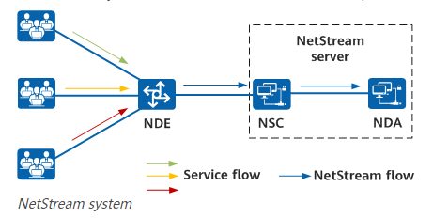



Full fine-grained traffic inversion
NetStream
An internal Huawei network monitoring tool that collects and analyzes a network traffic per flow.
In most cases sampling is inevitable…
How to obtain a full information from sampled data?
Let’s consider 2 possibilities:
Full flows are not directly available from NetStream sampled data.
Statistics: Easy to calculate
Loose a temporal structure of the flow data
Cheap
& Accurate
DNN/AI tools: May be very accurate
Require a lot of labeled data for the training
COMBINE

Slide 7




Input data
Device (router)
Standard sampled data tuple:
timestamp, {source IP, destination IP, input port, output port, PPS, BPS}
Network Monitoring Functionality
NetStream data example
equipped with a network monitoring tool
Timestamp
Source IP
Destination IP
Input port
Output port
Subnet
Information for traffic data pre-processing
Application
Group of servers
Traffic clustering/detection per user
For specific end-user, subnet
PPS
BPS
Sampled traffic
restore
Full traffic
Total Ingress/Egress traffic inversion
For application/group of applications

Slide 8

Full fine-grained traffic inversion
Data discussion:
Lots of observations are available from monitoring devices train DNN
Big problem: our sampled data is not labeled (corresponding full traffic is not usually available)
Literature suggests: incorporating knowledge of different noise and sampling patterns can significantly improve signal reconstruction
So, to achieve accurate recovery, it is crucial to replicate the sampling procedure used by the monitoring device
Why not to just multiply by sampling ratio? Even if total traffic is sampled deterministically (our use case) by inspecting every 𝑅𝑡ℎ packet, it would be generally inaccurate to assume that also every 𝑅𝑡ℎ application packet is considered
natural solution
Our algorithm highlights
Estimates an actual time-dependent fine-grained traffic with low error
Combines statistical approach with recent AI techniques:
Is data-driven and AI-based: it reflects the actual data features
Doesn’t require labeled data
Can be automatically adapted to a new data
Is implemented as a lightweight and efficient deep neural network

Slide 9
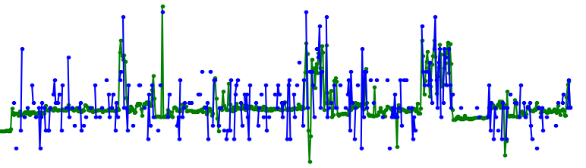
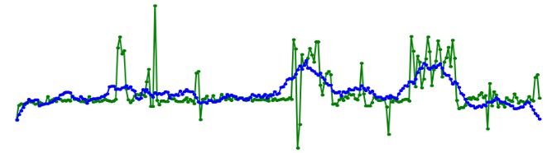
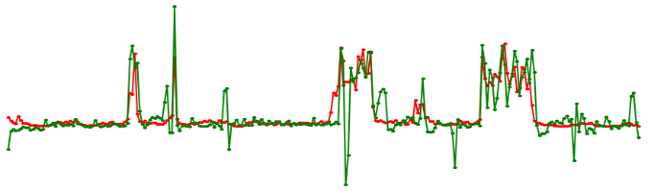
Simple statistical manipulations
Assumption:
if sampling ratio is know, we can scale back the sampled signal and obtain a good solution
Compare true signal to scaled sampled signal
Compare true signal to smoothed scaled sampled signal
MAPE = 31%
MAPE = 18%
Sampling Ratio * sampled application traffic
Sampling Ratio * smoothed sampled application traffic
full application traffic
full application traffic
Our model: Statistics + Attention-based DNN
Simple statistics are not enough:
Good average fit for a large time period
Poor local fit per timestamp (either too noisy or oversmoothed)
MAPE = 12%
Our result
full application traffic

Slide 10
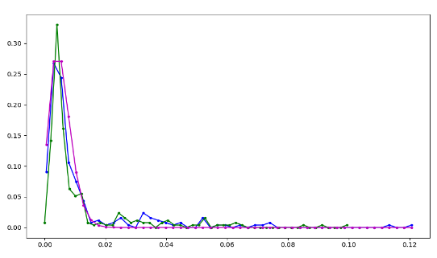
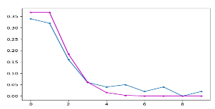
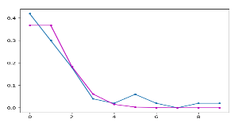
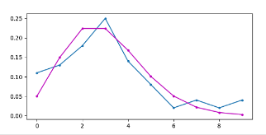
Train data modeling
as a base for the sampling principle: pdf (n_{f} / n) = pdf (N_{f} / N)
N_{f} << N , hence the ‘the law of small numbers’ (Poisson) is straightforward to apply
Empirical result
Definitions:
R - sampling ratio
n - sampled number of packets
pdf (N_{f} / N)
N - total number of packets
n_{f} - sampled number of flow packets (per application per user)
pdf (n_{f} / n)
N_{f} - total number of flow packets
Poisson
(traffic is aggregated)
pdf (n_{f} / n) ~ pdf (N_{f} / N) ~ Poisson distribution
Approach:
Extract and apply a noise scheme/sampling to NetStream data to create a ‘noisier’ signal.
Train a network to restore a noise signal from ‘noisier’ signal
Generated train data: inputs = n_{f} ^{sampled} , labels = n_{f}^{original}
pdf (n_{f} / n)
Poisson

Slide 11
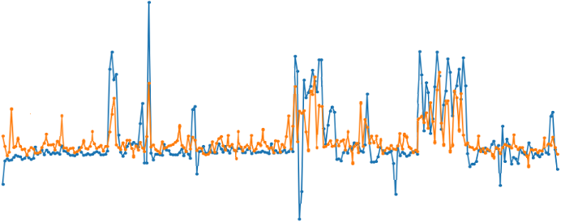
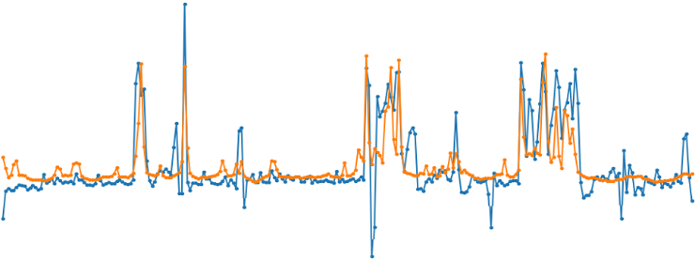
Spoiler: Why Poisson data modeling is better
Restored traffic (orange) vs ground truth traffic (blue)
(a) with random sampling
(b) with Poisson sampling
Although the network trained on double-sampled data, that underwent random sampling (instead of Poisson one) succeeded to restore the overall pattern, its result is much noisier and some important peaks are missed or underestimated
Conclusion:

Slide 12




Model structure
Network MONITORING TOOL (e.g. NETSTREAM)
Training phase
Original monitored traffic
Modified monitored traffic
Attention based DNN
- Training mode -
Restored monitored traffic
Train data modeling
Statistics based module
DNN based module
Functionality: Apply sampling principle to create double-sampled data
Functionality: Train a NN to restore full data from sampled data
Details: Extract traffic segments (pps, bps) and apply sampling principle
Details:
Sequence-to-sequence Encoder-Decoder scheme
Convolution + Attention mechanism
Double-loss scheme:
- estimation loss makes the output close to the provided label
- self-loss with high drop out serves as a regularization term
If sampling principle is known
If sampling principle is unknown:
Calculate statistics of the extracted application traffic
Generate train data based on calculated statistics
Apply general sampling procedure (based on random noise) to generate train data
Lightweight: small number of parameters, can be trained on CPU
Inference phase
Original monitored traffic
Restored full traffic
Attention based DNN
- Inference mode -

Slide 13

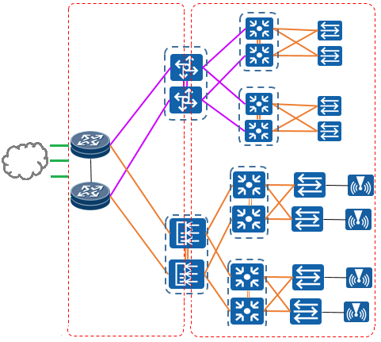

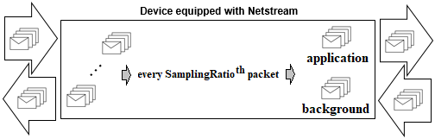

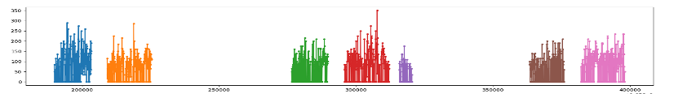
Use case: Campus Network
Real campus network with 2 routers equipped with NetStream feature are mounted on top of the campus network
Zoom In
General view
NetStream feature allows to collect sampled traffic that enters and exits the campus
Servers of the application of interest
Other applications servers
output port
input port
Router with NETSTREAM functionality
subnet
end user
Aggregation time: 1 min
end user
end user
Requirement:
A few examples of the CC traffic.
To reconstruct the complete traffic generated by a Conference Call (CC) application on a per-user basis
Each color denotes a separate conference call PPS along the time axis

Slide 14
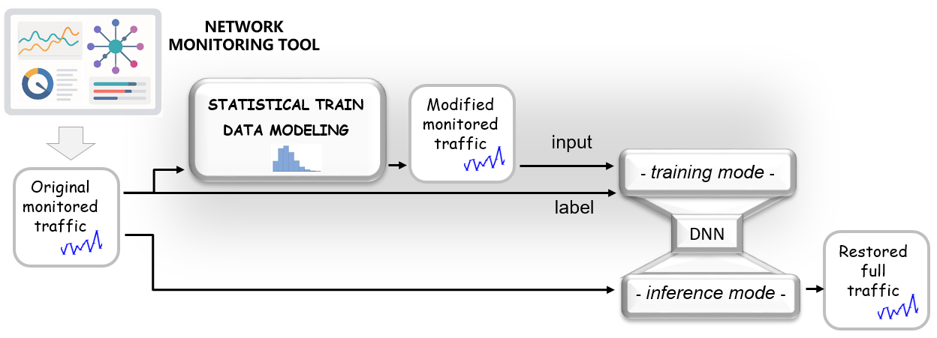


Conference Call traffic inversion
Training
Sampled data: NetStream measurements contained 19 large batches, each batch including both CC and background traffic samples from about 5-7 days of records
Data preparation
Define input CC traffic by identifying CC server IP (‘source IP’ from data tuple)
Extract CC PPS and BPS segments corresponding to various users (users = different 'destination IP’ from data tuple)
Model training
Use extracted CC segments as inputs to the model
2) Train model
Verification
Sampled data: NetStream measurements.
Ground truth: a few samples with total duration of 1,584 min of full fine grained CC traffic records
(obtained with Wireshark).
Mean Absolute Percentage Error
Symmetric Mean Absolute Percentage Error
Average inference time for 50 timestamp-long chunk: 17 ms for max number of parameters required. Can be further finetuned

Slide 15
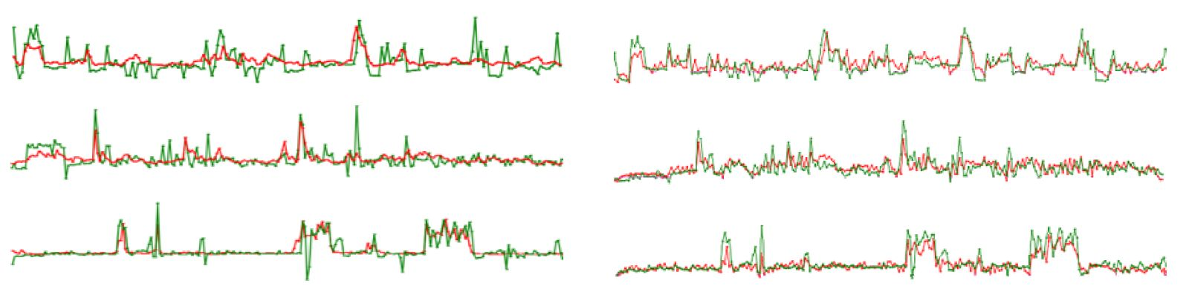
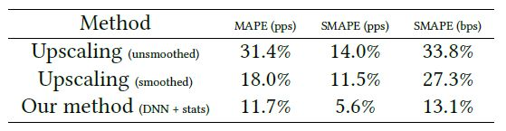


Evaluation and results
3 conference call samples pps
3 conference call samples bps
Restored signal is shown in red, true signal is shown in green
Visual comparison of the statistics-based method (blue) and our method (red) to the ground truth (green).
Statistical results hardly restore peaks (cyan circles) and over smooth the data (magenta circles)
SMAPE = 13%
SMAPE = 5.1%

Slide 16
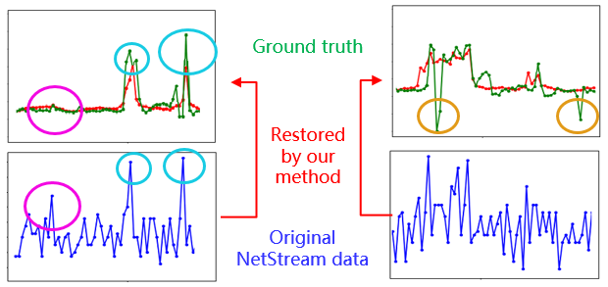
Summary and Discussion
a self-supervised algorithm to restore full traffic data from highly sampled traffic measurements
No labeled training data required
Low cost (adjustable number of parameters, can be trained on CPU, short inference time
Efficient & Accurate
Developed
(a) Method restores true peaks (cyan circles) and ignores irrelevant sampled peaks (magenta circle)
(b) Limitations: Low values are not presented in NetStream data and cannot be restored (yellow circles)
(a)
(b)
General applicability: Due to the standard input the product can be applied to the data collected by other vendors tools (like NetFlow)
Additional benefits and suggestions
Cost reduction: A trade-off between sampling ratio and inversion accuracy can be found.
Optimization: Internal parameters (aging cache etc.) can be fine-tuned with respect to the desired accuracy.

Slide 17
Thank you

