Slide 1
Debriefing the Open Innovation Platform for UnifiedBus
Wenjia Wei
Huawei, Network Technology Laboratory
Notes:
Good afternoon, everyone.
I am Wei Wenjia from the Huawei Network Technology Laboratory.
It is my great honor to be here today. The topic of my presentation is 'Debriefing the Open Innovation Platform for UnifiedBus.'
Over the next few minutes, I will walk you through our latest developments, the architecture of our platform, and how we are driving innovation in this field. Let’s get started.

Slide 2



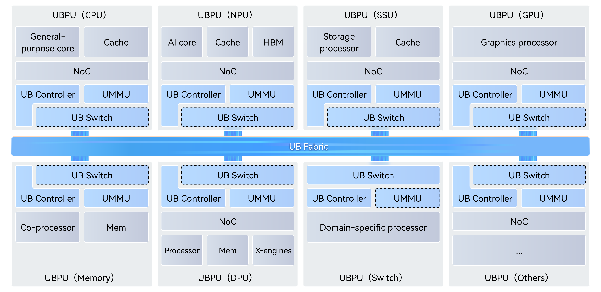
UnifiedBus: An Interconnect Protocol for SuperPoD
A unified interconnect to cover common bus & network scenarios.
UnifiedBus (UB) is a SuperPod-oriented interconnection protocol that unifies IO, memory access, and inter-process-unit communication.
Key Capabilities:
Low Latency: any port can connect and forward to any type of devices without protocol conversion overhead.
Higher bandwidth: all high speed SERDES can be utilized for any purpose, maximizes resource efficiency
Simplified Schema: Load/Store + RDMA + uRPC.
Compatibility: UBoE can run natively over Ethernet Network
N
G
CPU
NPU
GPU
MEM
SSU
DPU
Switch
UnifiedBus
UPI + PCIe + CXL + InfiniBand/RoCE + NVLink + NoF + FCoE + gRPC …
UB Domain Diagram
Notes:
First, let's look at UnifiedBus, or UB, which was proposed by Huawei. It serves as the core technology for SuperPod products, such as the CloudMatrix 384.
UB is an interconnect protocol designed specifically for these systems. It unifies IO, memory access, and communication into a single architecture, offering four key technical advantages:
First is Low Latency. The protocol allows any port to connect to any device type directly. This enables data forwarding without the overhead of protocol conversion.
Second is High Bandwidth. In any SoC, IO channels are critical resources. UB removes protocol-specific controllers, meaning any high-speed channel can be used for multiple purposes. This maximizes resource efficiency.
Third is a Simplified Schema. It supports Processor Direct Load/Store, alongside RDMA and uRPC. This efficiently handles both global shared memory and remote memory access.
Finally, Compatibility. UB runs natively over Ethernet. It works with mainstream protocols without the need for further translation.
These features make UB a powerful architecture. Our platform is designed to enable the academic community to research and innovate on top of it.

Slide 3





We Build Innovation Platforms Together with the Academic Community
The First Systematic Open Innovation Platform Designed for SuperPod Networks
Driving innovation in architectures, protocols, algorithms, memory semantics, and programmable hardware.
UB Simulation Platform
UB Protocol
Verification Platform
Scale-Up
Prototype Platform
SuperPod Networking
Innovation Platform
Scale-Out
Prototype Platform
Jointly released with academic partners
Openness · Innovation · Collaboration · Success
Notes:
From traditional DCNs to SuperPods—network technology is facing new challenges. Specifically for SuperPods, there is a massive new space for research in protocols, architectures, algorithms, hardware, and communication semantics.
To better support the academic community in exploring these areas, and to enable research into UnifiedBus networks within the SuperPod context, Huawei and Academic Partners have Jointly released five open innovation platforms.
These platforms are:
The UB Simulation Platform,
The UB Protocol Verification Platform,
The Scale-Up Prototype Platform,
The SuperPod Networking Innovation Platform,
And the Scale-Out Prototype Platform.
By opening up these tools, we hope to spark innovation through collaboration, and ultimately achieve success together with the academic community.

Slide 4

UB Simulation Platform: A UnifiedBus Specification Compliant Network Simulator
Supporting research into the following areas:
High-reliability, low-cost, traffic-affinity topologies.
Optimization for collective communication ops.
Novel transaction ordering and reliability mechanisms.
Transmission control mechanisms for Ld/St semantics in SuperPod.
New adaptive routing, LB, CC, and QoS algorithms.
Integrated Tools:
Flexible topology generation (e.g., CLOS, UB Mesh).
Custom traffic injection (supports collective ops).
Node/link fault injection.
Simulation log analysis and data visualization..
Access:
Base on ns-3.44. Repo: https://gitcode.com/open-usim/ns-3-ub
ns-3-ub Tools
UnifiedBus Protocol Stack
Topo
Routing
Coll Ops
DAG
Fault
Inj.
Function Layer
Topo Scripts
Traffic Scripts
URMA
Load/Store
ns-3-ub model
Transaction Layer
Mode
Ordering
W/R
UBPU
(Switch)
UBPU
(Switch)
Transport Layer
Multipath
CC
QoS
UBPU
UBPU
UBPU
UBPU
UBPU
UBPU
UBPU
UBPU
UBPU
UBPU
UBPU
UBPU
Network Layer
Addr
Routing
PS
UBPU
UBPU
UBPU
UBPU
UBPU
UBPU
UBPU
UBPU
UBPU
UBPU
UBPU
UBPU
Datalink Layer
PFC
CBFC
VL
ns-3
ns-3-ub Architecture Diagram
This project provides reference implementations for algorithms not defined in the specification (e.g., switch modeling, congestion marking, buffering, and arbitration).
Features out of scope: hardware modeling, physical layer, control plane behaviors (e.g., initialization, exception handling), memory management, and security policies.
Notes:
First is the UB Simulation Platform. This is a network simulator compliant with the UnifiedBus specification.
It supports research into a wide range of areas. For example, you can explore:
High-reliability, low-cost, and traffic-affinity topologies.
Optimization for collective communication operations.
Novel transaction ordering and reliability mechanisms.
Transmission control mechanisms, specifically for Load/Store semantics in a SuperPod.
And new algorithms, such as adaptive routing, load balancing, congestion control, and QoS.
To assist with this, we provide several integrated tools:
Flexible topology generation, for example, CLOS and UB Mesh.
Custom traffic injection, which supports collective operations.
Node and link fault injection.
And tools for simulation log analysis and data visualization.
The platform is based on ns-3, and the repository is available on GitCode.

Slide 5
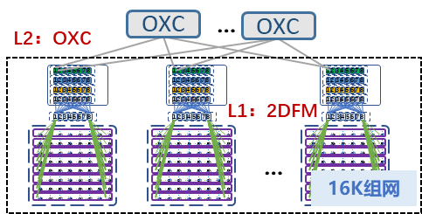
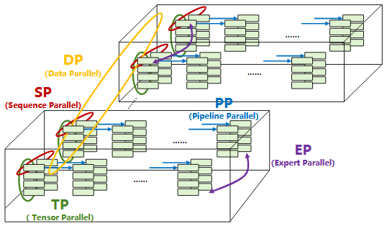
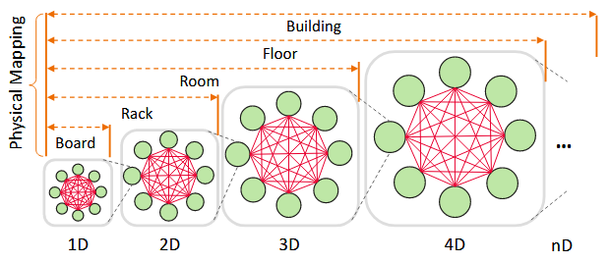
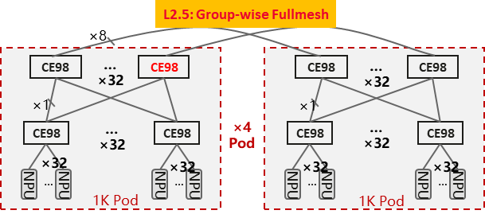
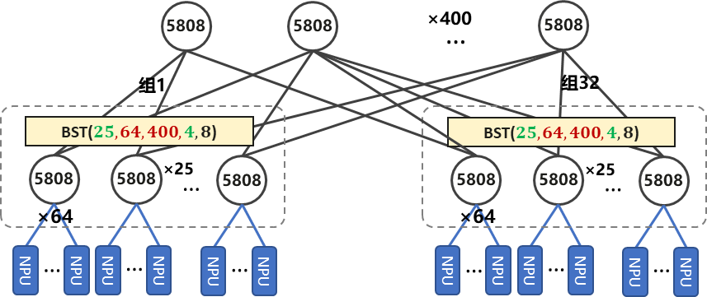
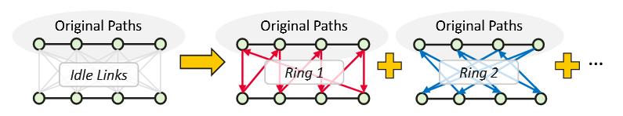
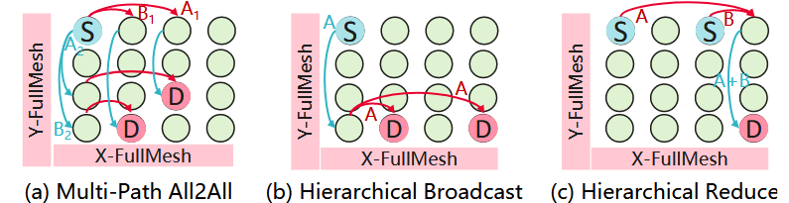
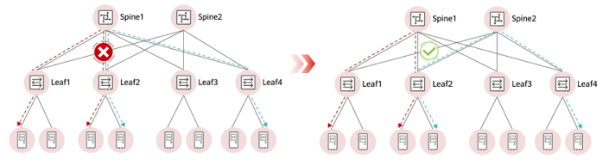
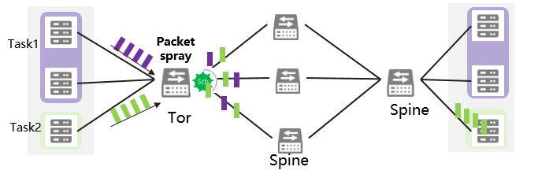
Supporting Research Areas: Architecture Exploration, Protocol Innovation, and Algorithm Design
Innovative Topology Architectures
UB Mesh Performance Evaluation
Sparsely Connected Topologies
Electrical + Optical Topology
Innovations in Protocol Stacks and Algorithms
Memory-Semantic Innovation
Innovative Collective Algorithms
Traffic Control Innovation
Transport Layer
New TA Layer
Multi-Ring
AllReduce
In-Order Delivery of Pkt.
Reliable Trans.
Load Balance
Congestion Control
In-Order Exec. of Inst.
Transaction Reliability
Credit
SW
Packet
SW
Compact TP Layer
Multi-Path and Hierarchical All-to-All
CBFC
Load Balance
Latency & Sending Rate Ctrl.
PFC
Network-Level Load Balancing
Congestion Control Algorithms
Packet Spraying & Adaptive Routing
Sending
Congestion
Mark
ACK
Ctrl
CAQM
LDCP
DCQCN
Simulation Framework Innovation
Notes:
Let’s look at the research areas and how we evaluate them on this platform.
First is the structure: Innovative Topology Architectures. The platform allows you to quickly build different layouts and benchmark them. For example, you can build a UB Mesh or a Sparsely Connected Topology, run standard traffic patterns, and measure the trade-off between performance and cost. You can also model hybrid Electrical and Optical Topologies to check their bandwidth efficiency.
Second is the behavior: Innovations in Protocol Stacks and Algorithms. Based on our framework, you can rapidly implement new codes and verify them against a baseline. For instance, you can refactor the Transaction Layer for Memory-Semantic scenarios and test if it reduces latency. You can design New Collective Algorithms and compare their completion times. It also supports comparing strategies for Traffic Control, Load Balancing, and Congestion Control. You can run dynamic routing, like Packet Spraying, and analyze the logs to see if it improves network utilization.
Finally, Simulation Framework Innovation. This is about improving the tool itself. For example, you can research simulation acceleration techniques to speed up large-scale experiments. You can also optimize the engine to support parallel processing or more complex device models.

Slide 6
Case 1: Memory Semantic Innovation
Utilize LD/ST interfaces to generate complex traffic patterns to evaluate the strengths and limitations of existing transmission, ordering, and reliability technologies.
Enables users to design and validate innovative mechanisms tailored for AI traffic and specific topologies.
Novel Transmission Control Mechanisms
Network-Level Transaction and Reliability Innovation
In memory-semantic scenarios, transmission uses a lightweight protocol stack that bypasses the transport layer.
For future larger-scale, complex scale-up networks, new lightweight transmission control mechanisms are needed to meet control requirements.
Straightforward ordering implementations suffer from additional RTT latency and buffering overhead in ROI/ROT transactions.
Design novel ordering and reliability schemes to ensure lightweight, high-efficiency transmission.
Supported
User-Customized
Ordering by Initiator
Ordering by Target
Traffic pattern
Initiator
Target
Initiator
Ordering
Target
thread1
thread2
thread3
Store
Store
ostd
ostd
ostd
UBPU
Scale-Up Network Topologies
UBPU
Store
Store Flag
New Ordering Mechanism
Low Latency
Minimal Buffering
ACK
UBPU
(Switch)
UBPU
(Switch)
ACK
novel transmission
control mechanisms
UBPU
UBPU
ACK
Store Flag
Reduces latency; requires extra reordering buffer.
Ld/St Interface
ACK
Transaction
Additional RTT
Design novel transmission control mechanisms for SuperPods and scale-up scenarios.
Develop novel reliability and ordering schemes to boost transmission performance for scale-up scenarios.
Notes:
Let's start with our first use case: Memory Semantic Innovation for SuperPods.
The platform allows you to use Load/Store interfaces to generate complex traffic patterns. This is essential for stress-testing existing technologies and identifying their limitations in terms of transmission, ordering, and reliability.
Based on this, we can explore two key areas of innovation:
First is Novel Transmission Control. In memory-semantic scenarios, we use a lightweight protocol stack that bypasses the traditional transport layer. However, as SuperPods grow larger and more complex, we need to design new, lightweight control mechanisms that can handle this scale without sacrificing performance.
Second is Transaction and Reliability Innovation. As you can see in the diagram, current ordering methods face a trade-off. 'Ordering by Initiator' introduces additional Round-Trip Time (RTT) latency, while 'Ordering by Target' reduces latency but requires significant buffering overhead. The platform enables you to design new ordering and reliability schemes. The goal is to achieve the best of both worlds: low latency and minimal buffering, ensuring high-efficiency transmission for scale-up networks.

Slide 7
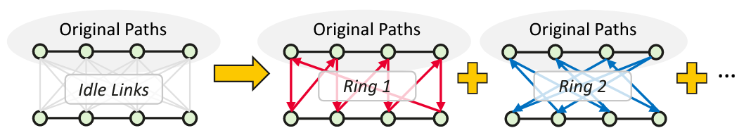
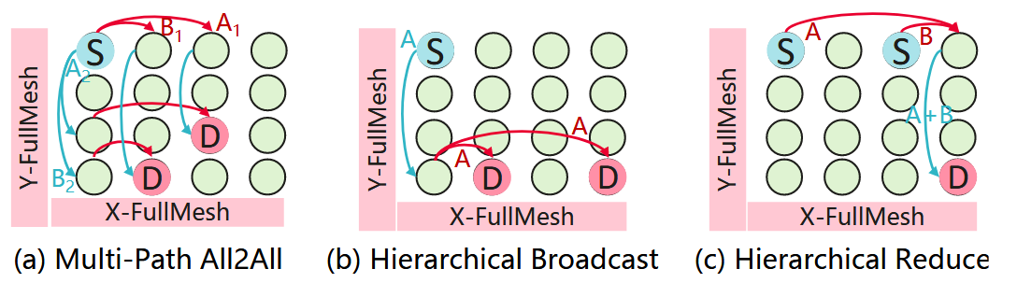

Case 2: Network Architecture & Algorithm Innovation
Build any network topology to investigate novel architectures tailored for AI training and inference scenarios.
Design innovative routing policies, collective communication algorithms, and flow control mechanisms based on new topologies.
Routing Mechanism
Collective Algorithm Innovation
Flow Control Algorithm Innovation
Supports UB protocol-defined routing strategies.
Design custom algorithms for innovative topologies.
Generates standard algorithms and injects traffic in arbitrary serial/parallel patterns.
Allows users to design and simulate custom algorithms based on specific topology and traffic needs.
Supports CBFC/PFC and Virtual Channels for verifying flow control and deadlock prevention.
Enables deadlock reproduction and resolution algorithm design.
Shortest
Per-flow
SPF
X-Fullmesh
Routing
Table
APR
UBPU
UBPU
UBPU
UBPU
All-paths
Per-packet
Packet Spray
Y-Fullmesh
Supported Routing Strategies
UB-Mesh Multi-Ring AllReduce
UBPU
UBPU
UBPU
UBPU
S
S
UBPU
UBPU
UBPU
UBPU
D
D
UBPU
UBPU
UBPU
UBPU
UB-Mesh Source Routing Strategy
UB-Mesh Multi-Path and Hierarchical All-to-All
Supports extensive routing strategies and enables user-defined mechanisms tailored to specific topology.
Validates innovative algorithms using tools to generate arbitrary traffic types.
Reproduces deadlocks and analyzes root causes via logs; resolves issues using Virtual Channels.
Notes:
Next, let’s look at Case 2: Network Architecture and Algorithm Innovation.
With this platform, users can build any network topology to study new architectures for AI training and inference. On top of these topologies, you can design and evaluate routing policies, collective communication algorithms, and flow control mechanisms.
For routing, the platform already supports UB protocol–defined strategies. With simple configuration, you can enable flow-based or packet-based routing, and combine shortest-path and all-path routing to form common policies such as SPF, APR, and packet spray. This makes it easy to compare how different routing strategies affect transmission performance.
Beyond built-in options, the platform also supports custom routing mechanisms. For example, based on the UB-Mesh work, users can define custom headers and routing logic to implement source routing on direct-connect topologies, and then measure the efficiency gains.
In short, the platform provides rich built-in routing strategies, and also lets users design their own mechanisms tailored to specific topologies.
Beyond routing, this case also focuses on collective algorithms and flow control.
Second, Collective Algorithm Innovation. The platform can generate standard collective algorithms and inject traffic in arbitrary serial or parallel patterns. On top of that, users can design and simulate custom collective algorithms that match a specific topology and traffic pattern. Using the traffic injection tools, you can generate different types of collective traffic to validate new algorithm ideas. As shown here in the UB-Mesh example, we can explore multi-ring AllReduce and multi-path or hierarchical All-to-All schemes on mesh-like topologies.
Third, Flow Control Algorithm Innovation. The platform supports CBFC, PFC, and Virtual Channels, so it can be used to verify different flow control schemes and deadlock prevention mechanisms. It also allows users to reproduce deadlocks, capture logs, and analyze the root causes. Based on these observations, you can design and evaluate deadlock resolution mechanisms, for example using Virtual Channels, and see how they behave under realistic network conditions.
With these capabilities, Case 2 provides a complete environment to co-design network architecture and algorithms—from routing, to collective communication, to flow control.

Slide 8

UB protocol Verification Platform: The Verifier for UnifiedBus Protocol Designing
Supporting verification in the following areas：
Correctness of protocol designs.
Correctness of configurations.
Compatibility of new designs.
Robustness of control plane algorithms.
Usage:
By defining new protocol designs in this platform, the verifier can automatically verify their correctness.
By inputting the deployment configurations to this platform, the verifier can determine the correctness of configurations and compatibility between protocols.
Access:
Repo: https://gitcode.com/open-uvfy/ub-NetVerify
Configuration
UB Topology
Formal definition of UB
UB Control Plane Model
Jetty
URMA
Load/Store
Routing
Load-balance
UB Data Plane Model
TP model
Retransmission
CC
FIBs
FIB of A
FIB of B
…
A
B
Load-balance
Priority
LLR
Access control
ACL of A
…
C
D
VL
CBFC
Routing
Data plane verification for UB
SPIN model checker
Notes:
This is the UB Protocol Verification Platform, a specialized tool for verifying UnifiedBus protocol designings.
Its primary function is to ensure reliability across four dimensions:
First, it verifies the logical correctness of protocol designs and configurations.
Second, it validates the compatibility of new design extensions.
And third, it tests the robustness of the control plane algorithms.
The workflow is automated. Developers define new protocol specifications directly in the platform, and the verifier executes checks to guarantee logical correctness. Additionally, by inputting deployment configurations, the system validates both configuration integrity and compatibility between different protocols.
The project is open source. You can access the source code and documentation via the GitCode repository listed on the screen.

Slide 9
Supporting Research Areas: Protocol Design and Control Plane Algorithm Design
Support for Innovative Protocol Design
Support for Control Plane Algorithm Design
The platform contains complete formal descriptions of the main features of the UB protocol, as shown below.
New protocol designs can be verified on this platform by modifying the formal description.
Verification of load balancing and packet reordering in the control plane.
The platform can verify the balance and multi-path consistency of innovative control plane algorithms under the following situations:
Different topologies, such as UB-mesh, CLOS, etc.
Link failures.
Different traffic characteristics.
Protocol Layer | Protocol Function | Verification Features
Datalink Layer | VL&CBFC | Correctness and deadlock-free of credit subscribe and release.
 | LLR | Correctness of state transition and error handling.
Network Layer | Routing | Correctness and compatibility of routing.
 | Isolation | Effectiveness of the isolation strategy and correctness of isolation.
 | Priority | Starvation detection and conflicts detection.
Transport Layer | TP model | Correctness of state transition and reliability function.
 | TP | Correctness of transmission process.
 | Retransmission | Detection of packet loss status and packet loss deadlock.
 | CC | Congestion control process verification.
Transaction Layer | Jetty | Correctness of Jetty state transition. Jetty abnormal state detection.
 | URMA | Correctness of URMA interaction process and state transition.
 | Security | Correctness of the security state space.
 | Load/Store | Correctness and deadlock-free of memory transactions.
Control Plane
Algorithms
Configuration
Output
Network Configuration
Control Plane Model
Link Failure Handling
Data Plane Model
Results:
No loops√
No black-hole √
Balanced enough √
Consistency ×
Counter Examples:
In topology X, the multi-path consistency of flow Y is inadequate
Topology
Fault definition
Verification Target
Control Plane Verification
Notes:
This platform supports two primary research areas: Protocol Design and Control Plane Algorithm Design.
For Protocol Design, we provide complete formal descriptions covering the full stack—from the Datalink Layer up to the Transaction Layer.
As shown in the table, this includes verifying critical mechanisms like credit-based flow control, routing compatibility, transport state transitions, and memory transaction deadlocks. Researchers can modify these formal descriptions to automatically verify the correctness of new protocol features.
For Control Plane Algorithm Design, the platform targets the verification of load balancing and packet reordering strategies. It validates algorithm consistency and multi-path performance under complex conditions, including different network topologies like UB-mesh and CLOS, link failure scenarios, and varying traffic characteristics.

Slide 10
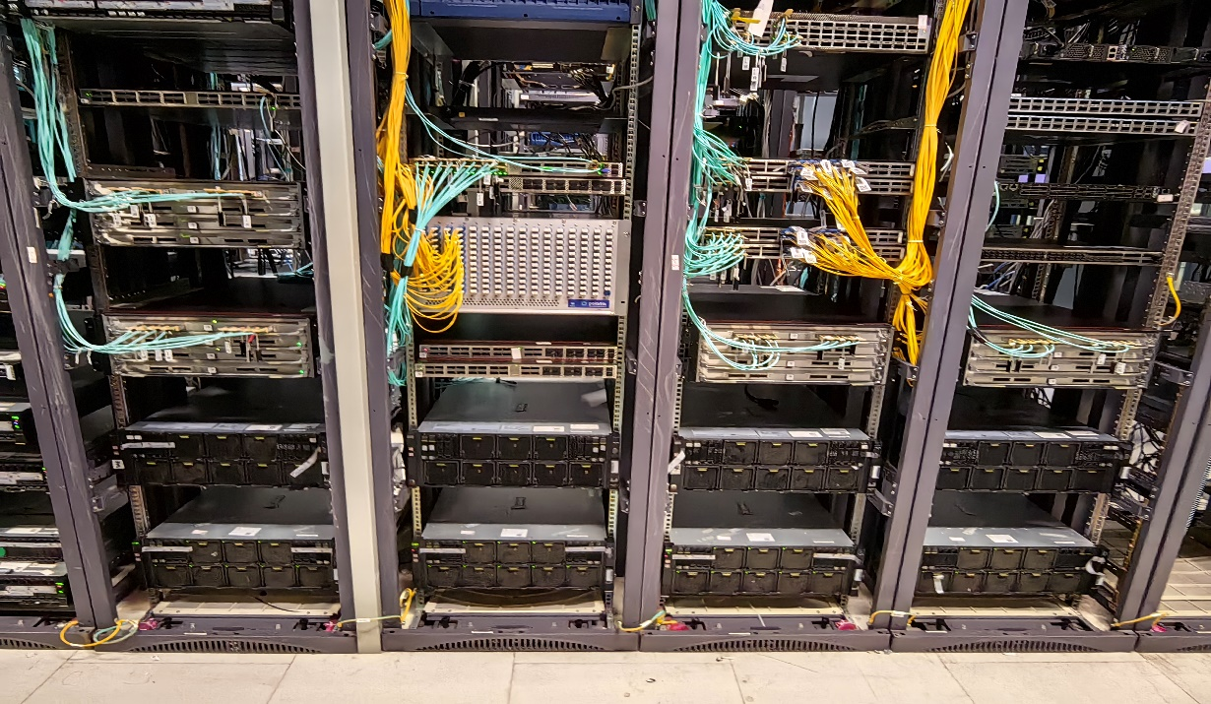
SuperPod Networking Innovation Platform: Support innovative UB topology construction and verification of topology designs.
Capability Features of the platform：
Infrastructure
Ascend / Kunpeng Servers, OCS, Electrical Switches
Networking Innovation Platform: Supports customized interconnection of Ascend servers, switches, and OCS hardware, and integration, configuration, and verification of routing and communication algorithms.
Feature 1: Innovative Topology Definition and Construction
Direct topologies (FullMesh, 2D-FM, Torus)
Indirect connection topologies (Clos, BST, etc.)
OCS-based variable direct topologies
Provides more accurate performance evaluation and realistic problem identification compared to simulators
OCS
Feature 2: Verification of Topology Algorithms
Routing algorithms (shortest path routing, full-path routing), LB algorithms (ECMP, NSLB, etc.), FC algorithms, and collective communication algorithm configurations under various topologies.
Supports Python-based HCCL translation.
Switches
Ascend Servers
Access: Huawei will assist in configuring and setting up the network, with remote access provided via the Huang Danian platform and the laboratory.
Notes:
Next is the SuperPod Networking Innovation Platform. This is a hardware-based testbed designed to build and verify new network topologies.
Unlike software simulators, this platform uses real Ascend servers and Optical Circuit Switches (OCS). This allows you to construct various physical topologies—whether direct, indirect, or dynamic OCS-based designs—and get accurate, real-world performance data.
On top of the hardware, you can verify your control logic. The platform supports testing for routing, load balancing, and flow control algorithms, ensuring they work correctly on the actual network structure.
For access, Huawei handles the complex physical setup, and we provide you with remote access to run your experiments

Slide 11
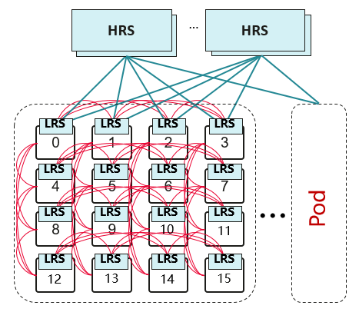

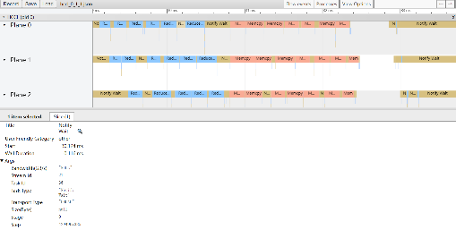


Innovations in UB SuperPod Topology Architecture, Routing, and Communication Algorithms
SuperPod topology innovation
Innovations in Routing and Collective Communication Algorithms
Network data monitoring, platform data visualization
Supporting UB-mesh topology (Example 1) and innovative switching topology (Example 2) prototype development.
Supports efficient configuration of source routing and static routing;
Innovative routing algorithms (full-path routing).
HCCL Operator Behavior Data Collection and Visualization on Device-Side (Ascend NPU)
Addressing
Routing
Static
Adaptive
…
msprof +
Addr A：EID1，EID2
Addr B：EID3
Addr C：EID4，EID5
…
LB
ECMP
PS
FC
PFC
CBC
Routing
Validation
hccn tool -ping
Example 1：
UB-mesh Topology
BW measurement
Network-side port mirroring, "flow-level/packet-level" traffic behavior observation strategy
Translating Python algorithm code to HCCL collective communication library supports efficient and agile innovation and development of communication algorithms.
Spine
Spine
Spine
Spine
Spine
Spine
Leaf
Leaf
Leaf
Leaf
Switch
Python → HCCL
Example 2:
Balanced Sparse Tree Topology
https://gitcode.com/HCCLang/HCCLang-ub-tools
Flexible and customized definition of Topology
Agile Development of Innovative Algorithm
Data transparency, facilitates academic and industry research.
Notes:
This platform empowers research through two main innovation directions, supported by comprehensive data visibility.
First, we enable Topology Architecture Innovation. The platform allows for the flexible definition of custom topologies. Instead of being locked into standard designs, you can prototype and verify novel structures, such as the UB-mesh or other specialized switching topologies.
Second, we support Routing and Communication Algorithm Innovation. We enable advanced routing strategies like full-path routing. To speed up your research, we provide a toolchain that translates Python code directly into the HCCL collective communication library. This allows for agile development and rapid iteration of new algorithms.
To validate these innovations, the platform provides complete Data Transparency. You get full visibility into NPU behavior and network traffic at the packet level. This monitoring capability is essential for analyzing performance and verifying your designs.

Slide 12
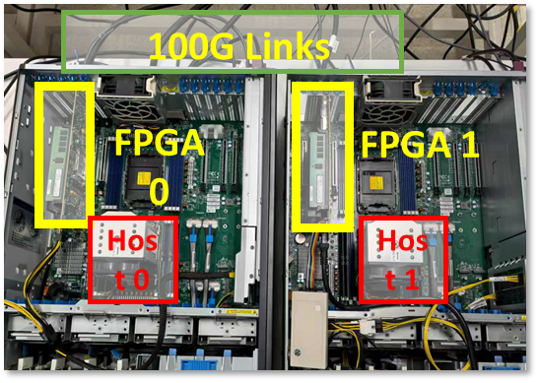
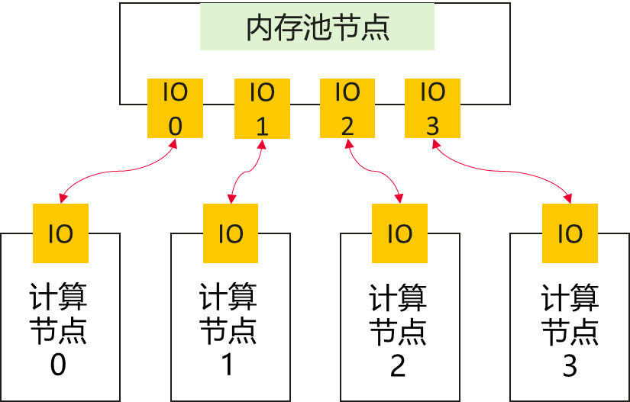
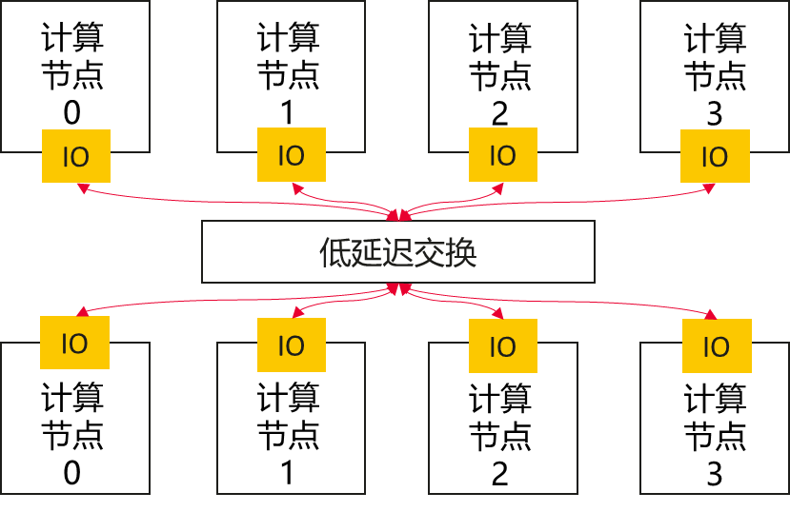
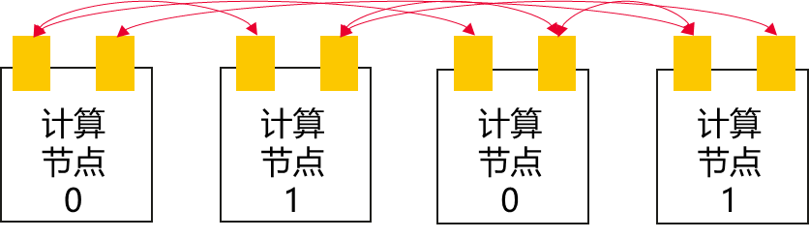
Scale-Up Prototype Platform: Open HW/SW Co-Design Capabilities to Support Innovation in UnifiedBus Interconnect Architecture
Features supported by the platform include: UB-Next basic memory semantic protocol, short-path migration engine, composite semantic processing engine, low-latency switching, and other innovative functions.
UB.mem: Supports native memory semantic read/write operations, on-path/off-path acceleration logic, etc.
UB-SSD: FPGA-based SSD with memory semantic capabilities, near-data computing, etc.
Low-latency Switching: Packet-Cell Converged Switching Based on FPGA
Memory Semantic Interconnect
UB.mem FPGA
UB.mem FPGA
CPU NPU
UB-SW
CPU NPU
UBoE FPGA
(DPU)
UB-SW
UBoE FPGA
( DPU )
UB-Next
UB-SW
PCIe
UB-SSD FPGA
Access: Remote access provided via the Huang Danian platform and the laboratory.
UB-SSD FPGA
Multi-head Memory Pool Architecture
Direct Borrowing Topology Architecture
Switch-based Interconnect Architecture
Mem Pool
Comp.
Node
Comp.
Node
Comp.
Node
Comp.
Node
Comp.
Node
Comp.
Node
Comp.
Node
Comp.
Node
Low-Latency Switching
Comp.
Node
Comp.
Node
Comp.
Node
Comp.
Node
Comp.
Node
Comp.
Node
Comp.
Node
Comp.
Node
Notes:
Let's look at our Scale-Up Prototype Platform. This platform is built for Hardware-Software Co-Design, specifically to drive innovation in the UnifiedBus interconnect architecture.
The core strength here is versatility. We provide a set of FPGA-based prototypes that allow you to verify different layers of the protocol stack:
First, for Memory Semantics (UB.mem), we support native read/write operations and acceleration logic, both on-path and off-path.
Second, for Network Transport (UBoE), we offer an FPGA-based DPU. This allows you to test the conversion between memory semantics and network transport protocols.
Third, we have Storage Verification (UB-SSD). This enables you to experiment with Near-Data Computing and memory semantics directly on the SSD.
And finally, we support Low-latency Switching, allowing you to test packet-cell converged switching logic.
As with our other platforms, we handle the physical setup, and you can access these resources remotely via the Huang Danian platform to run your verification tasks.

Slide 13
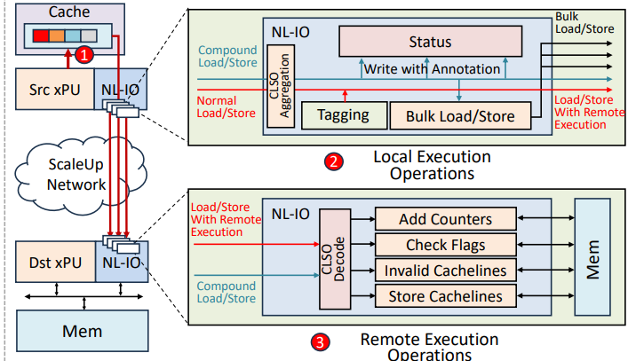
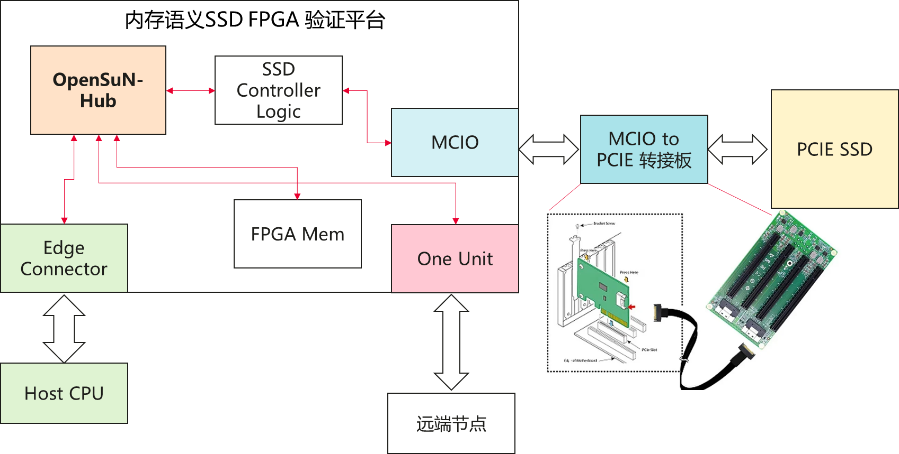
Exploration of Hardware-Software Co-Design Innovation Based on Scale-Up Prototype Platform
OpenCCU Collective Communication Accelerator
Compound Memory Semantics Microarchitecture
Memory Semantics UB SSD
CCU
PE
Link
Bridge
CCU
PE
CCU
PE
CCU
PE
RISCV Core
CCU
PE
CCU
PE
CCU
PE
CCU
PE
RISCV Core
CCU
PE
CCU
PE
CCU
PE
RISCV Core
CCU
PE
CCU
PE
CCU
PE
RISCV
CCU
PE
CCU
PE
$
PHY
SRAM
Buffer
Control Memory
DeSA
DaSA
AXI Bridge
Wide AXI
Data Path
Control Path
Device 0 HBM
Multi-core RISC-V Architecture: Based on RISC-V instruction set, parses collective communication instructions via parallel processing at the multi-core frontend.
Collective Communication Extension Instructions: Extends collective instructions via the RoCC interface, supporting ops such as Reduce, LoadTensor, and StoreTensor.
Automatic Architecture Design Optimization: Automatically optimizes parameters, identifying the optimal ratio of PEs to RV Cores.
FPGA exposes host memory semantics: Manages FPGA memory as SSD cache, supporting host semantic access.
Near-storage computing: Handles compression/decompression, encryption/decryption, and matrix computation.
GPU passthrough: Enables GPU/NPU passthrough to directly initiate SSD access.
NVMe-oF Target offloading: SSDs act as target nodes for network access.
Compound Memory Semantics Support: Trigger multiple transactions (bulk transfer, sync, conditional ops) via a single Ld/St request.
On-path measurement: Measures remote memory traffic and identifies hot pages/conflicts, enabling SW/HW co-optimization for hierarchical memory.
Notes:
Using this prototype platform, we are currently exploring three key directions in Hardware-Software Co-Design
.
First is the OpenCCU Accelerator. This is built on a RISC-V architecture. The key innovation here is that we have extended the instruction set to natively support collective communication. This allows the hardware to handle complex communication tasks much more efficiently than standard processors.
Second is Compound Memory Semantics. The goal here is efficiency. Instead of sending multiple requests, we allow a single load/store instruction to trigger complex, multi-step transactions. We also include real-time traffic monitoring to identify memory hot spots and optimize performance dynamically.
Third is the Memory Semantic UB SSD. We are transforming storage into an active computing unit. This design supports Near-Storage Computing, allowing the SSD to process data locally. It also enables Direct Access, meaning GPUs or NPUs can read and write directly to the SSD, completely bypassing the CPU to reduce latency.

Slide 14

Scale-Out Prototype Platform：Supporting Innovation in Protocols and Algorithms for Scale-Out Networks
Fundamental Capabilities
Platform overview
Basic components: 10+ NICs, 10+ switches. 2-layer Clos architecture; supports other common topologies.
Programmability: Programmable NICs and switches.
Protocol Capabilities: UBoE and standard RoCE. Supports UB TP/TPG, multipath, packet spraying, out-of-order reception, congestion control, and lossless/lossy modes.
Access: Remote access provided via the Huang Danian platform and the laboratory.
...
switches
...
...
Tester
NIC
...
NIC
NIC
...
NIC
...
Platform-Enabled Innovation Capabilities
Switch
NIC/ DPU
Host
Focuses on protocol and algorithm innovation
Per-packet load balancing
multi-path transmission
Congestion control
Packet trimming
Flow Control
Virtualization, etc.
New features coming soon, including NIC architecture, compute system
Load Balancing
Reliability/Fault Tolerant Transmission
Host Network
Resource Management
Programmabilities
Congestion Control
Virtualization
Out-of-Order Reception
fault detection
Flow control
Notes:
Moving on to the Scale-Out Prototype Platform.
At its core, the platform relies on a cluster of programmable NICs and switches. We typically run a 2-layer Clos architecture, but it is flexible enough to support other common topologies as well.
On the protocol side, it is fully compatible with both UBoE and standard RoCE. It natively supports advanced transmission features like multi-pathing, packet spraying, and out-of-order reception, covering both lossless and lossy modes.
For innovation, the platform is designed to support advanced protocol and algorithm research. It enables you to test per-packet load balancing, multi-path transmission, congestion control, packet trimming, and flow control.
Access is currently available via the Huawei internal network, and we are actively expanding the platform to include new NIC architectures and compute systems soon.
Traffic Generation Tool/ Classic Algorithm Capability Code
Development Interface/ Supported Latency

Slide 15
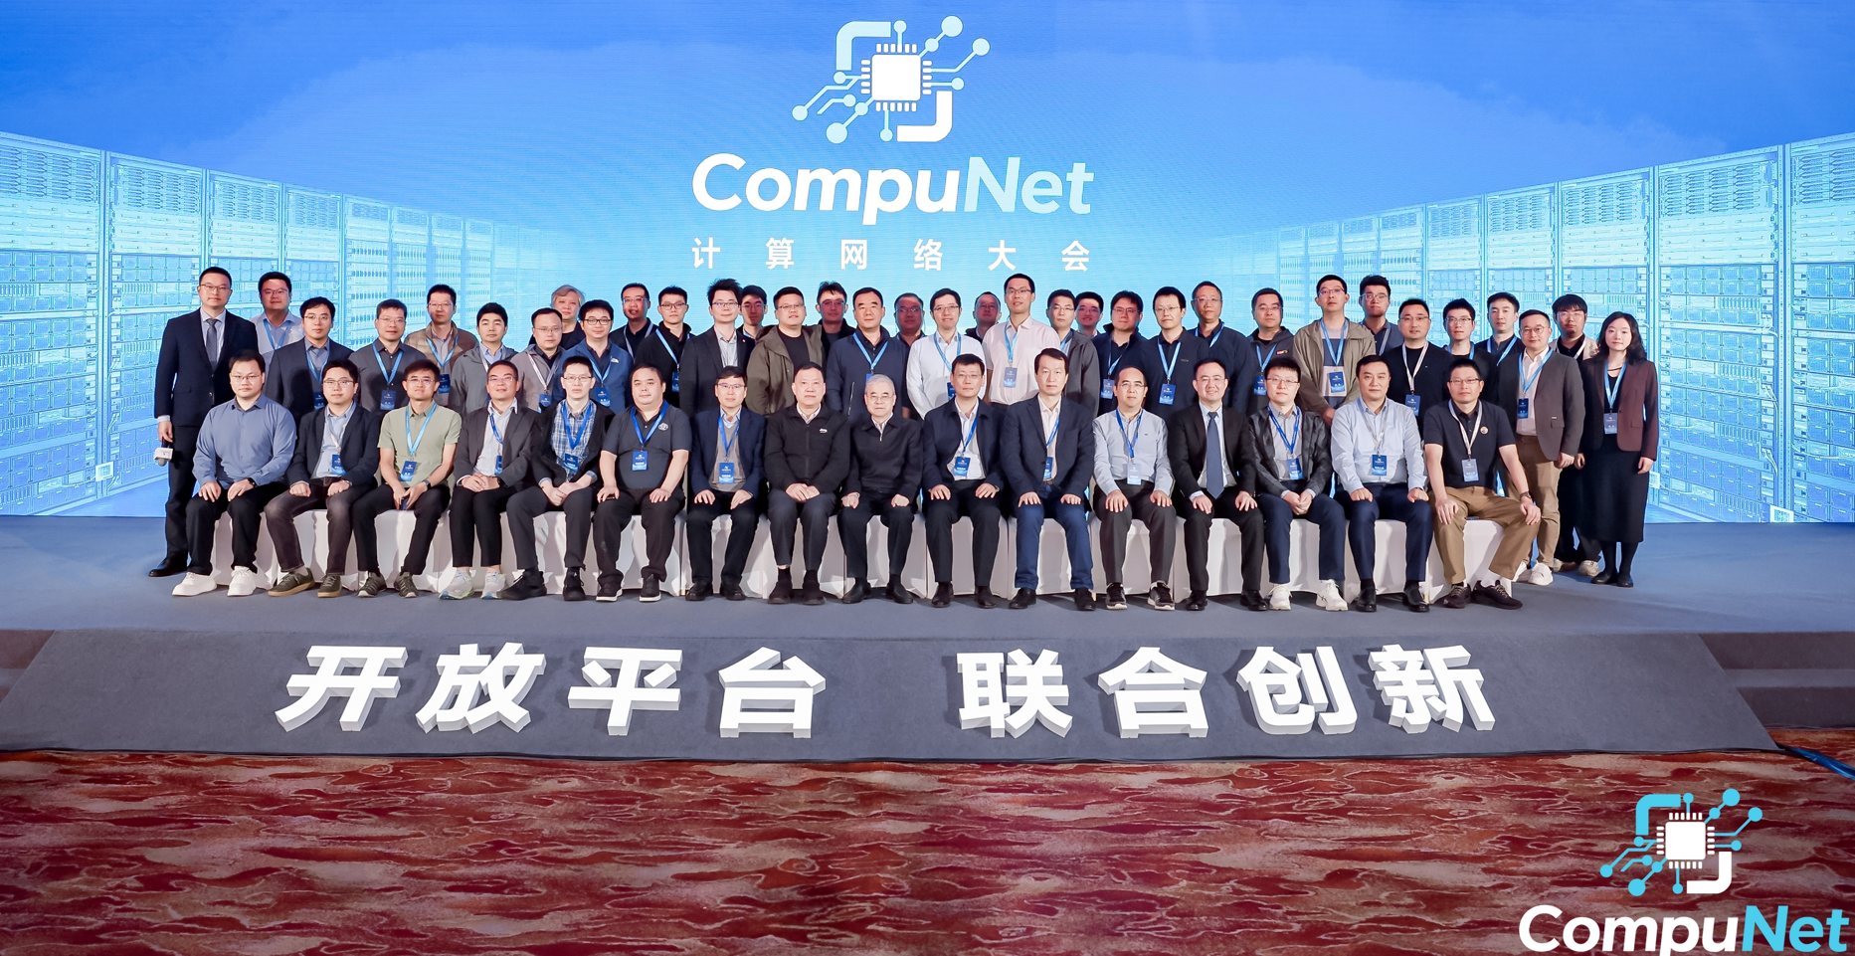
CompuNet: A Summit Focused on Computing Networks
CompuNet aims to build an open platform for exchange and innovation, fostering technological breakthroughs and industrial progress in computing networks while contributing to academic development and talent cultivation.
The 2nd CompuNet Summit was successfully held by Huawei and academic partners on Oct. 15, 2025.
The CompuNet Scale-Up Network Innovation Platform was officially released as the industry's first open innovation platform dedicated to Scale-Up networks.
A strategic collaboration was launched between CompuNet and the CCF (TCDCS, TCHPC, & TCI) to deepen industry-academia-research synergy. This initiative will explore cooperation through seminars, competitions, and academic courses, promoting cross-disciplinary innovation in Scale-Up networks across multiple computer science subfields.
Organization
Platform
Achievements
Huawei
Universities/Institutes
Partners
Academic organization
Exchange Platform
Cooperation Platform
Innovation Platform
Open Ecology
Technology Innovation
Industrial Application
Academic Publication
Talent Training
Notes:
CompuNet aims to build an open platform for exchange and innovation, driving technological progress in computing networks and supporting both academic growth and talent development. To further this mission, Huawei and leading academic institutions successfully held the 2nd CompuNet Scale-Up Summit on October 15, 2025. A highlight of the summit was the official release of the CompuNet Scale-Up Network Innovation Platform—the first open platform of its kind designed for Scale-Up networks. Additionally, CompuNet initiated a collaboration with the CCF (TCDCS, TCHPC, & TCI). Together, they will explore new avenues for industry-academia-research cooperation through seminars, technical competitions, and academic courses, promoting interdisciplinary innovation across the computer science landscape.
TCDCS: Technical Committee on Distributed Computing and Systems
TCHPC: High Performance Computing

