Slide 1
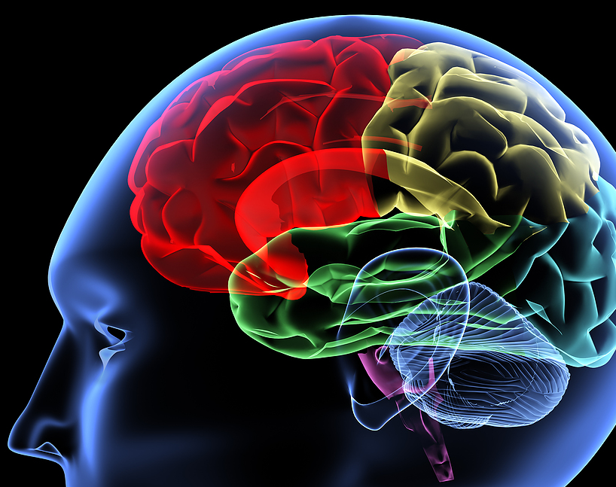
Neurobiology of Addiction
Itamar. J. Rachailovich

Slide 2
Goals
“Reward” System
Dopamine – It’s Mysterious Function
Theories of Addiction
Addictive Drugs

Slide 3
Goals
“Reward” System
Dopamine – It’s Mysterious Function
Theories of Addiction
Addictive Drugs

Slide 4
The “Reward” System

