Slide 1
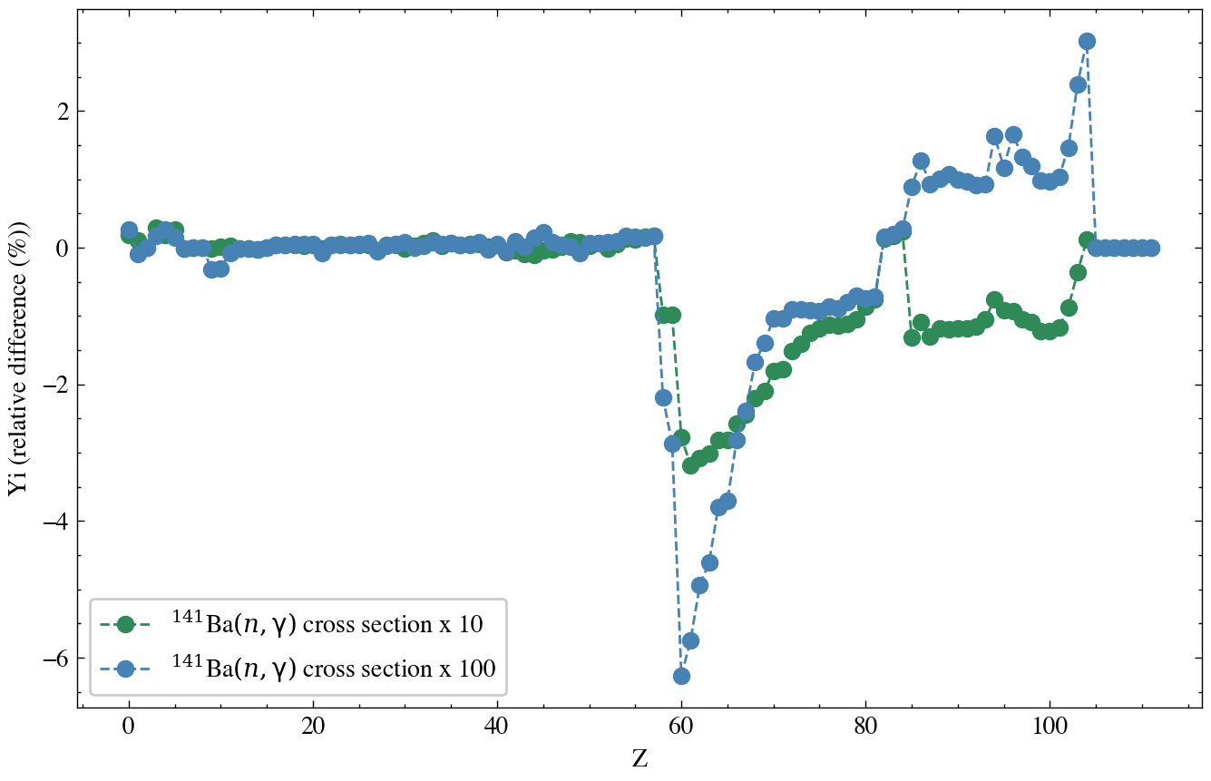
Sensitivity study for i-process using winnet.
Approach: Vary the reaction rate and quantify how the abundance varies for i-process nucleosynthesis.
Method:
We use the i-process simulation given in the example set.
Vary the reaction rate parameters in the reaclib file.
Compare the abundances for different cross sections
Preliminary

