Slide 1
A few words …
Schedule tomorrow
Presentation of Lecturers and Hackathon Support Group
Presentation of Teams and Projects
Cabin assignments

Slide 2
Tomorrow
8:15 am: here. lectures
6:30 pm: here. present your team

Slide 3
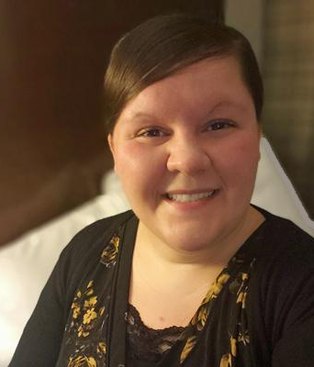
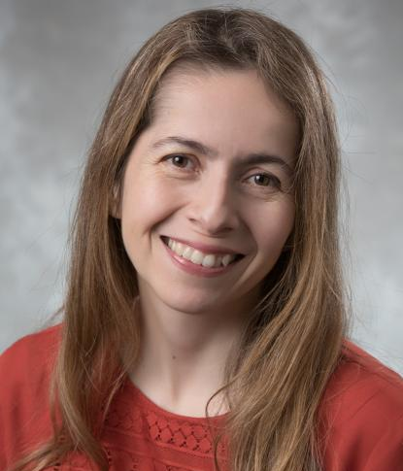
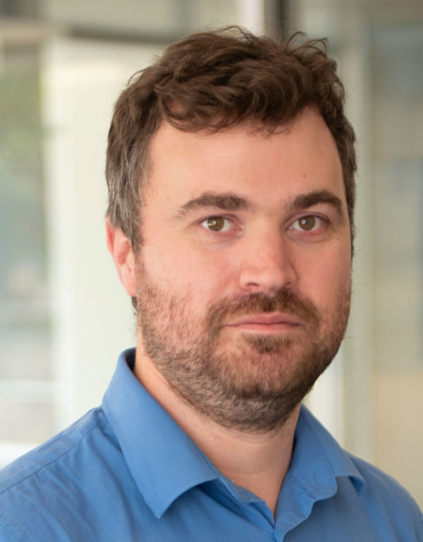
Summer school lecturers
Andrea Richard
Ohio University
Liliana Caballero
University of Guelph
Philip Adsley
Texas A&M University

Slide 4
Hackathon
The Challenge: Apply FRESCO or WinNet to a question relevant to nuclear astrophysics

Slide 5
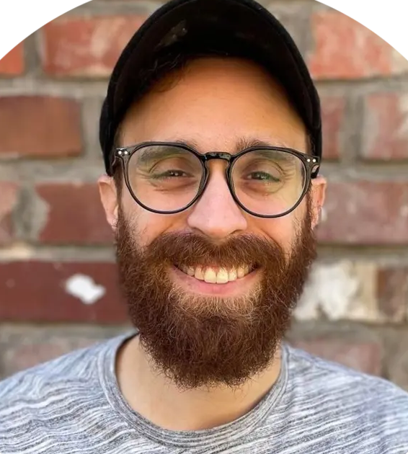
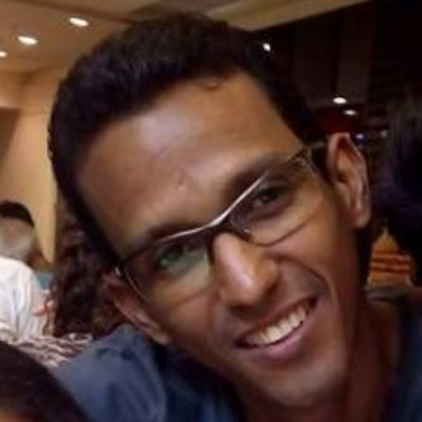
Hackathon:
Code Experts
Thanassis Psaltis
Duke University
WinNet
Jonas Ferreira
Universidad Federal Fluminense - FRESCO

Slide 6
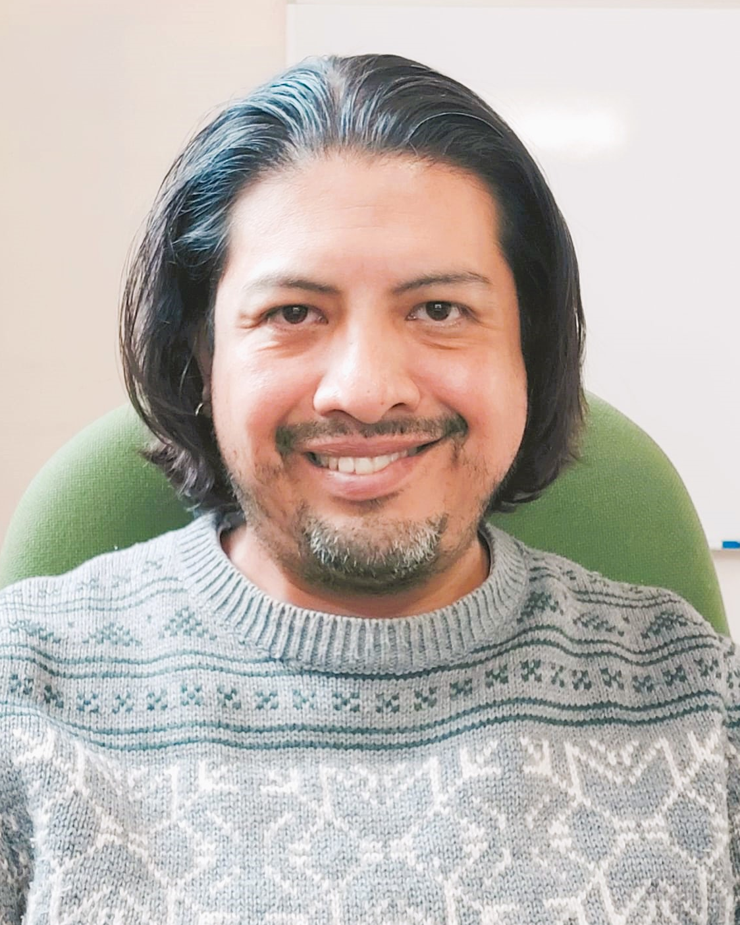
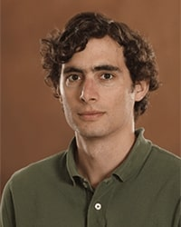
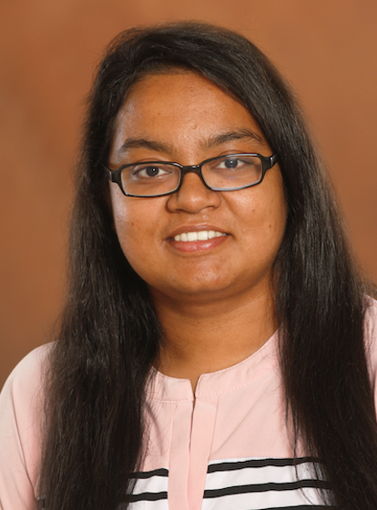
Hackathon:
Code Experts
Hackathon:
Supporting cast
Luis Acosta
IEM, CSIC
once upon a time, FRESCO
Alfredo Estrade
CMU
other networks that probably work like WinNet
Irin Sultana
CMU
Sensitivity studies, words of reason and wisdom
Thanassis Psaltis
Duke University
WinNet
Jonas Ferreira
Universidad Federal Fluminense - FRESCO

Slide 7
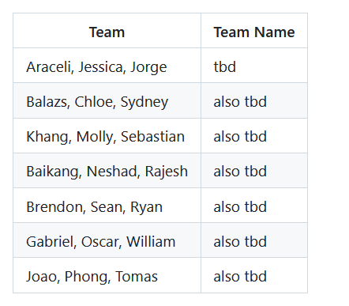
Presentation of Teams and Projects
Tomorrow, 6:30 pm, lecture room

Slide 8
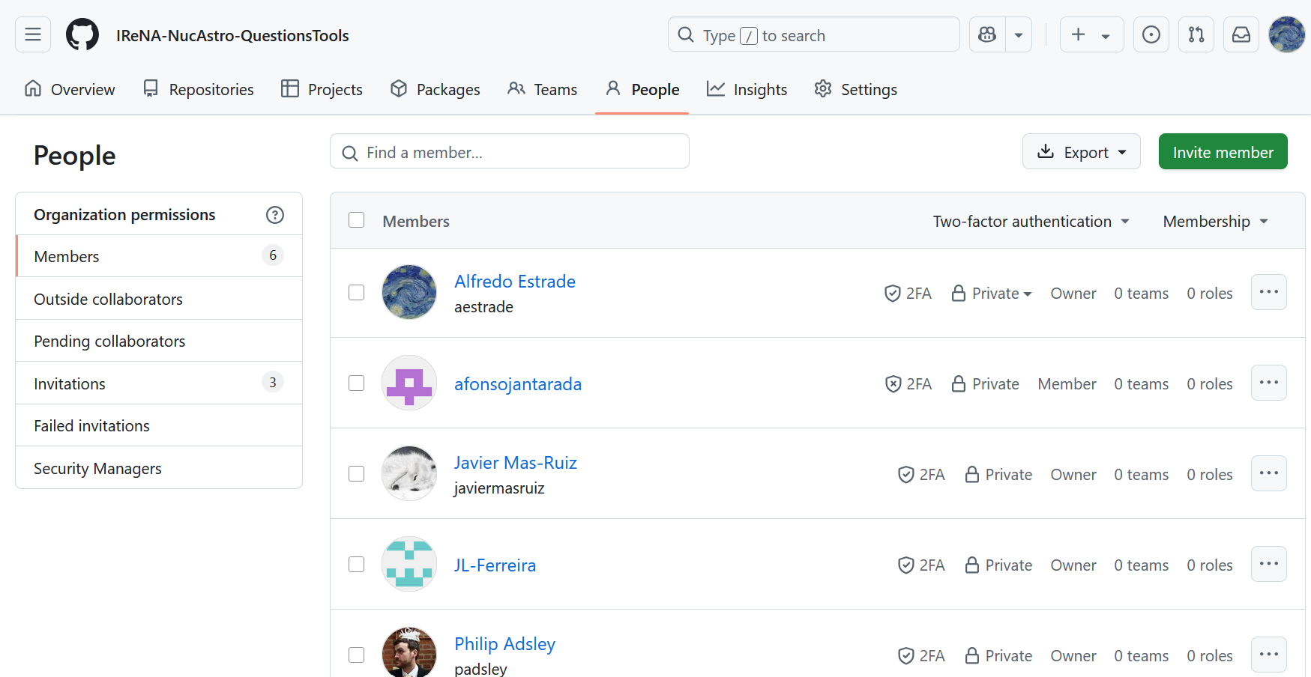
Presentation of Teams and Projects
Tomorrow, 6:30 pm, lecture room

