Slide 1
Thursday
A day in life on the island
Today’s schedule
Reimbursement information
Hackathon: the final stretch
Travel logistics for tomorrow

Slide 2
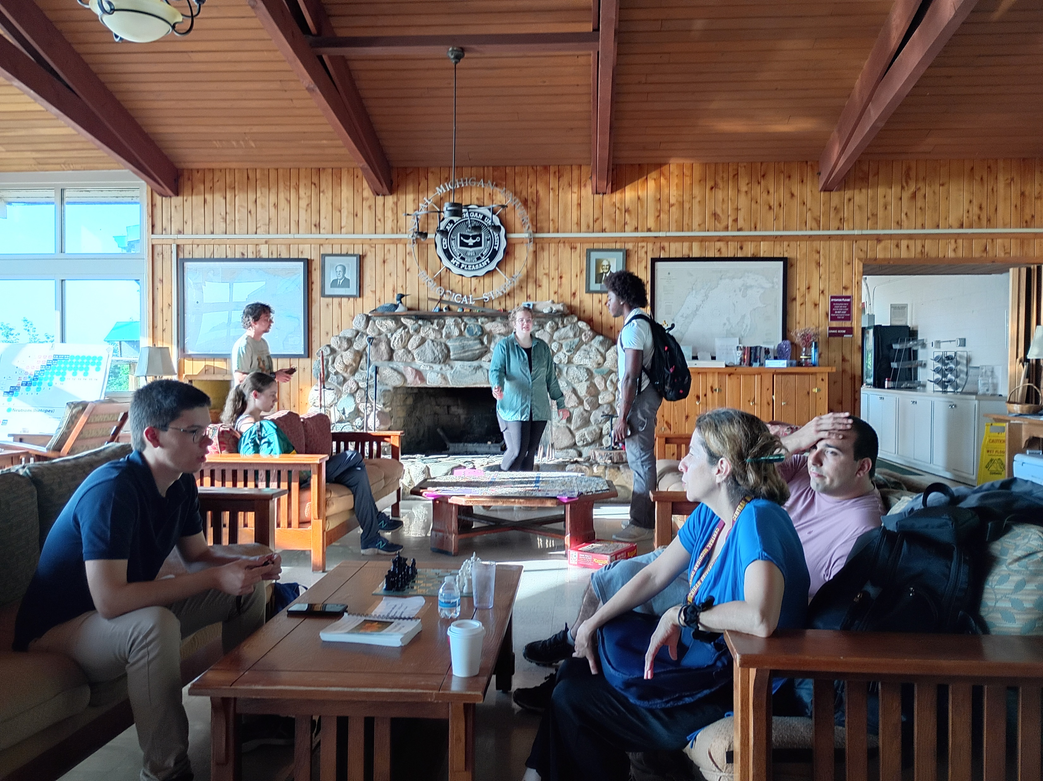
Thursday
A day in life on the island
Today’s schedule
Reimbursement information
Hackathon: the final stretch
Travel logistics for tomorrow

Slide 3
Thursday
Today’s schedule
Now: Lectures, lunch, lectures
2 pm: Hackathon status & Q&A
Rest of day: Hackathon crunch time (snack requests?)

Slide 4
Hackathon: the final stretch
Submission deadline: 11:00 pm
Send Alfredo an email with the link to the Wiki page
Presentation of results: tomorrow 8 am (after breakfast)
Use info in Wiki; no need for powerpoint slides

Slide 5
Thursday: after project status update
Info necessary for reimbursements
The usual stuff: name, address, etc
Itemized list of expenses
Signed CSE letter
Bank info: name, address, routing number, account number
Foreign banks: IBAN or SWIFT numbers
Non-US citizen: visa/permanent residency

Slide 6
Travel tomorrow
Campground cabins: truck will park in campground tonight. Load all your luggage before breakfast.
Faculty cabins: Load luggage at >8 am tomorrow.
Departure to town: 9:30 am, right after team’s presentations. Boat departs 11:20 am.
Arrival at East Lansing expected around 6pm (FRIB tour)

