Slide 1
Open Questions and Research Tools in Nuclear Astrophysics
Lecture 3: neutrinos and nucleosynthesis
Liliana Caballero
University of Guelph

Slide 2
Neutrinos (MeV)
Determine the evolution of supernovae, collapsars, and neutron star mergers
Their signals combined with other observations will lead to better understanding of several phenomena such as Gamma Ray Burst, the synthesis of heavy elements, and kilonova

Slide 3
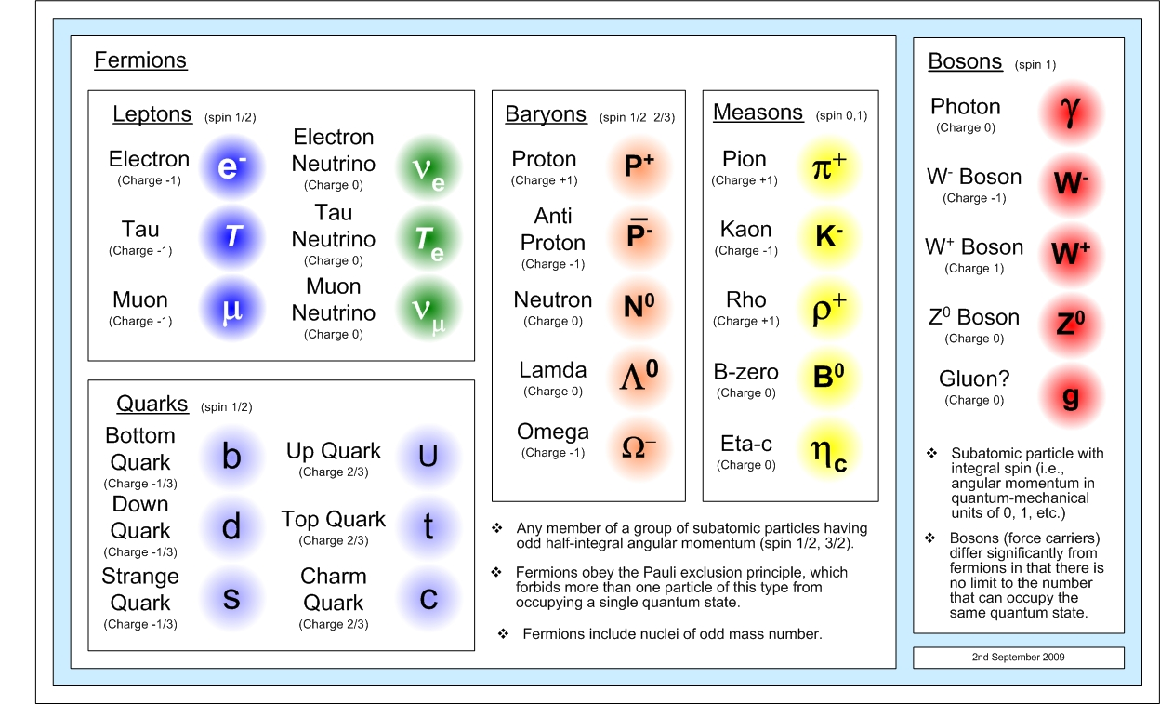



Basics
$$n→ⅇ+p+{\overline{ν}}_{e}$$
M_{n}= 939.56 MeV/c²
M_{p}= 938.272 MeV/c²
Mv ~ 0.1 eV
Cross sections:
$$α+A$$
1 x 10⁻²⁴ cm²
1 x 10⁻⁴⁴ cm²
only interact via the weak force
p$+{\overline{ν}}_{e}$

Slide 4
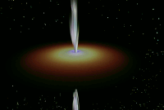
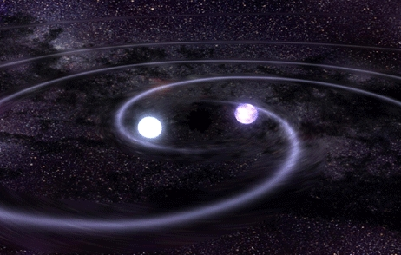
MeV neutrinos
Supernovae:
Dying star with 8 times more massive than our Sun
Collapsars :
rotating massive star collapsing to a black hole
Mergers:
Neutron star- Neutron star
Neutron star -Black Hole

Slide 5
Neutrinos from Supernova

Slide 6
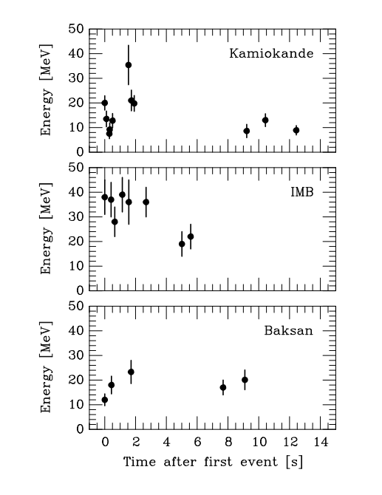
Supernova neutrinos SN1987
50 Kpc
A few, and Energy max 40 MeV
Energy 10⁵³ ergs in 10 sec
Sun: 3.86 x 10²⁶ watts =3.86x10³³ ergs/s
Supernova luminosity = 10¹⁹ Sun

Slide 7

Supernova neutrinos SN1987
50 Kpc
A few, and Energy max 40 MeV
Energy 10⁵³ ergs in 10 sec
Sun: 3.86 x 10²⁶ watts =3.86x10³³ ergs/s
Supernova's luminosity = 10¹⁹ Sun

Slide 8
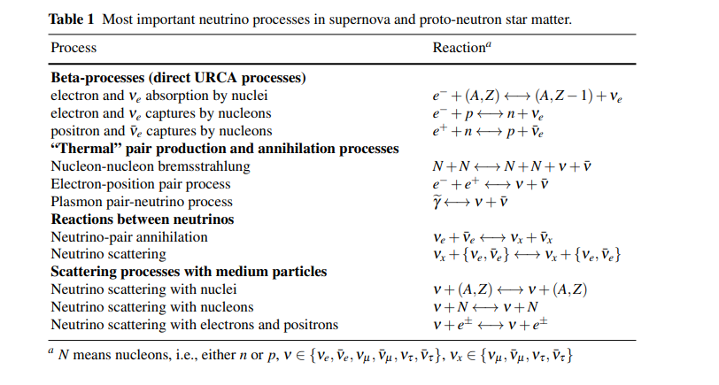

Slide 9
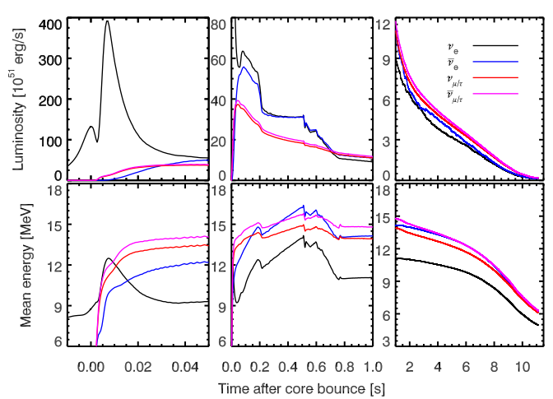
Neutrino spectra from Supernova
Detection rate R ~ 5/s,
L=10⁵² erg/s, E~ 11 MeV
t=10 sec
Shock-breakout post-bounce cooling
Janka, arxiv [1702.08713]

Slide 10
Neutrino spectra from Supernova
Simulations reproduce the main features observed
Detection rate R ~ 5/s,
L=10⁵² erg/s, E~ 11 MeV
t=10 sec
50 Kpc
Energy max 40 MeV
Energy 10⁵³ ergs in 10 sec
Shock-breakout post-bounce cooling
Janka, arxiv [1702.08713]

Slide 11
Passage through dense matter
Neutrinos are emitted and reabsorbed several times before leaving the stellar medium
Neutrinos are influenced by the properties of nuclear matter: nucleon-nucleon interaction
Neutrinos oscillate between flavor states
Neutrino spectrum is affected by strong gravitational fields

Slide 12
Cross sections are small, then why are neutrinos trapped?
Because they are many emitted and they scatter among themselves
Because the matter density is very high
Because there are more neutrons than protons in a proto-neutron star
All the above

Slide 13
Cross sections are small, then why are neutrinos trapped?
Because they are many emitted and they scatter among themselves
Because the matter density is very high
Because there are more neutrons than protons in a proto-neutron star
All the above

Slide 14


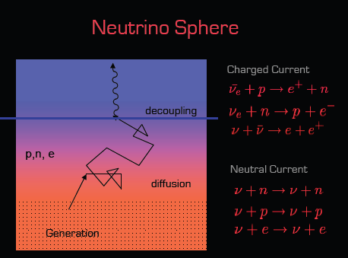
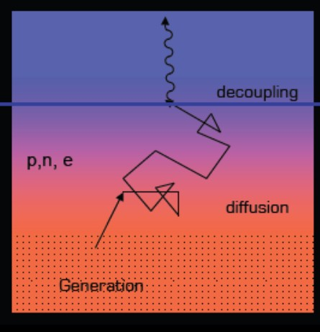







Neutrino Surface
Neutrino mean free path
opacity
n_{k} is the number density of particle k, and σ is the cross section

Slide 15
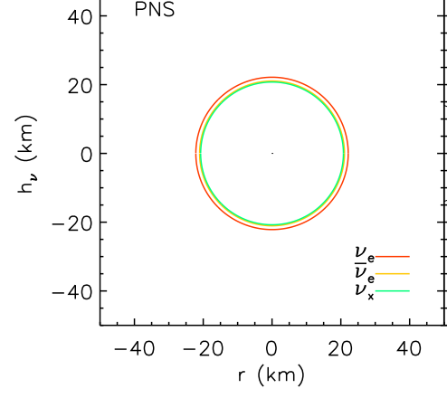
Neutrinosphere in Supernova
Neutrino spheres follow an order given by the particle density
The closer to the center the more energetic
McLaughin & Surman PRD 2006

Slide 16


Neutrinosphere in Supernova
Observed neutrino properties depend on the matter conditions at the neutrino sphere
McLaughin & Surman PRD 2006

Slide 17
Neutrinos from neutron star mergers and accretion disk around black holes

Slide 18
Mergers and disks neutrinos: what to expect?
A. They are more energetic than Supernovae
B. Faster evolution than Supernovae
C. More difficult to detect than Supernovae
D. They are many more than Supernova

Slide 19
Mergers and disks neutrinos: what to expect?
A. They are more energetic than Supernovae
B. Faster evolution than Supernovae
C. More difficult to detect than Supernovae
D. They are many more than Supernova

Slide 20
Event rates
Supernovae: 1 per century in the Milky Way
Binary neutron-star mergers: 100 per million years in the Milky Way
Advanced LIGO estimates for neutron star mergers: 8-12 events per year (reaching 485 Mpc)

Slide 21
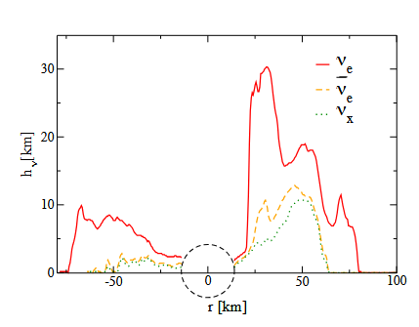
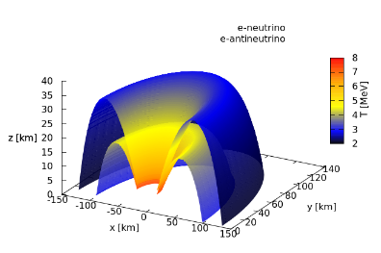
Neutrinos from black hole accretion disks
Neutrino surfaces are different for each flavor (recall SN)
Important effects for the synthesis of heavy element
OLC et al PRD 2009
OLC et al PRD 2016

Slide 22
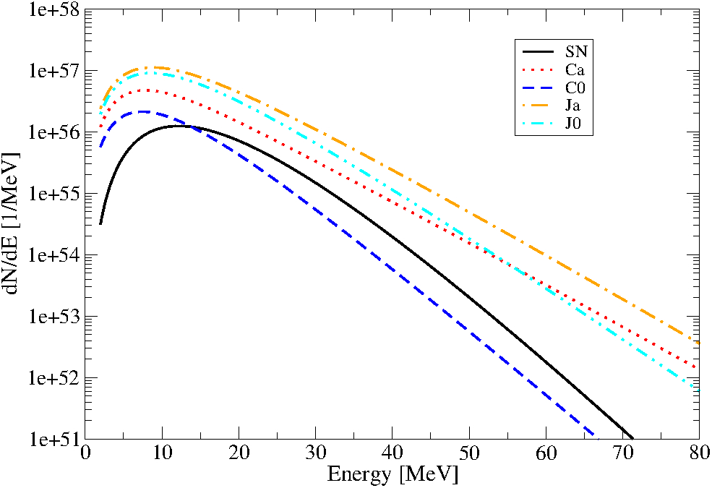
Neutrino Spectra from accretion disks
Observed at 10 kpc from the source
T. Schilbach*, O. L. Caballlero, McLaughlin (2018)

Slide 23
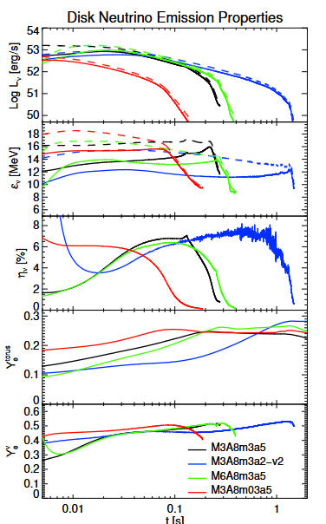
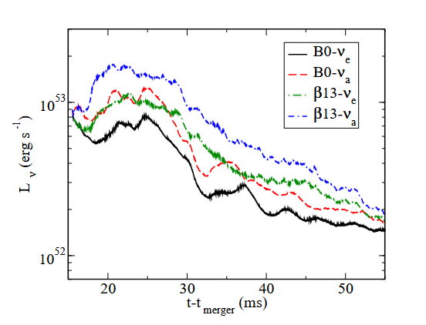
Black hole accretion disks
Accretion rates, spin, viscosity
Neutrinos from mergers
Black hole neutron star binary
With magnetic fields
Fatemeh Hossein Nouri et al PRD 2018
O. Just et al MNRAS 2015

Slide 24
How do neutrinos affect other observables in these environments?
In nucleosynthesis of heavy elements, neutrinos:
can aid the explosion in neutrino driven winds
can change the proton to neutron ratio
can be absorbed by nuclei changing the nuclear species

Slide 25
Recall on binary neutron stars and black hole mergers
GRB
Kilonova
GRB
Kilonova
Luminosity
Kilonova = 1/100 Supernova
GRB =10-100 Supernova
Outflows
Nucleosynthesis
O. Just et al MNRA, 2015

Slide 26
Nucleosynthesis

Slide 27
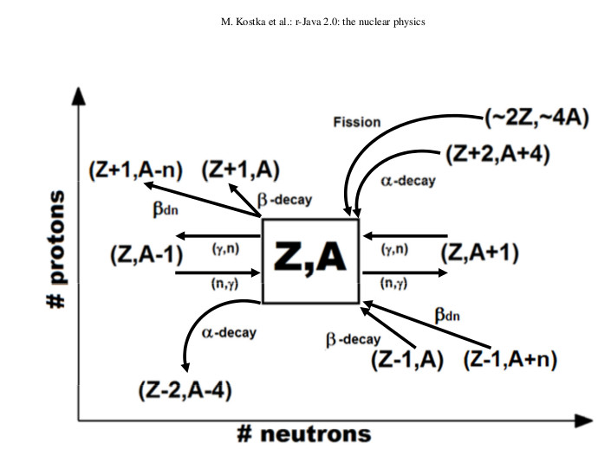

Slide 28
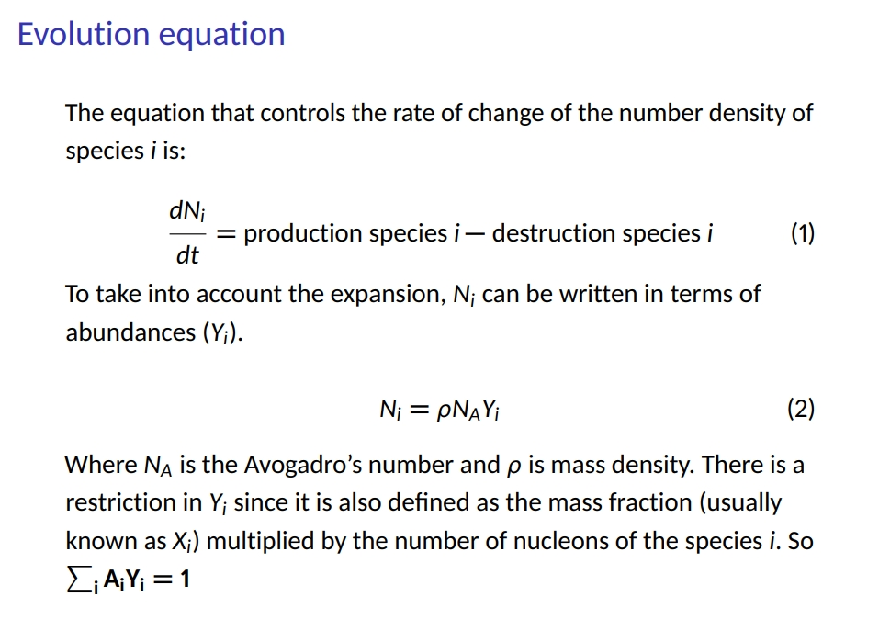
Credit: Jose Trujillo, U. Calgary

Slide 29
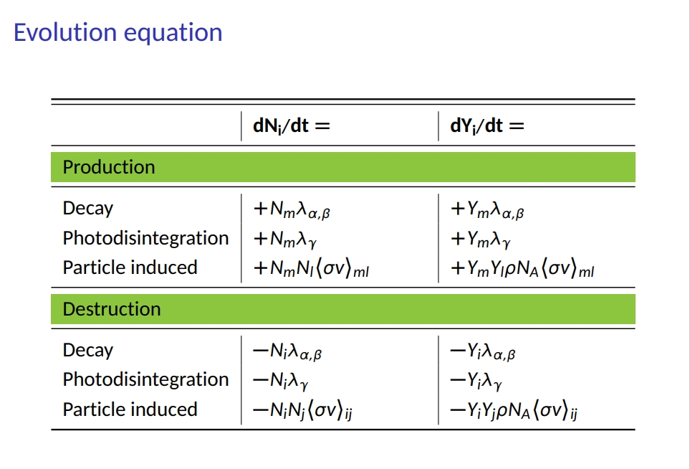
Credit: Jose Trujillo, U. Calgary

Slide 30
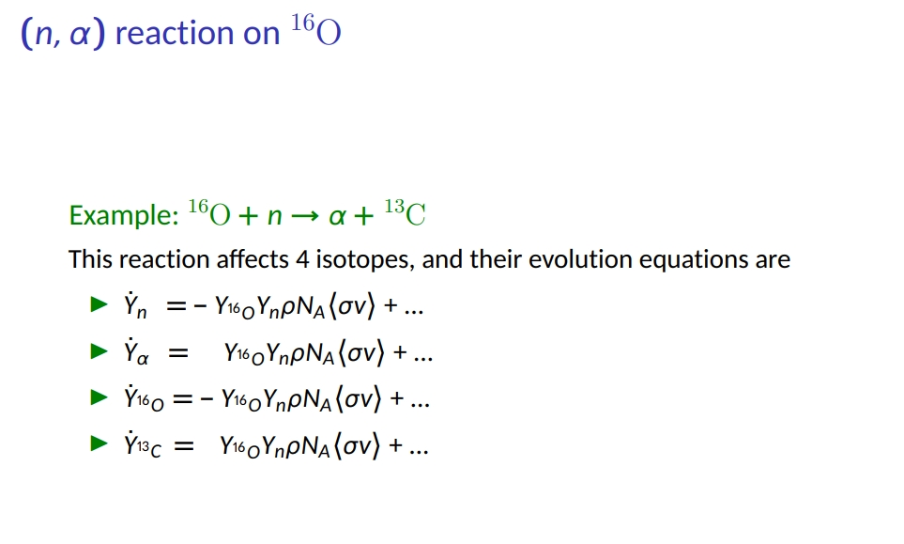
Credit: Jose Trujillo, U. Calgary
“Rate”

Slide 31
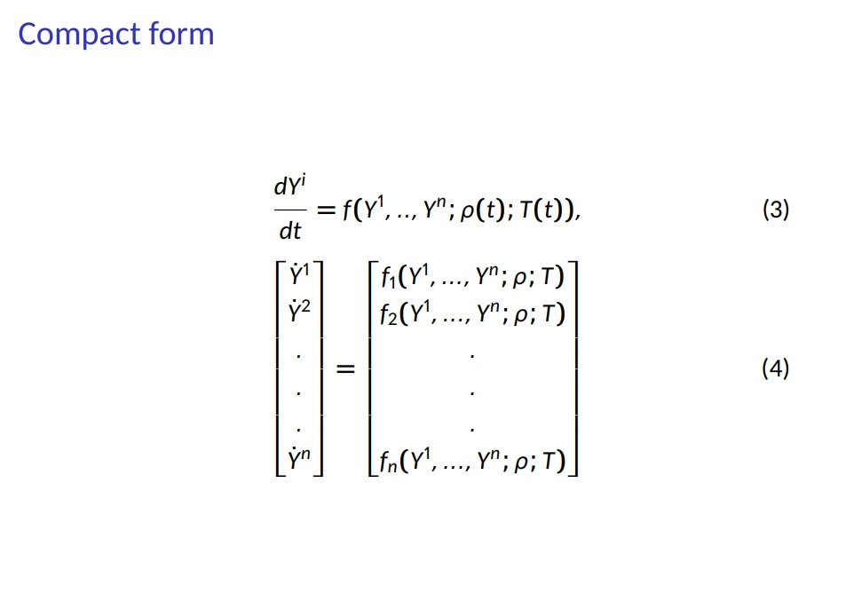
Credit: Jose Trujillo, U. Calgary
Different numerical methods can be used to solve the set of coupled differential equations

Slide 32
The equations require the knowledge of temperature, density (or entropy) in the astrophysical environment
Big bang
Main sequence star
Nova
Supernova
Mergers

Slide 33
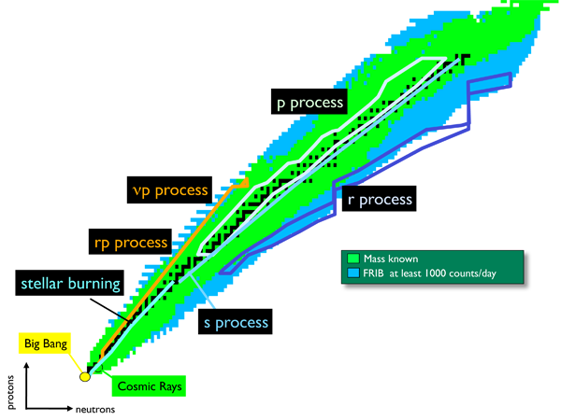
Rapid neutron capture process (r-process)
Fusion

Slide 34
Rapid neutron capture process (r-process)
Faster matter expansion than gravitational collapse
Faster photon dissociation than capture of neutrons
Faster neutron captures than beta decay
Faster (any) decay than neutron captures

Slide 35
Rapid neutron capture process (r-process) why fast?
Faster matter expansion than gravitational collapse
Faster photon dissociation than capture of neutrons
Faster neutron captures than beta decay
Faster (any) decay than neutron captures

Slide 36
Rapid neutron capture process (r-process) why fast?
Faster matter expansion than gravitational collapse
Faster photon dissociation than capture of neutrons
Faster neutron captures than beta decay
Faster (any) decay than neutron captures
Need many MANY neutrons to allow faster captures >> 10²⁰ /cm³

Slide 37
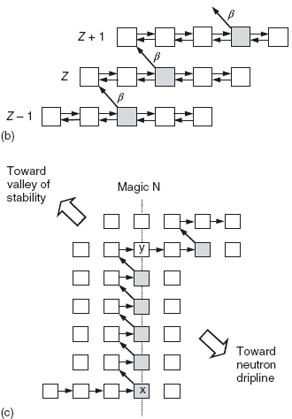
Rapid neutron capture process (r-process)

Slide 38

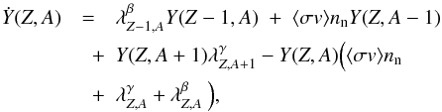
Rapid neutron capture process (r-process)
Limiting to neutron captures, photodissociation, beta decay

Slide 39
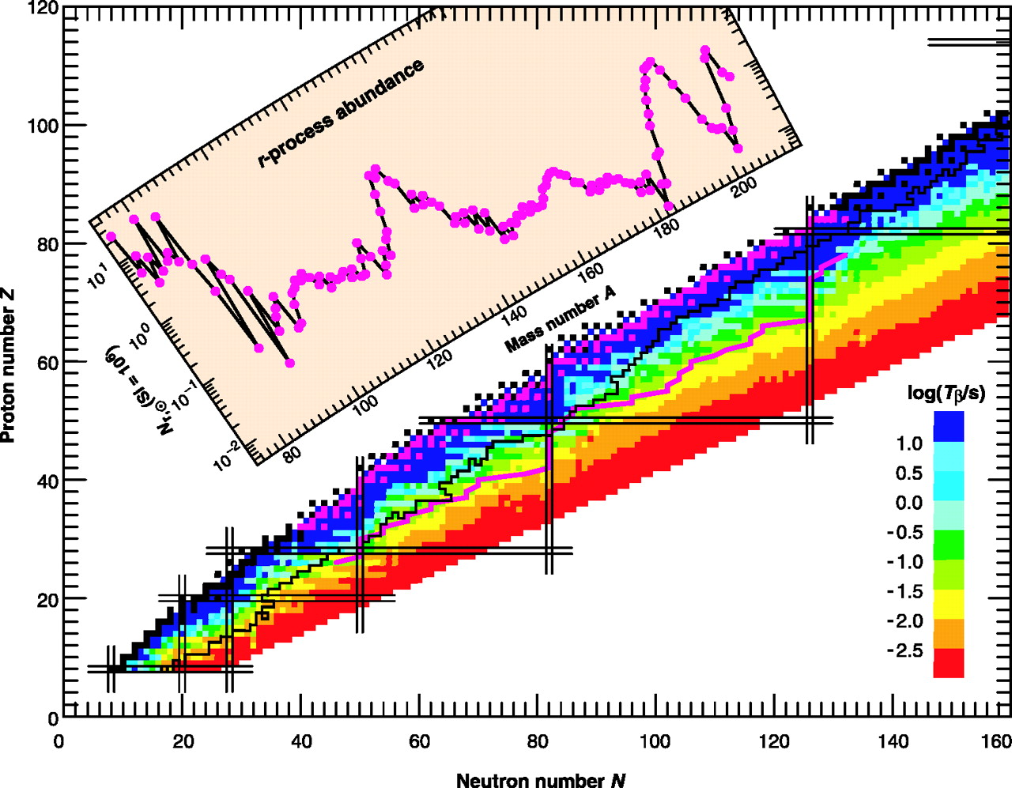
Synthesis of heavy elements
(P. Moeller et al 2003)

Slide 40
Nucleosynthesis and neutrinos

Slide 41




Neutrinos affect the synthesis of heavy elements
Proton rich
Neutron rich
(P. Moeller et al 2003)
Neutrinos set the electron fraction Y_{e}

Slide 42
Neutrino driven wind
Duncan et al 1986, Woosley et al 1994 , Arcones Thielemann 2012, Perego 2014, Just et al 2014
Core-collapse and mergers: binding energy transformed into internal energy
Neutrinos are trapped at high densities
After diffusing they can freely stream (from the neutrino surface)
Some of the escaping neutrinos deposit energy in the matter beyond the neutrino surface
Matter is blown off =wind

Slide 43
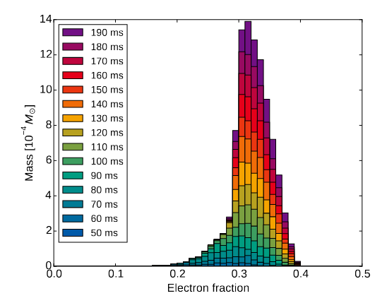
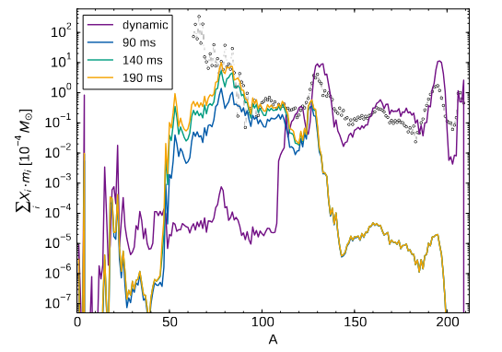
Neutrino driven wind and nucleosynthesis
Neutrinos have sufficient time to change the electron fraction
D. Martin et al ApJ 2015

Slide 44
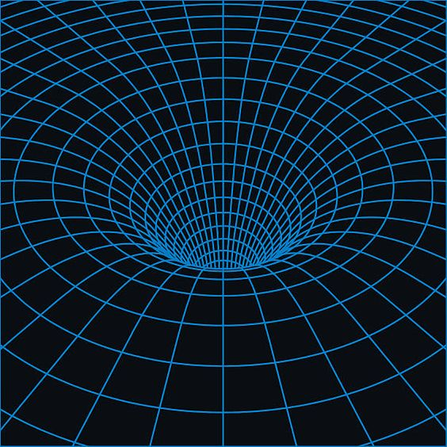
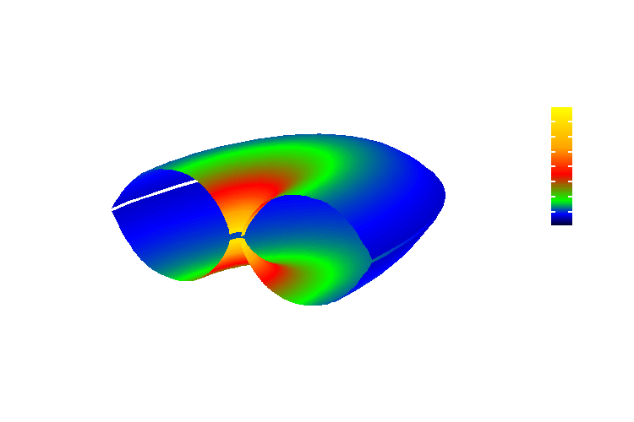
Neutrinos from compact objects
Neutrinos are deflected and redshifted
Electron neutrino

Slide 45
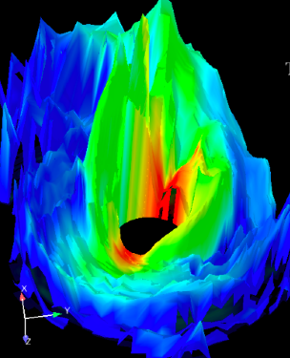


If antineutrinos are more energetic than neutrinos then they will drive the material neutron rich and vice versa
Outflow-Neutrino driven wind (observer)
Neutrinos
$${\overline{ν}}_{e}+p⟷e^{+}+n$$
$$ν_{e}+n⟷e+p$$
If both neutrino and antineutrino fluxes are weak the nucleosynthesis will strongly depend on the outflow conditions

Slide 46
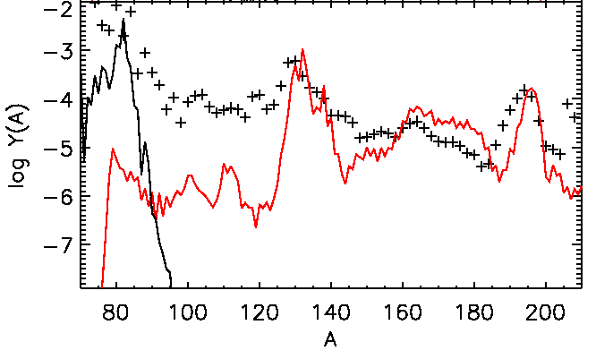
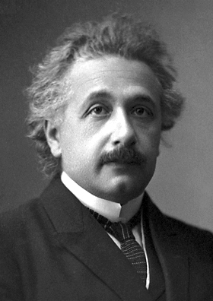
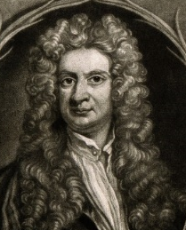
Nucleosynthesis and neutrinos
Abundances
Caballero, McLaughlin, Surman. ApJ 2012

Slide 47
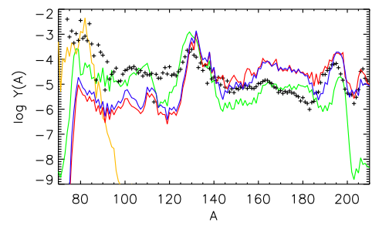


General relativity and Accretion disk Nucleosynthesis
More redshifted
No GR: only first peak achieved.
$${\overline{ν}}_{e}+p⟷e^{+}+n$$
Final abundances
$$ν_{e}+n⟷e+p$$
GR neutrinos are less energetic.
Material remains neutron rich
Caballero, McLaughlin, Surman. ApJ 2012
Yellow = Newtonian neutrinos
Green = Static disk and a=0
Red = Rotating disk and a=0
Blue = Rotating disk and a=0.6
Outflow model
Low entropy S/k=20
Fast outflow t=5 ms

Slide 48
Take away messages
Neutrinos from mergers will not be mistaken for Supernova neutrinos
We could detect neutrinos from:
Milky way and satellite galaxies in SuperK
Andromeda (780 kpc) in HyperK
Note that the 2017 NS merger observation led to a source distance of 40 Mpc.
Abundances (r-process) depend on the conditions of the outflow, the geometry of the source, and on neutrino fluxes.

Slide 49
Conclusions
This is a new era in Astronomy: nuclear physics expertise is integral to the success of multi-messenger studies.
MeV Neutrinos carry information from the interior of compact objects. Their detection (or by-products e.g. heavy element synthesis) will shed light on fundamental physics, and help interpret multi-messenger signals

Slide 50
Thank you!

