Slide 1
Develop more from less.
IDEEROTH AG · PRODUCT DEVELOPMENT FROM SWITZERLAND
Customer presentation · Romanshorn, 15 October 2026
20+
YEARS OF EXPERIENCE
100+
PROJECTS
5
SERVICES
Notes:
Key figures are placeholders.

Slide 2
Swiss engineered.
02 // COMPANY
Development, design, simulation and prototyping in house. From the first idea to series production.

Slide 3
What we do
02 // COMPANY
From the first idea to series production: engineering, simulation, development and prototyping under one roof.
Our team supports customers in product development and so improves their competitiveness. We value:
An independent and neutral perspective
Targeted implementation and results
A strong technological and business network
Industry-specific application expertise

Slide 4
What we do
02 // COMPANY
From the first idea to series production: engineering, simulation, development and prototyping under one roof.
Our team supports customers in product development and so improves their competitiveness. We value:
An independent and neutral perspective
Targeted implementation and results
A strong technological and business network
Industry-specific application expertise

Slide 5
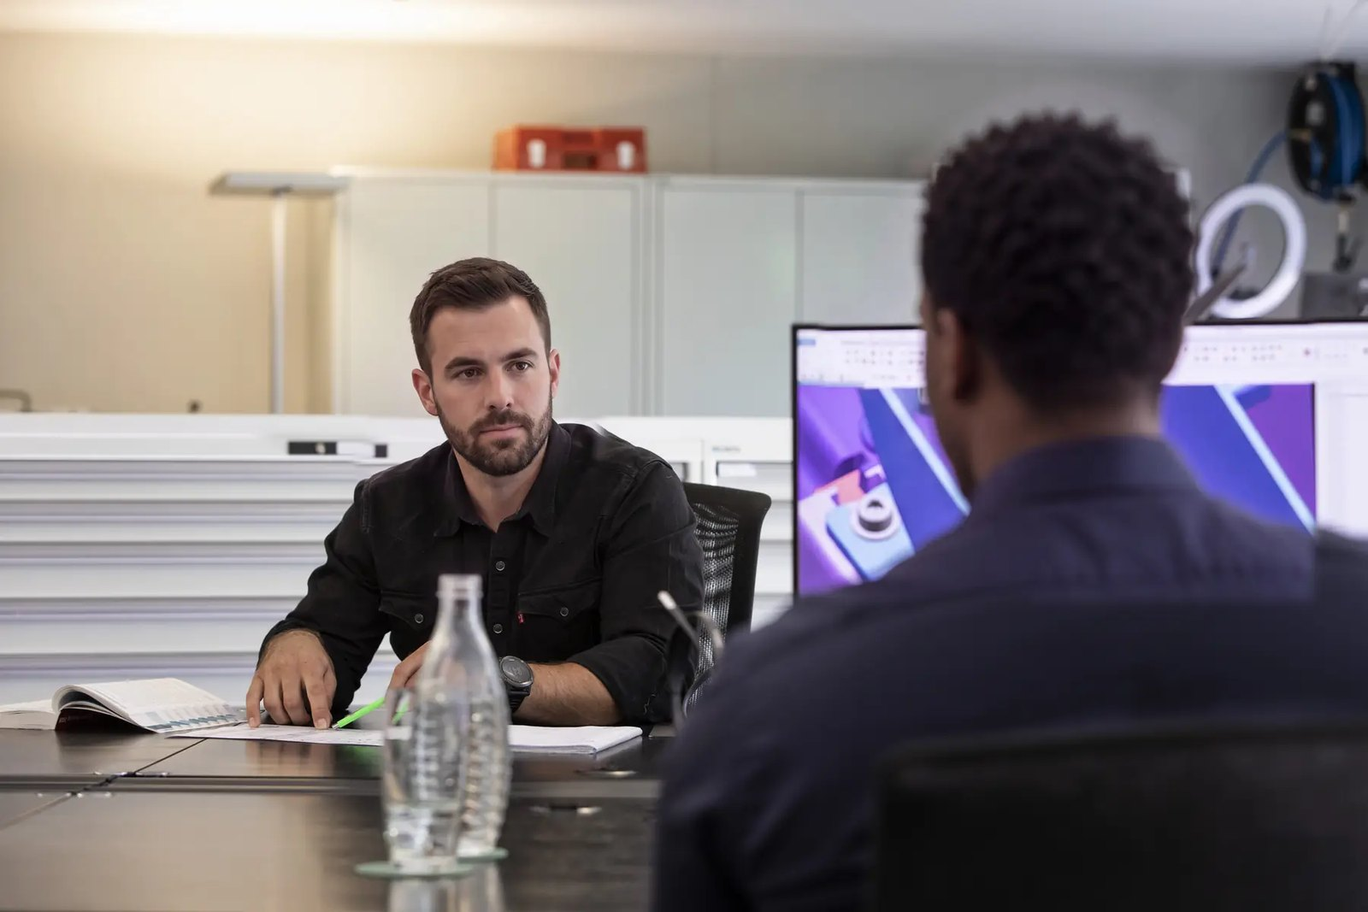
Design with 3D CAD
03 // EXPERTISE
We design assemblies, fixtures and devices so that they can be manufactured economically.
Every decision is checked in the model before it costs money: tolerances, assembly, choice of material and suitability for series production.
The result: fewer parts, shorter paths and products that last.

Slide 6
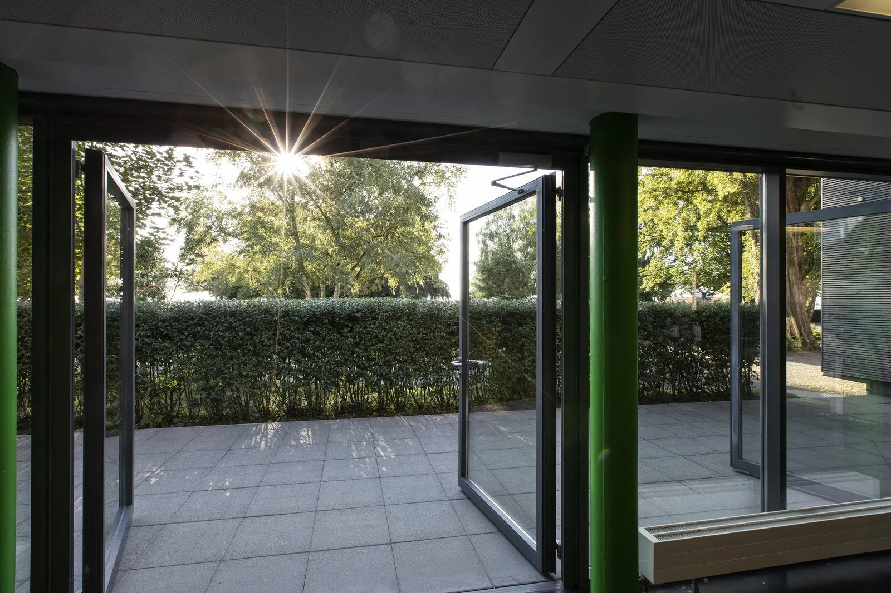

From the first idea. To series production.
VIEW FROM THE OFFICE ONTO THE TERRACE
Notes:
Insert the photo into the placeholder and keep the veil (black rectangle, 45 % transparent) on top.

Slide 7
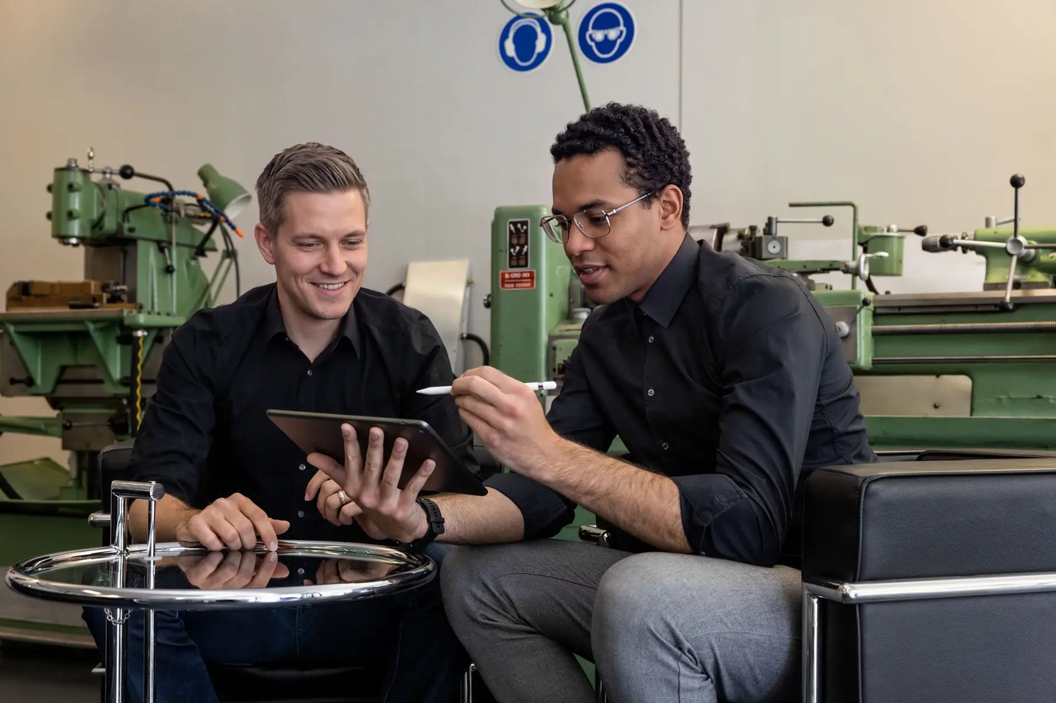
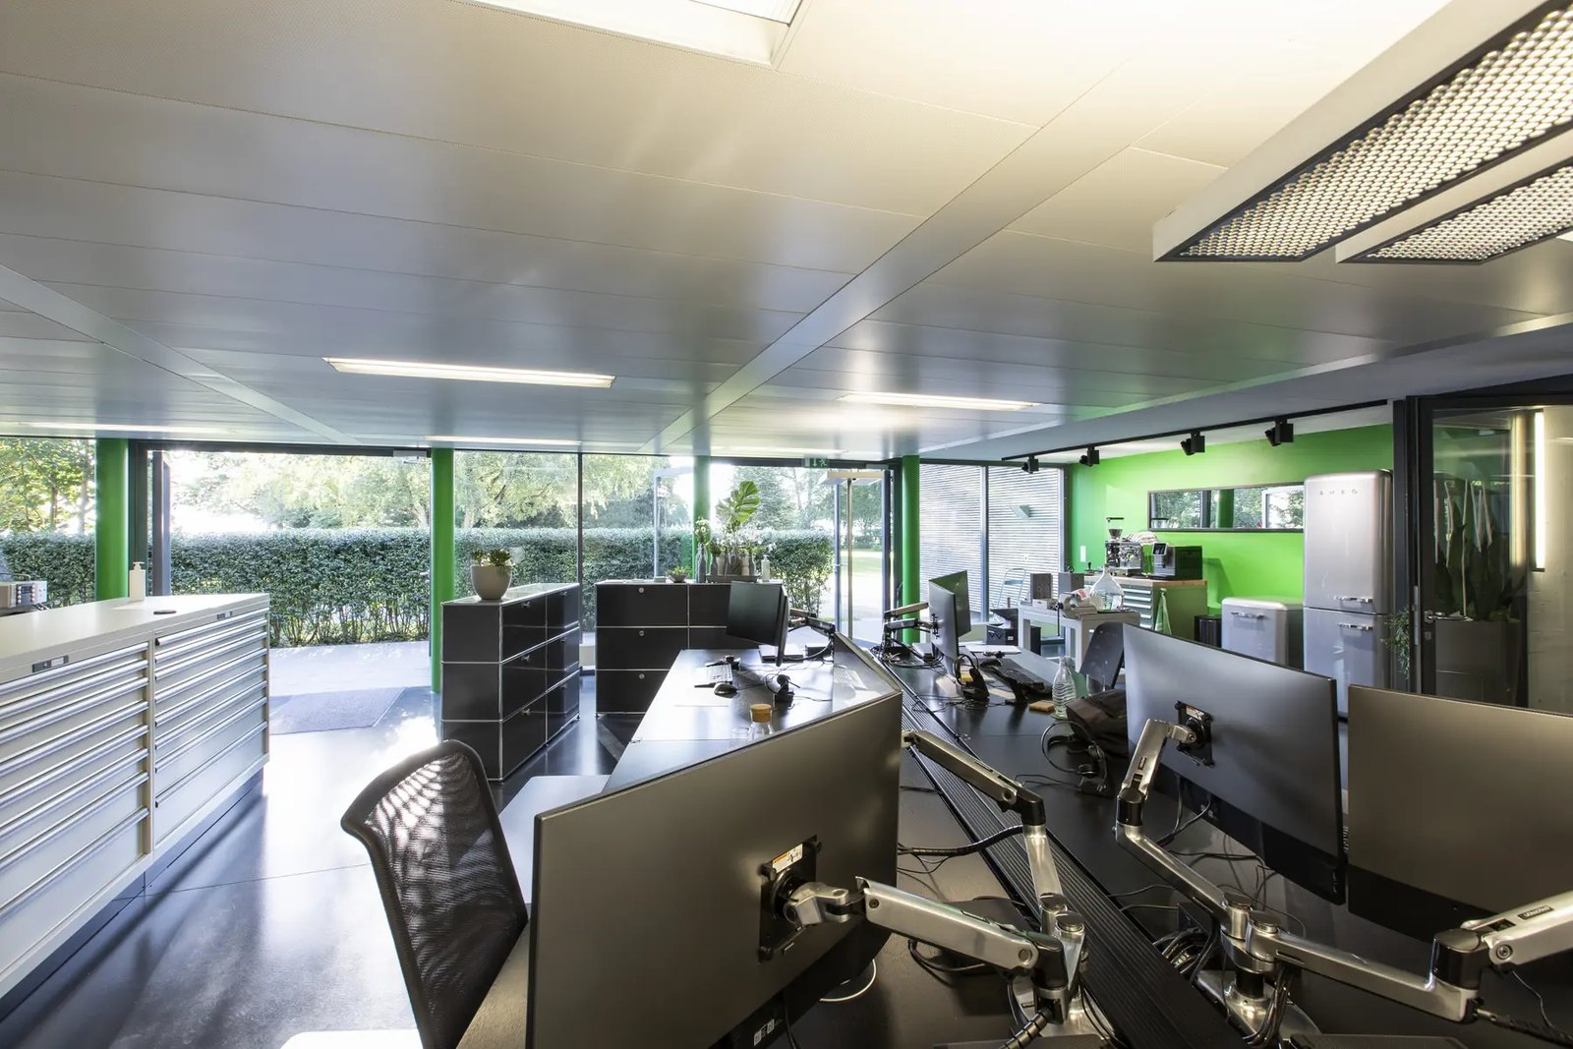
Expertise under one roof
03 // EXPERTISE
01 // IDEATION
02 // DEVELOPMENT
03 // SIMULATION
Ideation
Development
Simulation
Sharpen ideas, assess variants, find the simplest solution.
Design with 3D CAD, ready for manufacturing and series production.
Calculate strength and flow before the first part is made.

Slide 8

How we work
04 // SERVICES
01
Idea
02
Concept
03
Design
04
Development
05
Prototype
01 // IDEA · THREE COLLEAGUES CHECK PARTS

Slide 9
What we stand for
05 // TEAM
01 // VISION
Guided by this vision, we solve problems with our ideas. In our customers’ innovation networks we are a long-term partner - sustainable, ecological and efficient.
Better products for life.
02 // MISSION
Our team supports customers in product development and so improves their competitiveness.
Develop more from less.
03 // VALUES
Our people are our most important asset. We offer attractive workplaces and develop our people systematically.
Responsible, honest, loyal.

Slide 10
“Develop more from less - the simplest solution is usually the best.”
02 // COMPANY · MISSION
Alain Roth · Founder, IdeeRoth AG

Slide 11
A project in figures
04 // SERVICES
38%
6
100%
FEWER PARTS
WEEKS TO PROTOTYPE
IN HOUSE
Assembly rethought, assembly time halved.
From kick-off to the first functional sample.
Design, simulation and prototype.

Slide 12
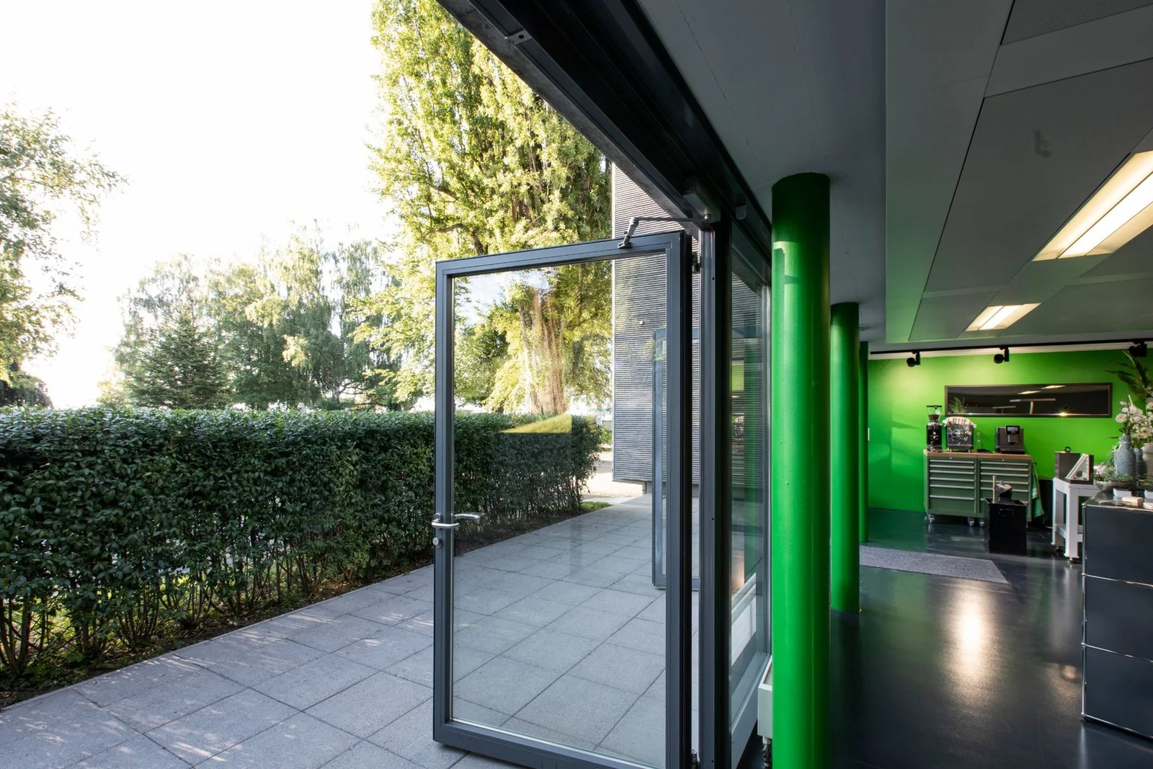
What today is about
AGENDA · CUSTOMER PRESENTATION · PROJECT NUMBER
01
Starting point and goal
02
Concept variants
03
Simulation and results
04
Prototype and tests
05
Schedule and costs
06
Next steps
15 OCTOBER 2026 · ROMANSHORN · 60 MINUTES

Slide 13
Work packages and status
05 // SCHEDULE AND COSTS
NO | WORK PACKAGE | RESPONSIBLE | DUE | EFFORT | STATUS
01 | Requirements and specification | A. Roth | 31 Mar 2026 | 8 days | DONE
02 | Concept variants A and B | Design team | 30 Jun 2026 | 22 days | DONE
03 | Simulation of strength and flow | Simulation team | 30 Nov 2026 | 12 days | ACTIVE
04 | Prototype and functional test | Workshop | 28 Feb 2027 | 18 days | OPEN
05 | Series preparation and documentation | A. Roth | 30 Apr 2027 | 10 days | OPEN
 | Total |  |  | 70 days

Slide 14
Fewer parts, less risk
03 // SIMULATION AND RESULTS
38% fewer parts
The new assembly combines several sheet-metal parts into injection-moulded parts. This cuts assembly steps almost in half and suppliers from nine to five.
Next step: verify tooling costs with two suppliers.
Count per assembly, as-is variant versus new variant

Slide 15
Product creation 2026
05 // SCHEDULE AND COSTS
IdeeRoth
Joint
Customer / supplier
59 days
Pre-development
1 Feb - 31 Mar
75 days
Product definition
15 Feb - 30 Apr
76 days
Concept development
1 Apr - 15 Jun
92 days
Series development
1 Jun - 31 Aug
78 days
Series preparation
15 Jul - 30 Sep
45 days
Ramp-up
1 Sep - 15 Oct
61 days
Series
1 Oct - 30 Nov
47 days
Product care
15 Nov - 31 Dec
JAN
FEB
MAR
APR
MAY
JUN
JUL
AUG
SEP
OCT
NOV
DEC
1
2
3
4
5
6
7
8
9
10
11
12
13
14
15
16
17
18
19
20
21
22
23
24
25
26
27
28
29
30
31
32
33
34
35
36
37
38
39
40
41
42
43
44
45
46
47
48
49
50
51
52
53
1 February 2026
Project start
Milestone 1 · Concept release
Milestone 2 · Series release
Today
31 December 2026
Project end
Notes:
Schedule made of shapes: move or stretch bars, edit labels, copy a row. For another year copy the slide and adjust the month band.

Slide 16
What we do
Was wir tun
02 // COMPANY · UNTERNEHMEN
From the first idea to series production: engineering, simulation, development and prototyping under one roof.
Von der ersten Idee bis zur fertigen Serienentwicklung: Konstruktion, Simulation, Entwicklung und Prototyping unter einem Dach.
An independent and neutral perspective
Eine unabhängige und neutrale Sichtweise
Targeted implementation and results
Eine zielgerichtete Umsetzung und Resultaterreichung
A strong technological and business network
Einen starken technologischen und betriebswirtschaftlichen Leistungsverbund
Industry-specific application expertise
Branchenspezifisches Anwendungsfachwissen
Notes:
Bilingual A: second language as a muted sub-line. For mixed audiences with little text.

Slide 17
What we do · Was wir tun
02 // COMPANY · UNTERNEHMEN
ENGLISH
DEUTSCH
From the first idea to series production: engineering, simulation, development and prototyping under one roof.
Von der ersten Idee bis zur fertigen Serienentwicklung: Konstruktion, Simulation, Entwicklung und Prototyping unter einem Dach.
An independent and neutral perspective
Eine unabhängige und neutrale Sichtweise
Targeted implementation and results
Eine zielgerichtete Umsetzung und Resultaterreichung
A strong technological and business network
Einen starken technologischen und betriebswirtschaftlichen Leistungsverbund
Industry-specific application expertise
Branchenspezifisches Anwendungsfachwissen

Slide 18
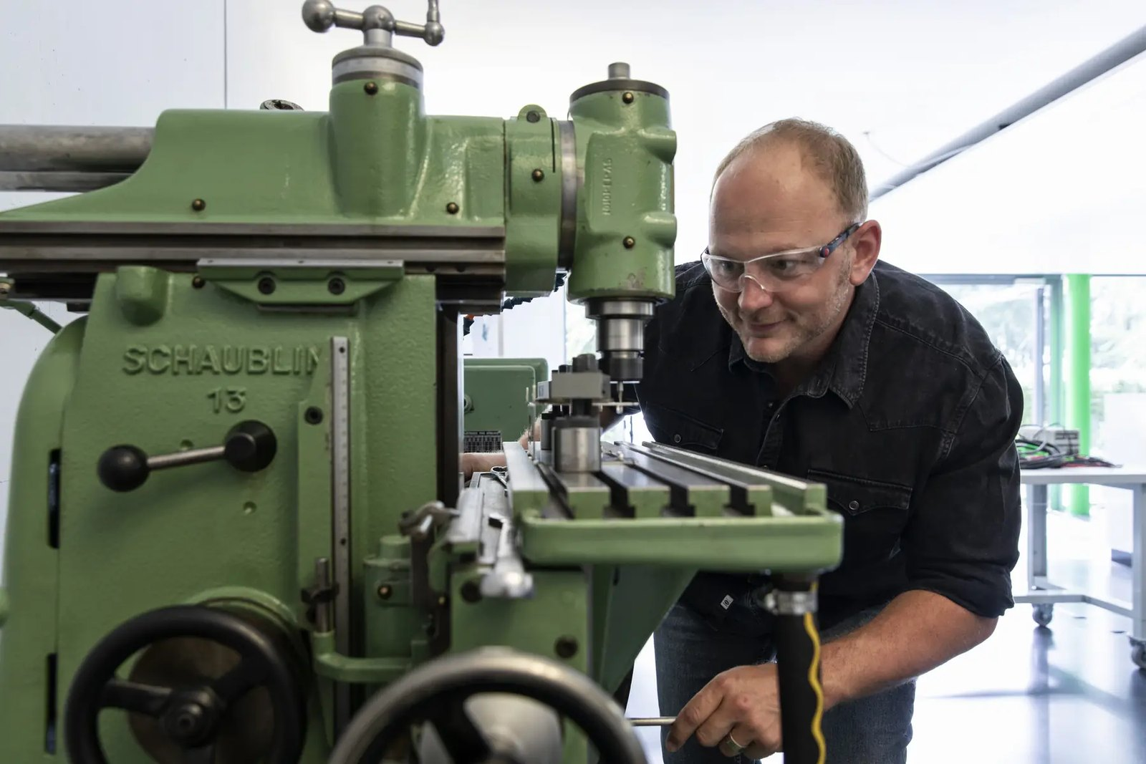
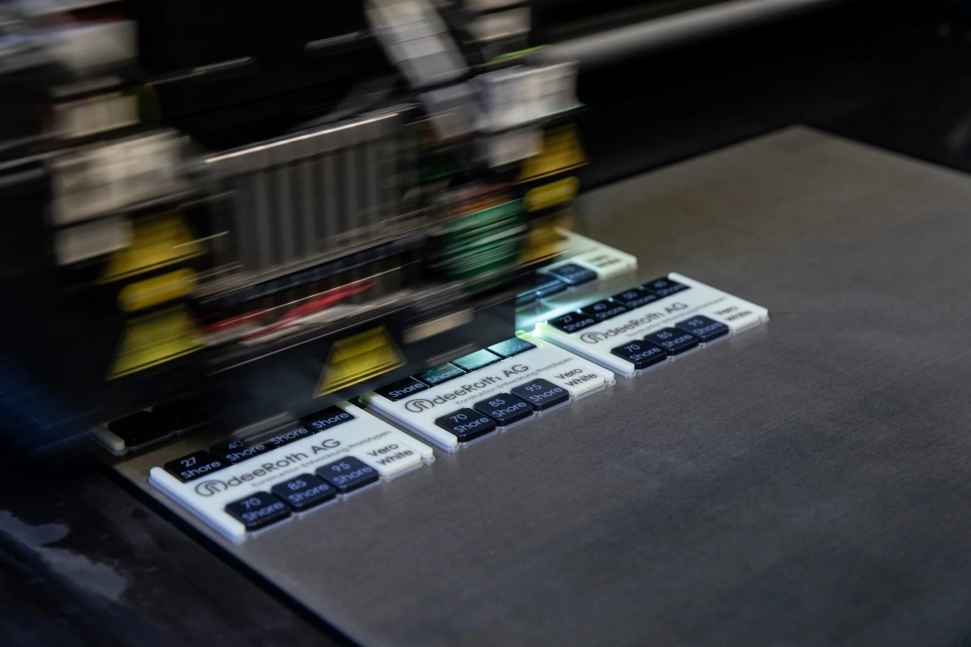
Sheet metal or injection moulding
02 // CONCEPT VARIANTS
VARIANT A · SHEET METAL
VARIANT B · INJECTION MOULDING
48 parts, 9 suppliers
Low tooling cost, high part cost
31 assembly steps
30 parts, 5 suppliers
High tooling cost, low part cost
17 assembly steps
48 parts · CHF 48 · tooling CHF 9,000
30 parts · CHF 31 · tooling CHF 42,000
RECOMMENDED

Slide 19
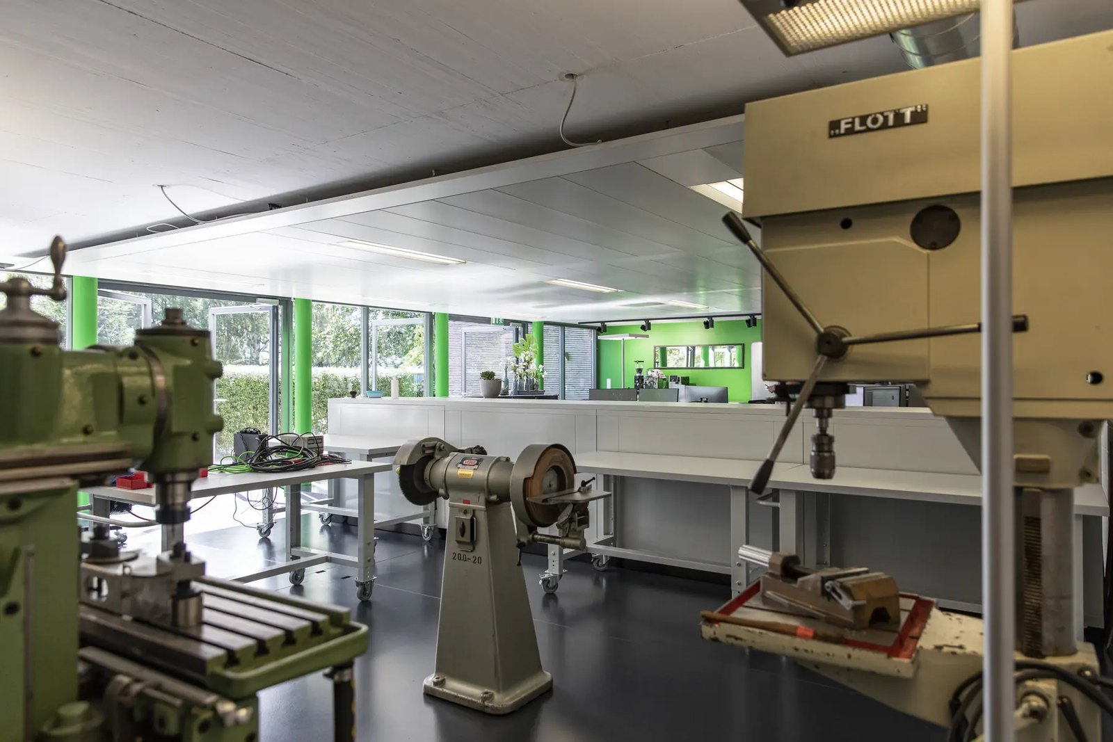

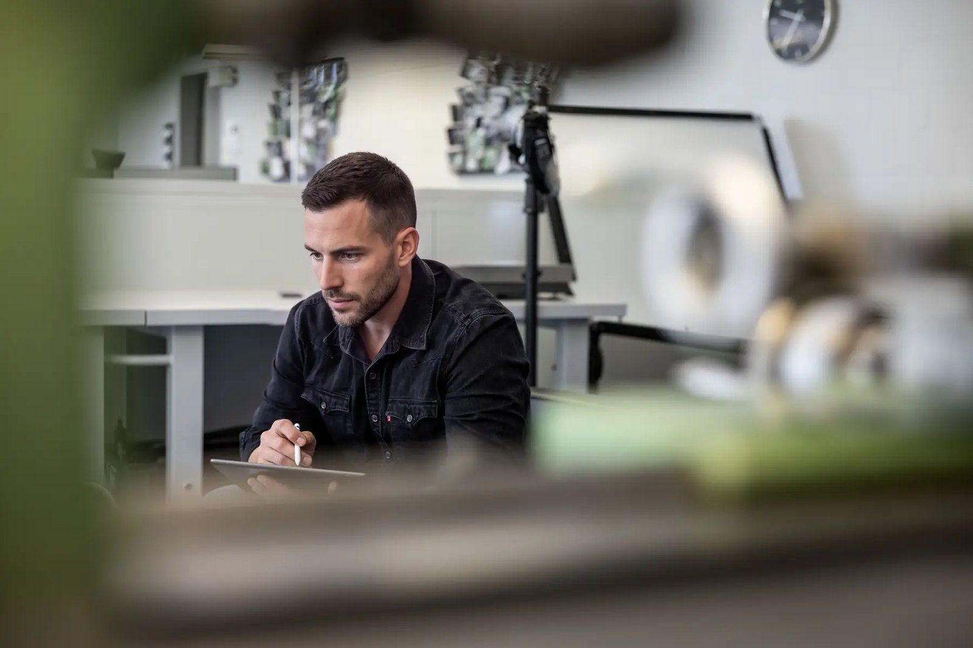
From sample to functional prototype
04 // PROTOTYPE AND TESTS
01 // SHORE HARDNESS SAMPLES
02 // TURNED PART
03 // SUB-ASSEMBLY
04 // MEASUREMENT
05 // FUNCTIONAL SAMPLE
06 // FINAL ASSEMBLY

Slide 20
Your contacts
06 // CONTACT
Alain Roth
Firstname Lastname
MANAGING DIRECTOR · DEVELOPMENT
PROJECT LEAD · DESIGN
+41 71 855 88 55
alain.roth@iro.swiss
+41 71 855 88 55
firstname.lastname@iro.swiss
Hafenstrasse 62 · CH-8590 Romanshorn
Hafenstrasse 62 · CH-8590 Romanshorn

Slide 21
Three parts, three release states
04 // PROTOTYPE AND TESTS · RELEASE STATUS
CONFIDENTIAL
UNDER REVIEW
RELEASED
01 // SHORE SAMPLES · DO NOT DISTRIBUTE
02 // TURNED PART · DIMENSIONS UNDER REVIEW
03 // FUNCTIONAL SAMPLE · RELEASED 12 OCT
Red means attention and prohibition, amber means under review, green means released. The label at the top right applies to the whole slide, the labels on the pictures apply to the individual item. The short form of the protection notice sits below the label.

Slide 22



Let us talk about your project.
EXPERTISE
TEAM
IdeeRoth AG
Hafenstrasse 62
CH-8590 Romanshorn
+41 71 855 88 55
info@iro.swiss
COMPANY
CAREERS
SERVICES
CONTACT

Slide 23
Building blocks for your own slides
TEMPLATE · GRAPHIC ELEMENTS
01 // TEXT FIELDS
02 // LINES, ARROWS, MARKERS
03 // STATUS AND RELEASE (TRAFFIC LIGHT)
Text field with a thin frame for notes, assumptions or quotations from documents.
Arrow, sequence
DONE
ACTIVE
OPEN
Arrow, emphasis
Task status: done, active, open (brand colours)
Arrow, option
CONFIDENTIAL
UNDER REVIEW
RELEASED
Highlight on Fresh Mint for the most important point of a slide, one per slide.
Line, divider
Release status as traffic light: red = attention, prohibition, confidential; amber = under review, preliminary; green = released. Labels only, never content.
Round corner markers around photos, sketches and screenshots
INTERNAL
DRAFT
Key message on Carbon Black, text in Ice Mint, number or keyword in Signal Green.
Neutral labels without traffic-light meaning
Dot instead of square as bullet
Same dot in every list
TO THE SIMULATION →
Arrow link as reference to another slide
Notes:
Building blocks to copy. This slide is hidden in the template and is not presented.

Slide 24
Colour concept: brand, ground, status
TEMPLATE · COLOURS
Carbon Black
Ice Mint
Signal Green
Fresh Mint
Steel Gray
Light Gray
DARK GROUND · TEXT ON LIGHT
MINT GROUND · TEXT ON DARK
ONE ACCENT PER SLIDE
SECOND HIGHLIGHT · LINKS
SECONDARY TEXT · LABELS · INACTIVE
PLACEHOLDERS · AS-IS VALUES
HEX #111418
RGB 17 · 20 · 24
CMYK 29 · 17 · 0 · 91
HSL 214° · 17 % · 8 %
HEX #E7FFF2
RGB 231 · 255 · 242
CMYK 9 · 0 · 5 · 0
HSL 148° · 100 % · 95 %
HEX #25C77A
RGB 37 · 199 · 122
CMYK 81 · 0 · 39 · 22
HSL 151° · 69 % · 46 %
HEX #B7F3D0
RGB 183 · 243 · 208
CMYK 25 · 0 · 14 · 5
HSL 145° · 71 % · 84 %
HEX #707981
RGB 112 · 121 · 129
CMYK 13 · 6 · 0 · 49
HSL 208° · 7 % · 47 %
HEX #C4C8CC
RGB 196 · 200 · 204
CMYK 4 · 2 · 0 · 20
HSL 210° · 7 % · 78 %
GROUND COLOURS
STATUS COLOURS (LABELS ONLY)
White
Documents, print, dense content
Mint
Presentation on screen
Dark
Title, chapter, quote, closing
Red
Attention, prohibition, confidential
#B8463A · 184 · 70 · 58
Amber
Under review, preliminary
#E2A33D · 226 · 163 · 61
Green
Released (Fresh Mint)
#B7F3D0 · 183 · 243 · 208
Notes:
Colour concept. CMYK is the standard conversion without a colour profile; agree print values with the printer. This slide is hidden in the template.

Slide 25
Which colour when
TEMPLATE · COLOURS
Ground
One ground colour per slide. White for documents to read and print, Mint for presentations on screen, Dark for title, chapter, quote and closing. Do not switch between White and Mint within one presentation.
Proportions
Ground colour about 70%, text and grey 25%, Signal Green at most 5%.
Signal Green
Accent only: active state, one key figure, today line, buttons, links, label "Recommended", series "New" in charts, IdeeRoth bars in the schedule. Never for body text, never as a surface behind text.
Fresh Mint
Surface behind a highlight, links and hover on Dark, light schedule bars, label "Released".
Lines
Text colour at 40% opacity: #A0A1A3 on White, #91A19B on Mint, #707274 (white) on Dark. 0.5 pt solid, like the line in the hero of the website.
Traffic light
Red, amber and green only for release labels: red = attention, prohibition, confidential; amber = under review, preliminary; green = released. Never for charts or text, otherwise the traffic light loses its meaning.
Print
CMYK is the standard conversion without a colour profile. Signal Green lies outside the print gamut and will look duller; agree print values with the printer once.
PowerPoint
Brand and status colours are available as theme colours in the colour picker; tints are generated automatically.
Notes:
Colour rules. This slide is hidden in the template.

