Slide 1
R2DBC
Notes:
Моя цель – рассказать что такое R2DBC, и как эта технология может повлиять на то, как мы будем писать приложения.

Slide 2
Поиграем в игру?
ODBC
  Open Database Connectivity
JDBC
  Java Database Connectivity
R2DBC
  Reactive Relation Database Connectivity

Slide 3
Поиграем в игру?
ODBC
  26
JDBC
  21
R2DBC
  ~1
Notes:
История как Sun сделал JDBC и использовал ODBC как основу, в отсутствии нативного драйвера

Slide 4
R2DBC
Reactive Streams - R2DBC is founded on Reactive Streams providing an asynchronous, non-blocking API
Relational Databases - R2DBC engages relational databases with a reactive API, something not possible with the blocking nature of JDBC and JPA

Slide 5


Why Reactive

Slide 6
Reactive API vs Coroutines API
 | Reactive | Coroutines
Single Value | fun single(): Mono<T> | suspend fun single(): T
Cold Stream | fun coldStream(): Flux<T> | -
Hot Stream | fun hotStream(): Flux<T> | fun hotStream(): ReceiveChannel<T>

Slide 7
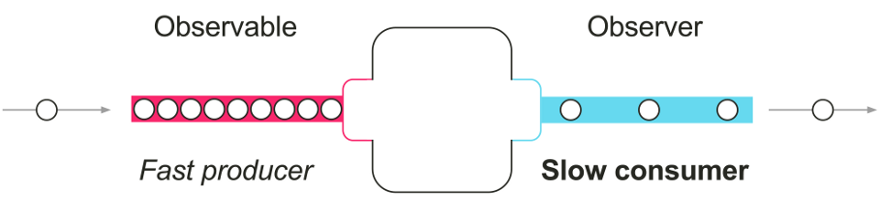

Slide 8
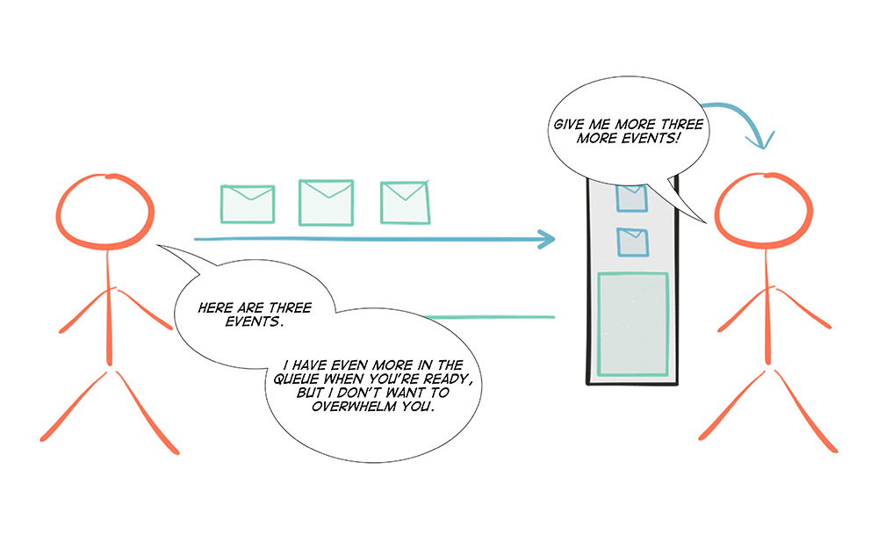

Slide 9
Why not ADBA?
Not Reactive
Java 12 – no way (Java 17 maybe, 2021)
var result: CompletableFuture<List<Map<String, Any>>>
ds.getSession().use({ session ->
val submit = session
.rowOperation("SELECT id, name, manual FROM legoset")
.collect(collectToMap())
.submit()
result = submit.getCompletionStage().toCompletableFuture()
})

Slide 10

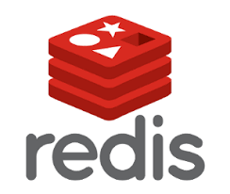
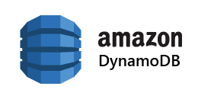
Relational

Slide 11
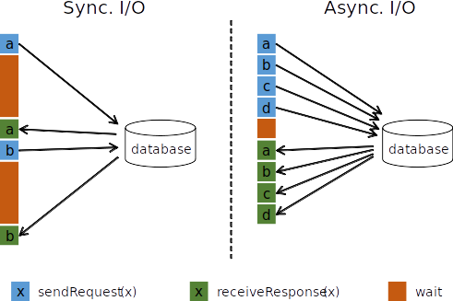
Non-Blocking
CPU/RAM consumption per request
Latency under load

Slide 12
RxNetty vs Tomcat
https://www.slideshare.net/brendangregg/rxnetty-vs-tomcat-performance-results

Slide 13
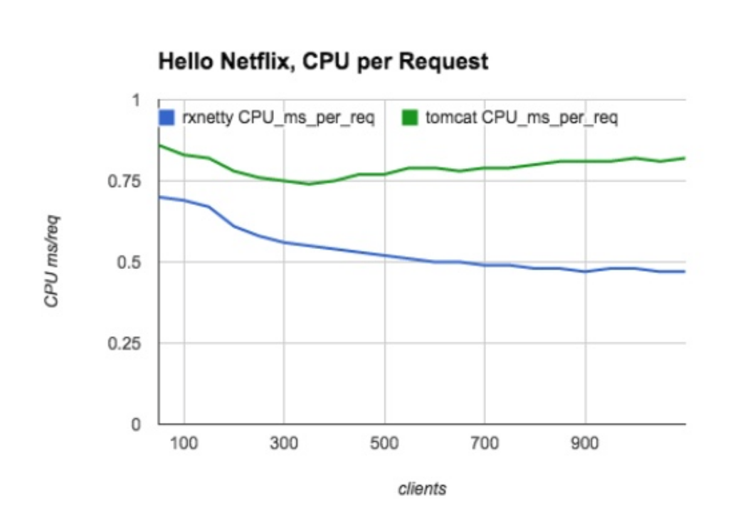
CPU/Request

Slide 14
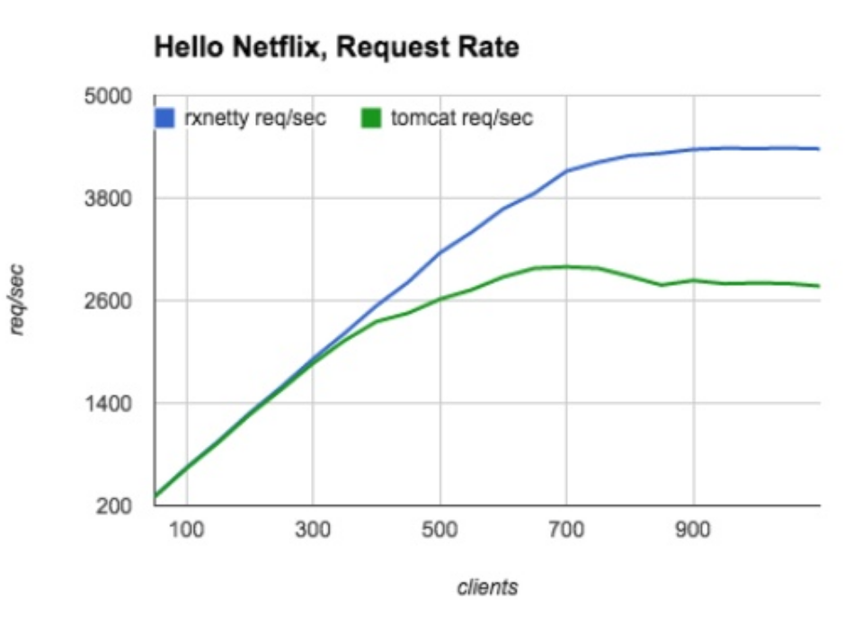
Request rate

Slide 15
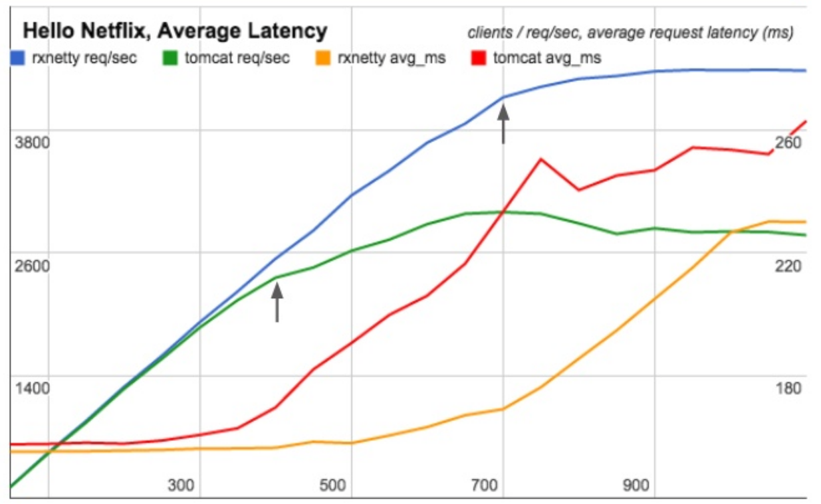
Reqest Latency (avg)

Slide 16
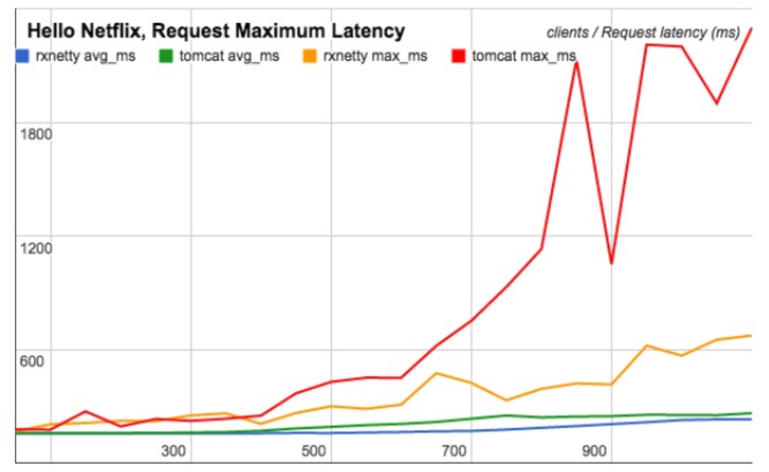
Reqest Latency (max)

Slide 17
R2DBC
r2dbc-spi
r2dbc-client
r2dbc-postgresql
r2dbc-over-adba

Slide 18
Supported DBs
PostgreSQL
H2
Microsoft SQL Server

Slide 19
Connection
val connectionFactory = PostgresqlConnectionFactory(
PostgresqlConnectionConfiguration.builder()
.host("localhost")
.database("bkug")
.username("bkug")
.password("password").build()
)

Slide 20
Select SPI
connectionFactory.create()
.flatMapMany { conn ->
conn.createStatement("SELECT value FROM bkug")
.execute()
.flatMap { result ->
result.map { row, meta -> row.get("value") }
}
}

Slide 21
Insert SPI
connectionFactory.create()
.flatMapMany { conn ->
conn.createStatement(
"INSERT INTO table (id, name, manual) VALUES($1, $2, $3)")
.bind("$1", 42055)
.bind("$2", "Description")
.bindNull("$3", Integer::class.java)
.execute()
}

Slide 22
Insert Transactional SPI
connectionFactory.create()
.flatMapMany { conn ->
conn.beginTransaction()
.thenMany(conn.createStatement(
"INSERT INTO table (id, name, manual) VALUES($1, $2, $3)")
.bind("$1", 42055)
.bind("$2", "Description")
.bindNull("$3", Integer::class.java)
.execute())
.delayUntil { conn.commitTransaction() }
.onErrorResume { e ->
conn.rollbackTransaction().then(Mono.error(e))
}
}

Slide 23
Select Client
val r2dbc = R2dbc(connectionFactory)
r2dbc.withHandle { handle ->
handle.select("SELECT value FROM bkug")
.mapRow { row -> row.get("value") }
}

Slide 24
Insert Client
r2dbc.withHandle { handle ->
handle.createUpdate("INSERT INTO bkug VALUES($1, $2)")
.bind("$1", 100)
.bind("$2", 200)
.execute()
}

Slide 25
Insert Transactional Client
r2dbc.inTransaction { handle ->
handle.createUpdate("INSERT INTO bkug VALUES($1, $2)")
.bind("$1", 100)
.bind("$2", 200)
.execute()
}

Slide 26
Insert Transactional Client
r2dbc.inTransaction { handle ->
handle.createUpdate("INSERT INTO bkug VALUES($1, $2)")
.bind("$1", 100)
.bind("$2", 200)
.execute()
}

Slide 27
Spring Data R2DBC
interface CustomerRepository extends ReactiveCrudRepository<Customer, Long> {
@Query("select id, firstname, lastname from customer c where c.lastname = $1")
Flux<Customer> findByLastnameLike(String lastname);
}

Slide 28
Spring Data R2DBC
Spring Fu
suspend fun count() = client.execute()
.sql("SELECT COUNT(*) FROM users").fetch().one()
suspend fun findAll() = client.select()
.from("users").asType(User::class).fetch().all()
suspend fun findOne(id: String) = client.execute()
.sql("SELECT * FROM users WHERE login = \$1")
.bind(1, id).fetch().one()

Slide 29

Benchmarks

Slide 30
Fin!

