Slide 1



ndertow
Notes:
Опрос: Кто слышал про Undertow?
Использовал напрямую?
Расскажу общие подходы к написанию севера (по сути то как все сервера устроены), общие подходы по использованию корутин в сервере (например реквест скоуп)

Slide 2
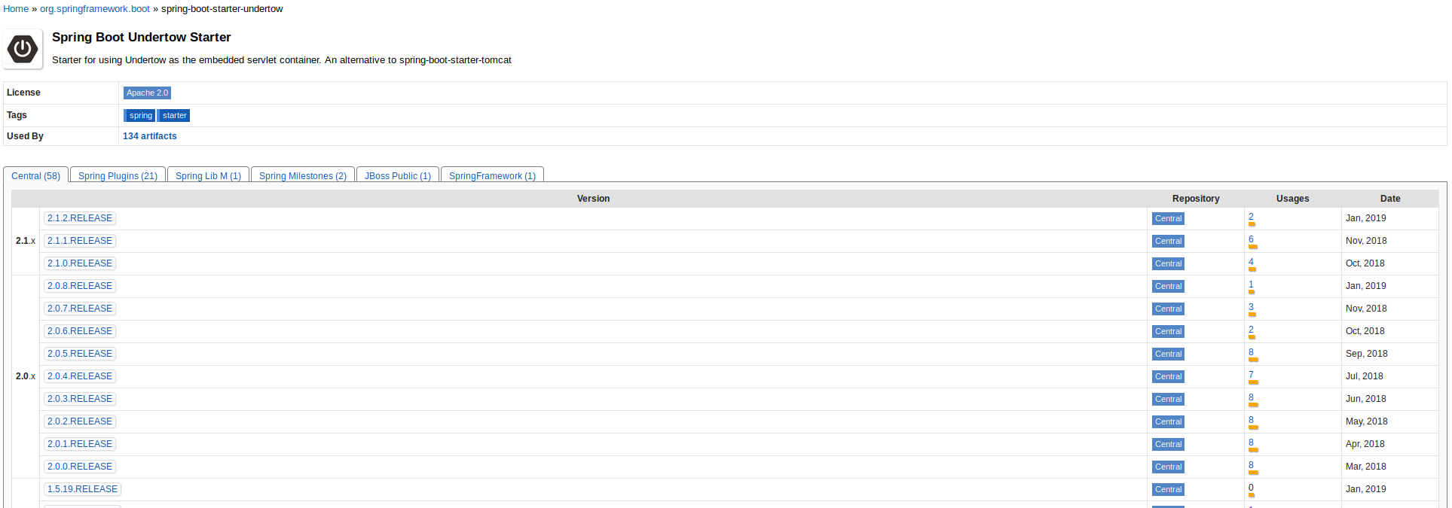
A Long Time Ago

Slide 3
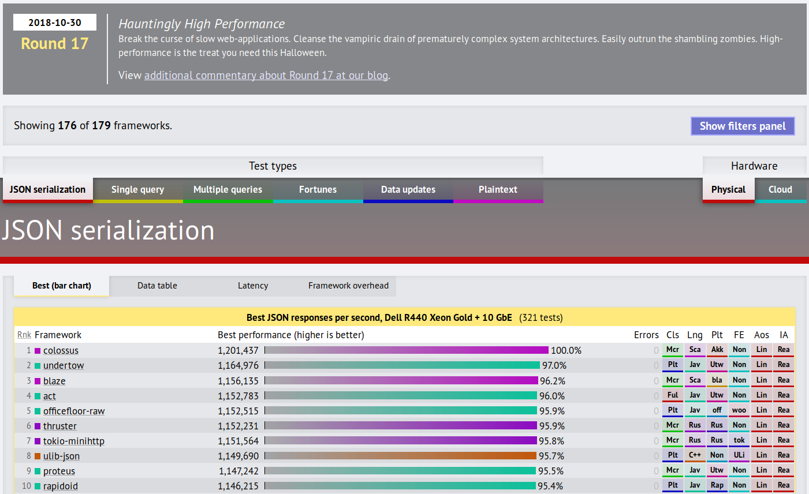
A Long Time Ago

Slide 4

A Long Time Ago

Slide 5
Undertow

Slide 6
Features
HTTP/HTTPS
HTTP/2
WebSockets

Slide 7
Hello, World!
Undertow.builder()
.addHttpListener(8080, "localhost") { it: HttpServerExchange
it.responseSender.send("Hello")
}
.build()
.start()

Slide 8
Hello, World!
Undertow.builder()
.addHttpListener(8080, "localhost") { it: HttpServerExchange
it.responseSender.send("Hello")
}
.build()
.start()

Slide 9
Hello, World!
Undertow.builder()
.addHttpListener(8080, "localhost") { it: HttpServerExchange
it.responseSender.send("Hello")
}
.build()
.start()

Slide 10
HttpHandler
public Builder addHttpListener(
int port,
String host,
HttpHandler rootHandler
) {
listeners.add(new ListenerConfig(ListenerType.HTTP, port, host, null, null, rootHandler));
return this;
}

Slide 11
HttpHandler
public interface HttpHandler {
/**
* Handle the request.
*
* @param exchange the HTTP request/response exchange
*
*/
void handleRequest(HttpServerExchange exchange) throws Exception;
}

Slide 12
HttpHandler
typealias HttpHandler = (exchange: HttpServerExchange) -> Unit

Slide 13
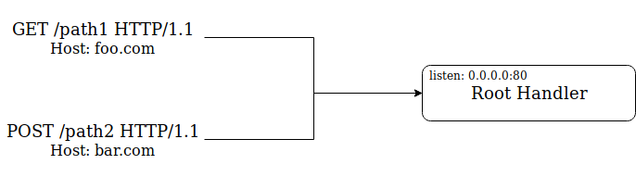
Architecture

Slide 14
Architecture
class BkugRootHandler : HttpHandler {
override fun handleRequest(exchange: HttpServerExchange) {
when (exchange.hostName) {
"foo.com" -> {
when (exchange.requestPath) {
"/path1" -> exchange.responseSender.send("foo.com/path1")
}
}
"bar.com" -> {
when (exchange.requestPath) {
"/path2" -> exchange.responseSender.send("bar.com/path2")
}
}
}
}
}

Slide 15
Architecture
class BkugRootHandler : HttpHandler {
override fun handleRequest(exchange: HttpServerExchange) {
when (exchange.hostName) {
"foo.com" -> {
when (exchange.requestPath) {
"/path1" -> exchange.responseSender.send("foo.com/path1")
}
}
"bar.com" -> {
when (exchange.requestPath) {
"/path2" -> exchange.responseSender.send("bar.com/path2")
}
}
}
}
}

Slide 16
Architecture
class BkugRootHandler : HttpHandler {
override fun handleRequest(exchange: HttpServerExchange) {
when (exchange.hostName) {
"foo.com" -> {
when (exchange.requestPath) {
"/path1" -> exchange.responseSender.send("foo.com/path1")
}
}
"bar.com" -> {
when (exchange.requestPath) {
"/path2" -> exchange.responseSender.send("bar.com/path2")
}
}
}
}
}

Slide 17
Architecture
fun main() {
Undertow.builder()
.addHttpListener(80, "0.0.0.0", BkugRootHandler())
.build()
.start()
}

Slide 18


Slide 19
Architecture - Composition
val fooHandler = RoutingHandler().get("/path1") {
it.responseSender.send("foo.com/path1")
}
Undertow.builder()
.addHttpListener(80, "0.0.0.0", fooHandler)
.build()
.start()

Slide 20
Architecture - Composition
val fooHandler = RoutingHandler().get("/path1") {
it.responseSender.send("foo.com/path1")
}
Undertow.builder()
.addHttpListener(80, "0.0.0.0", fooHandler)
.build()
.start()

Slide 21
Architecture - Composition
val fooHandler = RoutingHandler().get("/path1") {
it.responseSender.send("foo.com/path1")
}
Undertow.builder()
.addHttpListener(80, "0.0.0.0", fooHandler)
.build()
.start()

Slide 22
Architecture - Composition
val fooHandler = RoutingHandler()
.get("/path1", pathGetHandler)
.get("/path2", path2GetHandler)
.post("/path2", path3PostHandler)

Slide 23
Architecture - Composition
val fooHandler = RoutingHandler().get("/path1") {
it.responseSender.send("foo.com/path1")
}
val barHandler = RoutingHandler().post("/path2") {
it.responseSender.send("bar.com/path2")
}
val rootHandler = NameVirtualHostHandler()
.addHost("foo.com", fooHandler)
.addHost("bar.com", barHandler)
Undertow.builder()
.addHttpListener(80, "0.0.0.0", rootHandler)
.build()
.start()

Slide 24
Architecture - Composition
val fooHandler = RoutingHandler().get("/path1") {
it.responseSender.send("foo.com/path1")
}
val barHandler = RoutingHandler().post("/path2") {
it.responseSender.send("bar.com/path2")
}
val rootHandler = NameVirtualHostHandler()
.addHost("foo.com", fooHandler)
.addHost("bar.com", barHandler)
Undertow.builder()
.addHttpListener(80, "0.0.0.0", rootHandler)
.build()
.start()

Slide 25
Architecture - Composition
val rootHandler = NameVirtualHostHandler()
.addHost("foo.com", fooHandler)
.addHost("bar.com", barHandler)
class NameVirtualHostHandler : HttpHandler {
val hostToHandler = mapOf<String, HttpHandler>()
override fun handleRequest(exchange: HttpServerExchange) {
hostToHandler[exchange.hostName]
?.handleRequest(exchange)
}
}

Slide 26
Takeaway:
Applications are assembled from multiple handler (HttpHandler) classes
Notes:
У Undertow нету концепта контейнера, вместо него Undertow сервер собирается как композиция обработчиков, это делает Undertow очень гибким и позволяет приложению использовать только то, что ему нужно

Slide 27
Built-in Handlers
Path, Path Template, Virtual Host, Predicate
Resource
Websocket
Redirect
Trace
Header
Graceful Shutdown
Request Limiting Handler

Slide 28
Kotlin + Undertow
Handler Builder
Request Params
Request Headers
Response Body
Attachments

Slide 29
Kotlin + Undertow: Handler Builder
class HelloHandler : HttpHandler {
override fun handleRequest(exchange: HttpServerExchange) {
exchange.responseSender.send("Hello!")
}
}

Slide 30
Kotlin + Undertow: Handler Builder
inline fun handler(
crossinline body: HttpServerExchange.() -> Unit
): HttpHandler {
return HttpHandler { exchange -> body(exchange) }
}
val helloHandler = handler {
responseSender.send("Hello!")
}

Slide 31
Kotlin + Undertow: Request Params
val db = handler {
val query = queryParameters["query"]?.peekFirst()
}

Slide 32
Kotlin + Undertow: Request Params
val db = handler {
val filter by queryParam<String?>()
val page by queryParam<Int?>()
}

Slide 33
Kotlin + Undertow: Request Headers
val db = handler {
val auth = requestHeaders.get("Authorization")?.peekFirst()
// vs
val auth by header<String?>("Authorization")
}

Slide 34
Kotlin + Undertow: Response Body
class ShareCountHandler(
private val shareCountAggregateService: ShareCountAggregateService
) : CoroutinesHandler {
override suspend fun handleRequest(exchange: HttpServerExchange) {
val url by exchange.queryParam<String>()
val count = shareCountAggregateService.getCount(url)
exchange.sendObj(count)
}
}

Slide 35
Kotlin + Undertow: Response Body
class ShareCountHandler(
private val shareCountAggregateService: ShareCountAggregateService
) : CoroutinesHandler {
override suspend fun handleRequest(exchange: HttpServerExchange) {
val url by exchange.queryParam<String>()
val count = shareCountAggregateService.getCount(url)
exchange.sendObj(count)
}
}

Slide 36
Kotlin + Undertow: Attachments
val KEY: AttachmentKey<Any> = AttachmentKey.create(Any::class.java)
exchange.putAttachment(KEY, "HELLO")
exchange.getAttachment(KEY)
exchange.removeAttachment(KEY)

Slide 37
Kotlin + Undertow: Attachments
fun <T> HttpServerExchange.pull(key: AttachmentKey<T>): T? {
val attachment: T? = getAttachment(key)
attachment?.let { removeAttachment(key) }
return attachment
}

Slide 38

Coroutines Support
Notes:
По-умолчанию undertow не поддерживает никак корутины, но т.к. он по своей сути неблокирующий и асинхронный, то напрашивается использование корутин с undertow

Slide 39
Request
class HandlerWithBlockingOperation : HttpHandler {
override fun handleRequest(exchange: HttpServerExchange) {
// ... do long op here,
// some math or remote request possibly
}
}
Notes:
Затронем тему которую я полностью опустил, что будет если мы напишем такой обработчик и дадим нагрузку на сервер?

Slide 40
Request
class HandlerWithBlockingOperation : HttpHandler {
override fun handleRequest(exchange: HttpServerExchange) {
if (exchange.isInIoThread) {
exchange.dispatch(this)
}
// ... do long op here,
// some math or remote request possibly
}
}

Slide 41
Request
class HandlerWithBlockingOperation : HttpHandler {
override fun handleRequest(exchange: HttpServerExchange) {
if (exchange.isInIoThread) {
exchange.dispatch(this)
}
// ... do long op here,
// some math or remote request possibly
}
}

Slide 42
Request
val blocking = BlockingHandler(HandlerWithBlockingOperation())

Slide 43
Request
val blocking = BlockingHandler(HandlerWithBlockingOperation())

Slide 44
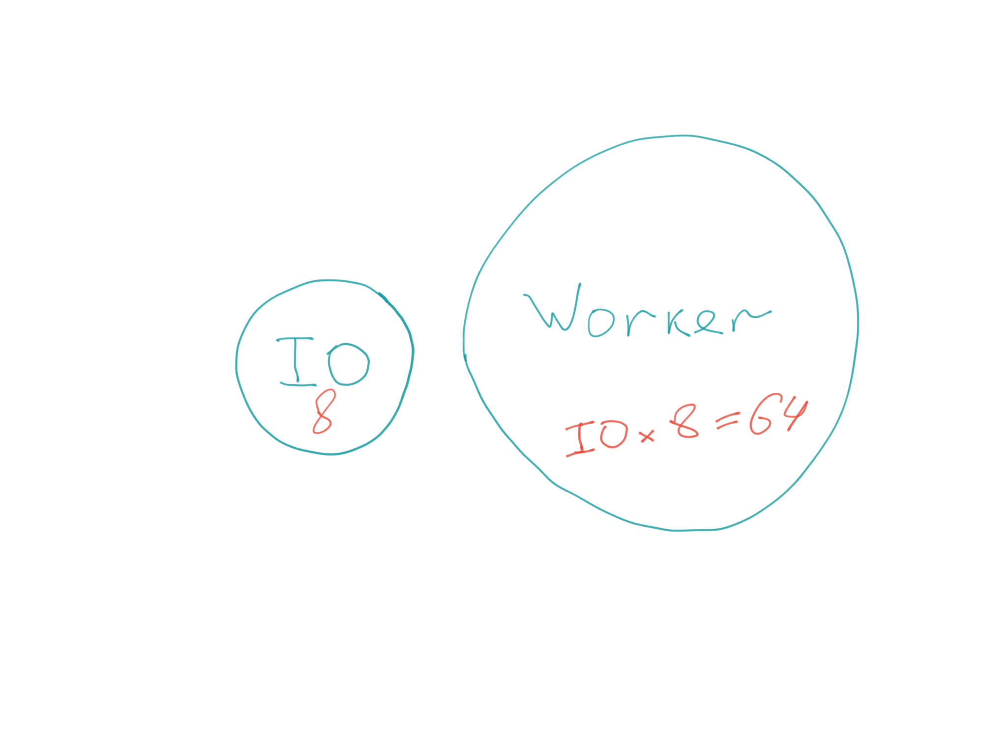
Threads

Slide 45
CoroutinesHandler
interface CoroutinesHandler {
suspend fun handleRequest(exchange: HttpServerExchange)
}

Slide 46
CoroutinesHandlerAdapter
CoroutinesHandler → HttpHandler
/**
* Bridge between thread and coroutines worlds.
*/
class CoroutinesHandlerAdapter(
private val handler: CoroutinesHandler
) : HttpHandler {
override fun handleRequest(exchange: HttpServerExchange) {
exchange.dispatch(SameThreadExecutor.INSTANCE, Runnable {
GlobalScope.launch(Dispatchers.Default) {
handler.handleRequest(exchange)
}
})
}
}

Slide 47
CoroutinesHandlerAdapter
/**
* Bridge between thread and coroutines worlds.
*/
class CoroutinesHandlerAdapter(
private val handler: CoroutinesHandler
) : HttpHandler {
override fun handleRequest(exchange: HttpServerExchange) {
exchange.dispatch(SameThreadExecutor.INSTANCE, Runnable {
GlobalScope.launch(Dispatchers.Default) {
handler.handleRequest(exchange)
}
})
}
}

Slide 48
CoroutinesHandlerAdapter
/**
* Bridge between thread and coroutines worlds.
*/
class CoroutinesHandlerAdapter(
private val handler: CoroutinesHandler
) : HttpHandler {
override fun handleRequest(exchange: HttpServerExchange) {
exchange.dispatch(SameThreadExecutor.INSTANCE, Runnable {
GlobalScope.launch(Dispatchers.Default) {
handler.handleRequest(exchange)
}
})
}
}

Slide 49
CoroutinesHandlerAdapter
val rootHandler = CoroutinesHandlerAdapter(SampleCoroutines())
Undertow.builder()
.addHttpListener(80, "0.0.0.0", rootHandler)
.build()
.start()

Slide 50

CoroutinesHandler
class ShareCountHandler(
private val shareCountAggregateService: ShareCountAggregateService
) : CoroutinesHandler {
override suspend fun handleRequest(exchange: HttpServerExchange) {
val url by exchange.queryParam<String>()
val count = shareCountAggregateService.getCount(url)
exchange.sendObj(count)
}
}

Slide 51
But
– Different Threads Pool
– Blocking handlers/wrapper not usable (*almost)

Slide 52
Request Scope with Coroutines
class RandomContext : CoroutineContext.Element {
override val key = RandomKey
val random: Random by lazy { Random() }
}
object RandomKey : CoroutineContext.Key<RandomContext>
suspend fun random(): Random {
return coroutineContext[RandomKey]?.random
?: throw RuntimeException("Random not found.")
}

Slide 53
Request Scope with Coroutines
class WithRequestScope : CoroutinesHandler {
override suspend fun handleRequest(exchange: HttpServerExchange) {
withContext(coroutineContext + RandomContext()) {
}
}
}

Slide 54
Request Scope with Coroutines
class WithRequestScope : CoroutinesHandler {
override suspend fun handleRequest(exchange: HttpServerExchange) {
withContext(coroutineContext + RandomContext()) {
random().nextInt()
}
}
}

Slide 55
Undertow VS ...
Ktor
Spring
Spark-java
vert.x, jetty, tomcat...
Notes:
Взять толк с jpoint, рассмотреть готовые интеграции, наличие типичных штук типо сервис дискавери, и т.д.
Сравнить краткость и перформанс своих обёрток и Спринга

Slide 56
Lightweight
2.2M undertow-core-2.0.17.Final.jar
508K xnio-api-3.3.8.Final.jar
116K xnio-nio-3.3.8.Final.jar
68K jboss-logging-3.3.2.Final.jar
---------------------------------------------------
2.9M Total

Slide 57
Lightweight
-Xmx3m – Start
-Xmx5m – ab -c 500
Startup time < 500ms

Slide 58
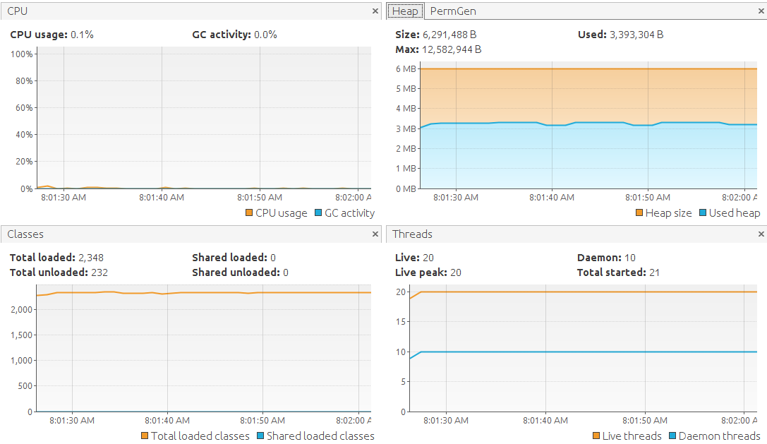
Lightweight

Slide 59
When
Proxy (https://github.com/IRus/kotlin-dev-proxy/)
Micro HTTP/WebSocket services
Swagger/OpenApi (https://github.com/networknt/light-4j)
File Server

Slide 60
Also
Undertow/JS
Servlet 4.0

Slide 61
Photo Credits
http://vectorply.com/reinforcement-fibers/
https://www.flickr.com/photos/blachswan/28445667452

Slide 62
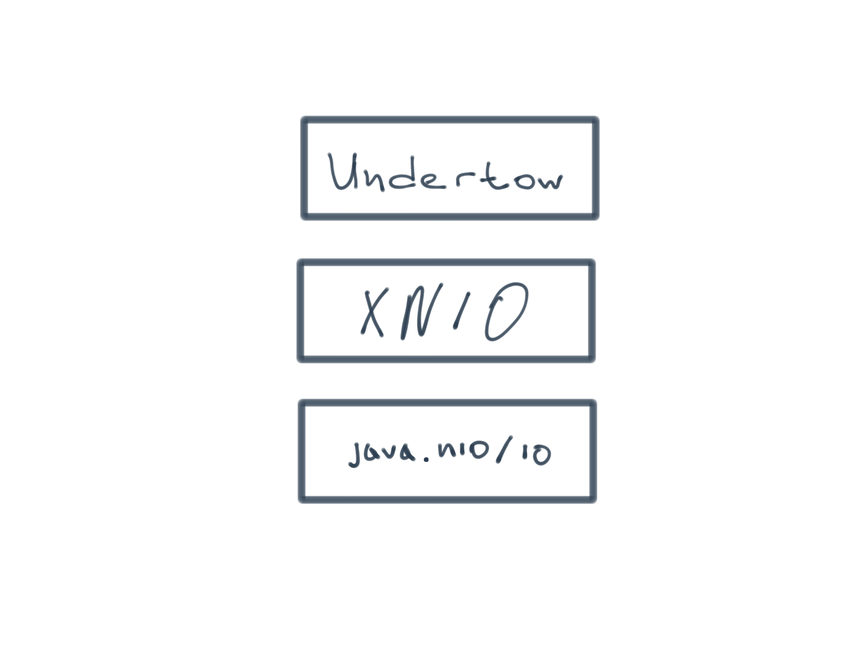
XNIO
Notes:
Undertow основан на XNIO. Проект XNIO обеспечивает тонкий уровень абстракции над Java NIO. В частности это обеспечивает следующее: управление потоками (IO и WorkerThreads) и Channel API – абстракция над NIO

Slide 63
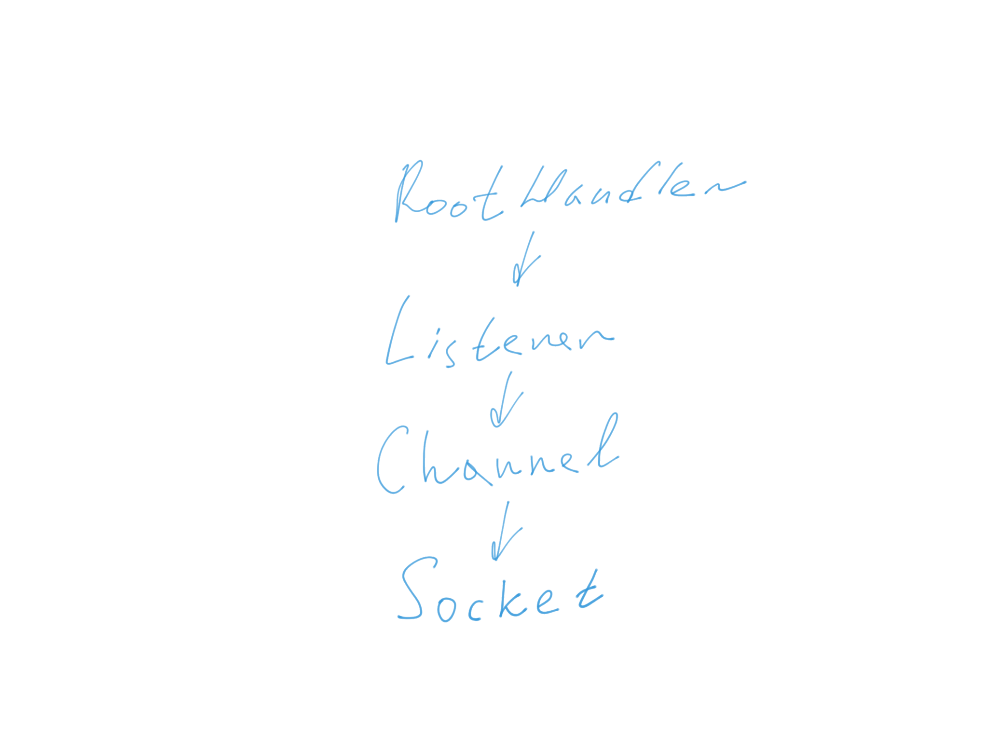
XNIO
Notes:
Undertow основан на XNIO. Проект XNIO обеспечивает тонкий уровень абстракции над Java NIO. В частности это обеспечивает следующее: управление потоками (IO и WorkerThreads) и Channel API – абстракция над NIO

Slide 64
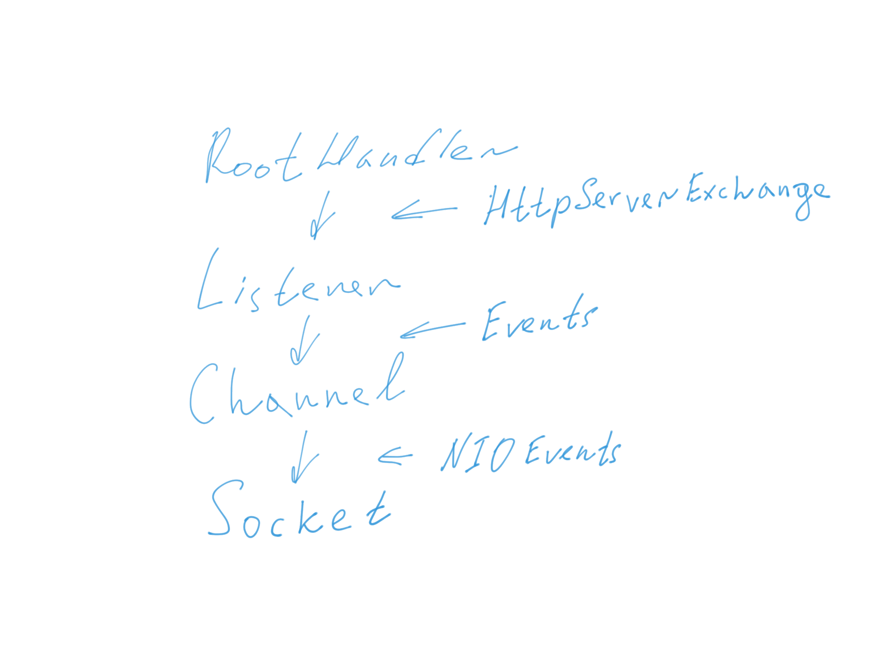
XNIO
Notes:
Undertow основан на XNIO. Проект XNIO обеспечивает тонкий уровень абстракции над Java NIO. В частности это обеспечивает следующее: управление потоками (IO и WorkerThreads) и Channel API – абстракция над NIO

