Slide 1

Ktor
Kotlin Night
Kiev
Ruslan Ibragimov
Notes:
С утра система такая: псс, парень, не хочешь обновить Libre Office? А я как раз в нем делаю слайды :) Не то что я не доверяю разработчикам, хотя кто им доверяет. Но в день когда у тебя две презентации обновлять тул от котого все зависит я не стал. Хотя может там какой-нибудь критический баг пофикшен…

Slide 2

Ktor

Slide 3
Agenda
Why yet another server framework
Hello, World!
Architecture
Features
Modularity
Testing
Configuration
Client

Slide 4
Ktor Adoption
Kotlin Census 2018
Total – 4400
Spring Boot – 1598
Ktor – 1065

Slide 5




Why
Usable with Kotlin
Async
Coroutines Support

Slide 6

One more thing...

Slide 7
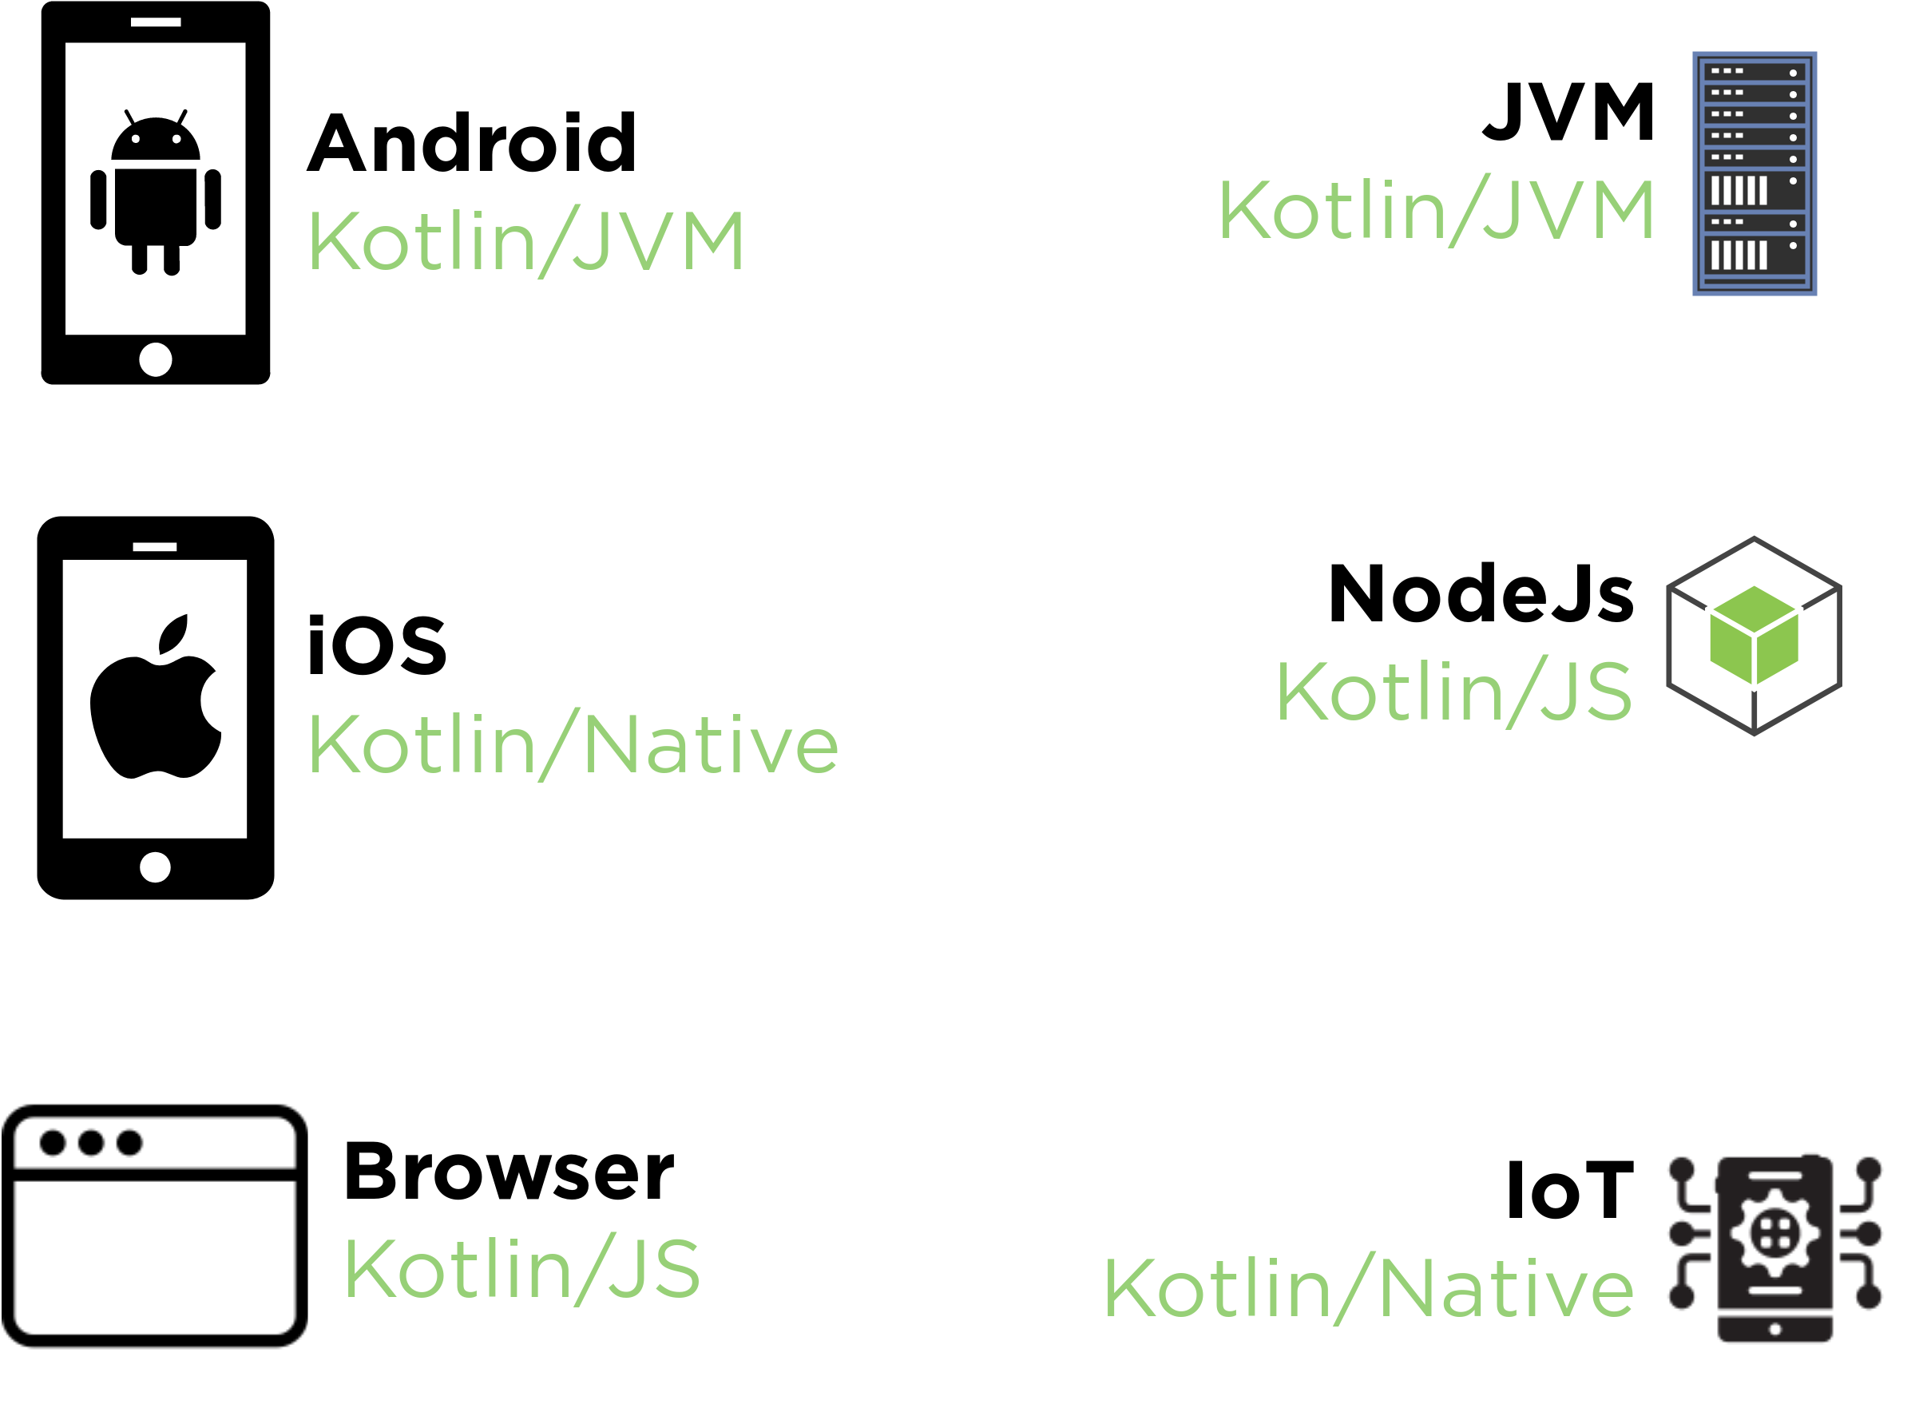
Multiplatform

Slide 8
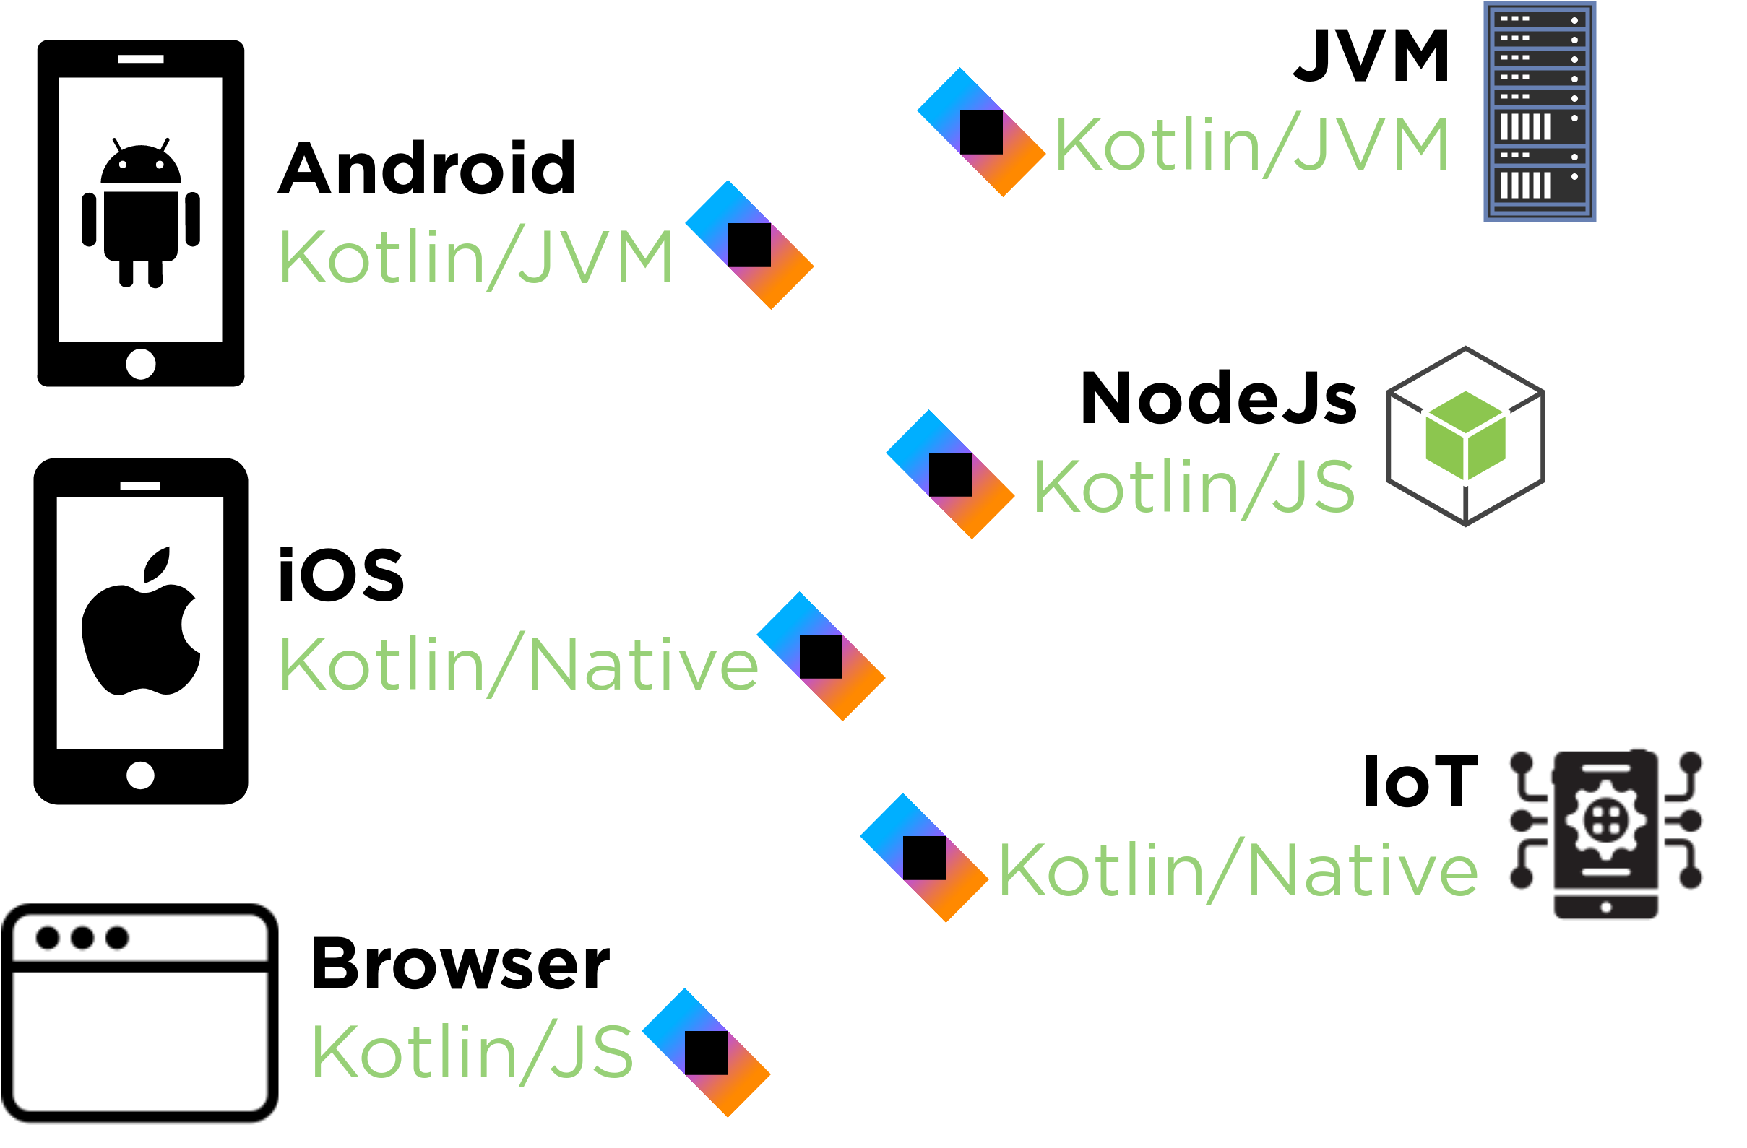
Multiplatform

Slide 9
Server Engines
Netty
Jetty
Tomcatty
Servletty 3.0+
CIO
TestEngine

Slide 10
Hello, World!
plugins {
kotlin("jvm") version "1.3.31"
}
repositories {
jcenter()
}
dependencies {
implementation("org.jetbrains.kotlin:kotlin-stdlib-jdk8")
implementation("ch.qos.logback:logback-classic:1.2.1")
implementation("io.ktor:ktor-server-netty:1.2.1")
testImplementation("io.ktor:ktor-server-tests:1.2.1")
}

Slide 11
Hello, World!
fun main() {
embeddedServer(Netty, 8080) {
routing {
get("/") {
call.respondText("I am Groot!", ContentType.Text.Html)
}
}
}.start(wait = true)
}

Slide 12
Hello, World!
fun main() {
embeddedServer(Netty, 8080) {
routing {
get("/") {
call.respondText("I am Groot!", ContentType.Text.Html)
}
}
}.start(wait = true)
}

Slide 13
Hello, World!
fun main() {
embeddedServer(Netty, 8080) {
routing {
get("/") {
call.respondText("I am Groot!", ContentType.Text.Html)
}
}
}.start(wait = true)
}

Slide 14
Hello, World!
fun main() {
embeddedServer(Netty, 8080) {
routing {
get("/") {
call.respondText("I am Groot!", ContentType.Text.Html)
}
}
}.start(wait = true)
}

Slide 15

Hello, World!
fun main() {
embeddedServer(Netty, 8080) {
routing {
get("/") {
call.respondText("I am Groot!", ContentType.Text.Html)
}
}
}.start(wait = true)
}

Slide 16
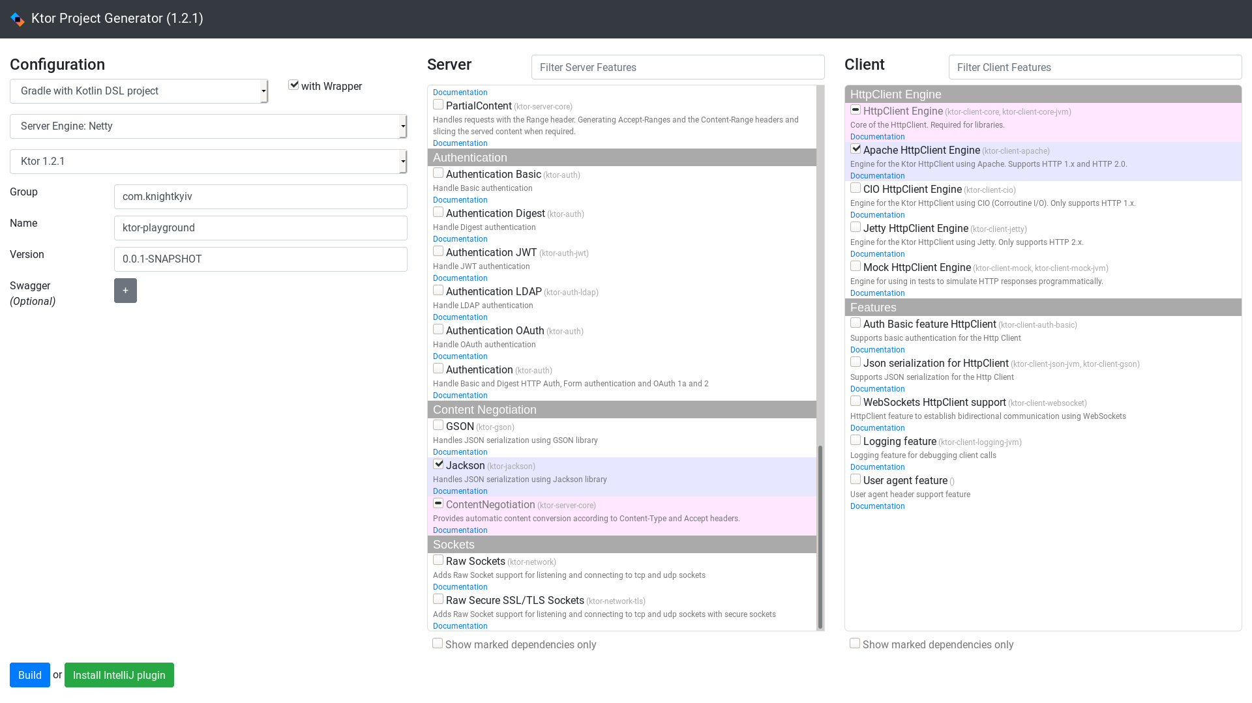
start.ktor.io
Notes:
В реальной жизни вы конечно же можете воспользоваться удобным UI, где можно накликать необходимые модули и получить готовый проект, который остается запушить в прод. Кроме UI есть плагин для Intellij Idea
Окей, теперь поговорим как это все работает

Slide 17
Application::class
fun main() {
embeddedServer(Netty, 8080) { this: Application
routing {
get("/") {
call.respondText("I am Groot!", ContentType.Text.Html)
}
}
}.start(wait = true)
}

Slide 18
Application::class
fun main() {
embeddedServer(Netty, 8080) { this: Application
this.routing {
get("/") {
call.respondText("I am Groot!", ContentType.Text.Html)
}
}
}.start(wait = true)
}

Slide 19
Application::class
Essentially is pipeline

Slide 20
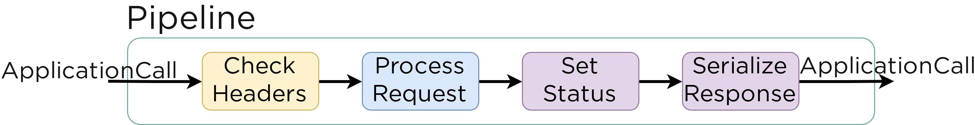
Application::class

Slide 21
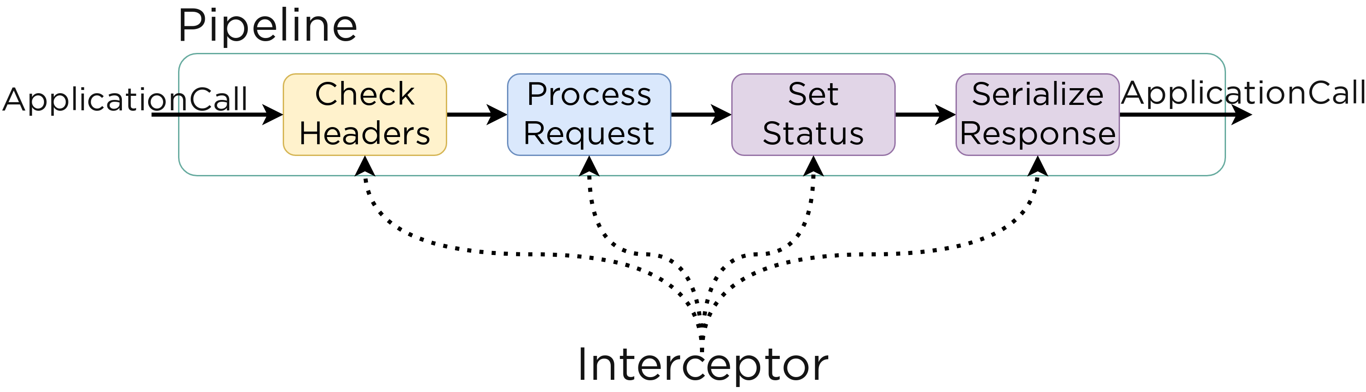
Application::class

Slide 22
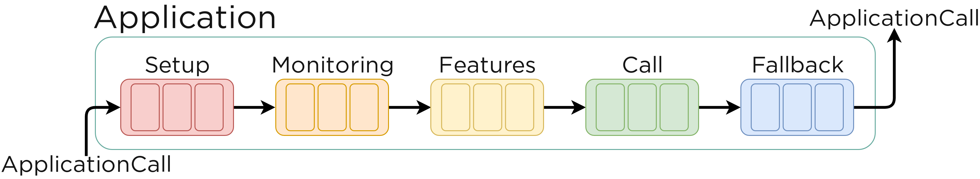
Pipeline Phase
Notes:
Phase for preparing call and it's attributes for processing
Phase for tracing calls, useful for logging, metrics, error handling and so on
Phase for features. Most features should intercept this phase.
Phase for processing a call and sending a response
Phase for handling unprocessed calls

Slide 23
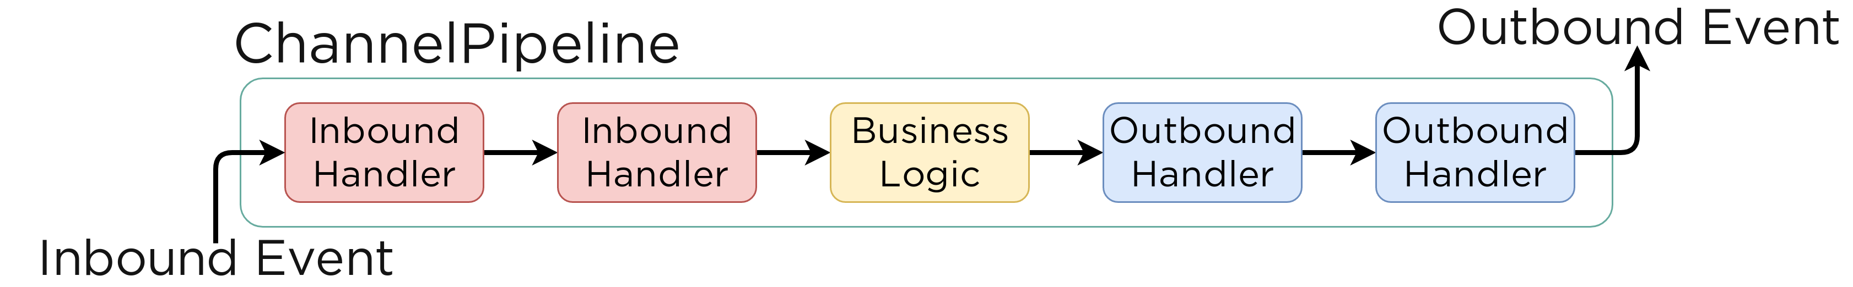
Netty
Notes:
Phase for preparing call and it's attributes for processing
Phase for tracing calls, useful for logging, metrics, error handling and so on
Phase for features. Most features should intercept this phase.
Phase for processing a call and sending a response
Phase for handling unprocessed calls

Slide 24
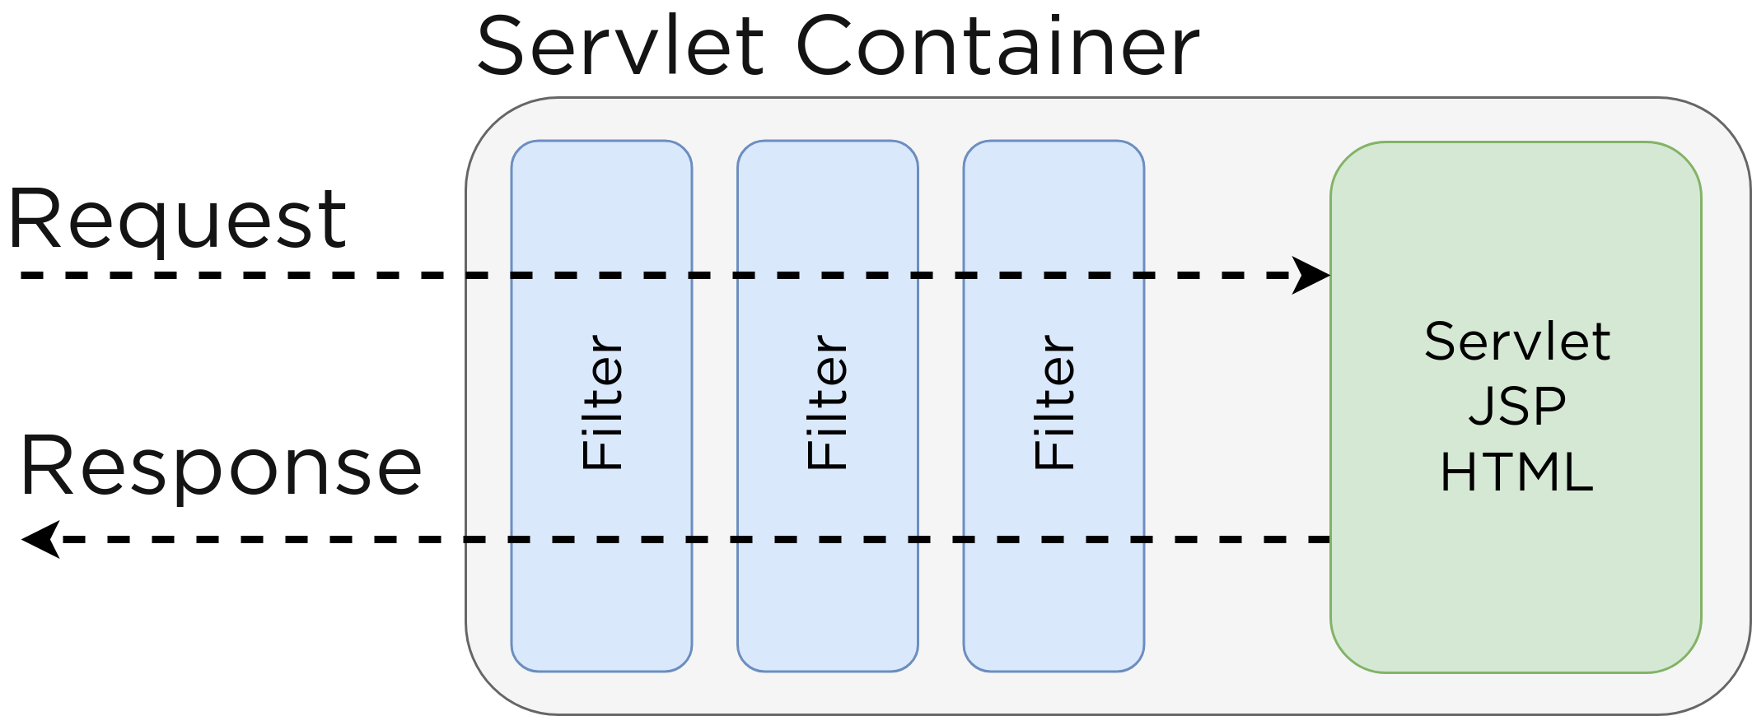
Servlets
Notes:
Phase for preparing call and it's attributes for processing
Phase for tracing calls, useful for logging, metrics, error handling and so on
Phase for features. Most features should intercept this phase.
Phase for processing a call and sending a response
Phase for handling unprocessed calls

Slide 25
Pipelines
ApplicationCallPipeline
ApplicationReceivePipeline
ApplicationSendPipeline

Slide 26
Pipelines
ApplicationCallPipeline
ApplicationReceivePipeline
– ApplicationCall
– ApplicationReceiveRequest
ApplicationSendPipeline
– ApplicationCall
– OutgoingContent

Slide 27
Interceptors
fun main() {
embeddedServer(Netty, 8080) { this: Application
this.routing {
get("/") {
call.respondText("I am Groot!", ContentType.Text.Html)
}
}
}.start(wait = true)
}

Slide 28
Application.intercept
embeddedServer(Netty, 8080) {
intercept(ApplicationCallPipeline.Monitoring) {
// log request headers
call.request.headers
.forEach { name, values ->
println("$name: ${values.joinToString()}")
}
}
}.start(wait = true)

Slide 29
Application.intercept
embeddedServer(Netty, 8080) {
intercept(ApplicationCallPipeline.Monitoring) {
// log request headers
call.request.headers
.forEach { name, values ->
println("$name: ${values.joinToString()}")
}
}
}.start(wait = true)

Slide 30
Application.intercept
embeddedServer(Netty, 8080) {
intercept(ApplicationCallPipeline.Monitoring) {
// log request headers
call.request.headers
.forEach { name, values ->
println("$name: ${values.joinToString()}")
}
}
}.start(wait = true)

Slide 31
Application.intercept
embeddedServer(Netty, 8080) {
intercept(ApplicationCallPipeline.Monitoring) {
// log request headers
call.request.headers
.forEach { name, values ->
println("$name: ${values.joinToString()}")
}
}
}.start(wait = true)

Slide 32
Application Call
Application
Request
Response
Attributes

Slide 33
Feature
Routing
ContentNegotiation
Auth
Call Logging
CORS
Metrics
Compression
etc. see ApplicationFeature

Slide 34
Feature
routing {
get("/") {
call.respondText("I am Groot!", ContentType.Text.Html)
}
}
install(Routing) {
get("/") {
call.respondText("I am Groot!", ContentType.Text.Html)
}
}

Slide 35
Feature
embeddedServer(Netty, 8080) {
install(DefaultHeaders)
install(CallLogging)
// ...
}.start(wait = true)

Slide 36
Interceptor → Feature
intercept(ApplicationCallPipeline.Monitoring) {
// log request headers
call.request.headers
.forEach { name, values ->
println("$name: ${values.joinToString()}")
}
}

Slide 37
Interceptor → Feature
typealias Configuration = Unit
class HeaderLoggingFeature {
companion object Feature : ApplicationFeature<ApplicationCallPipeline, Configuration, HeaderLoggingFeature> {
override val key = AttributeKey<HeaderLoggingFeature>("HeaderLoggingFeature")
override fun install(
pipeline: ApplicationCallPipeline,
configure: Configuration.() -> Unit
): HeaderLoggingFeature {
pipeline.intercept(ApplicationCallPipeline.Monitoring) {
call.request.headers
.forEach { name, values ->
println("$name: ${values.joinToString()}")
}
}
return HeaderLoggingFeature()
}
}
}

Slide 38
Interceptor → Feature
typealias Configuration = Unit
class HeaderLoggingFeature {
companion object Feature : ApplicationFeature<ApplicationCallPipeline, Configuration, HeaderLoggingFeature> {
override val key = AttributeKey<HeaderLoggingFeature>("HeaderLoggingFeature")
override fun install(
pipeline: ApplicationCallPipeline,
configure: Configuration.() -> Unit
): HeaderLoggingFeature {
pipeline.intercept(ApplicationCallPipeline.Monitoring) {
call.request.headers
.forEach { name, values ->
println("$name: ${values.joinToString()}")
}
}
return HeaderLoggingFeature()
}
}
}

Slide 39
Interceptor → Feature
typealias Configuration = Unit
class HeaderLoggingFeature {
companion object Feature : ApplicationFeature<ApplicationCallPipeline, Configuration, HeaderLoggingFeature> {
override val key = AttributeKey<HeaderLoggingFeature>("HeaderLoggingFeature")
override fun install(
pipeline: ApplicationCallPipeline,
configure: Configuration.() -> Unit
): HeaderLoggingFeature {
pipeline.intercept(ApplicationCallPipeline.Monitoring) {
call.request.headers
.forEach { name, values ->
println("$name: ${values.joinToString()}")
}
}
return HeaderLoggingFeature()
}
}
}

Slide 40
Interceptor → Feature
typealias Configuration = Unit
class HeaderLoggingFeature {
companion object Feature : ApplicationFeature<ApplicationCallPipeline, Configuration, HeaderLoggingFeature> {
override val key = AttributeKey<HeaderLoggingFeature>("HeaderLoggingFeature")
override fun install(
pipeline: ApplicationCallPipeline,
configure: Configuration.() -> Unit
): HeaderLoggingFeature {
pipeline.intercept(ApplicationCallPipeline.Monitoring) {
call.request.headers
.forEach { name, values ->
println("$name: ${values.joinToString()}")
}
}
return HeaderLoggingFeature()
}
}
}

Slide 41
Interceptor → Feature
typealias Configuration = Unit
class HeaderLoggingFeature {
companion object Feature : ApplicationFeature<ApplicationCallPipeline, Configuration, HeaderLoggingFeature> {
override val key = AttributeKey<HeaderLoggingFeature>("HeaderLoggingFeature")
override fun install(
pipeline: ApplicationCallPipeline,
configure: Configuration.() -> Unit
): HeaderLoggingFeature {
pipeline.intercept(ApplicationCallPipeline.Monitoring) {
call.request.headers
.forEach { name, values ->
println("$name: ${values.joinToString()}")
}
}
return HeaderLoggingFeature()
}
}
}

Slide 42
Interceptor → Feature
typealias Configuration = Unit
class HeaderLoggingFeature {
companion object Feature : ApplicationFeature<ApplicationCallPipeline, Configuration, HeaderLoggingFeature> {
override val key = AttributeKey<HeaderLoggingFeature>("HeaderLoggingFeature")
override fun install(
pipeline: ApplicationCallPipeline,
configure: Configuration.() -> Unit
): HeaderLoggingFeature {
pipeline.intercept(ApplicationCallPipeline.Monitoring) {
call.request.headers
.forEach { name, values ->
println("$name: ${values.joinToString()}")
}
}
return HeaderLoggingFeature()
}
}
}

Slide 43
Interceptor → Feature
intercept(ApplicationCallPipeline.Monitoring) {
// log request headers
call.request.headers
.forEach { name, values ->
println("$name: ${values.joinToString()}")
}
}
install(HeaderLoggingFeature)
install(HeaderLoggingFeature) {
exclusions = listOf("User-Agent")
}

Slide 44
Content Negotiation Feature
install(ContentNegotiation) {
jackson {
enable(SerializationFeature.INDENT_OUTPUT)
}
}
routing {
get("/resp") {
call.respond(mapOf("hello" to "world"))
}
}
// response
{
"hello" : "world"
}
Notes:
Content-Type
Accept

Slide 45
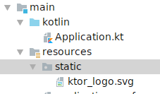
Static Files Serving Feature
static("/static") {
resources("static")
}
Notes:
Content-Type
Accept

Slide 46
Modularit y
fun main() {
embeddedServer(Netty, 8080) {
routing {
get("/") {
call.respondText("I am Groot!", ContentType.Text.Html)
}
}
}.start(wait = true)
}

Slide 47
Modularit y
@ContextDsl
fun Application.helloWorld() {
routing {
get("/") {
call.respondText("I am Groot!", ContentType.Text.Html)
}
}
}
fun main() {
embeddedServer(Netty, 8080) {
helloWorld()
}.start(wait = true)
}

Slide 48
Modularit y
fun main() {
embeddedServer(Netty, 8080) {
configuration()
users()
applications()
}.start(wait = true)
}

Slide 49
Testing
@Test
fun testRoot() {
withTestApplication({
configuration()
helloWorld()
}) {
handleRequest(HttpMethod.Get, "/").apply {
assertEquals(HttpStatusCode.OK, response.status())
assertEquals("HELLO WORLD!", response.content)
}
}
}

Slide 50
Testing
@Test
fun testRoot() {
withTestApplication({
configuration()
helloWorld()
}) {
handleRequest(HttpMethod.Get, "/").apply {
assertEquals(HttpStatusCode.OK, response.status())
assertEquals("HELLO WORLD!", response.content)
}
}
}

Slide 51
Testing
@Test
fun testRoot() {
withTestApplication({
configuration()
helloWorld()
}) {
handleRequest(HttpMethod.Get, "/").apply {
assertEquals(HttpStatusCode.OK, response.status())
assertEquals("HELLO WORLD!", response.content)
}
}
}

Slide 52
Autoreloading
// application.conf
ktor {
deployment {
port = 8080
port = ${?PORT}
watch = ["ktor-playground"]
}
application {
modules = [ com.knightkyiv.ApplicationKt.module ]
}
}

Slide 53

Autoreloading

Slide 54
Autoreloading
Works on JDK8!

Slide 55
Ktor Client
val client = HttpClient(Apache)

Slide 56
Ktor Client
fun Application.myApp() {
val client = HttpClient(Apache)
routing {
get("/call") {
val text = client.get<String>(
host = "localhost",
port = 8081,
path = "/text"
)
call.respondText(text)
}
}
}

Slide 57
Ktor Client
val client = HttpClient(Apache) {
install(JsonFeature)
}
val user = client.get<User>(
host = "localhost",
port = 8081,
path = "/json"
)

Slide 58
Client Engines
Apache
CIO
Jetty
OkHttp
Android
iOS
Js (JavaScript)
Curl
MockEngine

Slide 59
Configuration
interface ApplicationConfig {
fun property(path: String): ApplicationConfigValue
fun propertyOrNull(path: String): ApplicationConfigValue?
fun config(path: String): ApplicationConfig
fun configList(path: String): List<ApplicationConfig>
}

Slide 60
Configuration
deploymentConfig.propertyOrNull("shareWorkGroup")
?.getString()
?.toBoolean()
?.let {
shareWorkGroup = it
}
Notes:
Могу ли, и если могу, то стоит ли использовать application.conf для определения каких-то своих переменных окружения?
Или как вообще лучше\принято это делать? Например конфигурацию для DB пробрасывать как стоит в приложение?
Кто-нибудь с Ktor игрался? Не знаете, что он использует, чтобы работать с HOCON файлами?
Ktor только hocon'ом конфигурируется?

Slide 61
Configuration
// application.conf
jdbc {
user = "tgto"
password = "tgto"
url = "jdbc:postgresql://tgto_database:5432/tgto"
driver = "org.postgresql.Driver"
}
data class JdbcConfig(
val user: String,
val password: String,
val url: String,
val driver: String
)

Slide 62
Configuration
// build.gradle.kts
implementation("io.github.config4k:config4k:0.4.1")
// Application.module
val jdbcConfig = ConfigFactory.load().extract<JdbcConfig>("jdbc")

Slide 63
Takeaway
Ktor – connected systems, MPP
Application – Pipeline
Pipeline – Interceptors/Features
Modularity
Testability
https://bit.ly/2QALm28

Slide 64


