Slide 1
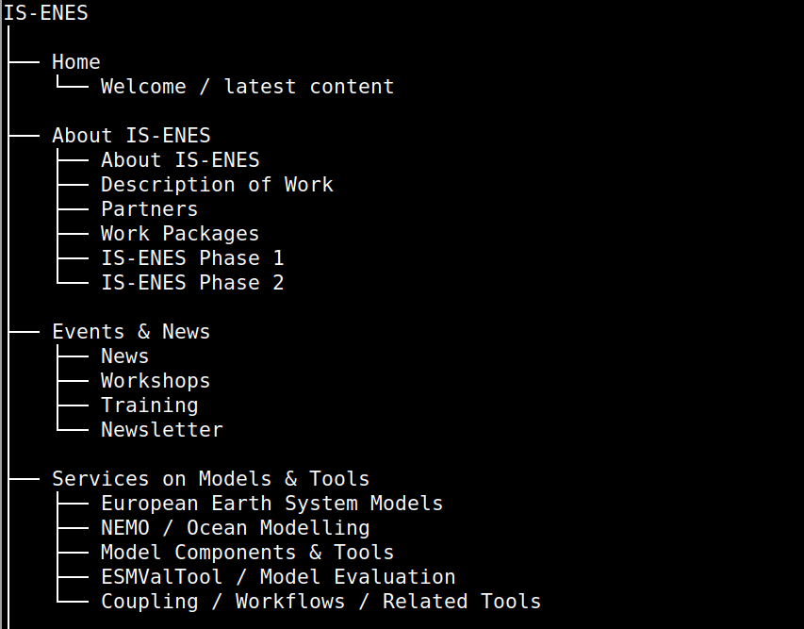
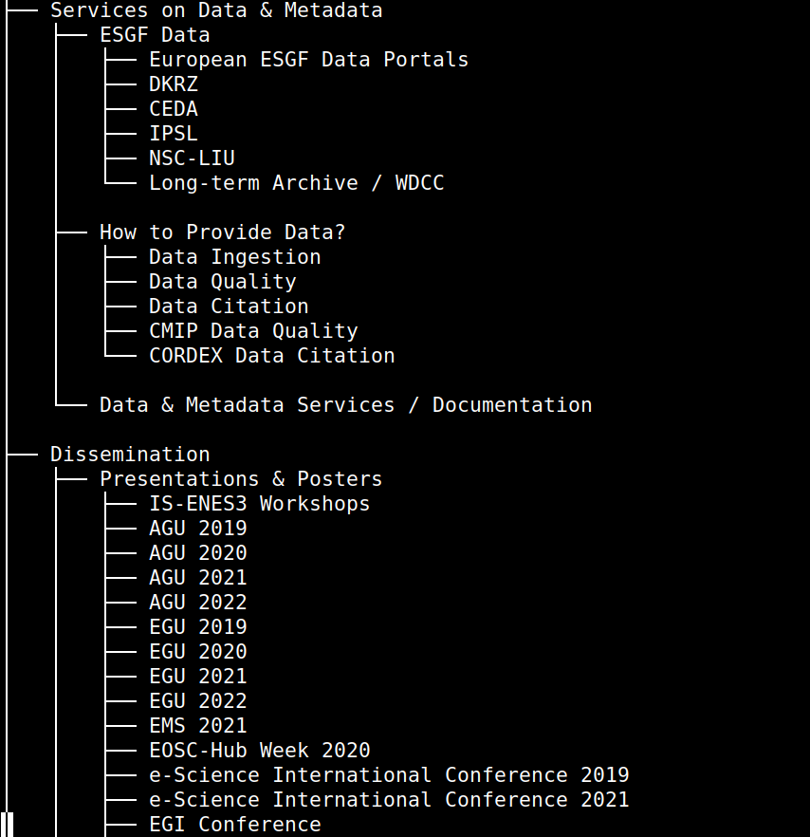
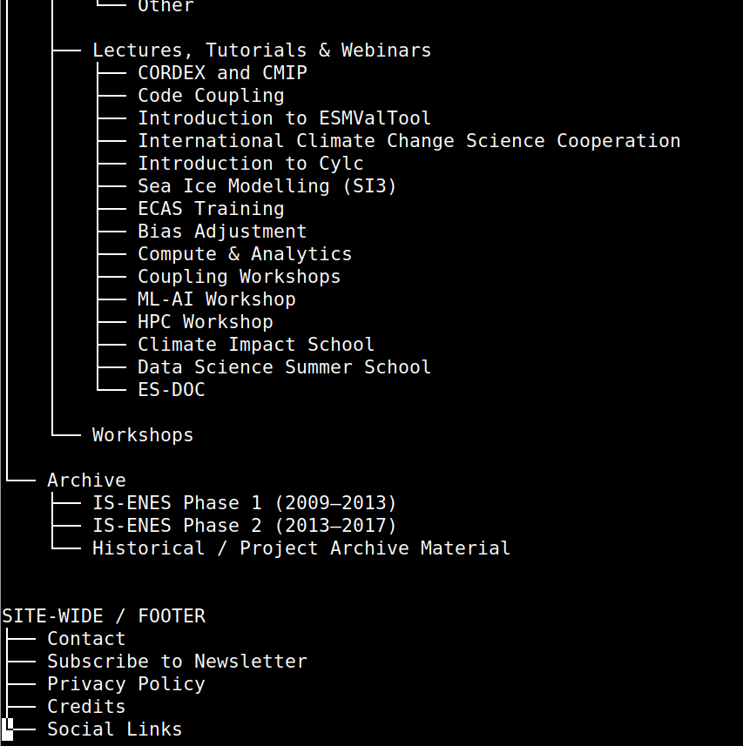
Upcoming ENES-RI website:
- hosted on Github in IS-NENES org https://github.com/IS-ENES3/ENES-RI-Website
- built with Github Pages, stright on Github https://github.com/IS-ENES3/ENES-RI-Website/actions/runs/35510548466
- up-to-date dependency environment
- content will be added via either simple Github commits or by setting up Copilot
- domanin name still TBA/TBI
- structure: rougly the same as for IS-ENES3 website https://is.enes.org/

