Slide 1
First Workshop on Dynamical Cores
Lecce, 14th-16th 2011
G. Aloisio

Slide 2
Objectives of the Workshop
Exchange information about the latest developments on dynamical cores
Organize sharing of experience on this topic among European groups (and also US groups!)
Agree on possible collaboration modes → joint projects

Slide 3
Workshop Structure
Issues on Climate Modeling
State of the art of methodological approaches
State of the art of engineering approaches
State of the art of Dycores projects
Breakout Groups
Group 1 : Methodological challenges
Group 2: Computational challenges

Slide 4
Breakout groups expected output
Identify critical issues in recent dycores developments
from a methodological point of view (Group1)
from a computational point of view (Group 2)
Propose a strategy for coordinated efforts in Europe & outside Europe (US Japan, …)
how to share results achieved by different groups
how to foster collaboration
organizing a Dycore modeling group?
report critical issues and result on a dedicated space of the ENES website
Wiki page?
….
Prepare a roadmap for future developments
Organizing specific meetings, telcos and workshops
Need content and date for 2nd workshop

Slide 5
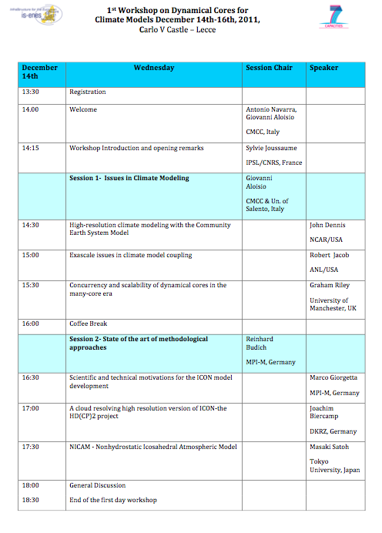

Slide 6
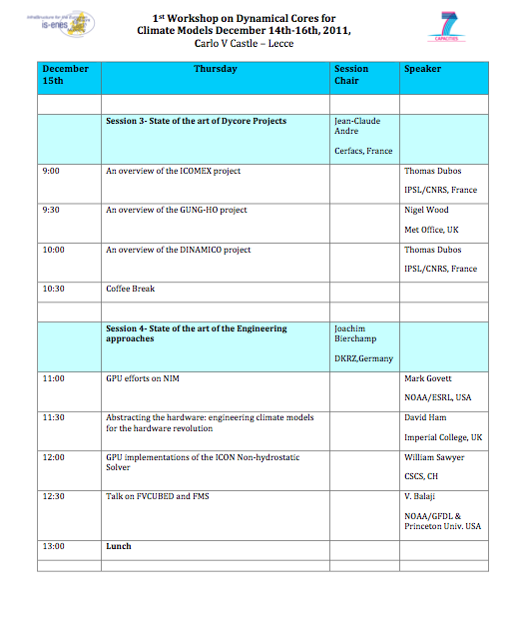

Slide 7
