Slide 1
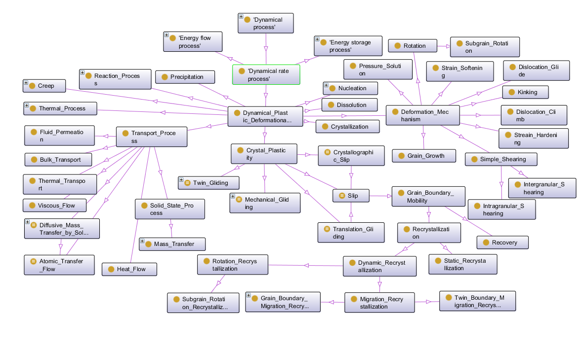
Hassan Babaie – Georgia State University, Geosciences & Computer Science
Recent Research:
Developing the ontology of experimental plastic deformation of polycrystalline rock

Slide 2
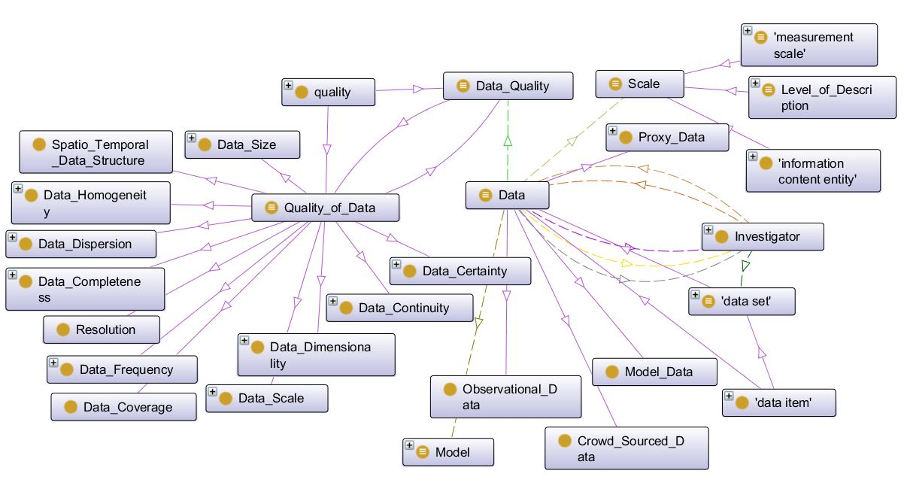
Hassan Babaie – Current Research: Design and development of the ontology of dynamic, nonlinear complex Earth processes Integration of the data of Earth’s major dynamic subsystems

