Slide 1
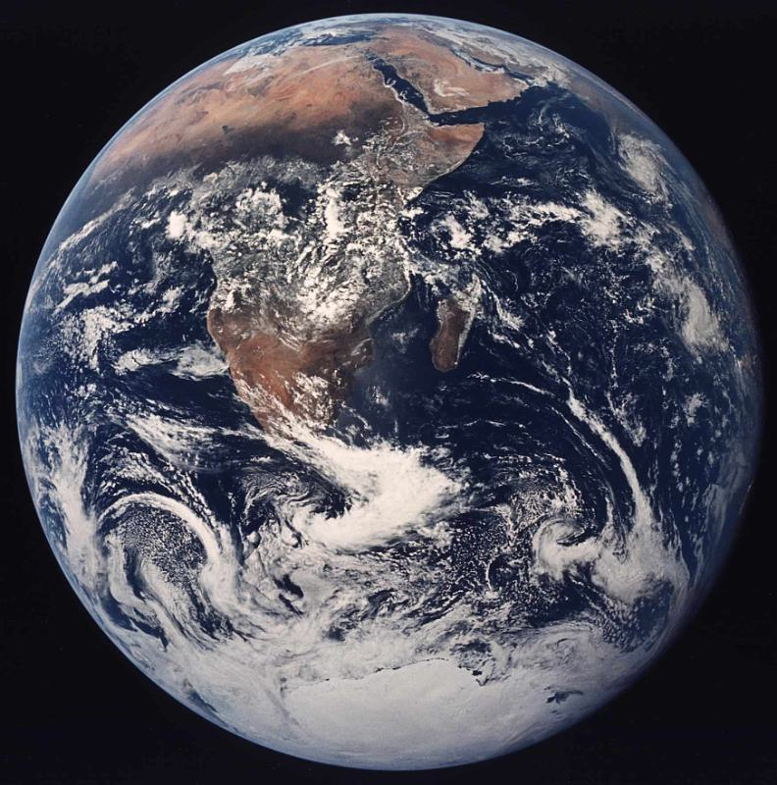

Imme Ebert-Uphoff
Knowledge discovery from data in the Geosciences
What can we learn about underlying physical processes from data ?
Primary tool: Causal Discovery methods, i.e. finding potential cause-effect relationships from data using conditional independence tests.
→ Identify interactions – between variables, locations, time scales, …
Observed data

Slide 2
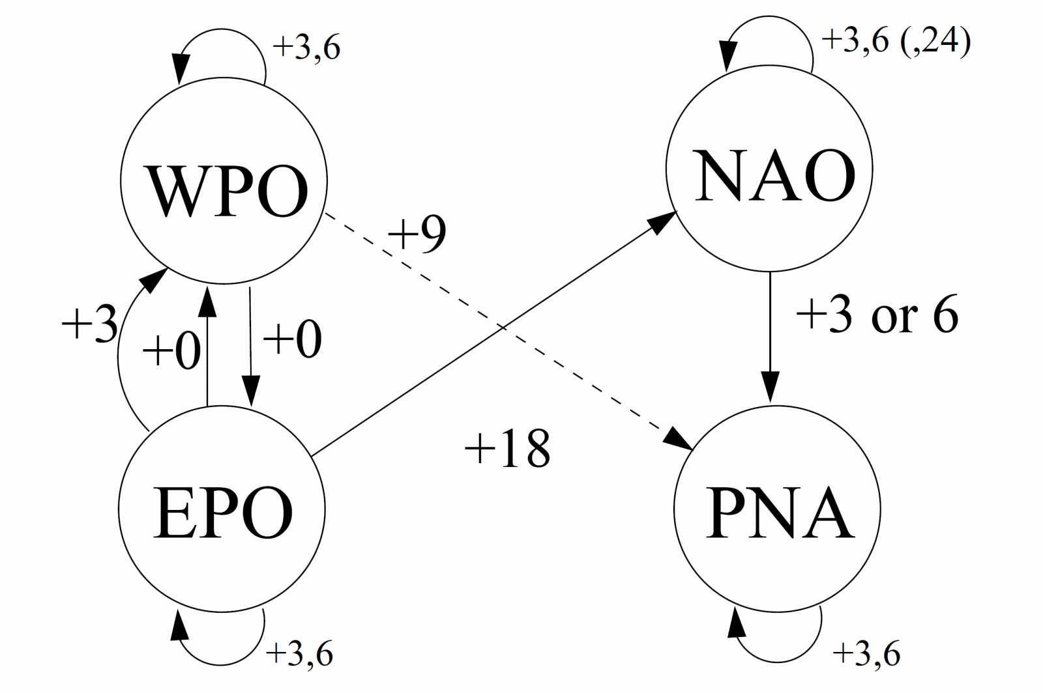
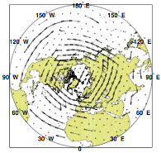
Identify interactions – between variables, locations, time scales
Examples:
Collaborations I’m looking for:
New applications to try these methods on.
Would you like to learn more about underlying processes from data?
Goals: (1) Derive new hypotheses about interactions from data. (2) Learn new details about patterns of interactions.
Needs large sample size. Can be spatio-temporal.
Fig. 1: Interactions between four different modes of the climate system (in days)
Fig. 2: Interactions between locations (due to storm tracks) deduced from geopotential height data.

