Slide 1
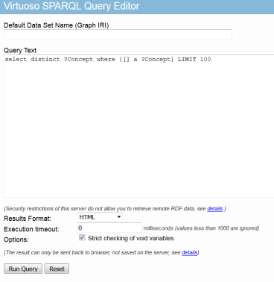
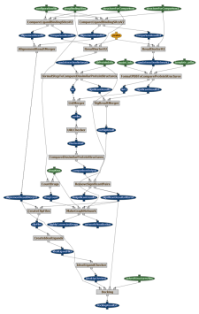
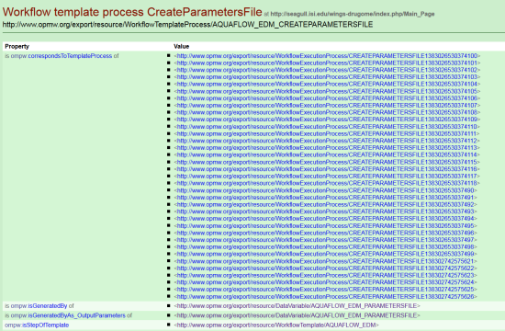
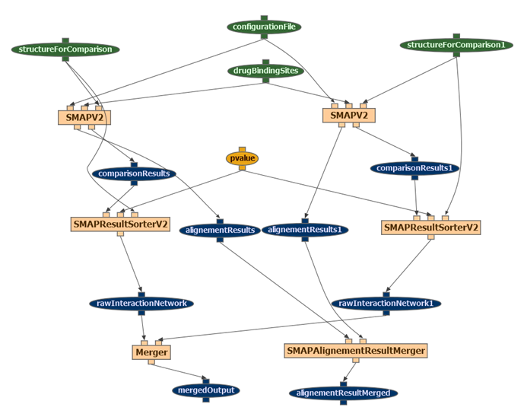
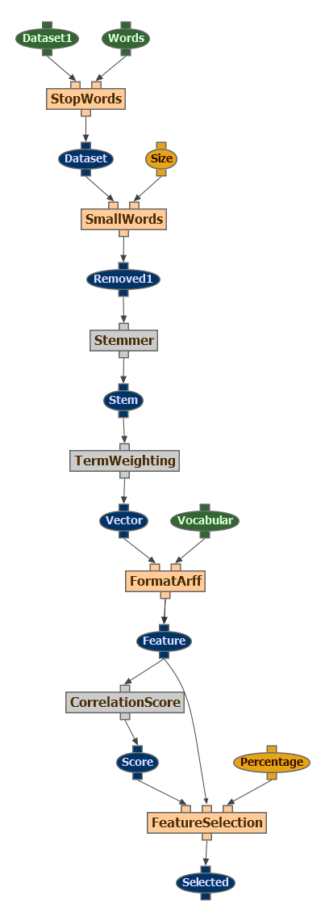
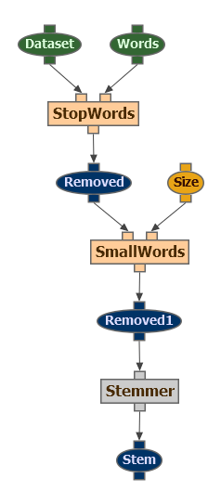
Scientific workflow publication and mining Daniel Garijo, with Yolanda Gil and Oscar Corcho (UPM)
Specification
Modeling
Generation
Publication
Exploitation
Linked Data
1
2
3
4
5
Workflow
Finding parts of a workflow in other workflows
Repeated workflow fragments in a workflow

Slide 2
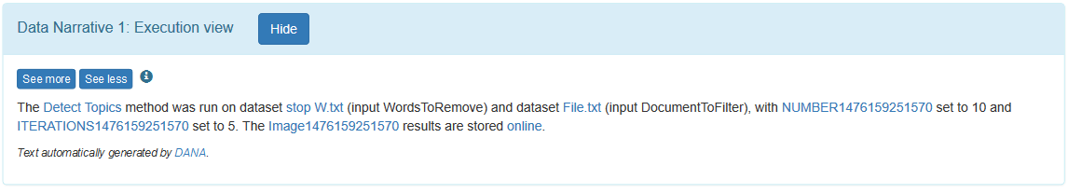
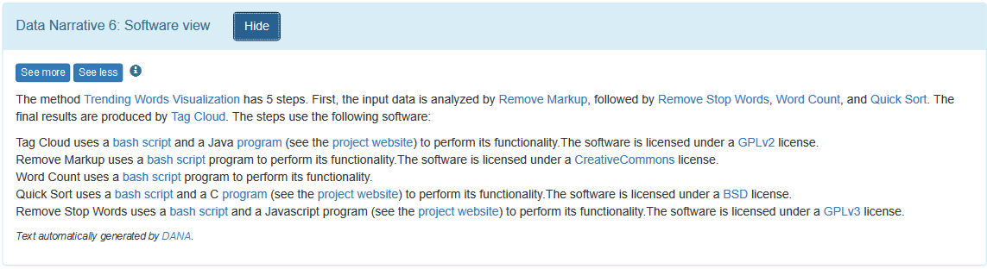
Data Narratives Daniel Garijo, with Yolanda Gil
Using the information produced by workflows and their executions to automatically write how the results were produced.
Parameters used in the execution
Links to results
Software used to produce the results

