Slide 1
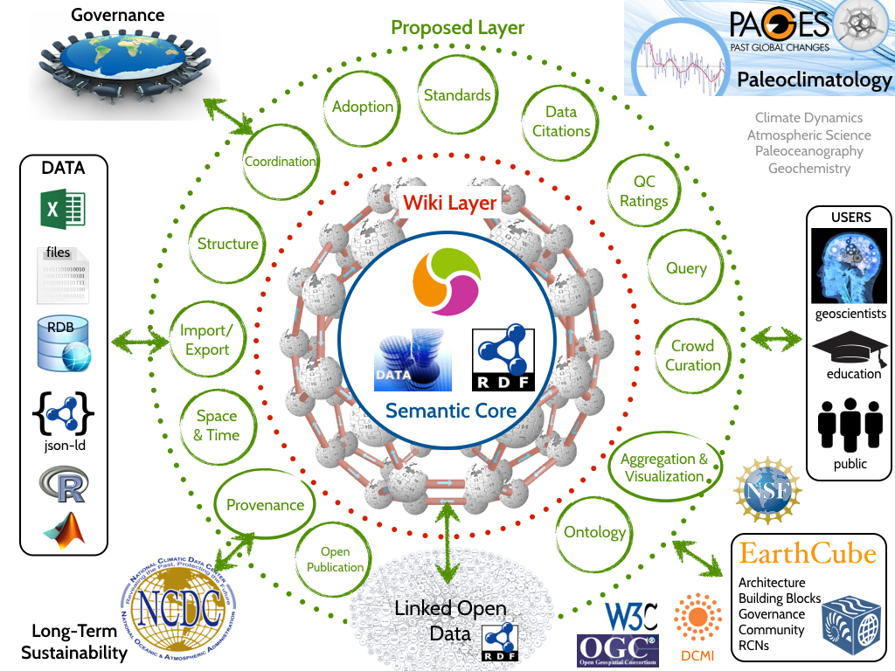

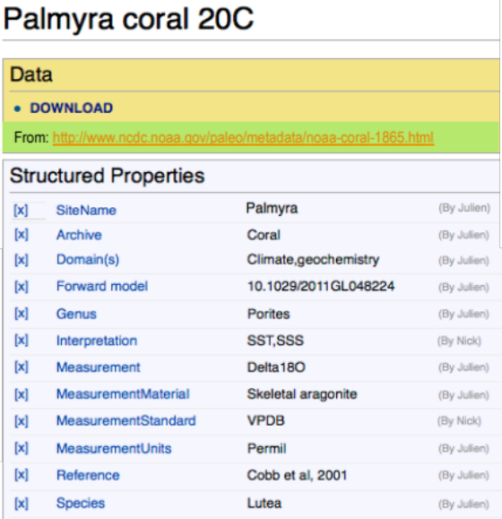
Linked Earth: Crowdsourcing Paleoclimate Ontologies through Semantic Wikis (http://wiki.linked.earth/)
Yolanda Gil (USC) with D. Garijo (USC), J. Geay (USC) and N. McKay (NAU)

Slide 2
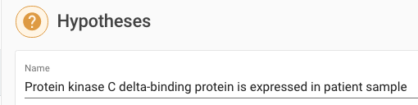

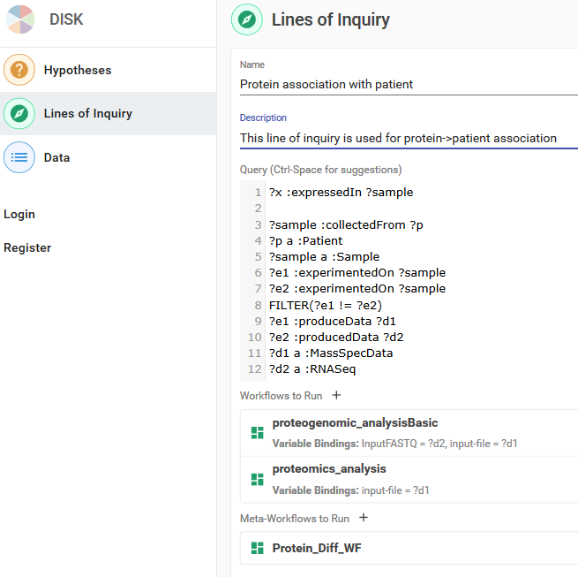
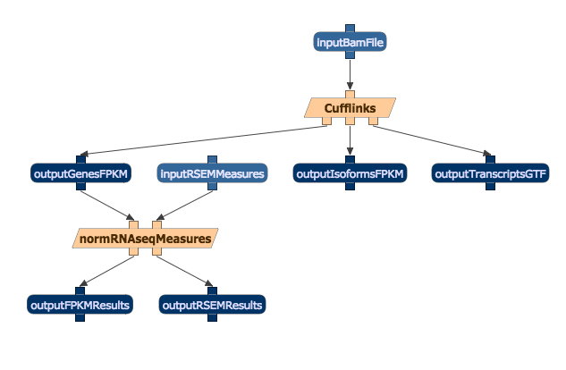
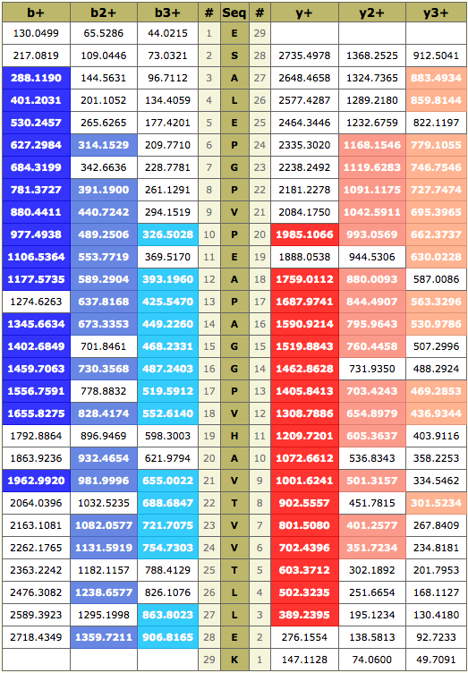
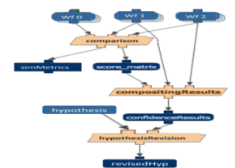
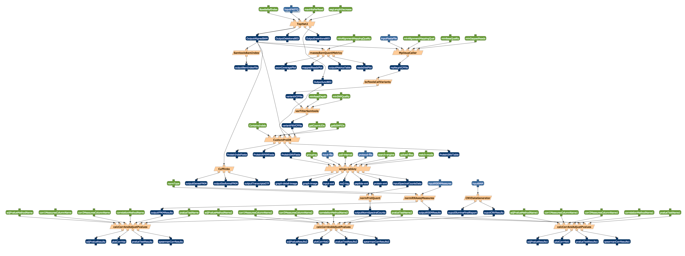
DISK: Automated Continuous Re-Analysis as New Data and Methods Become Available [Gil et al ACS-2016; Gil et al AAAI-2017]
Yolanda Gil (USC) with D. Garijo (USC/ISI), P. Mallick, R. Adusumilli, H. Boyce (Stanford)
Hypothesis
Lines of Inquiry
Specifies relevant analytic methods (workflows), type of data needed, and how to combine results
Report on interesting
changes and novel results
Data Query
Analytic Workflows
Meta-Workflows
New Results
Confidence Estimation
Data
Catalog
Workflow
Library
Benchmarking

