Slide 1
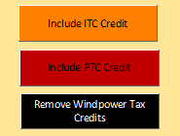
Input
Output: Farm Income
Agriculture
Federal tax incentives
Sales:
$0.0385 per kWh annual average
Energy
Water
Climate

Slide 3
Estimated usable lifetime of High Plains Aquifer, western Kansas

Slide 4
Years from 2005 to threshold saturated thickness (ST)
Already reached
Increasing
<25 years
25-50
50-100
100-250
>250
Extent of HPA

