Slide 1
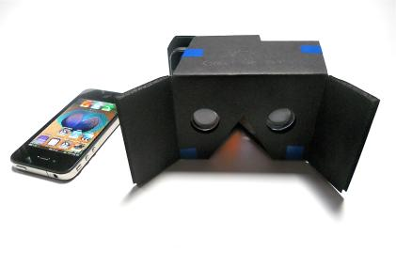
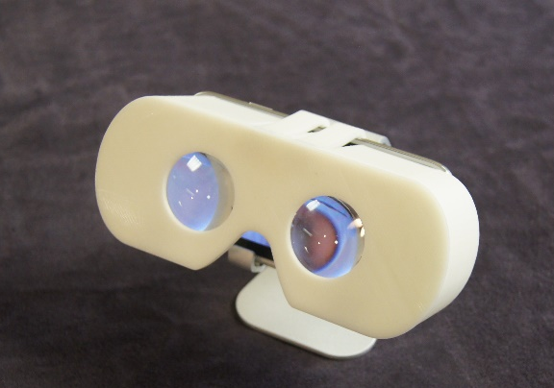
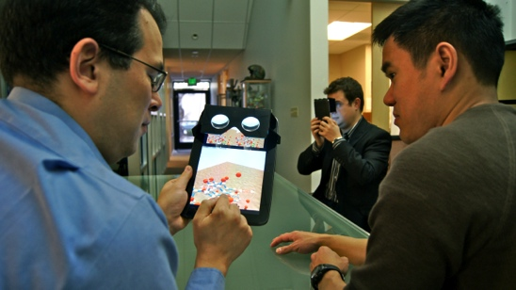
USC ICT Mixed Reality Lab
Research focus: Techniques and technologies for immersive experiences (virtual and augmented reality)
Looking for input on building VR tools for geoscientists.
Notes:
My name is Dr. David Krum. I’m an Associate Lab Director at the Mixed Reality Lab at the Institute for Creative Technologies, which is part of the University of Southern California.
The Mixed Reality lab is focused on developing and studying new techniques and technologies for improving immersive experiences.
The lab is known for having pioneered low cost VR display technologies that led to Oculus Rift, Google Cardboard, and Samsung Gear VR.
We are interested in building better VR tools for geoscientists. We want to work with you to understand the data, the measurements, and analysis you need to answer scientific questions.

Slide 2
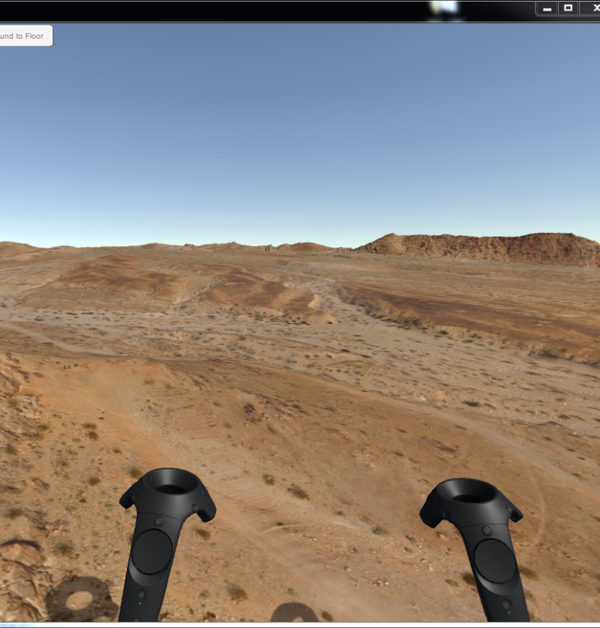
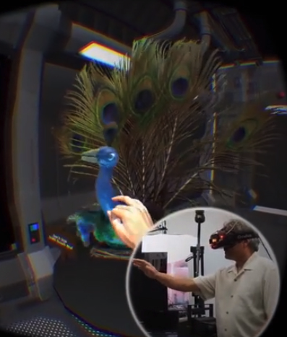
Virtual Reality Pipelines for Geo-Science
Imaging pipeline which creates image based renderings of translucent and finely detailed objects in VR.
Drone and photogrammetry pipeline which brings 3D terrain data into VR.
Contact: Dr. David M. Krum http://mxrlab.com email: krum@ict.usc.edu
Notes:
At ICT we have developed two imaging pipelines which allow us to capture real world data for display and interaction in virtual reality. These pipelines may be of interest to geoscientists.
One is a drone and photogrammetry pipeline that allows us to capture terrain data. We can go from drone flight to virtual reality view of the terrain in less than 1 day.
I am interested in working with domain experts to understand the types of interactions, measurements, and activities that could be supported in a virtual reality environment that would help geoscientists who want to work with 3D terrain data. I am told that folks studying geomorphology might have an interest.
The other is a table top imaging system that takes a series of images of an object on a turn table. We do not create a 3D model of the object, but instead display images of the object that best match the left and right eye viewpoints of the user as they look at the object in virtual reality. As there is no 3D geometry, the fine details, iridescence, and translucency of objects like peacock feathers can be captured and displayed. We have imaged sculptures of an artist who works in plastic and translucent colored glass.
I am interested to see if there might be any educational use or archival use of digitizing specimens for viewing in virtual reality.

