Slide 1
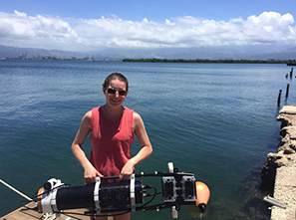
Katie Skinner
About Me
University of Michigan
Robotics Program, PhD Candidate
IS-GEO Early Career Researchers Committee
Research Interests
Real-time perception for marine robots
3D reconstruction of underwater scenes
Enabling technology for scientific discovery

Slide 2
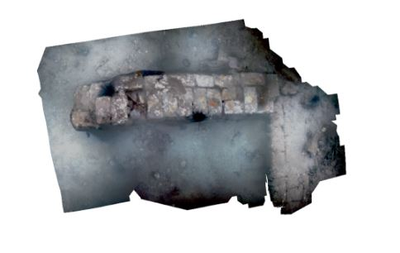
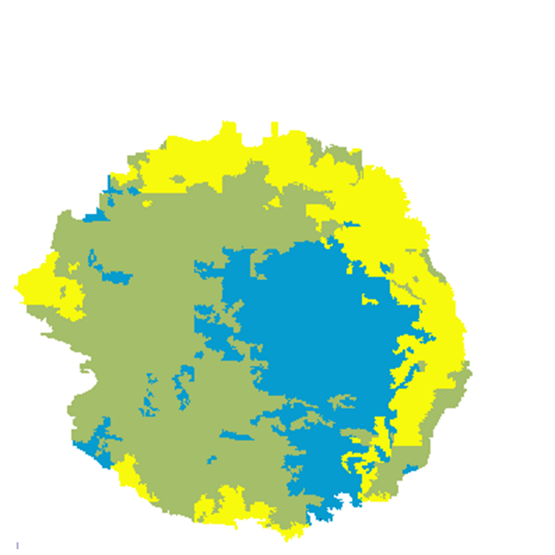
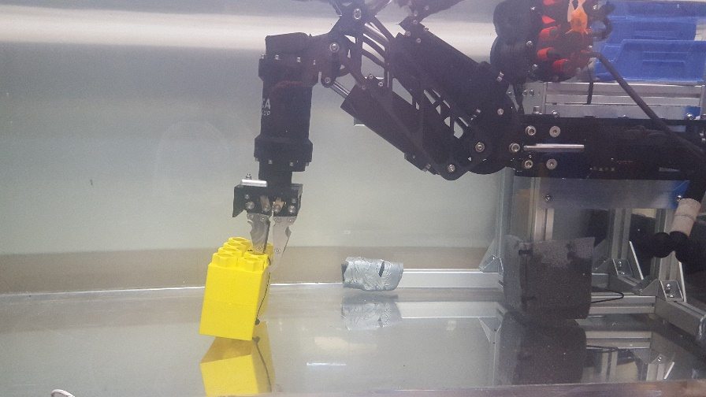
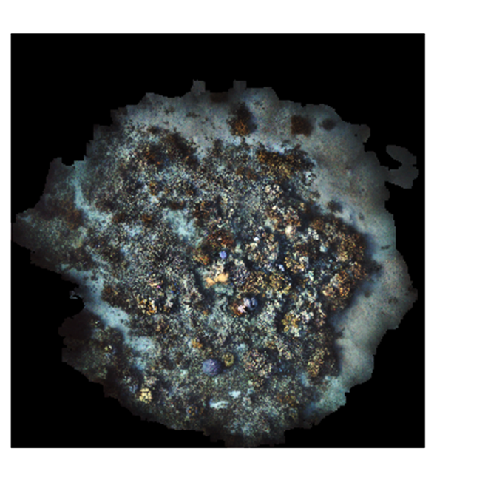
IS-GEO Projects
3D reconstruction
Robotic sampling
Deep learning for data discovery

