Slide 1
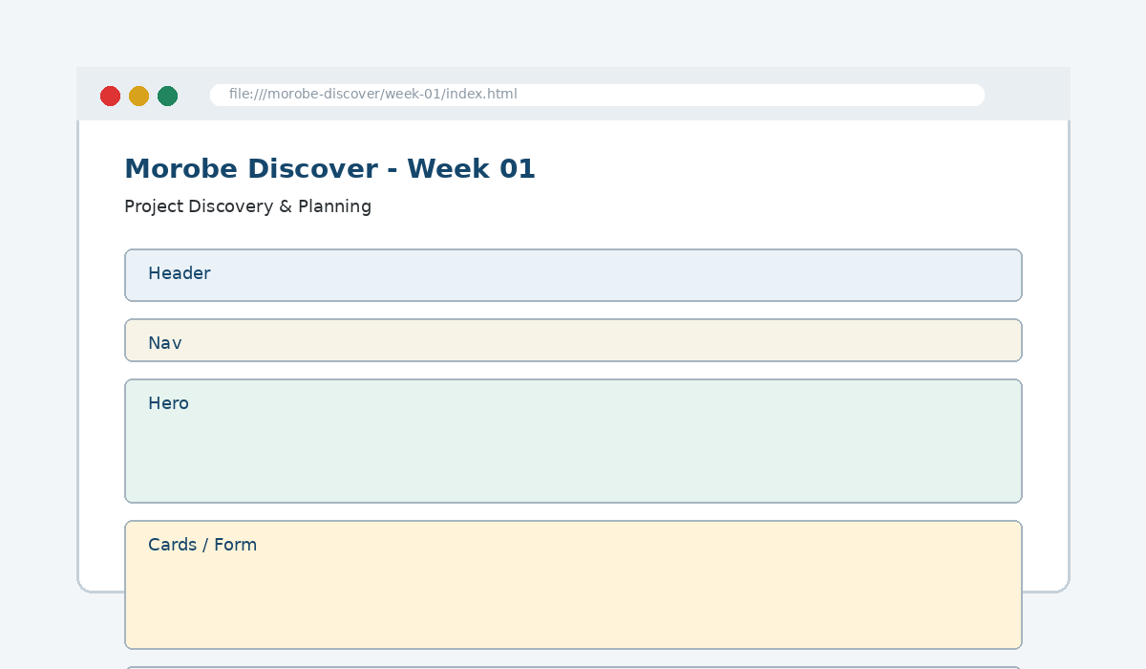
IS229 WEB DESIGN
Week 01
Project Discovery & Planning
Define the project problem, identify users/tasks, and structure the site architecture.
Prepared by Mr. Maxie Cletus Tepaiyan
School of Business Studies | Bachelor of Business in Information Technology
PNG University of Technology

Slide 2
WEEK 01 | PROJECT DISCOVERY & PLANNING
Learning outcomes
Define the project problem, identify users/tasks, and structure the site architecture.
Explain the core programming/design concept for this week
Read and modify key code patterns
Test the weekly project increment
Prepare evidence for GitHub submission
IS229 Web Design | Mr. Maxie Cletus Tepaiyan | School of Business Studies

Slide 3
WEEK 01 | PROJECT DISCOVERY & PLANNING
Today's problem
Why it matters
Plan the problem, the users and the content before choosing colours or writing HTML.
IS229 Web Design | Mr. Maxie Cletus Tepaiyan | School of Business Studies

Slide 4
WEEK 01 | PROJECT DISCOVERY & PLANNING
Project before -> after
Before Week 01
After Week 01
A website idea only; no project evidence or code structure exists.
A documented project plan and repository scaffold ready for semantic HTML.
IS229 Web Design | Mr. Maxie Cletus Tepaiyan | School of Business Studies

Slide 5
WEEK 01 | PROJECT DISCOVERY & PLANNING
What we build this week
Write a purpose statement
Create three user personas
Write five user stories with acceptance checks
Draw the sitemap and homepage wireframe
Create README.md and placeholder index.html
IS229 Web Design | Mr. Maxie Cletus Tepaiyan | School of Business Studies

Slide 6
WEEK 01 | PROJECT DISCOVERY & PLANNING
Core principle
Plan the problem, the users and the content before choosing colours or writing HTML.
Keep in mind
A good web developer can point to the code, the browser result, and the user reason behind the decision.
IS229 Web Design | Mr. Maxie Cletus Tepaiyan | School of Business Studies

Slide 7
WEEK 01 | PROJECT DISCOVERY & PLANNING
Key concepts
Concept 1
Concept 2
Concept 3
Problem statements guide feature decisions
Personas represent realistic user tasks
Sitemaps plan pages; wireframes plan page layout
IS229 Web Design | Mr. Maxie Cletus Tepaiyan | School of Business Studies

Slide 8
WEEK 01 | PROJECT DISCOVERY & PLANNING
Project anatomy
IS229 Web Design | Mr. Maxie Cletus Tepaiyan | School of Business Studies

Slide 9
WEEK 01 | PROJECT DISCOVERY & PLANNING
Key code pattern A
# Morobe Discover
Week 01 creates planning evidence.
## Output
- Project brief
- User stories
- Sitemap
Explain it
Which file contains this code?
Which line creates the visible change?
What should appear in the browser?
IS229 Web Design | Mr. Maxie Cletus Tepaiyan | School of Business Studies

Slide 10
WEEK 01 | PROJECT DISCOVERY & PLANNING
Code -> visual result
# Morobe Discover
Week 01 creates planning evidence.
## Output
- Project brief
IS229 Web Design | Mr. Maxie Cletus Tepaiyan | School of Business Studies

Slide 11
WEEK 01 | PROJECT DISCOVERY & PLANNING
What changed?
Project file changed for Project Discovery & Planning
The browser output is now closer to the required weekly evidence
The change supports a user task or quality requirement
The change can be tested and committed
IS229 Web Design | Mr. Maxie Cletus Tepaiyan | School of Business Studies

Slide 12
WEEK 01 | PROJECT DISCOVERY & PLANNING
Key code pattern B
Home
├── Destinations
├── Events
├── Plan a Trip
└── About
Why this pattern is needed
The second pattern usually applies the same idea to a different component, state, layout or data flow.
IS229 Web Design | Mr. Maxie Cletus Tepaiyan | School of Business Studies

Slide 13
WEEK 01 | PROJECT DISCOVERY & PLANNING
Apply it to Morobe Discover
Write a purpose statement
Create three user personas
Write five user stories with acceptance checks
Draw the sitemap and homepage wireframe
IS229 Web Design | Mr. Maxie Cletus Tepaiyan | School of Business Studies

Slide 14
WEEK 01 | PROJECT DISCOVERY & PLANNING
Compare the approaches
Weak approach
Professional approach
Memorise the definition
Copy code without understanding
No browser evidence
No test note
Explain the concept
Apply the correct code pattern
Inspect the result
Commit and describe the evidence
IS229 Web Design | Mr. Maxie Cletus Tepaiyan | School of Business Studies

Slide 15
WEEK 01 | PROJECT DISCOVERY & PLANNING
Common mistake
Mistake
Correction
The page appears unchanged, but the student assumes the feature is complete.
Check the correct file, refresh the browser, inspect DevTools, and verify the expected output.
IS229 Web Design | Mr. Maxie Cletus Tepaiyan | School of Business Studies

Slide 16
WEEK 01 | PROJECT DISCOVERY & PLANNING
Why does this fail?
// Broken checkpoint
// File changed, but the browser result does not change.
// Possible causes:
// - wrong file
// - file not linked
// - syntax error
// - browser not refreshed
Class question
Which cause would you check first, and why?
IS229 Web Design | Mr. Maxie Cletus Tepaiyan | School of Business Studies

Slide 17
WEEK 01 | PROJECT DISCOVERY & PLANNING
Fix the problem
Confirm the browser is opening the correct file
Check links to CSS/JS/data files
Inspect the console for errors
Use a small working example
Test again before committing
IS229 Web Design | Mr. Maxie Cletus Tepaiyan | School of Business Studies

Slide 18
WEEK 01 | PROJECT DISCOVERY & PLANNING
Class activity
Activity - 7 minutes
Given “make a tourism website”, rewrite it as a testable project problem.
Work in pairs
Point to the project evidence
Prepare one answer to share
IS229 Web Design | Mr. Maxie Cletus Tepaiyan | School of Business Studies

Slide 19
WEEK 01 | PROJECT DISCOVERY & PLANNING
Implementation steps 1-3
Write a purpose statement
Create three user personas
Write five user stories with acceptance checks
IS229 Web Design | Mr. Maxie Cletus Tepaiyan | School of Business Studies

Slide 20
WEEK 01 | PROJECT DISCOVERY & PLANNING
Implementation steps 4-5
Draw the sitemap and homepage wireframe
Create README.md and placeholder index.html
IS229 Web Design | Mr. Maxie Cletus Tepaiyan | School of Business Studies

Slide 21
WEEK 01 | PROJECT DISCOVERY & PLANNING
LIVE DEMO
Demo checklist
1. Open the current project
2. Locate the affected file
3. Add or modify the key code
4. Refresh the browser
5. Inspect the result
6. Explain the change
IS229 Web Design | Mr. Maxie Cletus Tepaiyan | School of Business Studies

Slide 22
WEEK 01 | PROJECT DISCOVERY & PLANNING
Predict the output
Home
├── Destinations
├── Events
├── Plan a Trip
└── About
Prediction prompt
What should change on screen when this code is applied correctly?
IS229 Web Design | Mr. Maxie Cletus Tepaiyan | School of Business Studies

Slide 23
WEEK 01 | PROJECT DISCOVERY & PLANNING
Browser result
IS229 Web Design | Mr. Maxie Cletus Tepaiyan | School of Business Studies

Slide 24
WEEK 01 | PROJECT DISCOVERY & PLANNING
Testing the feature
Open index.html in the browser
Check user stories include user, goal and reason
Confirm the sitemap matches the planned pages
Commit evidence to Git
IS229 Web Design | Mr. Maxie Cletus Tepaiyan | School of Business Studies

Slide 25
WEEK 01 | PROJECT DISCOVERY & PLANNING
Inspect with browser tools
Inspection path
Evidence to save
Right click -> Inspect
Elements panel -> structure/classes
Console -> JavaScript errors
Network/Application -> data/storage when relevant
Screenshot
Short test note
Changed files
Git commit message
IS229 Web Design | Mr. Maxie Cletus Tepaiyan | School of Business Studies

Slide 26
WEEK 01 | PROJECT DISCOVERY & PLANNING
Git evidence
git add .
git commit -m "Week 01 Project Discovery & Planning project increment"
Why it matters
Git history shows progression from Week 01 to final deployment. It is part of the assessment evidence.
IS229 Web Design | Mr. Maxie Cletus Tepaiyan | School of Business Studies

Slide 27
WEEK 01 | PROJECT DISCOVERY & PLANNING
Complete source code
Repository:
https://github.com/YOUR-USERNAME/is229-morobe-discover
Weekly folder:
/week-01/
Complete project:
/complete-project/
Reminder
Do not paste a whole file into a slide. Use the repository for complete code.
IS229 Web Design | Mr. Maxie Cletus Tepaiyan | School of Business Studies

Slide 28
WEEK 01 | PROJECT DISCOVERY & PLANNING
Mini challenge
Challenge
Modify one part of the Week 01 implementation and explain what changed in the browser.
State the file edited
State the line/section changed
Show the before and after result
IS229 Web Design | Mr. Maxie Cletus Tepaiyan | School of Business Studies

Slide 29
WEEK 01 | PROJECT DISCOVERY & PLANNING
What counts as evidence?
Technical evidence
Understanding evidence
Changed code files
Browser screenshot
Test note
Git commit
Code explanation
Why this method fits
Connection to previous week
Connection to next week
IS229 Web Design | Mr. Maxie Cletus Tepaiyan | School of Business Studies

Slide 30
WEEK 01 | PROJECT DISCOVERY & PLANNING
Project lab handoff
Write a purpose statement
Create three user personas
Write five user stories with acceptance checks
Draw the sitemap and homepage wireframe
Create README.md and placeholder index.html
IS229 Web Design | Mr. Maxie Cletus Tepaiyan | School of Business Studies

Slide 31
WEEK 01 | PROJECT DISCOVERY & PLANNING
Definition of done
Week 01 feature is implemented
Project still preserves earlier week features
Browser result matches the expected output
Test note and screenshot are saved
Git commit message is meaningful
IS229 Web Design | Mr. Maxie Cletus Tepaiyan | School of Business Studies

Slide 32
WEEK 01 | PROJECT DISCOVERY & PLANNING
What we built today
A documented project plan and repository scaffold ready for semantic HTML.
Evidence: Project brief, user stories, sitemap, wireframes, repository scaffold, purpose statement and user personas
Technology: Git / Planning Tools / Markdown
IS229 Web Design | Mr. Maxie Cletus Tepaiyan | School of Business Studies

Slide 33
WEEK 01 | PROJECT DISCOVERY & PLANNING
Lecture summary
Plan the problem, the users and the content before choosing colours or writing HTML.
Problem statements guide feature decisions
Personas represent realistic user tasks
Testing and Git are part of development, not extras
IS229 Web Design | Mr. Maxie Cletus Tepaiyan | School of Business Studies

Slide 34
WEEK 01 | PROJECT DISCOVERY & PLANNING
Prepare for next class
Finish this week’s lab before the next class
Read the next topic in advance
Bring the current project ready to extend
Be ready to explain one code decision
IS229 Web Design | Mr. Maxie Cletus Tepaiyan | School of Business Studies

Slide 35
WEEK 01 | PROJECT DISCOVERY & PLANNING
Exit question
How did Week 01 improve Morobe Discover, and what will the next week build on?
IS229 Web Design | Mr. Maxie Cletus Tepaiyan | School of Business Studies

