Slide 1
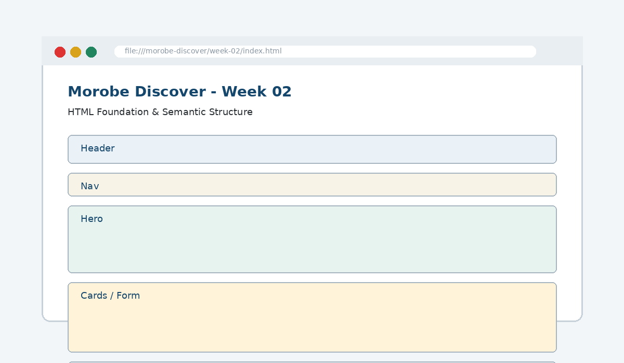
IS229 WEB DESIGN
Week 02
HTML Foundation & Semantic Structure
Create meaningful page regions and build web pages using appropriate structural elements.
Prepared by Mr. Maxie Cletus Tepaiyan
School of Business Studies | Bachelor of Business in Information Technology
PNG University of Technology

Slide 2
WEEK 02 | HTML FOUNDATION & SEMANTIC STRUCTURE
Learning outcomes
Create meaningful page regions and build web pages using appropriate structural elements.
Explain the core programming/design concept for this week
Read and modify key code patterns
Test the weekly project increment
Prepare evidence for GitHub submission
IS229 Web Design | Mr. Maxie Cletus Tepaiyan | School of Business Studies

Slide 3
WEEK 02 | HTML FOUNDATION & SEMANTIC STRUCTURE
Today's problem
Why it matters
HTML should describe the meaning and structure of the content before CSS changes the appearance.
IS229 Web Design | Mr. Maxie Cletus Tepaiyan | School of Business Studies

Slide 4
WEEK 02 | HTML FOUNDATION & SEMANTIC STRUCTURE
Project before -> after
Before Week 02
After Week 02
Week 01 produced the sitemap, wireframe and repository scaffold.
The homepage is coded as a meaningful HTML5 structure that reflects the wireframe.
IS229 Web Design | Mr. Maxie Cletus Tepaiyan | School of Business Studies

Slide 5
WEEK 02 | HTML FOUNDATION & SEMANTIC STRUCTURE
What we build this week
Create the HTML document shell
Add title and metadata
Translate wireframe regions into semantic elements
Add navigation links and headings
Add placeholder content for hero, cards and footer
IS229 Web Design | Mr. Maxie Cletus Tepaiyan | School of Business Studies

Slide 6
WEEK 02 | HTML FOUNDATION & SEMANTIC STRUCTURE
Core principle
HTML should describe the meaning and structure of the content before CSS changes the appearance.
Keep in mind
A good web developer can point to the code, the browser result, and the user reason behind the decision.
IS229 Web Design | Mr. Maxie Cletus Tepaiyan | School of Business Studies

Slide 7
WEEK 02 | HTML FOUNDATION & SEMANTIC STRUCTURE
Key concepts
Concept 1
Concept 2
Concept 3
The document shell gives the page its valid base
Semantic elements name regions by purpose
Heading order creates a document outline
IS229 Web Design | Mr. Maxie Cletus Tepaiyan | School of Business Studies

Slide 8
WEEK 02 | HTML FOUNDATION & SEMANTIC STRUCTURE
Project anatomy
IS229 Web Design | Mr. Maxie Cletus Tepaiyan | School of Business Studies

Slide 9
WEEK 02 | HTML FOUNDATION & SEMANTIC STRUCTURE
Key code pattern A
<header>
<h1>Morobe Discover</h1>
</header>
<nav>...</nav>
<main>...</main>
<footer>...</footer>
Explain it
Which file contains this code?
Which line creates the visible change?
What should appear in the browser?
IS229 Web Design | Mr. Maxie Cletus Tepaiyan | School of Business Studies

Slide 10
WEEK 02 | HTML FOUNDATION & SEMANTIC STRUCTURE
Code -> visual result
<header>
<h1>Morobe Discover</h1>
</header>
<nav>...</nav>
<main>...</main>
IS229 Web Design | Mr. Maxie Cletus Tepaiyan | School of Business Studies

Slide 11
WEEK 02 | HTML FOUNDATION & SEMANTIC STRUCTURE
What changed?
Project file changed for HTML Foundation & Semantic Structure
The browser output is now closer to the required weekly evidence
The change supports a user task or quality requirement
The change can be tested and committed
IS229 Web Design | Mr. Maxie Cletus Tepaiyan | School of Business Studies

Slide 12
WEEK 02 | HTML FOUNDATION & SEMANTIC STRUCTURE
Key code pattern B
<section class="hero">
<h2>Discover Morobe</h2>
<p>Find destinations, events and trip ideas.</p>
</section>
Why this pattern is needed
The second pattern usually applies the same idea to a different component, state, layout or data flow.
IS229 Web Design | Mr. Maxie Cletus Tepaiyan | School of Business Studies

Slide 13
WEEK 02 | HTML FOUNDATION & SEMANTIC STRUCTURE
Apply it to Morobe Discover
Create the HTML document shell
Add title and metadata
Translate wireframe regions into semantic elements
Add navigation links and headings
IS229 Web Design | Mr. Maxie Cletus Tepaiyan | School of Business Studies

Slide 14
WEEK 02 | HTML FOUNDATION & SEMANTIC STRUCTURE
Compare the approaches
Weak approach
Professional approach
Memorise the definition
Copy code without understanding
No browser evidence
No test note
Explain the concept
Apply the correct code pattern
Inspect the result
Commit and describe the evidence
IS229 Web Design | Mr. Maxie Cletus Tepaiyan | School of Business Studies

Slide 15
WEEK 02 | HTML FOUNDATION & SEMANTIC STRUCTURE
Common mistake
Mistake
Correction
The page appears unchanged, but the student assumes the feature is complete.
Check the correct file, refresh the browser, inspect DevTools, and verify the expected output.
IS229 Web Design | Mr. Maxie Cletus Tepaiyan | School of Business Studies

Slide 16
WEEK 02 | HTML FOUNDATION & SEMANTIC STRUCTURE
Why does this fail?
// Broken checkpoint
// File changed, but the browser result does not change.
// Possible causes:
// - wrong file
// - file not linked
// - syntax error
// - browser not refreshed
Class question
Which cause would you check first, and why?
IS229 Web Design | Mr. Maxie Cletus Tepaiyan | School of Business Studies

Slide 17
WEEK 02 | HTML FOUNDATION & SEMANTIC STRUCTURE
Fix the problem
Confirm the browser is opening the correct file
Check links to CSS/JS/data files
Inspect the console for errors
Use a small working example
Test again before committing
IS229 Web Design | Mr. Maxie Cletus Tepaiyan | School of Business Studies

Slide 18
WEEK 02 | HTML FOUNDATION & SEMANTIC STRUCTURE
Class activity
Activity - 7 minutes
Look at the wireframe and label which region becomes header, nav, main, section and footer.
Work in pairs
Point to the project evidence
Prepare one answer to share
IS229 Web Design | Mr. Maxie Cletus Tepaiyan | School of Business Studies

Slide 19
WEEK 02 | HTML FOUNDATION & SEMANTIC STRUCTURE
Implementation steps 1-3
Create the HTML document shell
Add title and metadata
Translate wireframe regions into semantic elements
IS229 Web Design | Mr. Maxie Cletus Tepaiyan | School of Business Studies

Slide 20
WEEK 02 | HTML FOUNDATION & SEMANTIC STRUCTURE
Implementation steps 4-5
Add navigation links and headings
Add placeholder content for hero, cards and footer
IS229 Web Design | Mr. Maxie Cletus Tepaiyan | School of Business Studies

Slide 21
WEEK 02 | HTML FOUNDATION & SEMANTIC STRUCTURE
LIVE DEMO
Demo checklist
1. Open the current project
2. Locate the affected file
3. Add or modify the key code
4. Refresh the browser
5. Inspect the result
6. Explain the change
IS229 Web Design | Mr. Maxie Cletus Tepaiyan | School of Business Studies

Slide 22
WEEK 02 | HTML FOUNDATION & SEMANTIC STRUCTURE
Predict the output
<section class="hero">
<h2>Discover Morobe</h2>
<p>Find destinations, events and trip ideas.</p>
</section>
Prediction prompt
What should change on screen when this code is applied correctly?
IS229 Web Design | Mr. Maxie Cletus Tepaiyan | School of Business Studies

Slide 23
WEEK 02 | HTML FOUNDATION & SEMANTIC STRUCTURE
Browser result
IS229 Web Design | Mr. Maxie Cletus Tepaiyan | School of Business Studies

Slide 24
WEEK 02 | HTML FOUNDATION & SEMANTIC STRUCTURE
Testing the feature
Validate the document structure
Check one h1 per page
Check navigation links point to planned pages
Inspect the browser output
IS229 Web Design | Mr. Maxie Cletus Tepaiyan | School of Business Studies

Slide 25
WEEK 02 | HTML FOUNDATION & SEMANTIC STRUCTURE
Inspect with browser tools
Inspection path
Evidence to save
Right click -> Inspect
Elements panel -> structure/classes
Console -> JavaScript errors
Network/Application -> data/storage when relevant
Screenshot
Short test note
Changed files
Git commit message
IS229 Web Design | Mr. Maxie Cletus Tepaiyan | School of Business Studies

Slide 26
WEEK 02 | HTML FOUNDATION & SEMANTIC STRUCTURE
Git evidence
git add .
git commit -m "Week 02 HTML Foundation & Semantic Structure project increment"
Why it matters
Git history shows progression from Week 01 to final deployment. It is part of the assessment evidence.
IS229 Web Design | Mr. Maxie Cletus Tepaiyan | School of Business Studies

Slide 27
WEEK 02 | HTML FOUNDATION & SEMANTIC STRUCTURE
Complete source code
Repository:
https://github.com/YOUR-USERNAME/is229-morobe-discover
Weekly folder:
/week-02/
Complete project:
/complete-project/
Reminder
Do not paste a whole file into a slide. Use the repository for complete code.
IS229 Web Design | Mr. Maxie Cletus Tepaiyan | School of Business Studies

Slide 28
WEEK 02 | HTML FOUNDATION & SEMANTIC STRUCTURE
Mini challenge
Challenge
Modify one part of the Week 02 implementation and explain what changed in the browser.
State the file edited
State the line/section changed
Show the before and after result
IS229 Web Design | Mr. Maxie Cletus Tepaiyan | School of Business Studies

Slide 29
WEEK 02 | HTML FOUNDATION & SEMANTIC STRUCTURE
What counts as evidence?
Technical evidence
Understanding evidence
Changed code files
Browser screenshot
Test note
Git commit
Code explanation
Why this method fits
Connection to previous week
Connection to next week
IS229 Web Design | Mr. Maxie Cletus Tepaiyan | School of Business Studies

Slide 30
WEEK 02 | HTML FOUNDATION & SEMANTIC STRUCTURE
Project lab handoff
Create the HTML document shell
Add title and metadata
Translate wireframe regions into semantic elements
Add navigation links and headings
Add placeholder content for hero, cards and footer
IS229 Web Design | Mr. Maxie Cletus Tepaiyan | School of Business Studies

Slide 31
WEEK 02 | HTML FOUNDATION & SEMANTIC STRUCTURE
Definition of done
Week 02 feature is implemented
Project still preserves earlier week features
Browser result matches the expected output
Test note and screenshot are saved
Git commit message is meaningful
IS229 Web Design | Mr. Maxie Cletus Tepaiyan | School of Business Studies

Slide 32
WEEK 02 | HTML FOUNDATION & SEMANTIC STRUCTURE
What we built today
The homepage is coded as a meaningful HTML5 structure that reflects the wireframe.
Evidence: Semantic HTML skeleton using header, nav, main, section, footer and a clear document outline
Technology: HTML
IS229 Web Design | Mr. Maxie Cletus Tepaiyan | School of Business Studies

Slide 33
WEEK 02 | HTML FOUNDATION & SEMANTIC STRUCTURE
Lecture summary
HTML should describe the meaning and structure of the content before CSS changes the appearance.
The document shell gives the page its valid base
Semantic elements name regions by purpose
Testing and Git are part of development, not extras
IS229 Web Design | Mr. Maxie Cletus Tepaiyan | School of Business Studies

Slide 34
WEEK 02 | HTML FOUNDATION & SEMANTIC STRUCTURE
Prepare for next class
Finish this week’s lab before the next class
Read the next topic in advance
Bring the current project ready to extend
Be ready to explain one code decision
IS229 Web Design | Mr. Maxie Cletus Tepaiyan | School of Business Studies

Slide 35
WEEK 02 | HTML FOUNDATION & SEMANTIC STRUCTURE
Exit question
How did Week 02 improve Morobe Discover, and what will the next week build on?
IS229 Web Design | Mr. Maxie Cletus Tepaiyan | School of Business Studies

