Slide 1
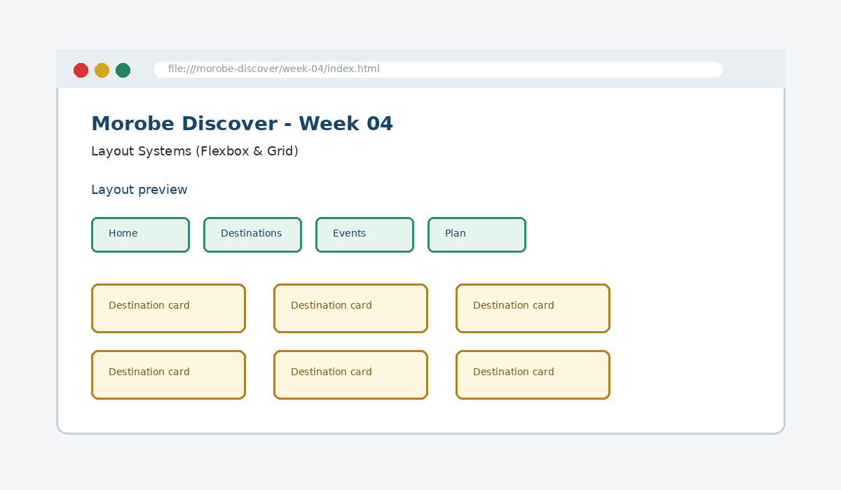
IS229 WEB DESIGN
Week 04
Layout Systems (Flexbox & Grid)
Manage one-dimensional and two-dimensional layouts for complex page sections.
Prepared by Mr. Maxie Cletus Tepaiyan
School of Business Studies | Bachelor of Business in Information Technology
PNG University of Technology

Slide 2
WEEK 04 | LAYOUT SYSTEMS (FLEXBOX & GRID)
Learning outcomes
Manage one-dimensional and two-dimensional layouts for complex page sections.
Explain the core programming/design concept for this week
Read and modify key code patterns
Test the weekly project increment
Prepare evidence for GitHub submission
IS229 Web Design | Mr. Maxie Cletus Tepaiyan | School of Business Studies

Slide 3
WEEK 04 | LAYOUT SYSTEMS (FLEXBOX & GRID)
Today's problem
Why it matters
Use Flexbox for one-dimensional alignment and Grid for two-dimensional page and card structures.
IS229 Web Design | Mr. Maxie Cletus Tepaiyan | School of Business Studies

Slide 4
WEEK 04 | LAYOUT SYSTEMS (FLEXBOX & GRID)
Project before -> after
Before Week 04
After Week 04
Week 03 produced forms and a basic visual design system.
The website uses intentional layout systems for navigation, forms, cards and page sections.
IS229 Web Design | Mr. Maxie Cletus Tepaiyan | School of Business Studies

Slide 5
WEEK 04 | LAYOUT SYSTEMS (FLEXBOX & GRID)
What we build this week
Convert navigation into a Flexbox row
Align form controls with consistent gap
Create a card gallery with CSS Grid
Use container width to improve readability
Remove manual spacing hacks
IS229 Web Design | Mr. Maxie Cletus Tepaiyan | School of Business Studies

Slide 6
WEEK 04 | LAYOUT SYSTEMS (FLEXBOX & GRID)
Core principle
Use Flexbox for one-dimensional alignment and Grid for two-dimensional page and card structures.
Keep in mind
A good web developer can point to the code, the browser result, and the user reason behind the decision.
IS229 Web Design | Mr. Maxie Cletus Tepaiyan | School of Business Studies

Slide 7
WEEK 04 | LAYOUT SYSTEMS (FLEXBOX & GRID)
Key concepts
Concept 1
Concept 2
Concept 3
Flexbox aligns items along one main axis
Grid creates rows and columns together
Gap creates maintainable spacing without layout hacks
IS229 Web Design | Mr. Maxie Cletus Tepaiyan | School of Business Studies

Slide 8
WEEK 04 | LAYOUT SYSTEMS (FLEXBOX & GRID)
Project anatomy
IS229 Web Design | Mr. Maxie Cletus Tepaiyan | School of Business Studies

Slide 9
WEEK 04 | LAYOUT SYSTEMS (FLEXBOX & GRID)
Key code pattern A
.site-nav {
display: flex;
gap: 1rem;
align-items: center;
}
Explain it
Which file contains this code?
Which line creates the visible change?
What should appear in the browser?
IS229 Web Design | Mr. Maxie Cletus Tepaiyan | School of Business Studies

Slide 10
WEEK 04 | LAYOUT SYSTEMS (FLEXBOX & GRID)
Code -> visual result
.site-nav {
display: flex;
gap: 1rem;
align-items: center;
}
IS229 Web Design | Mr. Maxie Cletus Tepaiyan | School of Business Studies

Slide 11
WEEK 04 | LAYOUT SYSTEMS (FLEXBOX & GRID)
What changed?
Project file changed for Layout Systems (Flexbox & Grid)
The browser output is now closer to the required weekly evidence
The change supports a user task or quality requirement
The change can be tested and committed
IS229 Web Design | Mr. Maxie Cletus Tepaiyan | School of Business Studies

Slide 12
WEEK 04 | LAYOUT SYSTEMS (FLEXBOX & GRID)
Key code pattern B
.card-grid {
display: grid;
grid-template-columns: repeat(3, 1fr);
gap: 1.25rem;
}
Why this pattern is needed
The second pattern usually applies the same idea to a different component, state, layout or data flow.
IS229 Web Design | Mr. Maxie Cletus Tepaiyan | School of Business Studies

Slide 13
WEEK 04 | LAYOUT SYSTEMS (FLEXBOX & GRID)
Apply it to Morobe Discover
Convert navigation into a Flexbox row
Align form controls with consistent gap
Create a card gallery with CSS Grid
Use container width to improve readability
IS229 Web Design | Mr. Maxie Cletus Tepaiyan | School of Business Studies

Slide 14
WEEK 04 | LAYOUT SYSTEMS (FLEXBOX & GRID)
Compare the approaches
Weak approach
Professional approach
Memorise the definition
Copy code without understanding
No browser evidence
No test note
Explain the concept
Apply the correct code pattern
Inspect the result
Commit and describe the evidence
IS229 Web Design | Mr. Maxie Cletus Tepaiyan | School of Business Studies

Slide 15
WEEK 04 | LAYOUT SYSTEMS (FLEXBOX & GRID)
Common mistake
Mistake
Correction
The page appears unchanged, but the student assumes the feature is complete.
Check the correct file, refresh the browser, inspect DevTools, and verify the expected output.
IS229 Web Design | Mr. Maxie Cletus Tepaiyan | School of Business Studies

Slide 16
WEEK 04 | LAYOUT SYSTEMS (FLEXBOX & GRID)
Why does this fail?
// Broken checkpoint
// File changed, but the browser result does not change.
// Possible causes:
// - wrong file
// - file not linked
// - syntax error
// - browser not refreshed
Class question
Which cause would you check first, and why?
IS229 Web Design | Mr. Maxie Cletus Tepaiyan | School of Business Studies

Slide 17
WEEK 04 | LAYOUT SYSTEMS (FLEXBOX & GRID)
Fix the problem
Confirm the browser is opening the correct file
Check links to CSS/JS/data files
Inspect the console for errors
Use a small working example
Test again before committing
IS229 Web Design | Mr. Maxie Cletus Tepaiyan | School of Business Studies

Slide 18
WEEK 04 | LAYOUT SYSTEMS (FLEXBOX & GRID)
Class activity
Activity - 7 minutes
Choose Flexbox or Grid for navigation, hero area, card gallery and form rows.
Work in pairs
Point to the project evidence
Prepare one answer to share
IS229 Web Design | Mr. Maxie Cletus Tepaiyan | School of Business Studies

Slide 19
WEEK 04 | LAYOUT SYSTEMS (FLEXBOX & GRID)
Implementation steps 1-3
Convert navigation into a Flexbox row
Align form controls with consistent gap
Create a card gallery with CSS Grid
IS229 Web Design | Mr. Maxie Cletus Tepaiyan | School of Business Studies

Slide 20
WEEK 04 | LAYOUT SYSTEMS (FLEXBOX & GRID)
Implementation steps 4-5
Use container width to improve readability
Remove manual spacing hacks
IS229 Web Design | Mr. Maxie Cletus Tepaiyan | School of Business Studies

Slide 21
WEEK 04 | LAYOUT SYSTEMS (FLEXBOX & GRID)
LIVE DEMO
Demo checklist
1. Open the current project
2. Locate the affected file
3. Add or modify the key code
4. Refresh the browser
5. Inspect the result
6. Explain the change
IS229 Web Design | Mr. Maxie Cletus Tepaiyan | School of Business Studies

Slide 22
WEEK 04 | LAYOUT SYSTEMS (FLEXBOX & GRID)
Predict the output
.card-grid {
display: grid;
grid-template-columns: repeat(3, 1fr);
gap: 1.25rem;
}
Prediction prompt
What should change on screen when this code is applied correctly?
IS229 Web Design | Mr. Maxie Cletus Tepaiyan | School of Business Studies

Slide 23
WEEK 04 | LAYOUT SYSTEMS (FLEXBOX & GRID)
Browser result
IS229 Web Design | Mr. Maxie Cletus Tepaiyan | School of Business Studies

Slide 24
WEEK 04 | LAYOUT SYSTEMS (FLEXBOX & GRID)
Testing the feature
Resize the browser width
Check navigation alignment
Inspect card gaps and wrapping
Confirm form labels align with controls
IS229 Web Design | Mr. Maxie Cletus Tepaiyan | School of Business Studies

Slide 25
WEEK 04 | LAYOUT SYSTEMS (FLEXBOX & GRID)
Inspect with browser tools
Inspection path
Evidence to save
Right click -> Inspect
Elements panel -> structure/classes
Console -> JavaScript errors
Network/Application -> data/storage when relevant
Screenshot
Short test note
Changed files
Git commit message
IS229 Web Design | Mr. Maxie Cletus Tepaiyan | School of Business Studies

Slide 26
WEEK 04 | LAYOUT SYSTEMS (FLEXBOX & GRID)
Git evidence
git add .
git commit -m "Week 04 Layout Systems (Flexbox & Grid) project increment"
Why it matters
Git history shows progression from Week 01 to final deployment. It is part of the assessment evidence.
IS229 Web Design | Mr. Maxie Cletus Tepaiyan | School of Business Studies

Slide 27
WEEK 04 | LAYOUT SYSTEMS (FLEXBOX & GRID)
Complete source code
Repository:
https://github.com/YOUR-USERNAME/is229-morobe-discover
Weekly folder:
/week-04/
Complete project:
/complete-project/
Reminder
Do not paste a whole file into a slide. Use the repository for complete code.
IS229 Web Design | Mr. Maxie Cletus Tepaiyan | School of Business Studies

Slide 28
WEEK 04 | LAYOUT SYSTEMS (FLEXBOX & GRID)
Mini challenge
Challenge
Modify one part of the Week 04 implementation and explain what changed in the browser.
State the file edited
State the line/section changed
Show the before and after result
IS229 Web Design | Mr. Maxie Cletus Tepaiyan | School of Business Studies

Slide 29
WEEK 04 | LAYOUT SYSTEMS (FLEXBOX & GRID)
What counts as evidence?
Technical evidence
Understanding evidence
Changed code files
Browser screenshot
Test note
Git commit
Code explanation
Why this method fits
Connection to previous week
Connection to next week
IS229 Web Design | Mr. Maxie Cletus Tepaiyan | School of Business Studies

Slide 30
WEEK 04 | LAYOUT SYSTEMS (FLEXBOX & GRID)
Project lab handoff
Convert navigation into a Flexbox row
Align form controls with consistent gap
Create a card gallery with CSS Grid
Use container width to improve readability
Remove manual spacing hacks
IS229 Web Design | Mr. Maxie Cletus Tepaiyan | School of Business Studies

Slide 31
WEEK 04 | LAYOUT SYSTEMS (FLEXBOX & GRID)
Definition of done
Week 04 feature is implemented
Project still preserves earlier week features
Browser result matches the expected output
Test note and screenshot are saved
Git commit message is meaningful
IS229 Web Design | Mr. Maxie Cletus Tepaiyan | School of Business Studies

Slide 32
WEEK 04 | LAYOUT SYSTEMS (FLEXBOX & GRID)
What we built today
The website uses intentional layout systems for navigation, forms, cards and page sections.
Evidence: Navigation bar, button rows, aligned form controls and card galleries
Technology: CSS Flexbox / CSS Grid
IS229 Web Design | Mr. Maxie Cletus Tepaiyan | School of Business Studies

Slide 33
WEEK 04 | LAYOUT SYSTEMS (FLEXBOX & GRID)
Lecture summary
Use Flexbox for one-dimensional alignment and Grid for two-dimensional page and card structures.
Flexbox aligns items along one main axis
Grid creates rows and columns together
Testing and Git are part of development, not extras
IS229 Web Design | Mr. Maxie Cletus Tepaiyan | School of Business Studies

Slide 34
WEEK 04 | LAYOUT SYSTEMS (FLEXBOX & GRID)
Prepare for next class
Finish this week’s lab before the next class
Read the next topic in advance
Bring the current project ready to extend
Be ready to explain one code decision
IS229 Web Design | Mr. Maxie Cletus Tepaiyan | School of Business Studies

Slide 35
WEEK 04 | LAYOUT SYSTEMS (FLEXBOX & GRID)
Exit question
How did Week 04 improve Morobe Discover, and what will the next week build on?
IS229 Web Design | Mr. Maxie Cletus Tepaiyan | School of Business Studies

