Slide 1
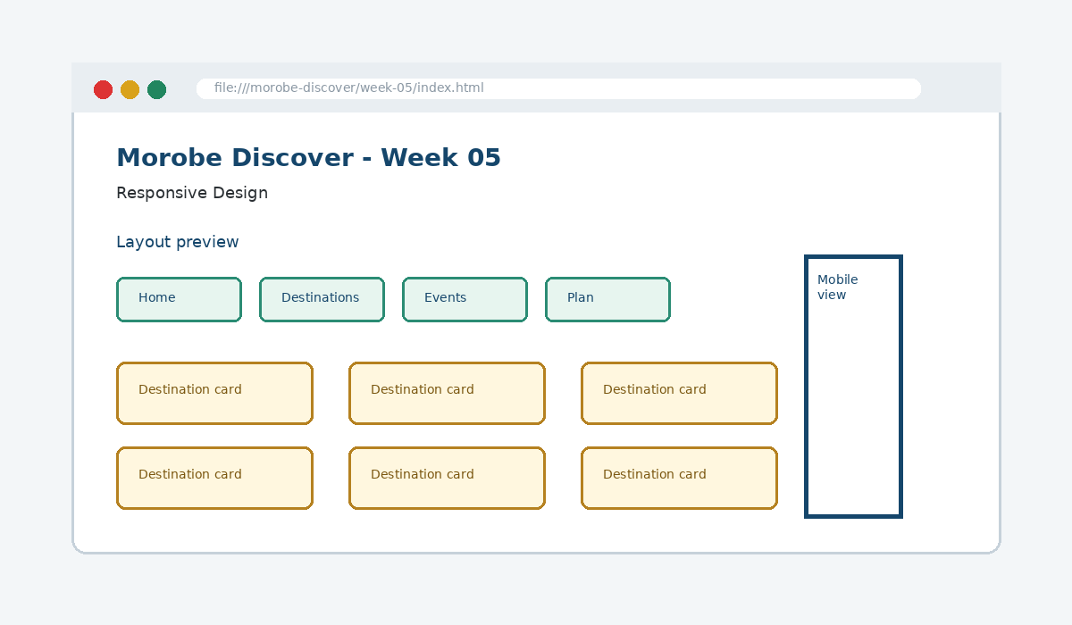
IS229 WEB DESIGN
Week 05
Responsive Design
Adapt the website interface to function across various device screen sizes.
Prepared by Mr. Maxie Cletus Tepaiyan
School of Business Studies | Bachelor of Business in Information Technology
PNG University of Technology

Slide 2
WEEK 05 | RESPONSIVE DESIGN
Learning outcomes
Adapt the website interface to function across various device screen sizes.
Explain the core programming/design concept for this week
Read and modify key code patterns
Test the weekly project increment
Prepare evidence for GitHub submission
IS229 Web Design | Mr. Maxie Cletus Tepaiyan | School of Business Studies

Slide 3
WEEK 05 | RESPONSIVE DESIGN
Today's problem
Why it matters
Start with flexible layouts and add breakpoints when the layout needs help, not because of a device name.
IS229 Web Design | Mr. Maxie Cletus Tepaiyan | School of Business Studies

Slide 4
WEEK 05 | RESPONSIVE DESIGN
Project before -> after
Before Week 05
After Week 05
Week 04 created structured layouts using Flexbox and Grid.
The same site works on mobile, tablet and desktop without separate versions.
IS229 Web Design | Mr. Maxie Cletus Tepaiyan | School of Business Studies

Slide 5
WEEK 05 | RESPONSIVE DESIGN
What we build this week
Stack navigation and cards on small screens
Add a tablet/desktop breakpoint
Make images and forms fluid
Test the main user journey at several widths
Record screenshots as evidence
IS229 Web Design | Mr. Maxie Cletus Tepaiyan | School of Business Studies

Slide 6
WEEK 05 | RESPONSIVE DESIGN
Core principle
Start with flexible layouts and add breakpoints when the layout needs help, not because of a device name.
Keep in mind
A good web developer can point to the code, the browser result, and the user reason behind the decision.
IS229 Web Design | Mr. Maxie Cletus Tepaiyan | School of Business Studies

Slide 7
WEEK 05 | RESPONSIVE DESIGN
Key concepts
Concept 1
Concept 2
Concept 3
Mobile-first CSS defines the simplest layout first
Media queries add layout changes at meaningful widths
Images and grids should be fluid
IS229 Web Design | Mr. Maxie Cletus Tepaiyan | School of Business Studies

Slide 8
WEEK 05 | RESPONSIVE DESIGN
Project anatomy
IS229 Web Design | Mr. Maxie Cletus Tepaiyan | School of Business Studies

Slide 9
WEEK 05 | RESPONSIVE DESIGN
Key code pattern A
img {
max-width: 100%;
height: auto;
}
Explain it
Which file contains this code?
Which line creates the visible change?
What should appear in the browser?
IS229 Web Design | Mr. Maxie Cletus Tepaiyan | School of Business Studies

Slide 10
WEEK 05 | RESPONSIVE DESIGN
Code -> visual result
img {
max-width: 100%;
height: auto;
}
IS229 Web Design | Mr. Maxie Cletus Tepaiyan | School of Business Studies

Slide 11
WEEK 05 | RESPONSIVE DESIGN
What changed?
Project file changed for Responsive Design
The browser output is now closer to the required weekly evidence
The change supports a user task or quality requirement
The change can be tested and committed
IS229 Web Design | Mr. Maxie Cletus Tepaiyan | School of Business Studies

Slide 12
WEEK 05 | RESPONSIVE DESIGN
Key code pattern B
@media (min-width: 768px) {
.card-grid {
grid-template-columns: repeat(3, 1fr);
}
}
Why this pattern is needed
The second pattern usually applies the same idea to a different component, state, layout or data flow.
IS229 Web Design | Mr. Maxie Cletus Tepaiyan | School of Business Studies

Slide 13
WEEK 05 | RESPONSIVE DESIGN
Apply it to Morobe Discover
Stack navigation and cards on small screens
Add a tablet/desktop breakpoint
Make images and forms fluid
Test the main user journey at several widths
IS229 Web Design | Mr. Maxie Cletus Tepaiyan | School of Business Studies

Slide 14
WEEK 05 | RESPONSIVE DESIGN
Compare the approaches
Weak approach
Professional approach
Memorise the definition
Copy code without understanding
No browser evidence
No test note
Explain the concept
Apply the correct code pattern
Inspect the result
Commit and describe the evidence
IS229 Web Design | Mr. Maxie Cletus Tepaiyan | School of Business Studies

Slide 15
WEEK 05 | RESPONSIVE DESIGN
Common mistake
Mistake
Correction
The page appears unchanged, but the student assumes the feature is complete.
Check the correct file, refresh the browser, inspect DevTools, and verify the expected output.
IS229 Web Design | Mr. Maxie Cletus Tepaiyan | School of Business Studies

Slide 16
WEEK 05 | RESPONSIVE DESIGN
Why does this fail?
// Broken checkpoint
// File changed, but the browser result does not change.
// Possible causes:
// - wrong file
// - file not linked
// - syntax error
// - browser not refreshed
Class question
Which cause would you check first, and why?
IS229 Web Design | Mr. Maxie Cletus Tepaiyan | School of Business Studies

Slide 17
WEEK 05 | RESPONSIVE DESIGN
Fix the problem
Confirm the browser is opening the correct file
Check links to CSS/JS/data files
Inspect the console for errors
Use a small working example
Test again before committing
IS229 Web Design | Mr. Maxie Cletus Tepaiyan | School of Business Studies

Slide 18
WEEK 05 | RESPONSIVE DESIGN
Class activity
Activity - 7 minutes
Find the first browser width where the card layout begins to fail.
Work in pairs
Point to the project evidence
Prepare one answer to share
IS229 Web Design | Mr. Maxie Cletus Tepaiyan | School of Business Studies

Slide 19
WEEK 05 | RESPONSIVE DESIGN
Implementation steps 1-3
Stack navigation and cards on small screens
Add a tablet/desktop breakpoint
Make images and forms fluid
IS229 Web Design | Mr. Maxie Cletus Tepaiyan | School of Business Studies

Slide 20
WEEK 05 | RESPONSIVE DESIGN
Implementation steps 4-5
Test the main user journey at several widths
Record screenshots as evidence
IS229 Web Design | Mr. Maxie Cletus Tepaiyan | School of Business Studies

Slide 21
WEEK 05 | RESPONSIVE DESIGN
LIVE DEMO
Demo checklist
1. Open the current project
2. Locate the affected file
3. Add or modify the key code
4. Refresh the browser
5. Inspect the result
6. Explain the change
IS229 Web Design | Mr. Maxie Cletus Tepaiyan | School of Business Studies

Slide 22
WEEK 05 | RESPONSIVE DESIGN
Predict the output
@media (min-width: 768px) {
.card-grid {
grid-template-columns: repeat(3, 1fr);
}
}
Prediction prompt
What should change on screen when this code is applied correctly?
IS229 Web Design | Mr. Maxie Cletus Tepaiyan | School of Business Studies

Slide 23
WEEK 05 | RESPONSIVE DESIGN
Browser result
IS229 Web Design | Mr. Maxie Cletus Tepaiyan | School of Business Studies

Slide 24
WEEK 05 | RESPONSIVE DESIGN
Testing the feature
Use DevTools responsive mode
Test 360px, 768px and desktop widths
Check tap targets and line length
Confirm no horizontal scrolling
IS229 Web Design | Mr. Maxie Cletus Tepaiyan | School of Business Studies

Slide 25
WEEK 05 | RESPONSIVE DESIGN
Inspect with browser tools
Inspection path
Evidence to save
Right click -> Inspect
Elements panel -> structure/classes
Console -> JavaScript errors
Network/Application -> data/storage when relevant
Screenshot
Short test note
Changed files
Git commit message
IS229 Web Design | Mr. Maxie Cletus Tepaiyan | School of Business Studies

Slide 26
WEEK 05 | RESPONSIVE DESIGN
Git evidence
git add .
git commit -m "Week 05 Responsive Design project increment"
Why it matters
Git history shows progression from Week 01 to final deployment. It is part of the assessment evidence.
IS229 Web Design | Mr. Maxie Cletus Tepaiyan | School of Business Studies

Slide 27
WEEK 05 | RESPONSIVE DESIGN
Complete source code
Repository:
https://github.com/YOUR-USERNAME/is229-morobe-discover
Weekly folder:
/week-05/
Complete project:
/complete-project/
Reminder
Do not paste a whole file into a slide. Use the repository for complete code.
IS229 Web Design | Mr. Maxie Cletus Tepaiyan | School of Business Studies

Slide 28
WEEK 05 | RESPONSIVE DESIGN
Mini challenge
Challenge
Modify one part of the Week 05 implementation and explain what changed in the browser.
State the file edited
State the line/section changed
Show the before and after result
IS229 Web Design | Mr. Maxie Cletus Tepaiyan | School of Business Studies

Slide 29
WEEK 05 | RESPONSIVE DESIGN
What counts as evidence?
Technical evidence
Understanding evidence
Changed code files
Browser screenshot
Test note
Git commit
Code explanation
Why this method fits
Connection to previous week
Connection to next week
IS229 Web Design | Mr. Maxie Cletus Tepaiyan | School of Business Studies

Slide 30
WEEK 05 | RESPONSIVE DESIGN
Project lab handoff
Stack navigation and cards on small screens
Add a tablet/desktop breakpoint
Make images and forms fluid
Test the main user journey at several widths
Record screenshots as evidence
IS229 Web Design | Mr. Maxie Cletus Tepaiyan | School of Business Studies

Slide 31
WEEK 05 | RESPONSIVE DESIGN
Definition of done
Week 05 feature is implemented
Project still preserves earlier week features
Browser result matches the expected output
Test note and screenshot are saved
Git commit message is meaningful
IS229 Web Design | Mr. Maxie Cletus Tepaiyan | School of Business Studies

Slide 32
WEEK 05 | RESPONSIVE DESIGN
What we built today
The same site works on mobile, tablet and desktop without separate versions.
Evidence: Responsive rules, media queries and fluid mobile-friendly layouts
Technology: CSS Media Queries
IS229 Web Design | Mr. Maxie Cletus Tepaiyan | School of Business Studies

Slide 33
WEEK 05 | RESPONSIVE DESIGN
Lecture summary
Start with flexible layouts and add breakpoints when the layout needs help, not because of a device name.
Mobile-first CSS defines the simplest layout first
Media queries add layout changes at meaningful widths
Testing and Git are part of development, not extras
IS229 Web Design | Mr. Maxie Cletus Tepaiyan | School of Business Studies

Slide 34
WEEK 05 | RESPONSIVE DESIGN
Prepare for next class
Finish this week’s lab before the next class
Read the next topic in advance
Bring the current project ready to extend
Be ready to explain one code decision
IS229 Web Design | Mr. Maxie Cletus Tepaiyan | School of Business Studies

Slide 35
WEEK 05 | RESPONSIVE DESIGN
Exit question
How did Week 05 improve Morobe Discover, and what will the next week build on?
IS229 Web Design | Mr. Maxie Cletus Tepaiyan | School of Business Studies

