Slide 1
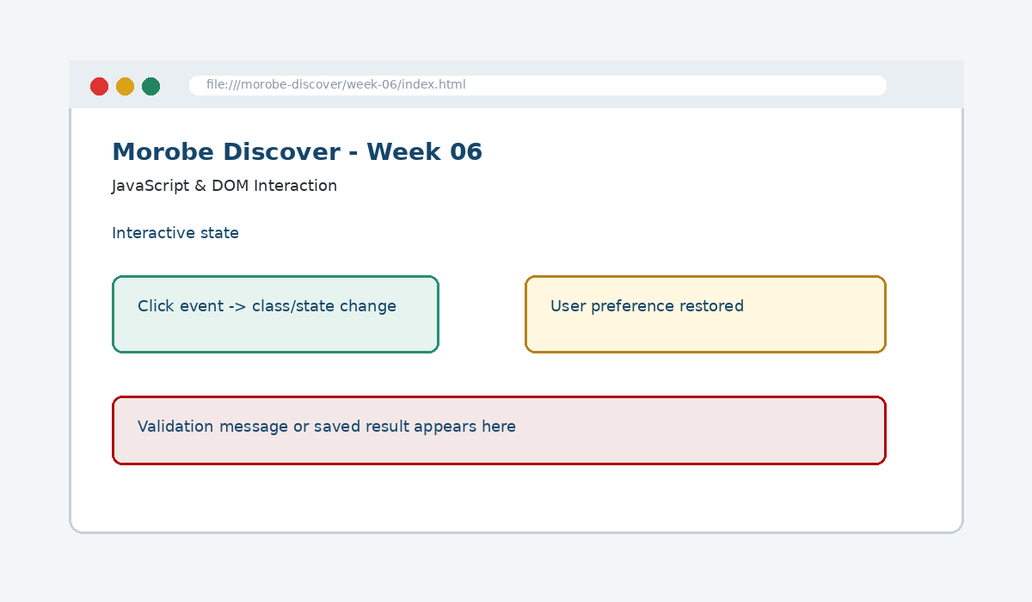
IS229 WEB DESIGN
Week 06
JavaScript & DOM Interaction
Add behaviour to a page by connecting programming logic to user actions via the DOM.
Prepared by Mr. Maxie Cletus Tepaiyan
School of Business Studies | Bachelor of Business in Information Technology
PNG University of Technology

Slide 2
WEEK 06 | JAVASCRIPT & DOM INTERACTION
Learning outcomes
Add behaviour to a page by connecting programming logic to user actions via the DOM.
Explain the core programming/design concept for this week
Read and modify key code patterns
Test the weekly project increment
Prepare evidence for GitHub submission
IS229 Web Design | Mr. Maxie Cletus Tepaiyan | School of Business Studies

Slide 3
WEEK 06 | JAVASCRIPT & DOM INTERACTION
Today's problem
Why it matters
Use JavaScript to listen for events, update state and change the interface deliberately.
IS229 Web Design | Mr. Maxie Cletus Tepaiyan | School of Business Studies

Slide 4
WEEK 06 | JAVASCRIPT & DOM INTERACTION
Project before -> after
Before Week 06
After Week 06
Week 05 produced a responsive interface ready for interaction.
The site responds to user actions using JavaScript, DOM selection and class changes.
IS229 Web Design | Mr. Maxie Cletus Tepaiyan | School of Business Studies

Slide 5
WEEK 06 | JAVASCRIPT & DOM INTERACTION
What we build this week
Add DOM hooks to the navigation
Write an event listener for the mobile menu
Toggle a state class instead of inline styles
Add a simple theme or FAQ interaction
Test interaction with click and keyboard focus
IS229 Web Design | Mr. Maxie Cletus Tepaiyan | School of Business Studies

Slide 6
WEEK 06 | JAVASCRIPT & DOM INTERACTION
Core principle
Use JavaScript to listen for events, update state and change the interface deliberately.
Keep in mind
A good web developer can point to the code, the browser result, and the user reason behind the decision.
IS229 Web Design | Mr. Maxie Cletus Tepaiyan | School of Business Studies

Slide 7
WEEK 06 | JAVASCRIPT & DOM INTERACTION
Key concepts
Concept 1
Concept 2
Concept 3
The DOM is the browser’s object model of the page
Event listeners connect actions to functions
Class toggling separates behaviour from style
IS229 Web Design | Mr. Maxie Cletus Tepaiyan | School of Business Studies

Slide 8
WEEK 06 | JAVASCRIPT & DOM INTERACTION
Project anatomy
IS229 Web Design | Mr. Maxie Cletus Tepaiyan | School of Business Studies

Slide 9
WEEK 06 | JAVASCRIPT & DOM INTERACTION
Key code pattern A
const menuButton = document.querySelector(".menu-toggle");
const nav = document.querySelector(".site-nav");
menuButton.addEventListener("click", () => {
nav.classList.toggle("is-open");
});
Explain it
Which file contains this code?
Which line creates the visible change?
What should appear in the browser?
IS229 Web Design | Mr. Maxie Cletus Tepaiyan | School of Business Studies

Slide 10
WEEK 06 | JAVASCRIPT & DOM INTERACTION
Code -> visual result
const menuButton = document.querySelector(".menu-toggle");
const nav = document.querySelector(".site-nav");
menuButton.addEventListener("click", () => {
nav.classList.toggle("is-open");
});
IS229 Web Design | Mr. Maxie Cletus Tepaiyan | School of Business Studies

Slide 11
WEEK 06 | JAVASCRIPT & DOM INTERACTION
What changed?
Project file changed for JavaScript & DOM Interaction
The browser output is now closer to the required weekly evidence
The change supports a user task or quality requirement
The change can be tested and committed
IS229 Web Design | Mr. Maxie Cletus Tepaiyan | School of Business Studies

Slide 12
WEEK 06 | JAVASCRIPT & DOM INTERACTION
Key code pattern B
.site-nav.is-open {
display: flex;
}
Why this pattern is needed
The second pattern usually applies the same idea to a different component, state, layout or data flow.
IS229 Web Design | Mr. Maxie Cletus Tepaiyan | School of Business Studies

Slide 13
WEEK 06 | JAVASCRIPT & DOM INTERACTION
Apply it to Morobe Discover
Add DOM hooks to the navigation
Write an event listener for the mobile menu
Toggle a state class instead of inline styles
Add a simple theme or FAQ interaction
IS229 Web Design | Mr. Maxie Cletus Tepaiyan | School of Business Studies

Slide 14
WEEK 06 | JAVASCRIPT & DOM INTERACTION
Compare the approaches
Weak approach
Professional approach
Memorise the definition
Copy code without understanding
No browser evidence
No test note
Explain the concept
Apply the correct code pattern
Inspect the result
Commit and describe the evidence
IS229 Web Design | Mr. Maxie Cletus Tepaiyan | School of Business Studies

Slide 15
WEEK 06 | JAVASCRIPT & DOM INTERACTION
Common mistake
Mistake
Correction
The page appears unchanged, but the student assumes the feature is complete.
Check the correct file, refresh the browser, inspect DevTools, and verify the expected output.
IS229 Web Design | Mr. Maxie Cletus Tepaiyan | School of Business Studies

Slide 16
WEEK 06 | JAVASCRIPT & DOM INTERACTION
Why does this fail?
// Broken checkpoint
// File changed, but the browser result does not change.
// Possible causes:
// - wrong file
// - file not linked
// - syntax error
// - browser not refreshed
Class question
Which cause would you check first, and why?
IS229 Web Design | Mr. Maxie Cletus Tepaiyan | School of Business Studies

Slide 17
WEEK 06 | JAVASCRIPT & DOM INTERACTION
Fix the problem
Confirm the browser is opening the correct file
Check links to CSS/JS/data files
Inspect the console for errors
Use a small working example
Test again before committing
IS229 Web Design | Mr. Maxie Cletus Tepaiyan | School of Business Studies

Slide 18
WEEK 06 | JAVASCRIPT & DOM INTERACTION
Class activity
Activity - 7 minutes
Predict what happens when classList.toggle() runs twice.
Work in pairs
Point to the project evidence
Prepare one answer to share
IS229 Web Design | Mr. Maxie Cletus Tepaiyan | School of Business Studies

Slide 19
WEEK 06 | JAVASCRIPT & DOM INTERACTION
Implementation steps 1-3
Add DOM hooks to the navigation
Write an event listener for the mobile menu
Toggle a state class instead of inline styles
IS229 Web Design | Mr. Maxie Cletus Tepaiyan | School of Business Studies

Slide 20
WEEK 06 | JAVASCRIPT & DOM INTERACTION
Implementation steps 4-5
Add a simple theme or FAQ interaction
Test interaction with click and keyboard focus
IS229 Web Design | Mr. Maxie Cletus Tepaiyan | School of Business Studies

Slide 21
WEEK 06 | JAVASCRIPT & DOM INTERACTION
LIVE DEMO
Demo checklist
1. Open the current project
2. Locate the affected file
3. Add or modify the key code
4. Refresh the browser
5. Inspect the result
6. Explain the change
IS229 Web Design | Mr. Maxie Cletus Tepaiyan | School of Business Studies

Slide 22
WEEK 06 | JAVASCRIPT & DOM INTERACTION
Predict the output
.site-nav.is-open {
display: flex;
}
Prediction prompt
What should change on screen when this code is applied correctly?
IS229 Web Design | Mr. Maxie Cletus Tepaiyan | School of Business Studies

Slide 23
WEEK 06 | JAVASCRIPT & DOM INTERACTION
Browser result
IS229 Web Design | Mr. Maxie Cletus Tepaiyan | School of Business Studies

Slide 24
WEEK 06 | JAVASCRIPT & DOM INTERACTION
Testing the feature
Open the browser console
Click the menu several times
Check class changes in DevTools
Verify the site still works if JavaScript fails gracefully
IS229 Web Design | Mr. Maxie Cletus Tepaiyan | School of Business Studies

Slide 25
WEEK 06 | JAVASCRIPT & DOM INTERACTION
Inspect with browser tools
Inspection path
Evidence to save
Right click -> Inspect
Elements panel -> structure/classes
Console -> JavaScript errors
Network/Application -> data/storage when relevant
Screenshot
Short test note
Changed files
Git commit message
IS229 Web Design | Mr. Maxie Cletus Tepaiyan | School of Business Studies

Slide 26
WEEK 06 | JAVASCRIPT & DOM INTERACTION
Git evidence
git add .
git commit -m "Week 06 JavaScript & DOM Interaction project increment"
Why it matters
Git history shows progression from Week 01 to final deployment. It is part of the assessment evidence.
IS229 Web Design | Mr. Maxie Cletus Tepaiyan | School of Business Studies

Slide 27
WEEK 06 | JAVASCRIPT & DOM INTERACTION
Complete source code
Repository:
https://github.com/YOUR-USERNAME/is229-morobe-discover
Weekly folder:
/week-06/
Complete project:
/complete-project/
Reminder
Do not paste a whole file into a slide. Use the repository for complete code.
IS229 Web Design | Mr. Maxie Cletus Tepaiyan | School of Business Studies

Slide 28
WEEK 06 | JAVASCRIPT & DOM INTERACTION
Mini challenge
Challenge
Modify one part of the Week 06 implementation and explain what changed in the browser.
State the file edited
State the line/section changed
Show the before and after result
IS229 Web Design | Mr. Maxie Cletus Tepaiyan | School of Business Studies

Slide 29
WEEK 06 | JAVASCRIPT & DOM INTERACTION
What counts as evidence?
Technical evidence
Understanding evidence
Changed code files
Browser screenshot
Test note
Git commit
Code explanation
Why this method fits
Connection to previous week
Connection to next week
IS229 Web Design | Mr. Maxie Cletus Tepaiyan | School of Business Studies

Slide 30
WEEK 06 | JAVASCRIPT & DOM INTERACTION
Project lab handoff
Add DOM hooks to the navigation
Write an event listener for the mobile menu
Toggle a state class instead of inline styles
Add a simple theme or FAQ interaction
Test interaction with click and keyboard focus
IS229 Web Design | Mr. Maxie Cletus Tepaiyan | School of Business Studies

Slide 31
WEEK 06 | JAVASCRIPT & DOM INTERACTION
Definition of done
Week 06 feature is implemented
Project still preserves earlier week features
Browser result matches the expected output
Test note and screenshot are saved
Git commit message is meaningful
IS229 Web Design | Mr. Maxie Cletus Tepaiyan | School of Business Studies

Slide 32
WEEK 06 | JAVASCRIPT & DOM INTERACTION
What we built today
The site responds to user actions using JavaScript, DOM selection and class changes.
Evidence: Event listeners, state changes, class toggling and interactive mobile menus
Technology: JavaScript DOM
IS229 Web Design | Mr. Maxie Cletus Tepaiyan | School of Business Studies

Slide 33
WEEK 06 | JAVASCRIPT & DOM INTERACTION
Lecture summary
Use JavaScript to listen for events, update state and change the interface deliberately.
The DOM is the browser’s object model of the page
Event listeners connect actions to functions
Testing and Git are part of development, not extras
IS229 Web Design | Mr. Maxie Cletus Tepaiyan | School of Business Studies

Slide 34
WEEK 06 | JAVASCRIPT & DOM INTERACTION
Prepare for next class
Finish this week’s lab before the next class
Read the next topic in advance
Bring the current project ready to extend
Be ready to explain one code decision
IS229 Web Design | Mr. Maxie Cletus Tepaiyan | School of Business Studies

Slide 35
WEEK 06 | JAVASCRIPT & DOM INTERACTION
Exit question
How did Week 06 improve Morobe Discover, and what will the next week build on?
IS229 Web Design | Mr. Maxie Cletus Tepaiyan | School of Business Studies

