Slide 1
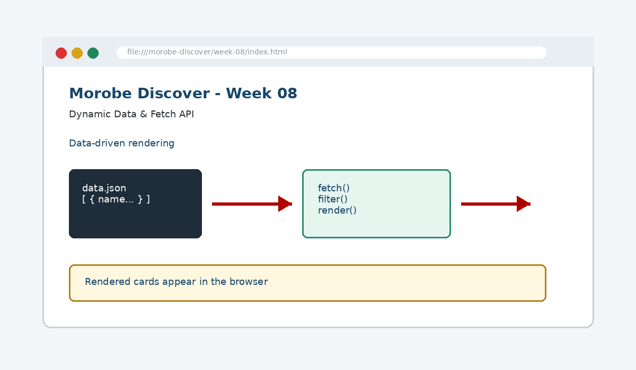
IS229 WEB DESIGN
Week 08
Dynamic Data & Fetch API
Decouple content from structure by loading and rendering dynamic external data.
Prepared by Mr. Maxie Cletus Tepaiyan
School of Business Studies | Bachelor of Business in Information Technology
PNG University of Technology

Slide 2
WEEK 08 | DYNAMIC DATA & FETCH API
Learning outcomes
Decouple content from structure by loading and rendering dynamic external data.
Explain the core programming/design concept for this week
Read and modify key code patterns
Test the weekly project increment
Prepare evidence for GitHub submission
IS229 Web Design | Mr. Maxie Cletus Tepaiyan | School of Business Studies

Slide 3
WEEK 08 | DYNAMIC DATA & FETCH API
Today's problem
Why it matters
Store repeatable content as data, fetch it, then render the interface from that data.
IS229 Web Design | Mr. Maxie Cletus Tepaiyan | School of Business Studies

Slide 4
WEEK 08 | DYNAMIC DATA & FETCH API
Project before -> after
Before Week 08
After Week 08
Week 07 added validation and saved lightweight user choices.
Destination and event cards are generated from JSON data instead of repeated static HTML.
IS229 Web Design | Mr. Maxie Cletus Tepaiyan | School of Business Studies

Slide 5
WEEK 08 | DYNAMIC DATA & FETCH API
What we build this week
Create destinations.json
Fetch the JSON file from JavaScript
Render cards into the DOM
Add search or category filtering
Show loading and error states
IS229 Web Design | Mr. Maxie Cletus Tepaiyan | School of Business Studies

Slide 6
WEEK 08 | DYNAMIC DATA & FETCH API
Core principle
Store repeatable content as data, fetch it, then render the interface from that data.
Keep in mind
A good web developer can point to the code, the browser result, and the user reason behind the decision.
IS229 Web Design | Mr. Maxie Cletus Tepaiyan | School of Business Studies

Slide 7
WEEK 08 | DYNAMIC DATA & FETCH API
Key concepts
Concept 1
Concept 2
Concept 3
JSON represents structured content
fetch() loads external resources asynchronously
Filtering transforms data before rendering
IS229 Web Design | Mr. Maxie Cletus Tepaiyan | School of Business Studies

Slide 8
WEEK 08 | DYNAMIC DATA & FETCH API
Project anatomy
IS229 Web Design | Mr. Maxie Cletus Tepaiyan | School of Business Studies

Slide 9
WEEK 08 | DYNAMIC DATA & FETCH API
Key code pattern A
const response = await fetch("data/destinations.json");
if (!response.ok) throw new Error("Data failed to load");
const destinations = await response.json();
Explain it
Which file contains this code?
Which line creates the visible change?
What should appear in the browser?
IS229 Web Design | Mr. Maxie Cletus Tepaiyan | School of Business Studies

Slide 10
WEEK 08 | DYNAMIC DATA & FETCH API
Code -> visual result
const response = await fetch("data/destinations.json");
if (!response.ok) throw new Error("Data failed to load");
const destinations = await response.json();
IS229 Web Design | Mr. Maxie Cletus Tepaiyan | School of Business Studies

Slide 11
WEEK 08 | DYNAMIC DATA & FETCH API
What changed?
Project file changed for Dynamic Data & Fetch API
The browser output is now closer to the required weekly evidence
The change supports a user task or quality requirement
The change can be tested and committed
IS229 Web Design | Mr. Maxie Cletus Tepaiyan | School of Business Studies

Slide 12
WEEK 08 | DYNAMIC DATA & FETCH API
Key code pattern B
const html = destinations
.map(item => `<article class="card">${item.name}</article>`)
.join("");
Why this pattern is needed
The second pattern usually applies the same idea to a different component, state, layout or data flow.
IS229 Web Design | Mr. Maxie Cletus Tepaiyan | School of Business Studies

Slide 13
WEEK 08 | DYNAMIC DATA & FETCH API
Apply it to Morobe Discover
Create destinations.json
Fetch the JSON file from JavaScript
Render cards into the DOM
Add search or category filtering
IS229 Web Design | Mr. Maxie Cletus Tepaiyan | School of Business Studies

Slide 14
WEEK 08 | DYNAMIC DATA & FETCH API
Compare the approaches
Weak approach
Professional approach
Memorise the definition
Copy code without understanding
No browser evidence
No test note
Explain the concept
Apply the correct code pattern
Inspect the result
Commit and describe the evidence
IS229 Web Design | Mr. Maxie Cletus Tepaiyan | School of Business Studies

Slide 15
WEEK 08 | DYNAMIC DATA & FETCH API
Common mistake
Mistake
Correction
The page appears unchanged, but the student assumes the feature is complete.
Check the correct file, refresh the browser, inspect DevTools, and verify the expected output.
IS229 Web Design | Mr. Maxie Cletus Tepaiyan | School of Business Studies

Slide 16
WEEK 08 | DYNAMIC DATA & FETCH API
Why does this fail?
// Broken checkpoint
// File changed, but the browser result does not change.
// Possible causes:
// - wrong file
// - file not linked
// - syntax error
// - browser not refreshed
Class question
Which cause would you check first, and why?
IS229 Web Design | Mr. Maxie Cletus Tepaiyan | School of Business Studies

Slide 17
WEEK 08 | DYNAMIC DATA & FETCH API
Fix the problem
Confirm the browser is opening the correct file
Check links to CSS/JS/data files
Inspect the console for errors
Use a small working example
Test again before committing
IS229 Web Design | Mr. Maxie Cletus Tepaiyan | School of Business Studies

Slide 18
WEEK 08 | DYNAMIC DATA & FETCH API
Class activity
Activity - 7 minutes
Explain what is gained by moving destination content from HTML into JSON.
Work in pairs
Point to the project evidence
Prepare one answer to share
IS229 Web Design | Mr. Maxie Cletus Tepaiyan | School of Business Studies

Slide 19
WEEK 08 | DYNAMIC DATA & FETCH API
Implementation steps 1-3
Create destinations.json
Fetch the JSON file from JavaScript
Render cards into the DOM
IS229 Web Design | Mr. Maxie Cletus Tepaiyan | School of Business Studies

Slide 20
WEEK 08 | DYNAMIC DATA & FETCH API
Implementation steps 4-5
Add search or category filtering
Show loading and error states
IS229 Web Design | Mr. Maxie Cletus Tepaiyan | School of Business Studies

Slide 21
WEEK 08 | DYNAMIC DATA & FETCH API
LIVE DEMO
Demo checklist
1. Open the current project
2. Locate the affected file
3. Add or modify the key code
4. Refresh the browser
5. Inspect the result
6. Explain the change
IS229 Web Design | Mr. Maxie Cletus Tepaiyan | School of Business Studies

Slide 22
WEEK 08 | DYNAMIC DATA & FETCH API
Predict the output
const html = destinations
.map(item => `<article class="card">${item.name}</article>`)
.join("");
Prediction prompt
What should change on screen when this code is applied correctly?
IS229 Web Design | Mr. Maxie Cletus Tepaiyan | School of Business Studies

Slide 23
WEEK 08 | DYNAMIC DATA & FETCH API
Browser result
IS229 Web Design | Mr. Maxie Cletus Tepaiyan | School of Business Studies

Slide 24
WEEK 08 | DYNAMIC DATA & FETCH API
Testing the feature
Run through a local web server
Break the JSON path and observe the error state
Test filters with empty results
Check rendered cards preserve accessibility labels
IS229 Web Design | Mr. Maxie Cletus Tepaiyan | School of Business Studies

Slide 25
WEEK 08 | DYNAMIC DATA & FETCH API
Inspect with browser tools
Inspection path
Evidence to save
Right click -> Inspect
Elements panel -> structure/classes
Console -> JavaScript errors
Network/Application -> data/storage when relevant
Screenshot
Short test note
Changed files
Git commit message
IS229 Web Design | Mr. Maxie Cletus Tepaiyan | School of Business Studies

Slide 26
WEEK 08 | DYNAMIC DATA & FETCH API
Git evidence
git add .
git commit -m "Week 08 Dynamic Data & Fetch API project increment"
Why it matters
Git history shows progression from Week 01 to final deployment. It is part of the assessment evidence.
IS229 Web Design | Mr. Maxie Cletus Tepaiyan | School of Business Studies

Slide 27
WEEK 08 | DYNAMIC DATA & FETCH API
Complete source code
Repository:
https://github.com/YOUR-USERNAME/is229-morobe-discover
Weekly folder:
/week-08/
Complete project:
/complete-project/
Reminder
Do not paste a whole file into a slide. Use the repository for complete code.
IS229 Web Design | Mr. Maxie Cletus Tepaiyan | School of Business Studies

Slide 28
WEEK 08 | DYNAMIC DATA & FETCH API
Mini challenge
Challenge
Modify one part of the Week 08 implementation and explain what changed in the browser.
State the file edited
State the line/section changed
Show the before and after result
IS229 Web Design | Mr. Maxie Cletus Tepaiyan | School of Business Studies

Slide 29
WEEK 08 | DYNAMIC DATA & FETCH API
What counts as evidence?
Technical evidence
Understanding evidence
Changed code files
Browser screenshot
Test note
Git commit
Code explanation
Why this method fits
Connection to previous week
Connection to next week
IS229 Web Design | Mr. Maxie Cletus Tepaiyan | School of Business Studies

Slide 30
WEEK 08 | DYNAMIC DATA & FETCH API
Project lab handoff
Create destinations.json
Fetch the JSON file from JavaScript
Render cards into the DOM
Add search or category filtering
Show loading and error states
IS229 Web Design | Mr. Maxie Cletus Tepaiyan | School of Business Studies

Slide 31
WEEK 08 | DYNAMIC DATA & FETCH API
Definition of done
Week 08 feature is implemented
Project still preserves earlier week features
Browser result matches the expected output
Test note and screenshot are saved
Git commit message is meaningful
IS229 Web Design | Mr. Maxie Cletus Tepaiyan | School of Business Studies

Slide 32
WEEK 08 | DYNAMIC DATA & FETCH API
What we built today
Destination and event cards are generated from JSON data instead of repeated static HTML.
Evidence: JSON content, Fetch API requests and data filters
Technology: JSON / Fetch API
IS229 Web Design | Mr. Maxie Cletus Tepaiyan | School of Business Studies

Slide 33
WEEK 08 | DYNAMIC DATA & FETCH API
Lecture summary
Store repeatable content as data, fetch it, then render the interface from that data.
JSON represents structured content
fetch() loads external resources asynchronously
Testing and Git are part of development, not extras
IS229 Web Design | Mr. Maxie Cletus Tepaiyan | School of Business Studies

Slide 34
WEEK 08 | DYNAMIC DATA & FETCH API
Prepare for next class
Finish this week’s lab before the next class
Read the next topic in advance
Bring the current project ready to extend
Be ready to explain one code decision
IS229 Web Design | Mr. Maxie Cletus Tepaiyan | School of Business Studies

Slide 35
WEEK 08 | DYNAMIC DATA & FETCH API
Exit question
How did Week 08 improve Morobe Discover, and what will the next week build on?
IS229 Web Design | Mr. Maxie Cletus Tepaiyan | School of Business Studies

