Slide 1
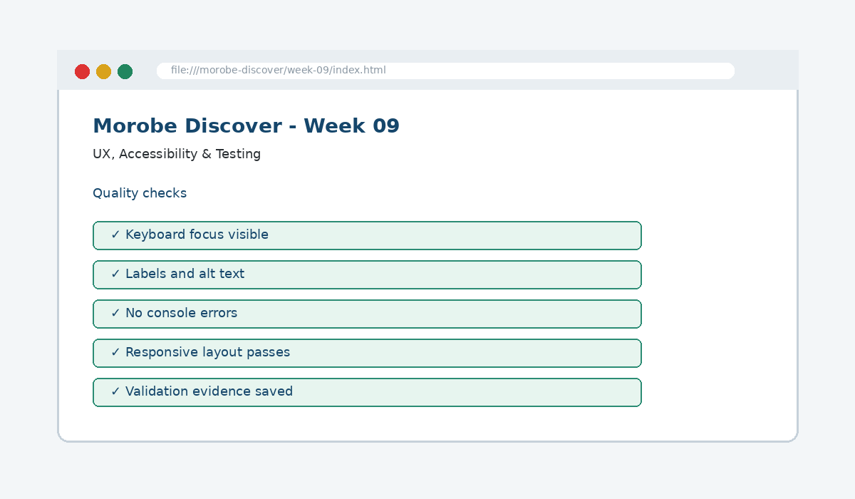
IS229 WEB DESIGN
Week 09
UX, Accessibility & Testing
Ensure the site is usable for people with different abilities and optimized for performance.
Prepared by Mr. Maxie Cletus Tepaiyan
School of Business Studies | Bachelor of Business in Information Technology
PNG University of Technology

Slide 2
WEEK 09 | UX, ACCESSIBILITY & TESTING
Learning outcomes
Ensure the site is usable for people with different abilities and optimized for performance.
Explain the core programming/design concept for this week
Read and modify key code patterns
Test the weekly project increment
Prepare evidence for GitHub submission
IS229 Web Design | Mr. Maxie Cletus Tepaiyan | School of Business Studies

Slide 3
WEEK 09 | UX, ACCESSIBILITY & TESTING
Today's problem
Why it matters
Accessibility is not an optional add-on; it is part of professional interface quality.
IS229 Web Design | Mr. Maxie Cletus Tepaiyan | School of Business Studies

Slide 4
WEEK 09 | UX, ACCESSIBILITY & TESTING
Project before -> after
Before Week 09
After Week 09
Week 08 created dynamic data rendering and filtering.
The site is tested as a user experience, including keyboard access, labels, focus and feedback.
IS229 Web Design | Mr. Maxie Cletus Tepaiyan | School of Business Studies

Slide 5
WEEK 09 | UX, ACCESSIBILITY & TESTING
What we build this week
Add or confirm labels and alt text
Add visible focus styles
Test the journey using keyboard only
Document validation and accessibility checks
Fix the highest-impact issues first
IS229 Web Design | Mr. Maxie Cletus Tepaiyan | School of Business Studies

Slide 6
WEEK 09 | UX, ACCESSIBILITY & TESTING
Core principle
Accessibility is not an optional add-on; it is part of professional interface quality.
Keep in mind
A good web developer can point to the code, the browser result, and the user reason behind the decision.
IS229 Web Design | Mr. Maxie Cletus Tepaiyan | School of Business Studies

Slide 7
WEEK 09 | UX, ACCESSIBILITY & TESTING
Key concepts
Concept 1
Concept 2
Concept 3
Native HTML gives built-in accessibility
Visible focus shows keyboard position
Testing must include both successful and failure paths
IS229 Web Design | Mr. Maxie Cletus Tepaiyan | School of Business Studies

Slide 8
WEEK 09 | UX, ACCESSIBILITY & TESTING
Project anatomy
IS229 Web Design | Mr. Maxie Cletus Tepaiyan | School of Business Studies

Slide 9
WEEK 09 | UX, ACCESSIBILITY & TESTING
Key code pattern A
.skip-link:focus {
position: static;
padding: .75rem;
}
Explain it
Which file contains this code?
Which line creates the visible change?
What should appear in the browser?
IS229 Web Design | Mr. Maxie Cletus Tepaiyan | School of Business Studies

Slide 10
WEEK 09 | UX, ACCESSIBILITY & TESTING
Code -> visual result
.skip-link:focus {
position: static;
padding: .75rem;
}
IS229 Web Design | Mr. Maxie Cletus Tepaiyan | School of Business Studies

Slide 11
WEEK 09 | UX, ACCESSIBILITY & TESTING
What changed?
Project file changed for UX, Accessibility & Testing
The browser output is now closer to the required weekly evidence
The change supports a user task or quality requirement
The change can be tested and committed
IS229 Web Design | Mr. Maxie Cletus Tepaiyan | School of Business Studies

Slide 12
WEEK 09 | UX, ACCESSIBILITY & TESTING
Key code pattern B
<label for="destinationSearch">Search destinations</label>
<input id="destinationSearch" type="search">
Why this pattern is needed
The second pattern usually applies the same idea to a different component, state, layout or data flow.
IS229 Web Design | Mr. Maxie Cletus Tepaiyan | School of Business Studies

Slide 13
WEEK 09 | UX, ACCESSIBILITY & TESTING
Apply it to Morobe Discover
Add or confirm labels and alt text
Add visible focus styles
Test the journey using keyboard only
Document validation and accessibility checks
IS229 Web Design | Mr. Maxie Cletus Tepaiyan | School of Business Studies

Slide 14
WEEK 09 | UX, ACCESSIBILITY & TESTING
Compare the approaches
Weak approach
Professional approach
Memorise the definition
Copy code without understanding
No browser evidence
No test note
Explain the concept
Apply the correct code pattern
Inspect the result
Commit and describe the evidence
IS229 Web Design | Mr. Maxie Cletus Tepaiyan | School of Business Studies

Slide 15
WEEK 09 | UX, ACCESSIBILITY & TESTING
Common mistake
Mistake
Correction
The page appears unchanged, but the student assumes the feature is complete.
Check the correct file, refresh the browser, inspect DevTools, and verify the expected output.
IS229 Web Design | Mr. Maxie Cletus Tepaiyan | School of Business Studies

Slide 16
WEEK 09 | UX, ACCESSIBILITY & TESTING
Why does this fail?
// Broken checkpoint
// File changed, but the browser result does not change.
// Possible causes:
// - wrong file
// - file not linked
// - syntax error
// - browser not refreshed
Class question
Which cause would you check first, and why?
IS229 Web Design | Mr. Maxie Cletus Tepaiyan | School of Business Studies

Slide 17
WEEK 09 | UX, ACCESSIBILITY & TESTING
Fix the problem
Confirm the browser is opening the correct file
Check links to CSS/JS/data files
Inspect the console for errors
Use a small working example
Test again before committing
IS229 Web Design | Mr. Maxie Cletus Tepaiyan | School of Business Studies

Slide 18
WEEK 09 | UX, ACCESSIBILITY & TESTING
Class activity
Activity - 7 minutes
Find three barriers that might not be obvious when using only a mouse.
Work in pairs
Point to the project evidence
Prepare one answer to share
IS229 Web Design | Mr. Maxie Cletus Tepaiyan | School of Business Studies

Slide 19
WEEK 09 | UX, ACCESSIBILITY & TESTING
Implementation steps 1-3
Add or confirm labels and alt text
Add visible focus styles
Test the journey using keyboard only
IS229 Web Design | Mr. Maxie Cletus Tepaiyan | School of Business Studies

Slide 20
WEEK 09 | UX, ACCESSIBILITY & TESTING
Implementation steps 4-5
Document validation and accessibility checks
Fix the highest-impact issues first
IS229 Web Design | Mr. Maxie Cletus Tepaiyan | School of Business Studies

Slide 21
WEEK 09 | UX, ACCESSIBILITY & TESTING
LIVE DEMO
Demo checklist
1. Open the current project
2. Locate the affected file
3. Add or modify the key code
4. Refresh the browser
5. Inspect the result
6. Explain the change
IS229 Web Design | Mr. Maxie Cletus Tepaiyan | School of Business Studies

Slide 22
WEEK 09 | UX, ACCESSIBILITY & TESTING
Predict the output
<label for="destinationSearch">Search destinations</label>
<input id="destinationSearch" type="search">
Prediction prompt
What should change on screen when this code is applied correctly?
IS229 Web Design | Mr. Maxie Cletus Tepaiyan | School of Business Studies

Slide 23
WEEK 09 | UX, ACCESSIBILITY & TESTING
Browser result
IS229 Web Design | Mr. Maxie Cletus Tepaiyan | School of Business Studies

Slide 24
WEEK 09 | UX, ACCESSIBILITY & TESTING
Testing the feature
Tab through the page
Run HTML/CSS validation
Use Lighthouse or manual checklist
Confirm errors are visible and understandable
IS229 Web Design | Mr. Maxie Cletus Tepaiyan | School of Business Studies

Slide 25
WEEK 09 | UX, ACCESSIBILITY & TESTING
Inspect with browser tools
Inspection path
Evidence to save
Right click -> Inspect
Elements panel -> structure/classes
Console -> JavaScript errors
Network/Application -> data/storage when relevant
Screenshot
Short test note
Changed files
Git commit message
IS229 Web Design | Mr. Maxie Cletus Tepaiyan | School of Business Studies

Slide 26
WEEK 09 | UX, ACCESSIBILITY & TESTING
Git evidence
git add .
git commit -m "Week 09 UX, Accessibility & Testing project increment"
Why it matters
Git history shows progression from Week 01 to final deployment. It is part of the assessment evidence.
IS229 Web Design | Mr. Maxie Cletus Tepaiyan | School of Business Studies

Slide 27
WEEK 09 | UX, ACCESSIBILITY & TESTING
Complete source code
Repository:
https://github.com/YOUR-USERNAME/is229-morobe-discover
Weekly folder:
/week-09/
Complete project:
/complete-project/
Reminder
Do not paste a whole file into a slide. Use the repository for complete code.
IS229 Web Design | Mr. Maxie Cletus Tepaiyan | School of Business Studies

Slide 28
WEEK 09 | UX, ACCESSIBILITY & TESTING
Mini challenge
Challenge
Modify one part of the Week 09 implementation and explain what changed in the browser.
State the file edited
State the line/section changed
Show the before and after result
IS229 Web Design | Mr. Maxie Cletus Tepaiyan | School of Business Studies

Slide 29
WEEK 09 | UX, ACCESSIBILITY & TESTING
What counts as evidence?
Technical evidence
Understanding evidence
Changed code files
Browser screenshot
Test note
Git commit
Code explanation
Why this method fits
Connection to previous week
Connection to next week
IS229 Web Design | Mr. Maxie Cletus Tepaiyan | School of Business Studies

Slide 30
WEEK 09 | UX, ACCESSIBILITY & TESTING
Project lab handoff
Add or confirm labels and alt text
Add visible focus styles
Test the journey using keyboard only
Document validation and accessibility checks
Fix the highest-impact issues first
IS229 Web Design | Mr. Maxie Cletus Tepaiyan | School of Business Studies

Slide 31
WEEK 09 | UX, ACCESSIBILITY & TESTING
Definition of done
Week 09 feature is implemented
Project still preserves earlier week features
Browser result matches the expected output
Test note and screenshot are saved
Git commit message is meaningful
IS229 Web Design | Mr. Maxie Cletus Tepaiyan | School of Business Studies

Slide 32
WEEK 09 | UX, ACCESSIBILITY & TESTING
What we built today
The site is tested as a user experience, including keyboard access, labels, focus and feedback.
Evidence: Alt text, labels, visible keyboard focus styles and interactive state checks
Technology: HTML / CSS / Testing Tools
IS229 Web Design | Mr. Maxie Cletus Tepaiyan | School of Business Studies

Slide 33
WEEK 09 | UX, ACCESSIBILITY & TESTING
Lecture summary
Accessibility is not an optional add-on; it is part of professional interface quality.
Native HTML gives built-in accessibility
Visible focus shows keyboard position
Testing and Git are part of development, not extras
IS229 Web Design | Mr. Maxie Cletus Tepaiyan | School of Business Studies

Slide 34
WEEK 09 | UX, ACCESSIBILITY & TESTING
Prepare for next class
Finish this week’s lab before the next class
Read the next topic in advance
Bring the current project ready to extend
Be ready to explain one code decision
IS229 Web Design | Mr. Maxie Cletus Tepaiyan | School of Business Studies

Slide 35
WEEK 09 | UX, ACCESSIBILITY & TESTING
Exit question
How did Week 09 improve Morobe Discover, and what will the next week build on?
IS229 Web Design | Mr. Maxie Cletus Tepaiyan | School of Business Studies

