Slide 1
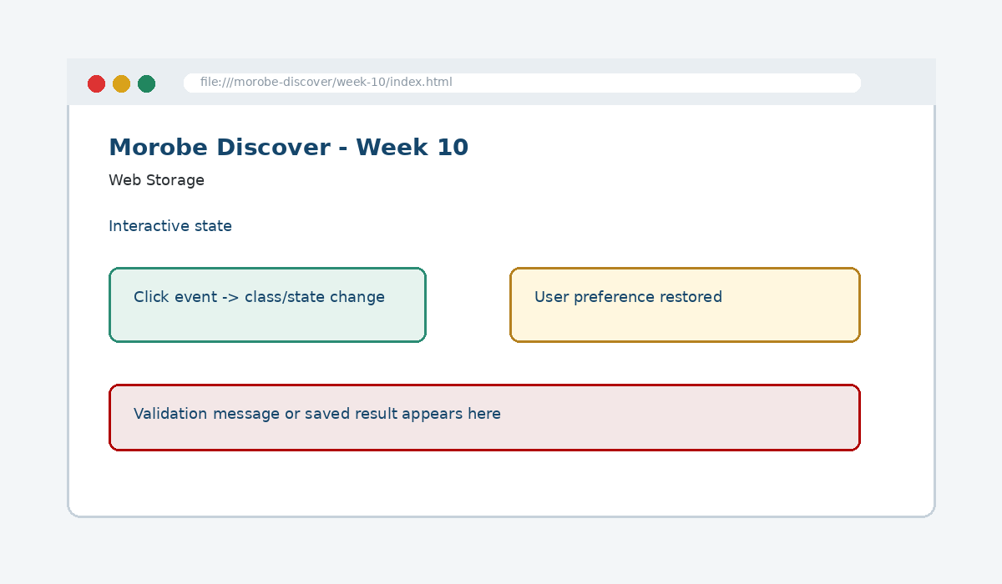
IS229 WEB DESIGN
Week 10
Web Storage
Persist lightweight user preferences between browser sessions.
Prepared by Mr. Maxie Cletus Tepaiyan
School of Business Studies | Bachelor of Business in Information Technology
PNG University of Technology

Slide 2
WEEK 10 | WEB STORAGE
Learning outcomes
Persist lightweight user preferences between browser sessions.
Explain the core programming/design concept for this week
Read and modify key code patterns
Test the weekly project increment
Prepare evidence for GitHub submission
IS229 Web Design | Mr. Maxie Cletus Tepaiyan | School of Business Studies

Slide 3
WEEK 10 | WEB STORAGE
Today's problem
Why it matters
Browser storage is useful for convenience, but it must be small, safe and recoverable.
IS229 Web Design | Mr. Maxie Cletus Tepaiyan | School of Business Studies

Slide 4
WEEK 10 | WEB STORAGE
Project before -> after
Before Week 10
After Week 10
Week 09 identified usability and accessibility issues in the interactive site.
The site remembers non-sensitive user preferences and restores them predictably.
IS229 Web Design | Mr. Maxie Cletus Tepaiyan | School of Business Studies

Slide 5
WEEK 10 | WEB STORAGE
What we build this week
Review current storage use
Store favourite destination IDs
Restore saved theme on page load
Handle missing or corrupted storage safely
Provide a clear reset option
IS229 Web Design | Mr. Maxie Cletus Tepaiyan | School of Business Studies

Slide 6
WEEK 10 | WEB STORAGE
Core principle
Browser storage is useful for convenience, but it must be small, safe and recoverable.
Keep in mind
A good web developer can point to the code, the browser result, and the user reason behind the decision.
IS229 Web Design | Mr. Maxie Cletus Tepaiyan | School of Business Studies

Slide 7
WEEK 10 | WEB STORAGE
Key concepts
Concept 1
Concept 2
Concept 3
localStorage persists after the browser closes
sessionStorage lasts only for a session
Storage values are strings and should be parsed carefully
IS229 Web Design | Mr. Maxie Cletus Tepaiyan | School of Business Studies

Slide 8
WEEK 10 | WEB STORAGE
Project anatomy
IS229 Web Design | Mr. Maxie Cletus Tepaiyan | School of Business Studies

Slide 9
WEEK 10 | WEB STORAGE
Key code pattern A
const favourites = JSON.parse(localStorage.getItem("favourites") || "[]");
favourites.push("rainforest-walk");
localStorage.setItem("favourites", JSON.stringify(favourites));
Explain it
Which file contains this code?
Which line creates the visible change?
What should appear in the browser?
IS229 Web Design | Mr. Maxie Cletus Tepaiyan | School of Business Studies

Slide 10
WEEK 10 | WEB STORAGE
Code -> visual result
const favourites = JSON.parse(localStorage.getItem("favourites") || "[]");
favourites.push("rainforest-walk");
localStorage.setItem("favourites", JSON.stringify(favourites));
IS229 Web Design | Mr. Maxie Cletus Tepaiyan | School of Business Studies

Slide 11
WEEK 10 | WEB STORAGE
What changed?
Project file changed for Web Storage
The browser output is now closer to the required weekly evidence
The change supports a user task or quality requirement
The change can be tested and committed
IS229 Web Design | Mr. Maxie Cletus Tepaiyan | School of Business Studies

Slide 12
WEEK 10 | WEB STORAGE
Key code pattern B
try {
const data = JSON.parse(savedValue);
} catch {
localStorage.removeItem("favourites");
}
Why this pattern is needed
The second pattern usually applies the same idea to a different component, state, layout or data flow.
IS229 Web Design | Mr. Maxie Cletus Tepaiyan | School of Business Studies

Slide 13
WEEK 10 | WEB STORAGE
Apply it to Morobe Discover
Review current storage use
Store favourite destination IDs
Restore saved theme on page load
Handle missing or corrupted storage safely
IS229 Web Design | Mr. Maxie Cletus Tepaiyan | School of Business Studies

Slide 14
WEEK 10 | WEB STORAGE
Compare the approaches
Weak approach
Professional approach
Memorise the definition
Copy code without understanding
No browser evidence
No test note
Explain the concept
Apply the correct code pattern
Inspect the result
Commit and describe the evidence
IS229 Web Design | Mr. Maxie Cletus Tepaiyan | School of Business Studies

Slide 15
WEEK 10 | WEB STORAGE
Common mistake
Mistake
Correction
The page appears unchanged, but the student assumes the feature is complete.
Check the correct file, refresh the browser, inspect DevTools, and verify the expected output.
IS229 Web Design | Mr. Maxie Cletus Tepaiyan | School of Business Studies

Slide 16
WEEK 10 | WEB STORAGE
Why does this fail?
// Broken checkpoint
// File changed, but the browser result does not change.
// Possible causes:
// - wrong file
// - file not linked
// - syntax error
// - browser not refreshed
Class question
Which cause would you check first, and why?
IS229 Web Design | Mr. Maxie Cletus Tepaiyan | School of Business Studies

Slide 17
WEEK 10 | WEB STORAGE
Fix the problem
Confirm the browser is opening the correct file
Check links to CSS/JS/data files
Inspect the console for errors
Use a small working example
Test again before committing
IS229 Web Design | Mr. Maxie Cletus Tepaiyan | School of Business Studies

Slide 18
WEEK 10 | WEB STORAGE
Class activity
Activity - 7 minutes
Compare localStorage and sessionStorage for a trip-planning draft.
Work in pairs
Point to the project evidence
Prepare one answer to share
IS229 Web Design | Mr. Maxie Cletus Tepaiyan | School of Business Studies

Slide 19
WEEK 10 | WEB STORAGE
Implementation steps 1-3
Review current storage use
Store favourite destination IDs
Restore saved theme on page load
IS229 Web Design | Mr. Maxie Cletus Tepaiyan | School of Business Studies

Slide 20
WEEK 10 | WEB STORAGE
Implementation steps 4-5
Handle missing or corrupted storage safely
Provide a clear reset option
IS229 Web Design | Mr. Maxie Cletus Tepaiyan | School of Business Studies

Slide 21
WEEK 10 | WEB STORAGE
LIVE DEMO
Demo checklist
1. Open the current project
2. Locate the affected file
3. Add or modify the key code
4. Refresh the browser
5. Inspect the result
6. Explain the change
IS229 Web Design | Mr. Maxie Cletus Tepaiyan | School of Business Studies

Slide 22
WEEK 10 | WEB STORAGE
Predict the output
try {
const data = JSON.parse(savedValue);
} catch {
localStorage.removeItem("favourites");
}
Prediction prompt
What should change on screen when this code is applied correctly?
IS229 Web Design | Mr. Maxie Cletus Tepaiyan | School of Business Studies

Slide 23
WEEK 10 | WEB STORAGE
Browser result
IS229 Web Design | Mr. Maxie Cletus Tepaiyan | School of Business Studies

Slide 24
WEEK 10 | WEB STORAGE
Testing the feature
Refresh and reopen the browser
Inspect Application > Local Storage
Test corrupted data recovery
Verify sensitive data is not stored
IS229 Web Design | Mr. Maxie Cletus Tepaiyan | School of Business Studies

Slide 25
WEEK 10 | WEB STORAGE
Inspect with browser tools
Inspection path
Evidence to save
Right click -> Inspect
Elements panel -> structure/classes
Console -> JavaScript errors
Network/Application -> data/storage when relevant
Screenshot
Short test note
Changed files
Git commit message
IS229 Web Design | Mr. Maxie Cletus Tepaiyan | School of Business Studies

Slide 26
WEEK 10 | WEB STORAGE
Git evidence
git add .
git commit -m "Week 10 Web Storage project increment"
Why it matters
Git history shows progression from Week 01 to final deployment. It is part of the assessment evidence.
IS229 Web Design | Mr. Maxie Cletus Tepaiyan | School of Business Studies

Slide 27
WEEK 10 | WEB STORAGE
Complete source code
Repository:
https://github.com/YOUR-USERNAME/is229-morobe-discover
Weekly folder:
/week-10/
Complete project:
/complete-project/
Reminder
Do not paste a whole file into a slide. Use the repository for complete code.
IS229 Web Design | Mr. Maxie Cletus Tepaiyan | School of Business Studies

Slide 28
WEEK 10 | WEB STORAGE
Mini challenge
Challenge
Modify one part of the Week 10 implementation and explain what changed in the browser.
State the file edited
State the line/section changed
Show the before and after result
IS229 Web Design | Mr. Maxie Cletus Tepaiyan | School of Business Studies

Slide 29
WEEK 10 | WEB STORAGE
What counts as evidence?
Technical evidence
Understanding evidence
Changed code files
Browser screenshot
Test note
Git commit
Code explanation
Why this method fits
Connection to previous week
Connection to next week
IS229 Web Design | Mr. Maxie Cletus Tepaiyan | School of Business Studies

Slide 30
WEEK 10 | WEB STORAGE
Project lab handoff
Review current storage use
Store favourite destination IDs
Restore saved theme on page load
Handle missing or corrupted storage safely
Provide a clear reset option
IS229 Web Design | Mr. Maxie Cletus Tepaiyan | School of Business Studies

Slide 31
WEEK 10 | WEB STORAGE
Definition of done
Week 10 feature is implemented
Project still preserves earlier week features
Browser result matches the expected output
Test note and screenshot are saved
Git commit message is meaningful
IS229 Web Design | Mr. Maxie Cletus Tepaiyan | School of Business Studies

Slide 32
WEEK 10 | WEB STORAGE
What we built today
The site remembers non-sensitive user preferences and restores them predictably.
Evidence: localStorage for theme choice and saved IDs
Technology: Web Storage API
IS229 Web Design | Mr. Maxie Cletus Tepaiyan | School of Business Studies

Slide 33
WEEK 10 | WEB STORAGE
Lecture summary
Browser storage is useful for convenience, but it must be small, safe and recoverable.
localStorage persists after the browser closes
sessionStorage lasts only for a session
Testing and Git are part of development, not extras
IS229 Web Design | Mr. Maxie Cletus Tepaiyan | School of Business Studies

Slide 34
WEEK 10 | WEB STORAGE
Prepare for next class
Finish this week’s lab before the next class
Read the next topic in advance
Bring the current project ready to extend
Be ready to explain one code decision
IS229 Web Design | Mr. Maxie Cletus Tepaiyan | School of Business Studies

Slide 35
WEEK 10 | WEB STORAGE
Exit question
How did Week 10 improve Morobe Discover, and what will the next week build on?
IS229 Web Design | Mr. Maxie Cletus Tepaiyan | School of Business Studies

