Slide 1
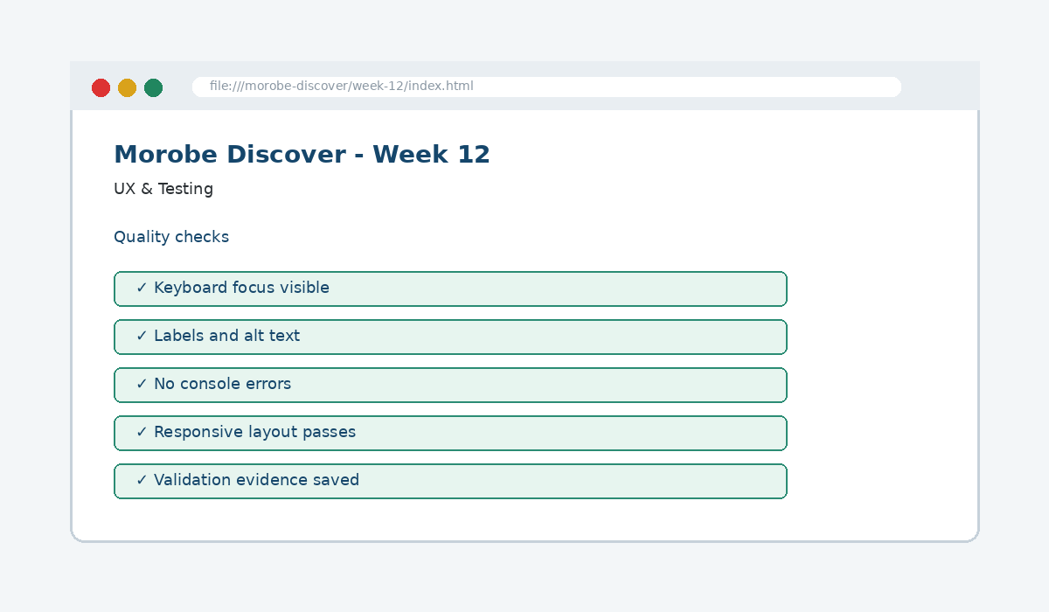
IS229 WEB DESIGN
Week 12
UX & Testing
Ensure the site is accessible, validated and optimized for performance.
Prepared by Mr. Maxie Cletus Tepaiyan
School of Business Studies | Bachelor of Business in Information Technology
PNG University of Technology

Slide 2
WEEK 12 | UX & TESTING
Learning outcomes
Ensure the site is accessible, validated and optimized for performance.
Explain the core programming/design concept for this week
Read and modify key code patterns
Test the weekly project increment
Prepare evidence for GitHub submission
IS229 Web Design | Mr. Maxie Cletus Tepaiyan | School of Business Studies

Slide 3
WEEK 12 | UX & TESTING
Today's problem
Why it matters
Professional release requires evidence: tests, screenshots, validation reports and fixes.
IS229 Web Design | Mr. Maxie Cletus Tepaiyan | School of Business Studies

Slide 4
WEEK 12 | UX & TESTING
Project before -> after
Before Week 12
After Week 12
Week 11 completed dynamic data rendering and filter behaviour.
The site has documented quality evidence: validation, accessibility, responsiveness and performance checks.
IS229 Web Design | Mr. Maxie Cletus Tepaiyan | School of Business Studies

Slide 5
WEEK 12 | UX & TESTING
What we build this week
Create a testing checklist
Validate HTML and CSS
Test keyboard navigation and focus
Run responsive and performance checks
Record fixes in a test report
IS229 Web Design | Mr. Maxie Cletus Tepaiyan | School of Business Studies

Slide 6
WEEK 12 | UX & TESTING
Core principle
Professional release requires evidence: tests, screenshots, validation reports and fixes.
Keep in mind
A good web developer can point to the code, the browser result, and the user reason behind the decision.
IS229 Web Design | Mr. Maxie Cletus Tepaiyan | School of Business Studies

Slide 7
WEEK 12 | UX & TESTING
Key concepts
Concept 1
Concept 2
Concept 3
Testing checks what users actually do
Validation finds code errors that browsers may hide
Performance and accessibility are quality requirements
IS229 Web Design | Mr. Maxie Cletus Tepaiyan | School of Business Studies

Slide 8
WEEK 12 | UX & TESTING
Project anatomy
IS229 Web Design | Mr. Maxie Cletus Tepaiyan | School of Business Studies

Slide 9
WEEK 12 | UX & TESTING
Key code pattern A
// Test note example
Expected: menu opens with keyboard.
Actual: focus moves to first link.
Result: Pass.
Explain it
Which file contains this code?
Which line creates the visible change?
What should appear in the browser?
IS229 Web Design | Mr. Maxie Cletus Tepaiyan | School of Business Studies

Slide 10
WEEK 12 | UX & TESTING
Code -> visual result
// Test note example
Expected: menu opens with keyboard.
Actual: focus moves to first link.
Result: Pass.
IS229 Web Design | Mr. Maxie Cletus Tepaiyan | School of Business Studies

Slide 11
WEEK 12 | UX & TESTING
What changed?
Project file changed for UX & Testing
The browser output is now closer to the required weekly evidence
The change supports a user task or quality requirement
The change can be tested and committed
IS229 Web Design | Mr. Maxie Cletus Tepaiyan | School of Business Studies

Slide 12
WEEK 12 | UX & TESTING
Key code pattern B
<img src="assets/images/market.jpg" alt="Local market in Morobe">
Why this pattern is needed
The second pattern usually applies the same idea to a different component, state, layout or data flow.
IS229 Web Design | Mr. Maxie Cletus Tepaiyan | School of Business Studies

Slide 13
WEEK 12 | UX & TESTING
Apply it to Morobe Discover
Create a testing checklist
Validate HTML and CSS
Test keyboard navigation and focus
Run responsive and performance checks
IS229 Web Design | Mr. Maxie Cletus Tepaiyan | School of Business Studies

Slide 14
WEEK 12 | UX & TESTING
Compare the approaches
Weak approach
Professional approach
Memorise the definition
Copy code without understanding
No browser evidence
No test note
Explain the concept
Apply the correct code pattern
Inspect the result
Commit and describe the evidence
IS229 Web Design | Mr. Maxie Cletus Tepaiyan | School of Business Studies

Slide 15
WEEK 12 | UX & TESTING
Common mistake
Mistake
Correction
The page appears unchanged, but the student assumes the feature is complete.
Check the correct file, refresh the browser, inspect DevTools, and verify the expected output.
IS229 Web Design | Mr. Maxie Cletus Tepaiyan | School of Business Studies

Slide 16
WEEK 12 | UX & TESTING
Why does this fail?
// Broken checkpoint
// File changed, but the browser result does not change.
// Possible causes:
// - wrong file
// - file not linked
// - syntax error
// - browser not refreshed
Class question
Which cause would you check first, and why?
IS229 Web Design | Mr. Maxie Cletus Tepaiyan | School of Business Studies

Slide 17
WEEK 12 | UX & TESTING
Fix the problem
Confirm the browser is opening the correct file
Check links to CSS/JS/data files
Inspect the console for errors
Use a small working example
Test again before committing
IS229 Web Design | Mr. Maxie Cletus Tepaiyan | School of Business Studies

Slide 18
WEEK 12 | UX & TESTING
Class activity
Activity - 7 minutes
Inspect the project and list the three most important issues to fix before deployment.
Work in pairs
Point to the project evidence
Prepare one answer to share
IS229 Web Design | Mr. Maxie Cletus Tepaiyan | School of Business Studies

Slide 19
WEEK 12 | UX & TESTING
Implementation steps 1-3
Create a testing checklist
Validate HTML and CSS
Test keyboard navigation and focus
IS229 Web Design | Mr. Maxie Cletus Tepaiyan | School of Business Studies

Slide 20
WEEK 12 | UX & TESTING
Implementation steps 4-5
Run responsive and performance checks
Record fixes in a test report
IS229 Web Design | Mr. Maxie Cletus Tepaiyan | School of Business Studies

Slide 21
WEEK 12 | UX & TESTING
LIVE DEMO
Demo checklist
1. Open the current project
2. Locate the affected file
3. Add or modify the key code
4. Refresh the browser
5. Inspect the result
6. Explain the change
IS229 Web Design | Mr. Maxie Cletus Tepaiyan | School of Business Studies

Slide 22
WEEK 12 | UX & TESTING
Predict the output
<img src="assets/images/market.jpg" alt="Local market in Morobe">
Prediction prompt
What should change on screen when this code is applied correctly?
IS229 Web Design | Mr. Maxie Cletus Tepaiyan | School of Business Studies

Slide 23
WEEK 12 | UX & TESTING
Browser result
IS229 Web Design | Mr. Maxie Cletus Tepaiyan | School of Business Studies

Slide 24
WEEK 12 | UX & TESTING
Testing the feature
Verify broken links
Check console errors
Run Lighthouse or manual accessibility checks
Retest after fixing problems
IS229 Web Design | Mr. Maxie Cletus Tepaiyan | School of Business Studies

Slide 25
WEEK 12 | UX & TESTING
Inspect with browser tools
Inspection path
Evidence to save
Right click -> Inspect
Elements panel -> structure/classes
Console -> JavaScript errors
Network/Application -> data/storage when relevant
Screenshot
Short test note
Changed files
Git commit message
IS229 Web Design | Mr. Maxie Cletus Tepaiyan | School of Business Studies

Slide 26
WEEK 12 | UX & TESTING
Git evidence
git add .
git commit -m "Week 12 UX & Testing project increment"
Why it matters
Git history shows progression from Week 01 to final deployment. It is part of the assessment evidence.
IS229 Web Design | Mr. Maxie Cletus Tepaiyan | School of Business Studies

Slide 27
WEEK 12 | UX & TESTING
Complete source code
Repository:
https://github.com/YOUR-USERNAME/is229-morobe-discover
Weekly folder:
/week-12/
Complete project:
/complete-project/
Reminder
Do not paste a whole file into a slide. Use the repository for complete code.
IS229 Web Design | Mr. Maxie Cletus Tepaiyan | School of Business Studies

Slide 28
WEEK 12 | UX & TESTING
Mini challenge
Challenge
Modify one part of the Week 12 implementation and explain what changed in the browser.
State the file edited
State the line/section changed
Show the before and after result
IS229 Web Design | Mr. Maxie Cletus Tepaiyan | School of Business Studies

Slide 29
WEEK 12 | UX & TESTING
What counts as evidence?
Technical evidence
Understanding evidence
Changed code files
Browser screenshot
Test note
Git commit
Code explanation
Why this method fits
Connection to previous week
Connection to next week
IS229 Web Design | Mr. Maxie Cletus Tepaiyan | School of Business Studies

Slide 30
WEEK 12 | UX & TESTING
Project lab handoff
Create a testing checklist
Validate HTML and CSS
Test keyboard navigation and focus
Run responsive and performance checks
Record fixes in a test report
IS229 Web Design | Mr. Maxie Cletus Tepaiyan | School of Business Studies

Slide 31
WEEK 12 | UX & TESTING
Definition of done
Week 12 feature is implemented
Project still preserves earlier week features
Browser result matches the expected output
Test note and screenshot are saved
Git commit message is meaningful
IS229 Web Design | Mr. Maxie Cletus Tepaiyan | School of Business Studies

Slide 32
WEEK 12 | UX & TESTING
What we built today
The site has documented quality evidence: validation, accessibility, responsiveness and performance checks.
Evidence: Accessibility checks, validation reports and quality tests
Technology: Testing Tools
IS229 Web Design | Mr. Maxie Cletus Tepaiyan | School of Business Studies

Slide 33
WEEK 12 | UX & TESTING
Lecture summary
Professional release requires evidence: tests, screenshots, validation reports and fixes.
Testing checks what users actually do
Validation finds code errors that browsers may hide
Testing and Git are part of development, not extras
IS229 Web Design | Mr. Maxie Cletus Tepaiyan | School of Business Studies

Slide 34
WEEK 12 | UX & TESTING
Prepare for next class
Finish this week’s lab before the next class
Read the next topic in advance
Bring the current project ready to extend
Be ready to explain one code decision
IS229 Web Design | Mr. Maxie Cletus Tepaiyan | School of Business Studies

Slide 35
WEEK 12 | UX & TESTING
Exit question
How did Week 12 improve Morobe Discover, and what will the next week build on?
IS229 Web Design | Mr. Maxie Cletus Tepaiyan | School of Business Studies

