Slide 1
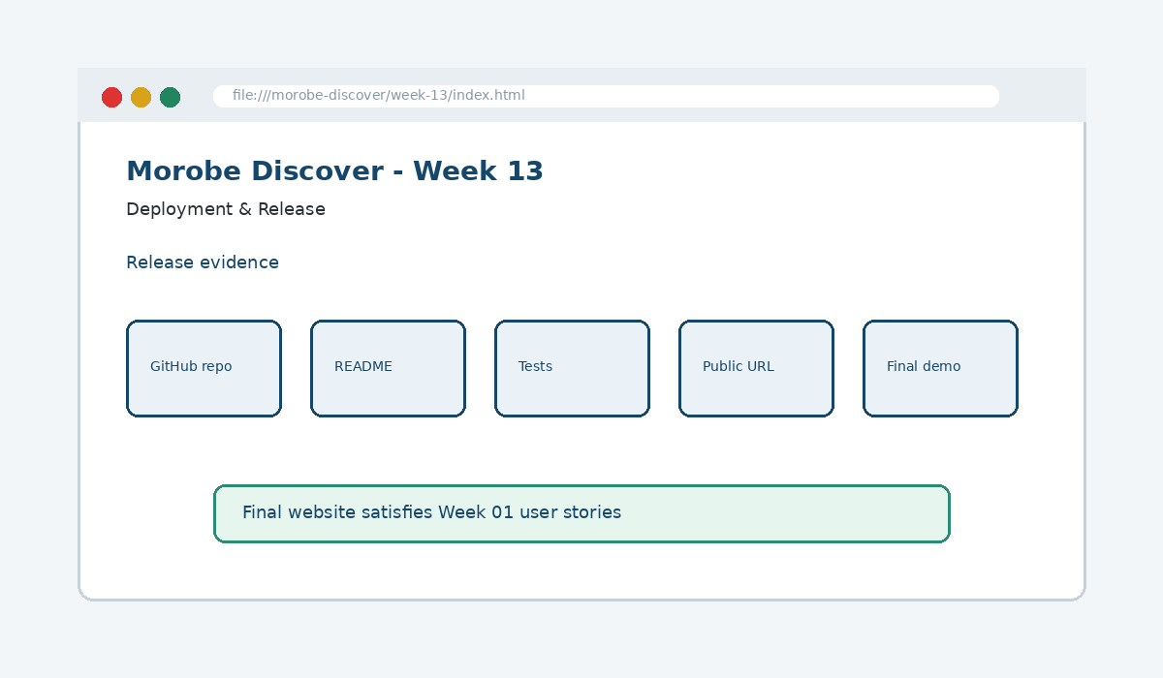
IS229 WEB DESIGN
Week 13
Deployment & Release
Publish a production-ready website to a live public URL.
Prepared by Mr. Maxie Cletus Tepaiyan
School of Business Studies | Bachelor of Business in Information Technology
PNG University of Technology

Slide 2
WEEK 13 | DEPLOYMENT & RELEASE
Learning outcomes
Publish a production-ready website to a live public URL.
Explain the core programming/design concept for this week
Read and modify key code patterns
Test the weekly project increment
Prepare evidence for GitHub submission
IS229 Web Design | Mr. Maxie Cletus Tepaiyan | School of Business Studies

Slide 3
WEEK 13 | DEPLOYMENT & RELEASE
Today's problem
Why it matters
Release joins the technical product, documentation, testing evidence and public URL into one final deliverable.
IS229 Web Design | Mr. Maxie Cletus Tepaiyan | School of Business Studies

Slide 4
WEEK 13 | DEPLOYMENT & RELEASE
Project before -> after
Before Week 13
After Week 13
Week 12 produced test evidence and fixed quality issues.
The project is uploaded, documented, deployed and ready for final demonstration/code defence.
IS229 Web Design | Mr. Maxie Cletus Tepaiyan | School of Business Studies

Slide 5
WEEK 13 | DEPLOYMENT & RELEASE
What we build this week
Finish README and run instructions
Check final file paths and assets
Push final code to GitHub
Enable GitHub Pages
Prepare a user-journey-based demonstration
IS229 Web Design | Mr. Maxie Cletus Tepaiyan | School of Business Studies

Slide 6
WEEK 13 | DEPLOYMENT & RELEASE
Core principle
Release joins the technical product, documentation, testing evidence and public URL into one final deliverable.
Keep in mind
A good web developer can point to the code, the browser result, and the user reason behind the decision.
IS229 Web Design | Mr. Maxie Cletus Tepaiyan | School of Business Studies

Slide 7
WEEK 13 | DEPLOYMENT & RELEASE
Key concepts
Concept 1
Concept 2
Concept 3
README documents purpose and running instructions
Git history proves progress
Deployment reveals path and asset problems
IS229 Web Design | Mr. Maxie Cletus Tepaiyan | School of Business Studies

Slide 8
WEEK 13 | DEPLOYMENT & RELEASE
Project anatomy
IS229 Web Design | Mr. Maxie Cletus Tepaiyan | School of Business Studies

Slide 9
WEEK 13 | DEPLOYMENT & RELEASE
Key code pattern A
git add .
git commit -m "Week 13 final release"
git push origin main
Explain it
Which file contains this code?
Which line creates the visible change?
What should appear in the browser?
IS229 Web Design | Mr. Maxie Cletus Tepaiyan | School of Business Studies

Slide 10
WEEK 13 | DEPLOYMENT & RELEASE
Code -> visual result
git add .
git commit -m "Week 13 final release"
git push origin main
IS229 Web Design | Mr. Maxie Cletus Tepaiyan | School of Business Studies

Slide 11
WEEK 13 | DEPLOYMENT & RELEASE
What changed?
Project file changed for Deployment & Release
The browser output is now closer to the required weekly evidence
The change supports a user task or quality requirement
The change can be tested and committed
IS229 Web Design | Mr. Maxie Cletus Tepaiyan | School of Business Studies

Slide 12
WEEK 13 | DEPLOYMENT & RELEASE
Key code pattern B
Repository -> Settings -> Pages
Source: main branch
Folder: /complete-project
Why this pattern is needed
The second pattern usually applies the same idea to a different component, state, layout or data flow.
IS229 Web Design | Mr. Maxie Cletus Tepaiyan | School of Business Studies

Slide 13
WEEK 13 | DEPLOYMENT & RELEASE
Apply it to Morobe Discover
Finish README and run instructions
Check final file paths and assets
Push final code to GitHub
Enable GitHub Pages
IS229 Web Design | Mr. Maxie Cletus Tepaiyan | School of Business Studies

Slide 14
WEEK 13 | DEPLOYMENT & RELEASE
Compare the approaches
Weak approach
Professional approach
Memorise the definition
Copy code without understanding
No browser evidence
No test note
Explain the concept
Apply the correct code pattern
Inspect the result
Commit and describe the evidence
IS229 Web Design | Mr. Maxie Cletus Tepaiyan | School of Business Studies

Slide 15
WEEK 13 | DEPLOYMENT & RELEASE
Common mistake
Mistake
Correction
The page appears unchanged, but the student assumes the feature is complete.
Check the correct file, refresh the browser, inspect DevTools, and verify the expected output.
IS229 Web Design | Mr. Maxie Cletus Tepaiyan | School of Business Studies

Slide 16
WEEK 13 | DEPLOYMENT & RELEASE
Why does this fail?
// Broken checkpoint
// File changed, but the browser result does not change.
// Possible causes:
// - wrong file
// - file not linked
// - syntax error
// - browser not refreshed
Class question
Which cause would you check first, and why?
IS229 Web Design | Mr. Maxie Cletus Tepaiyan | School of Business Studies

Slide 17
WEEK 13 | DEPLOYMENT & RELEASE
Fix the problem
Confirm the browser is opening the correct file
Check links to CSS/JS/data files
Inspect the console for errors
Use a small working example
Test again before committing
IS229 Web Design | Mr. Maxie Cletus Tepaiyan | School of Business Studies

Slide 18
WEEK 13 | DEPLOYMENT & RELEASE
Class activity
Activity - 7 minutes
Demonstrate one user story from requirement to live webpage evidence.
Work in pairs
Point to the project evidence
Prepare one answer to share
IS229 Web Design | Mr. Maxie Cletus Tepaiyan | School of Business Studies

Slide 19
WEEK 13 | DEPLOYMENT & RELEASE
Implementation steps 1-3
Finish README and run instructions
Check final file paths and assets
Push final code to GitHub
IS229 Web Design | Mr. Maxie Cletus Tepaiyan | School of Business Studies

Slide 20
WEEK 13 | DEPLOYMENT & RELEASE
Implementation steps 4-5
Enable GitHub Pages
Prepare a user-journey-based demonstration
IS229 Web Design | Mr. Maxie Cletus Tepaiyan | School of Business Studies

Slide 21
WEEK 13 | DEPLOYMENT & RELEASE
LIVE DEMO
Demo checklist
1. Open the current project
2. Locate the affected file
3. Add or modify the key code
4. Refresh the browser
5. Inspect the result
6. Explain the change
IS229 Web Design | Mr. Maxie Cletus Tepaiyan | School of Business Studies

Slide 22
WEEK 13 | DEPLOYMENT & RELEASE
Predict the output
Repository -> Settings -> Pages
Source: main branch
Folder: /complete-project
Prediction prompt
What should change on screen when this code is applied correctly?
IS229 Web Design | Mr. Maxie Cletus Tepaiyan | School of Business Studies

Slide 23
WEEK 13 | DEPLOYMENT & RELEASE
Browser result
IS229 Web Design | Mr. Maxie Cletus Tepaiyan | School of Business Studies

Slide 24
WEEK 13 | DEPLOYMENT & RELEASE
Testing the feature
Open the public URL
Test navigation after deployment
Check console and missing assets
Trace final features back to Week 01 user stories
IS229 Web Design | Mr. Maxie Cletus Tepaiyan | School of Business Studies

Slide 25
WEEK 13 | DEPLOYMENT & RELEASE
Inspect with browser tools
Inspection path
Evidence to save
Right click -> Inspect
Elements panel -> structure/classes
Console -> JavaScript errors
Network/Application -> data/storage when relevant
Screenshot
Short test note
Changed files
Git commit message
IS229 Web Design | Mr. Maxie Cletus Tepaiyan | School of Business Studies

Slide 26
WEEK 13 | DEPLOYMENT & RELEASE
Git evidence
git add .
git commit -m "Week 13 Deployment & Release project increment"
Why it matters
Git history shows progression from Week 01 to final deployment. It is part of the assessment evidence.
IS229 Web Design | Mr. Maxie Cletus Tepaiyan | School of Business Studies

Slide 27
WEEK 13 | DEPLOYMENT & RELEASE
Complete source code
Repository:
https://github.com/YOUR-USERNAME/is229-morobe-discover
Weekly folder:
/week-13/
Complete project:
/complete-project/
Reminder
Do not paste a whole file into a slide. Use the repository for complete code.
IS229 Web Design | Mr. Maxie Cletus Tepaiyan | School of Business Studies

Slide 28
WEEK 13 | DEPLOYMENT & RELEASE
Mini challenge
Challenge
Modify one part of the Week 13 implementation and explain what changed in the browser.
State the file edited
State the line/section changed
Show the before and after result
IS229 Web Design | Mr. Maxie Cletus Tepaiyan | School of Business Studies

Slide 29
WEEK 13 | DEPLOYMENT & RELEASE
What counts as evidence?
Technical evidence
Understanding evidence
Changed code files
Browser screenshot
Test note
Git commit
Code explanation
Why this method fits
Connection to previous week
Connection to next week
IS229 Web Design | Mr. Maxie Cletus Tepaiyan | School of Business Studies

Slide 30
WEEK 13 | DEPLOYMENT & RELEASE
Project lab handoff
Finish README and run instructions
Check final file paths and assets
Push final code to GitHub
Enable GitHub Pages
Prepare a user-journey-based demonstration
IS229 Web Design | Mr. Maxie Cletus Tepaiyan | School of Business Studies

Slide 31
WEEK 13 | DEPLOYMENT & RELEASE
Definition of done
Week 13 feature is implemented
Project still preserves earlier week features
Browser result matches the expected output
Test note and screenshot are saved
Git commit message is meaningful
IS229 Web Design | Mr. Maxie Cletus Tepaiyan | School of Business Studies

Slide 32
WEEK 13 | DEPLOYMENT & RELEASE
What we built today
The project is uploaded, documented, deployed and ready for final demonstration/code defence.
Evidence: README, GitHub Pages deployment and final demo
Technology: Git / GitHub
IS229 Web Design | Mr. Maxie Cletus Tepaiyan | School of Business Studies

Slide 33
WEEK 13 | DEPLOYMENT & RELEASE
Lecture summary
Release joins the technical product, documentation, testing evidence and public URL into one final deliverable.
README documents purpose and running instructions
Git history proves progress
Testing and Git are part of development, not extras
IS229 Web Design | Mr. Maxie Cletus Tepaiyan | School of Business Studies

Slide 34
WEEK 13 | DEPLOYMENT & RELEASE
Prepare for next class
Finish this week’s lab before the next class
Read the next topic in advance
Bring the current project ready to extend
Be ready to explain one code decision
IS229 Web Design | Mr. Maxie Cletus Tepaiyan | School of Business Studies

Slide 35
WEEK 13 | DEPLOYMENT & RELEASE
Exit question
How did Week 13 improve Morobe Discover, and what will the next week build on?
IS229 Web Design | Mr. Maxie Cletus Tepaiyan | School of Business Studies

