Slide 1
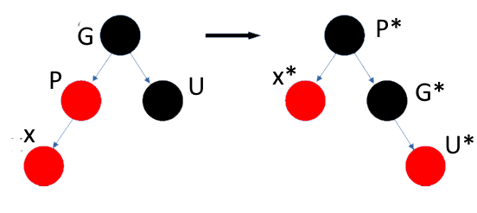
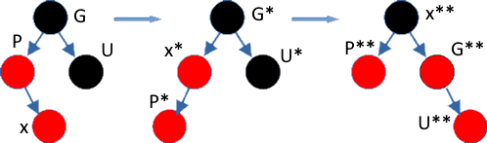
Image | Program
X:R; P:R; G:B; U:B
X:R; P:R; G:B; U:B
X:R; P:R; G:B; U:B

Slide 2
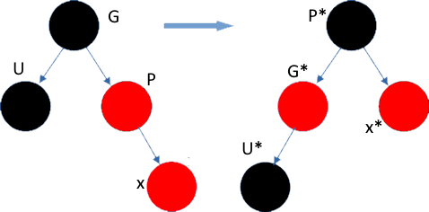
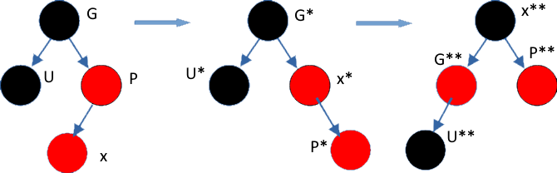
X:R; P:R; G:B; U:B

Slide 3
34
34
43
11
35
47
43

