Slide 1
Dynamic web APPLication

Slide 2
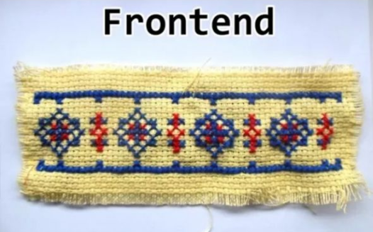
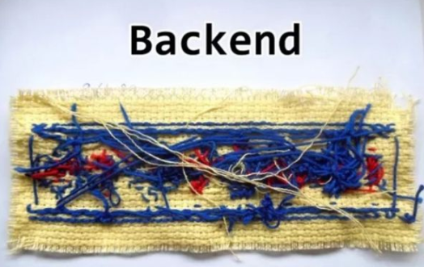
Two Basic building blocks of websites/ web applications

Slide 3
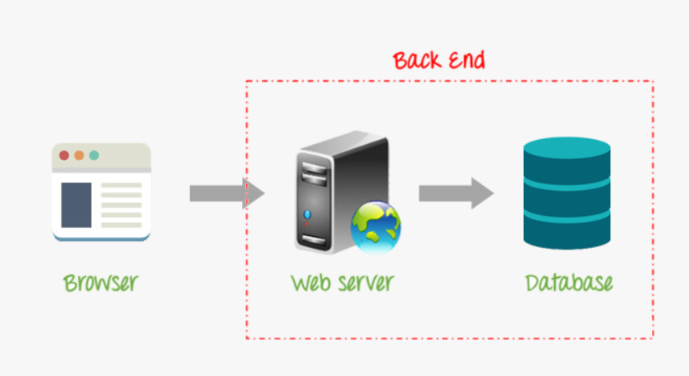
What’s backend & how it works

Slide 4
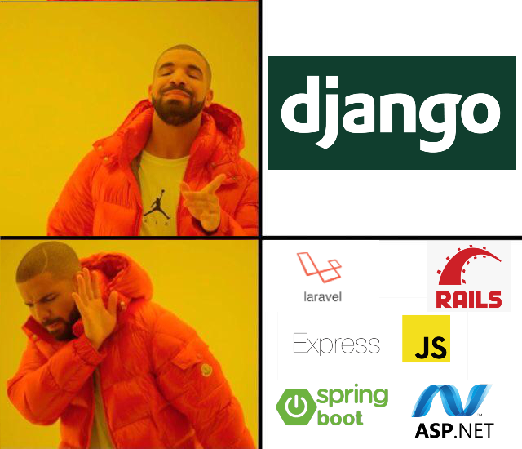

Slide 5

Also Available framework

Slide 6
BUT WHY DJANGO ?

Slide 7
Features of Django
Excellent Documentation
Highly Scalable
Huge library of packages
1
3
5
2
4
6
Fast & Stable
Security
Utilizes SEO

Slide 8
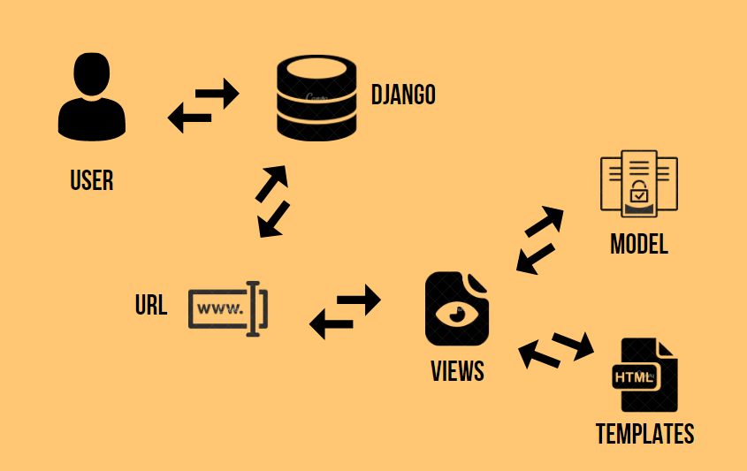
Architecture

